Slide 1
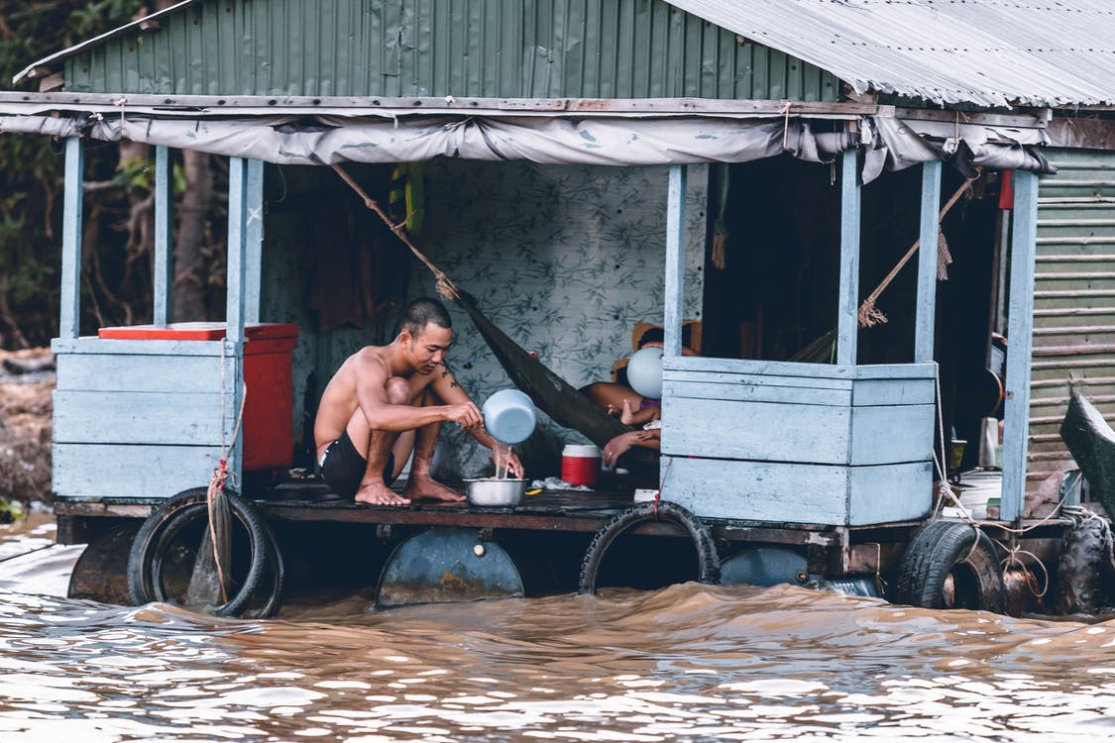
Construction in the Climate Crisis
Notes:
Photo: https://www.pexels.com/photo/man-pouring-water-from-dipper-on-blue-and-grey-house-1739855/

Slide 3
Equidistant from a point
Can you find all the points which are 5km away from the school?
1cm:1km
School
x

Slide 4
Equidistant from a point
Can you find all the points which are 5km away from the school?
1cm: 1km
School
The circle is the locus of the points which are equidistant (of equal distance) from the school.

Slide 5
Equidistant from a point
The locus of points that are equal distance from a point form a circle.
G
Locus= all the points that satisfy a certain rule.
e.g. Draw the locus of all the points that are 3cm from point g

Slide 6
Locus of points equidistant from an object
Abdul wants to make a gravel path that is exactly 1m thick all the way around the edge of the house. Draw the locus of points which would mark the edge of the 1m path.
1cm: 2m

Slide 7
Abdul wants to make a gravel path that is exactly 1m thick all the way around the edge of the house. Draw the locus of points which would mark the edge of the 1m path.
1cm: 2m
The locus of the points equidistant from an object are rounded at the corners

Slide 8
Locus of points equidistant from two points
A
B
A house is exactly the same distance from water tap A and water tap B.
Draw the locus of points which represents where the house could be.

Slide 9
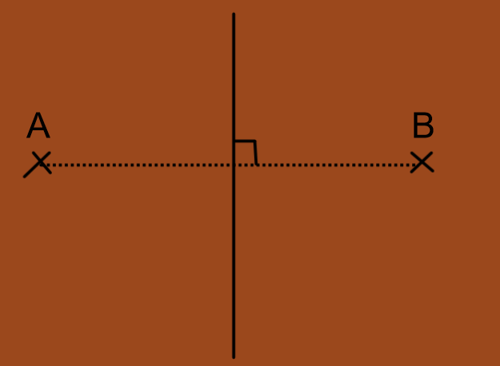
The locus of points equidistant from two fixed points is a line.
The lines is at right angles to the line which joins up your two fixed points (the line AB) and exactly halfway between them.
It is the perpendicular bisector of the line AB.

Slide 10
Constructing a perpendicular bisector
Example: Construct the perpendicular bisector of the line AB
A
B
Aim: To construct a line that is perpendicular to the line AB and cuts the line AB exactly in half

Slide 11
Constructing a perpendicular bisector
A
B
Step 1- Place your compass point at either end of your line. Make sure your compass is open to more than half the length of the line.

Slide 12
Constructing a perpendicular bisector
A
B
Step 2- Draw an arc above and below the line.

Slide 13
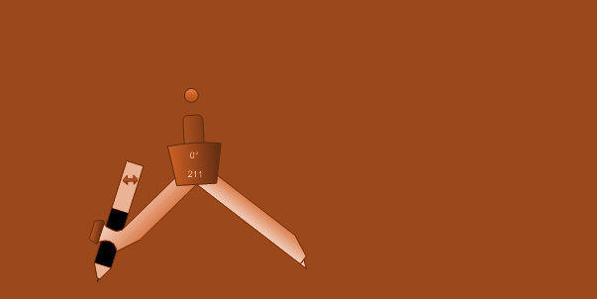
Constructing a perpendicular bisector
A
B
Step 3- Repeat step 2 but with your compass point on the other end of your line. Make sure the width at which your compass is open does not change.

Slide 14
Constructing a perpendicular bisector
A
B
Step 4- Draw a straight line through the points where the two arcs intersect- this will be the perpendicular bisector of the line AB.

Slide 15
Practice: Construct the perpendicular bisectors of the following:
1) The line AB
A
B
2) The points A and B
A
B

Slide 16
Reasoning
Why was it important that the compass was open to more than half the length of the line?
Why was it important that the width of the compass did not change between steps 2 and 3?
Should we leave on our arcs? Why?
When might we need to carry out a perpendicular bisector?

Slide 17
The locus of points that are equidistant from two lines
Mary wants to plant her tree so that it's exactly halfway between the two walls of her garden so that it can get the most sunlight. Find the locus of points where Mary could plant her tree.

Slide 18
Equidistant from two lines
The locus of points equidistant from two lines is a line.
It cuts the angle that the two lines from in half- we call it an angle bisector.

Slide 19
Constructing an angle bisector
Example: Construct the angle bisector of the angle ABC.
A
B
c
Aim: Construct a line which cuts the angle ABC exactly in half.

Slide 20
Constructing an angle bisector
A
B
c
Step 1: Move your compass point to the place where the two lines meet, with your compass open to a fraction of the length of the lines.

Slide 21
Constructing an angle bisector
A
B
c
Step 2: Draw an arc on both lines

Slide 22
Constructing an angle bisector
A
B
c
Step 3: Place your compass on each of the points where the arcs cross the lines and draw a new arc- not changing the width at the which the compass is open.

Slide 23
Constructing an angle bisector
A
B
c
Step 4: Where the arcs in between the lines AB and BC intersect, join the point with the centre of ABC
Then you will have constructed the angle bisector of the line ABC.

Slide 24
Practice: constructing an angle bisector
Construct the angle bisector of these angles

Slide 25
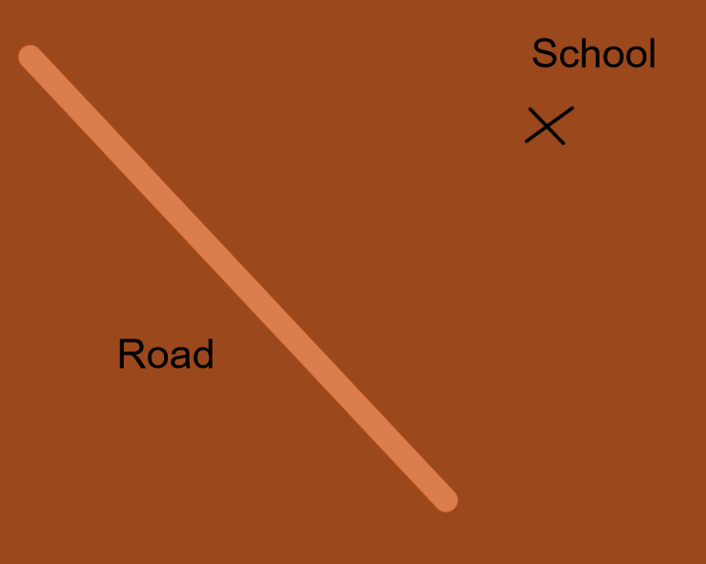
A road is to be constructed from a school to the road. The school would like the road to be as short as possible so that the journey to the school can be as quick as possible.
How could we find the shortest possible road?

Slide 26
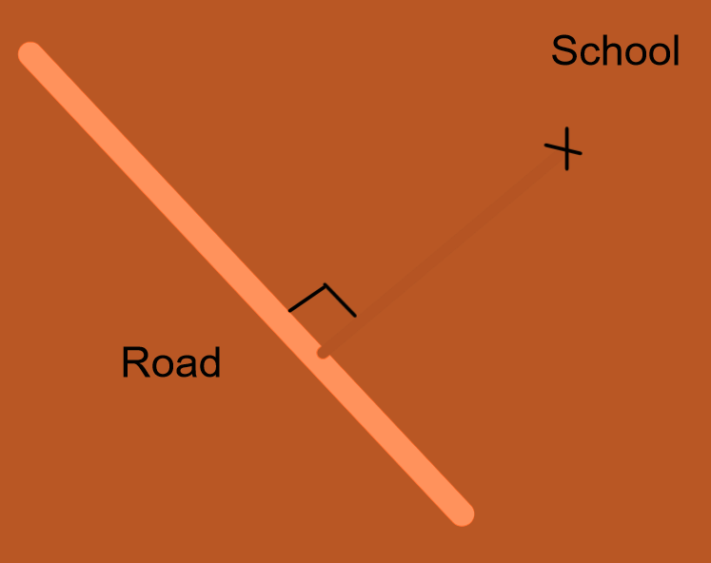
Constructing the perpendicular from a point to a line would find us the shortest possible route.

Slide 27
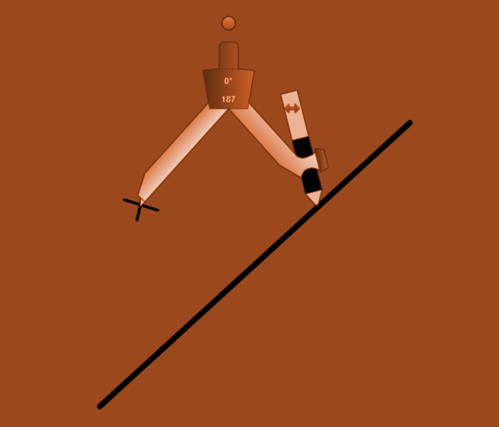
Constructing the perpendicular from a point to a line
Step 1: Place your compass on the point

Slide 28
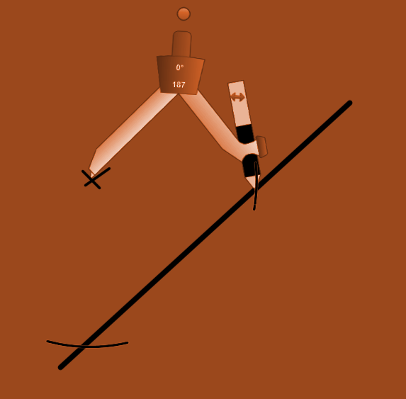
Constructing the perpendicular from a point to a line
Step 2: Open the compass so that it draws below the line and draw two arcs

Slide 29
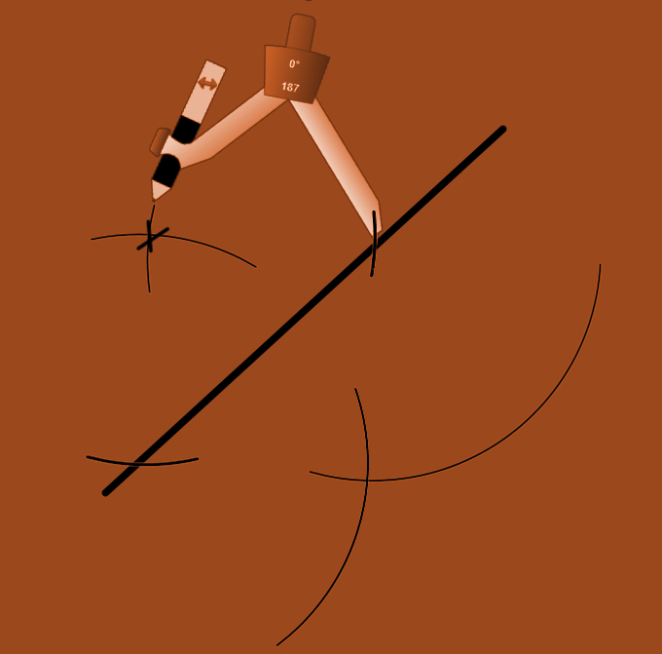
Constructing the perpendicular from a point to a line
Step 3: Where your arcs cross your line, draw two new arcs beneath and above your line so that they cross.

Slide 30
Constructing the perpendicular from a point to a line
Step 4: Join the intersection of your second set of arcs with your original point.
This is the perpendicular from the point to the line and the shortest route between them.

Slide 31
Practice:
1) Draw the perpendicular from the point to the line
2) Find the shortest distance between point A and the line BC
A
B
C

Slide 32
Tom wants to construct a garden path which forms a right angle with his current garden path and crosses his path at the point where his frog path stone sits (marked with a cross).
Draw on the diagram where Tom's new path should go.

Slide 33
The new path is perpendicular to the line but is not the perpendicular bisector as it doesn't cut the original line in half.

Slide 34
Constructing the perpendicular to a line through a point
Step 1: Place your compass on point P and draw small arcs either side of point P which intersect with the line AB. Keep your compass open to the same width.
B
P
A

Slide 35
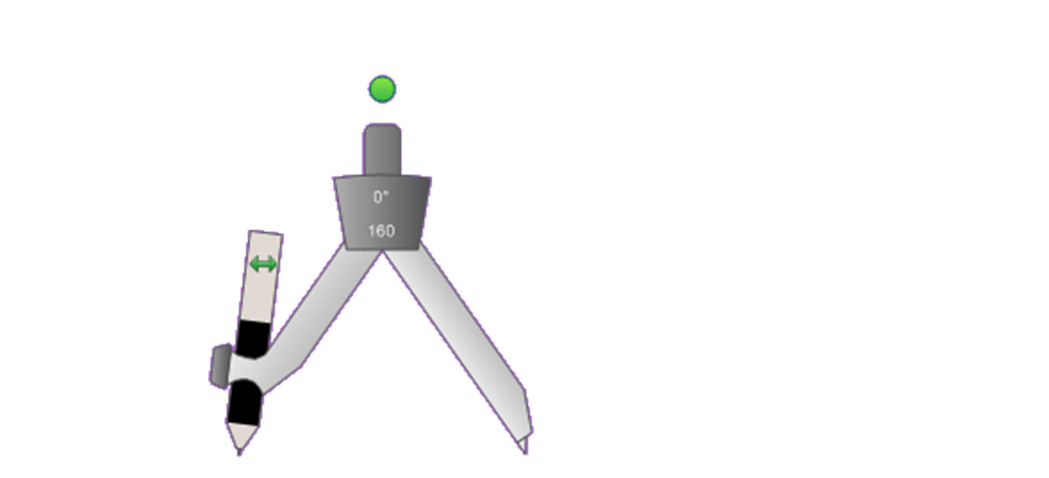
Constructing the perpendicular to a line through a point
Step 2: Use the points where your arcs intersect with the line AB as the ends of a new smaller line which has P at the centre. Then carry out the perpendicular bisector of this smaller line.
B
P
A

Slide 36
Practice:
Construct the perpendicular to the line segment AB which passes through the point G.
A
G
B
Construct the line which forms a right angle with the line AB and passes through the point H.
B
H
A

Slide 37
Constructing loci- key vocabulary
Locus= the set of points which satisfy a rule
Equidistant= equal distance
Bisect= cut in half
Perpendicular bisector= cuts a line in half at right angles
Angle bisector= cuts an angle in half

Slide 38
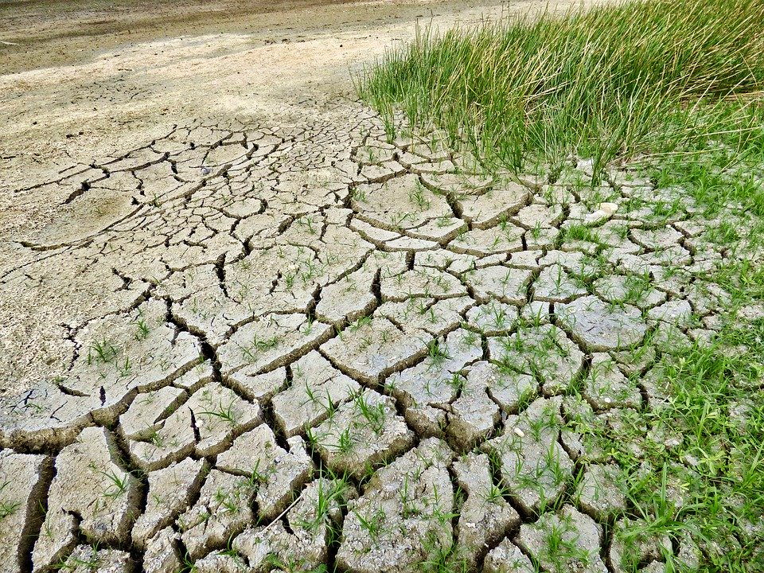
Throughout the world, there is a
need to respond to the effects of
climate change in order to keep people
safe and to ensure their continued livelihoods.
Often the people who have contributed the least to the pollution which causes climate change are seeing the earliest and most severe effects.
Because of a lack of income and resources, they are often also the least able to cope with the new dangers and threats that climate change brings.
Notes:
Photo: https://pixabay.com/da/photos/klima%C3%A6ndringer-t%C3%B8rke-klima-t%C3%B8r-2241061/

Slide 39
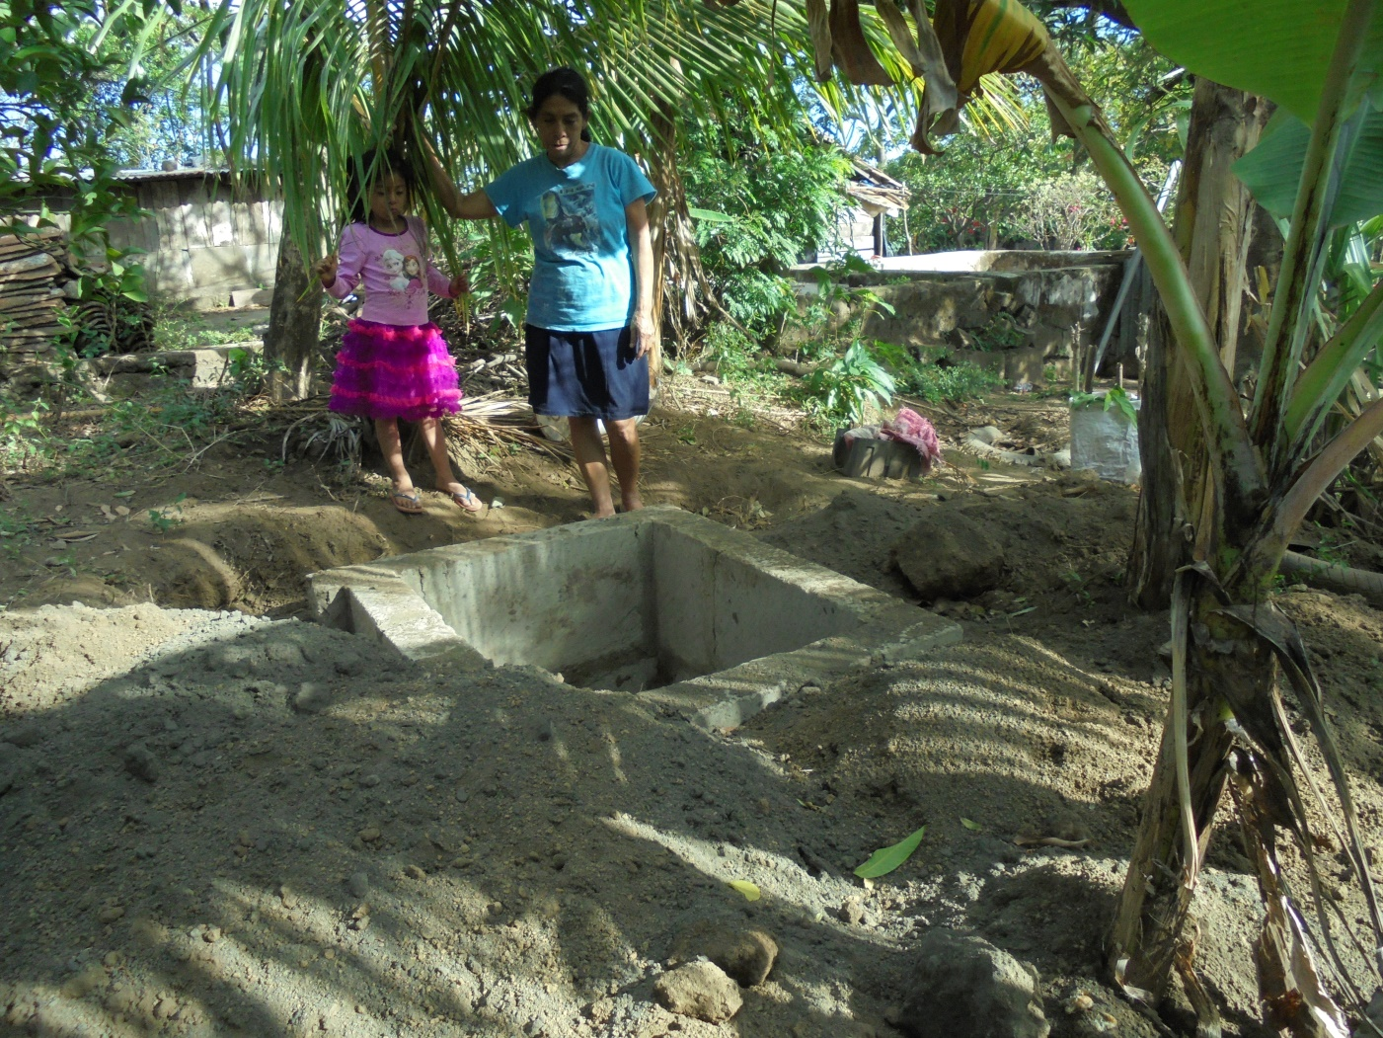
We are going to use
our construction skills
to help solve fictional
problems based on real life problems that charities, governments and ordinary citizens face, many to do with responding to new threats due to climate change.
Notes:
Photo: Leeds Central America Solidarity Campaign

Slide 40
Construction problems

Slide 41
Problem A: Drainage canal
Below is a plan view of Amir's house and bathroom. He wants to dig a drainage canal around the perimeter of his house and bathroom to help prevent rainwater flooding which is increasing due to the effects of climate change. He wants the canal to be exactly 75cm from his house. Plot the drainage canal on the diagram.
1cm: 1m
Notes:
A reason to take climate action: Flooding
“Global warming leads to more rain and rising sea levels.” Channel 4 Factcheck.
https://www.channel4.com/news/factcheck/factcheck-qa-does-climate-change-cause-flooding
“There were between 100 and 150 families along the riverbank. All their homes were washed away. We lost everything”. Ruma Begum, from Mehendiganj who was forced to move to Dhaka
https://ejfoundation.org/reports/climate-displacement-in-bangladesh
Met Office: Scientists have published more than 150 attribution studies looking at weather events around the world:
Extreme heat: Almost all studies on extreme heat events indicate human influence.
Drought: About half the studies on drought show significant human influence.
Extreme rainfall: A smaller but increasing number of studies on extreme rainfall detect a human signal.
Tropical storms and hurricanes: The picture here is complex. There is strong evidence that increasing sea temperatures increase the intensity of tropical storms. Rising sea levels also increase the risk of coastal flooding. However, there may be an overall decrease in the global total number of tropical cyclones.
https://www.metoffice.gov.uk/weather/climate/climate-and-extreme-weather

Slide 42
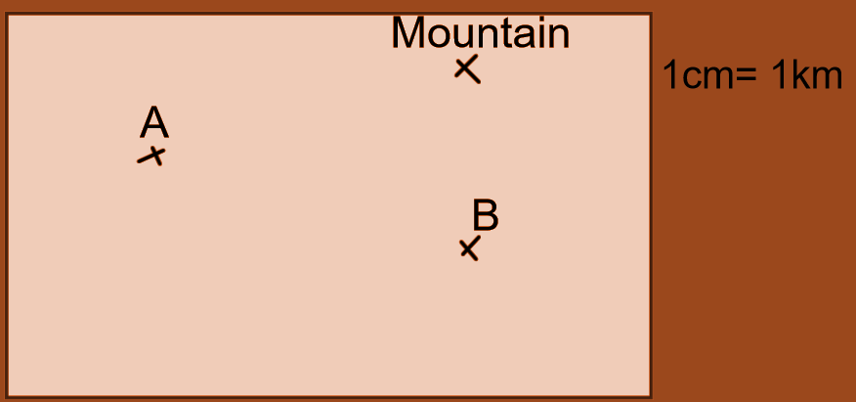
Problem B: Water tap
Cheru and Kamama live in separate villages in rural Kenya. Cheru lives in village A and Kamama lives in village B. Following severe droughts, water sources near each village have dried up. Now their only source of water is 16km away and their only option is to walk there. A Kenyan water charity has decided that they will dig a new bore hole and construct a water tap which will shorten the journey for both girls.
The people of both villages have requested that the water tap should be an equal distance from each village. The tap also needs to be within 2km of the mountain as this is the only area where there is water to be found. Find the point where the new water point should be constructed.
1cm: 1km
Notes:
A reason to take climate action: Drought
Droughts affect millions of people in the world, increasing the number of people facing hunger and starvation.
“The most recent research shows climate change is already making many parts of the world drier and droughts are likely to pack more punch as the climate warms further”. Dr Benjamin Cook ,climate scientist at the NASA Goddard Institute for Space Studies and the Lamont-Doherty Earth Observatory
https://www.carbonbrief.org/guest-post-climate-change-is-already-making-droughts-worse
https://www.climaterealityproject.org/blog/facts-about-climate-change-and-drought
‘’Severe drought has dried up water resources in half of Kenya’s 47 counties and an estimated 3 million people lack access to clean water.’’ https://reliefweb.int/report/kenya/kenya-humanitarian-dashboard-26-may-2017

Slide 43
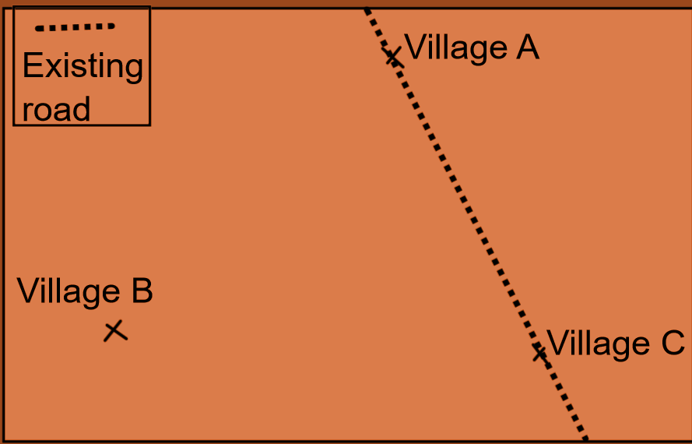
Problem C: New road
Due to a flood caused by an extreme weather event which washed away an existing road, a new road needs to be built between three villages in rural Tanzania so that the villagers are able to get to the nearby town to sell and buy goods. The road should pass through village B, and exactly halfway between village A and C so that they can be connected to the new road by their existing road. Mark on the map where the road should be built.
Notes:
A reason to take climate action: Extreme rainfall
Rain-triggered disasters, including flash floods and landslides affected some three million people across East Africa in 2019. The heavy rainfall has been linked to warmer ocean temperatures in the Indian Ocean.
https://www.bbc.co.uk/news/world-africa-50628420

Slide 44
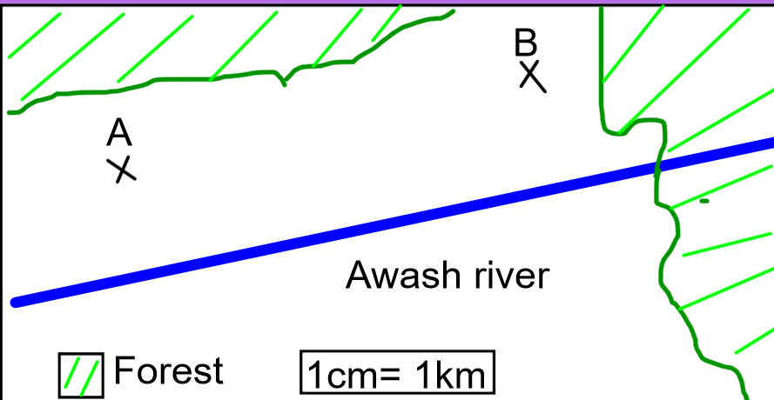
Problem D: Internet mast
Two towns (in Oromia region, Ethiopia) have decided to build a new Internet mast. They can then use an early warning system to save lives during flooding and landslides (which are becoming more frequent and severe due to climate change).
The mast needs to be within 4km of both the towns. In order to avoid flood damage, the mast should not be built within 500m of the Awash river.
Find the area which the mast can be built in.
1cm: 1km
Notes:
A reason to take climate action: Extreme rainfall and flooding
Winter 2019: Heavy rains and floods have killed more than 50 people and forced hundreds of thousands of people from their homes across East Africa as researchers warn warming oceans are causing unpredictable weather patterns in the region.
The phenomenon, named the Indian Ocean Dipole, follows a cycle. When the Dipole is negative, drought ensues in the region. When it is positive, there is rain.
Analysts say this is a regular weather cycle, but they warn warming oceans will bring more unpredictable weather.
“We are more likely to see events like this,” said Nathanial Matthews of the Stockholm-based Global Resilience Partnership. “The oceans are warming because of climate change.”
https://www.japantimes.co.jp/news/2019/11/07/world/displaced-east-africa-floods/#.XhNZufzgrcs

Slide 45
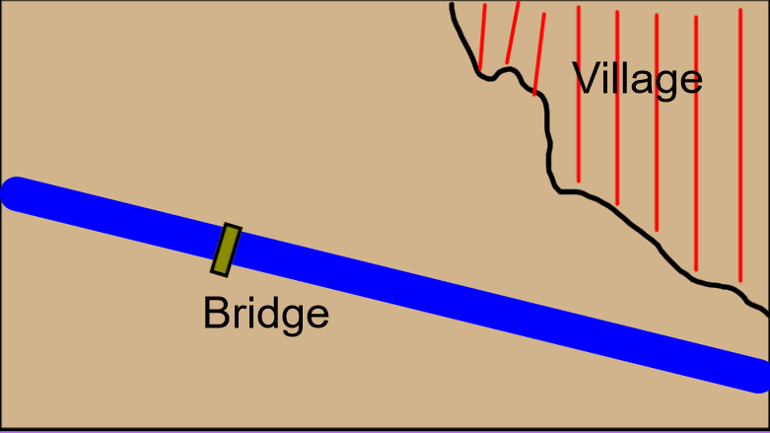
Problem E: Bridge road
A new bridge has been planned over the Imo River in Nigeria to replace the old one (which was washed away in a flood).
Mark on the map where the connecting road should go.
The road needs to pass over the bridge and form a right angle with the river.
Notes:
A reason to take climate action: Extreme rainfall
"The rain started at 23:30 at night, we heard a loud 'boom'. Before I knew it, I was up to my neck in water. We couldn't salvage anything... we have to save our lives. My house was well built but the water brought it down.
We need help. I haven't been able to cook food since yesterday and I'm living on the goodwill of other people.“
https://www.bbc.co.uk/news/world-africa-40720985

Slide 46
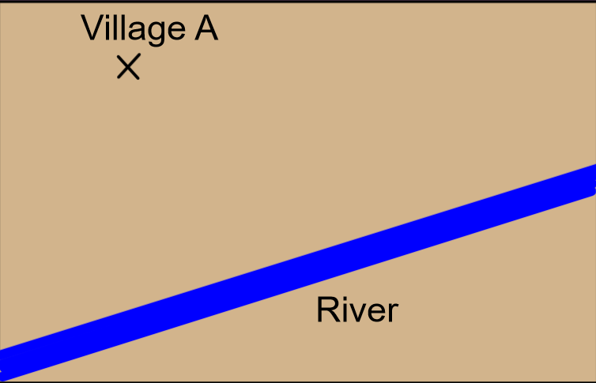
Problem F: Shortest possible path
A new path is to be built between village A and the river in Andhra Pradesh, India, following a landslide caused by flooding, which destroyed the old path.
The villagers would like the path to be as short as possible, as they often carry heavy washing or buckets of water to and from the river.
Mark on the map the shortest possible path between the village and the river.
Notes:
A reason to take climate action: Extreme weather
The frequency of landslides causing death or affecting people in Asia has increased more than five-fold since the 1970’s. Poor countries have significantly higher numbers of landslide deaths than wealthier countries. Planting trees can prevent landslides and reduce flooding.
http://www.fao.org/3/i3245e/i3245e.pdf

Slide 47
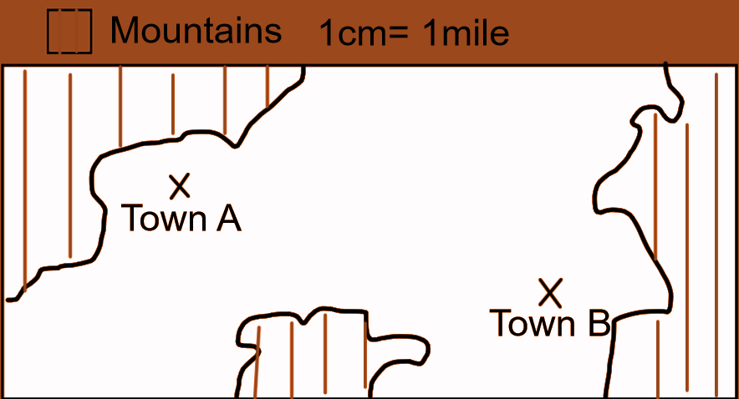
Problem G: Mobile mast
Towns A and B (in Cuba) are 8 miles apart. They want to put up a mobile phone mast. Better internet will help warn them of hurricanes and save lives. Climate change is making hurricanes more frequent and intense.
The mast needs to be less than 5 miles from Town A and nearer to Town B than Town A. Shade the region where the mast can be built.
Notes:
A reason to take climate action: Extreme weather
While the overall number of hurricanes has remained roughly the same in recent decades, there is evidence they are intensifying more quickly, resulting in a greater number of the most severe category four and five storms.
The proportion of tropical storms that rapidly strengthen into powerful hurricanes has tripled over the past 30 years, according to recent research. A swift increase in pace over a 24-hour period makes hurricanes less predictable, despite improving hurricane forecasting systems, and more likely to cause widespread damage. https://www.theguardian.com/world/2019/may/20/are-hurricanes-getting-stronger-and-is-the-climate-crisis-to-blame
The 2017 hurricane season in the Caribbean was unprecedented. High-powered, high impact hurricanes, including Irma and Maria, left a path of destruction, infrastructure damage and casualties in more than a dozen territories in the region. Without forecasts and warnings, the tragic loss of life would have been even higher.
https://www.itu.int/en/ITU-D/Emergency-Telecommunications/Documents/2019/GET_2019/Caribbean-Report-WMO-CREWS.pdf

Slide 48
Problem H: Solar street lamp
Below is a scale drawing of a village square in rural Bangladesh.
Lighting in the square is poor at night, due to a lack of electricity. Villagers have saved up enough money to buy 1 solar powered street lamp.
They want the lamp to be closer to the West border of the square than to the South (as the school is here), and to be within 9m of the village shop. Find the region where the lamp can be built.
1cm= 3m
1cm: 3m
School
North
Village shop
Notes:
Renewable Energy: acting on Climate Change.
Lower Income countries are now leading the way in renewable energy. Investment in renewable energy was higher in the world’s poorest countries than the richest ones for the first time in 2015. https://www.independent.co.uk/environment/climate-change/renewable-energy-investment-developed-world-developing-world-ren21-report-a7058436.html
By 2019, renewable energy production in developing countries had surpassed the capacity generated by fossil sources.
https://www.enelgreenpower.com/stories/a/2019/01/developing-countries-and-renewable-energy-for-a-sustainable-future

Slide 49
Problem I: toilet building
Maria’s family needs a new toilet (latrine). Their village in Nicaragua is suffering from flooding due to climate change. Flooded latrines spread diseases and cause deaths.
So the latrine needs to be at least 20m away from the stream and 15m away from the house. She wants it as near the house as possible, so that her children don’t have to go too far to go to the toilet after dark.
Mark the area that the latrine could be built.
1cm: 5m
1cm= 5m
Notes:
A reason to take climate action: Impact on people’s health
It is generally the case that the largest impacts of climate change on health are experienced in developing regions of the world such as the tropics, whereas those most responsible for greenhouse gas emissions are often richer countries which do not currently suffer the consequences of extreme events to the same extent.
Central America is very vulnerable to the effects of extreme weather, and there is an high risk of water borne disease such as cholera resulting from flooding. https://www.mdpi.com/2073-4433/9/10/385/htm
Photo: Leeds Central America Solidarity Group

Slide 50
Problem J: Coffee plantation
Karla’s family has been growing coffee in the mountains of northern Nicaragua for generations. Because the climate is getting hotter, coffee can now only be grown higher up (where it is cooler).
Experts advise her to plant her new bushes within 3km of the mountain summit. Karla also wants to plant them to be close to the road, so that she doesn’t have to carry the coffee too far.
Mark the area where she could put her new coffee plantation.
1cm= 1km
1cm: 1km
Mountain summit
Road
Karla’s house
Old coffee plantation
Notes:
Effects of Climate Change: Farming threatened
Karla is a real farmer in Nicaragua facing this problem. As temperatures rise and droughts intensify, good coffee will become increasingly difficult to grow and expensive to buy. Rising temperatures worldwide will bring drought, increase the range of diseases and kill large swaths of the insects that pollinate coffee plants. About half of the land around the world currently used to produce high-quality coffee could be unproductive by 2050.
https://time.com/5318245/coffee-industry-climate-change/
It’s not just coffee that is affected. The Intergovernmental Panel on Climate Change projects that warming temperatures, severe heat, drought, wildfire, and major storms will “increasingly disrupt agricultural productivity,” threatening not only farmers’ livelihoods but also food security, quality, and price stability.
http://www.ipsnews.net/2019/09/a-brief-guide-to-the-impacts-of-climate-change-on-food-production/
Photo: Leeds Central America Solidarity Group

Slide 51
World Class Teaching project has been funded with support from the European Commission. The contents of these actions are the sole responsibility of the contractor and can in no way be taken to reflect the views of the European Union.

