Slide 1
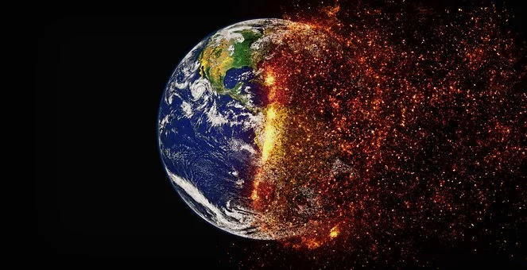
KS3
Biodiversity 2
Climate Change
Notes:
https://cdn.pixabay.com/photo/2017/04/23/19/17/climate-change-2254711__340.jpg

Slide 4
What causes animals to become endangered and biodiversity to be reduced?
No attribution necessary https://pixabay.com/photos/gorilla-monkey-animal-furry-3719960/
Notes:
https://cdn.pixabay.com/photo/2018/10/02/21/21/gorilla-3719960_960_720.jpg

Slide 5
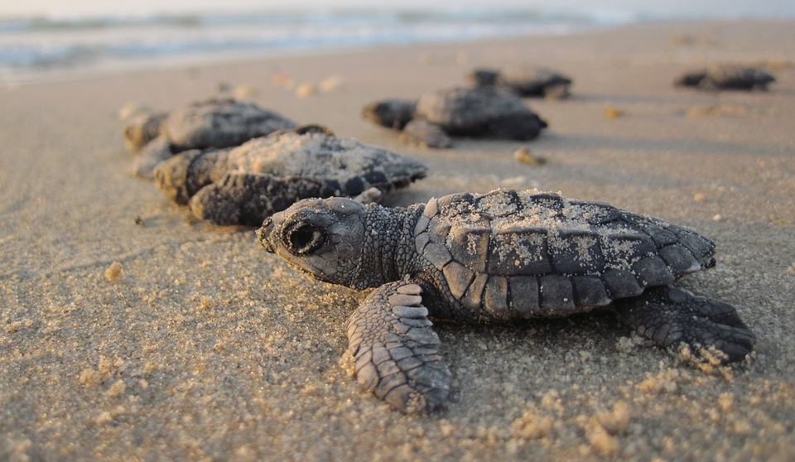
Turtle eggs produce male or female babies depending on the temperature of their sandy nest. If the temperature rises above 30ºC the babies are all females.
Could this affect biodiversity in the oceans?
3.Climate change
In the last century Earth’s global average temperature rose by a little less than 1ºC . This might seem like a very small amount.
BUT
Notes:
https://cdn.pixabay.com/photo/2016/07/07/23/49/sea-turtles-1503461_960_720.jpg

Slide 6
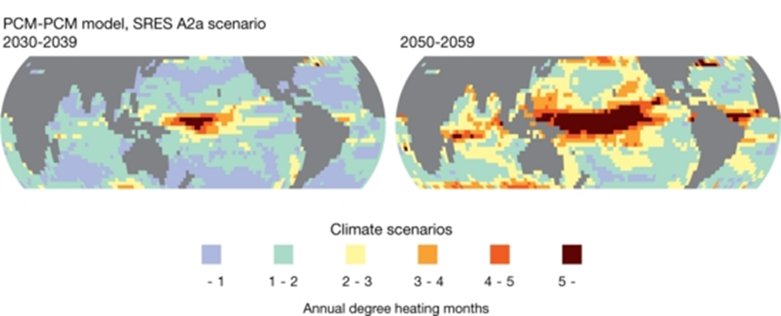
Climate change
Find out about the effect of acid rain on lakes . What might be the effect of the ocean becoming more acidic?
Freely available Hugo Ahlenius, UNEP/GRID-Arendal) http://www.grida.no/resources/7215
Rising carbon dioxide levels in the atmosphere cause more carbon dioxide to dissolves in the ocean. This causes the ocean to become more acid.
No attribution necessary: https://pixabay.com/photos/coral-reef-sea-underwater-fish-2745962/
Notes:
Find worksheet in “Resource” section.

Slide 7
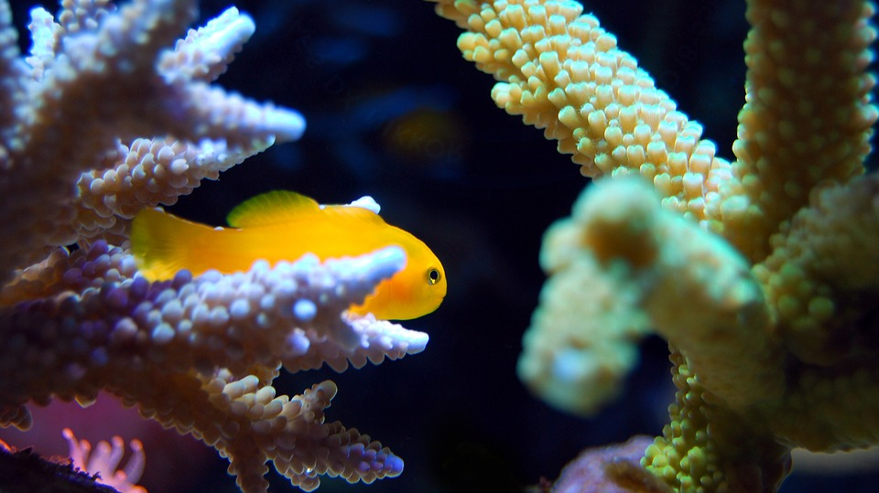
Climate change
What effect might this have on humans?
Coral reefs are dying causing a loss of biodiversity in the world’s most productive fishing grounds.
No attribution necessary https://pixabay.com/photos/coral-reef-sea-underwater-fish-2745962/

Slide 8
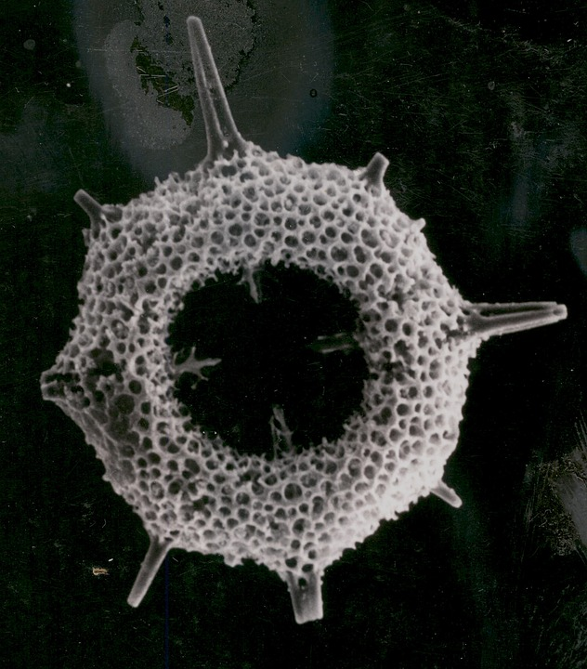
Student investigation
Ocean water absorbs carbon dioxide from the atmosphere.
Higher carbon dioxide levels in the atmosphere are causing ocean water to become more acid.
This is damaging tiny shell-building animals such as coral and plankton, and the entire food web of which they are a part and humans who catch, eat and sell fish to survive.
No attribution necessary https://pixabay.com/photos/radiolarian-plankton-fossil-936194/
Notes:
https://cdn.pixabay.com/photo/2015/09/11/18/01/radiolarian-936194_960_720.jpg

Slide 9
Biodiversity is good for the economy.
What words do you think of when you hear the word economy?

Slide 10
Biodiversity is good for the economy. An example
A few decades ago, some fishermen campaigned for killing whales because they were threatening the fish supply and therefore the fishermen’s jobs.
A chain of events eventually came full circle and led to a loss of jobs:
Notes:
Find worksheet in “Resource” section.

Slide 11
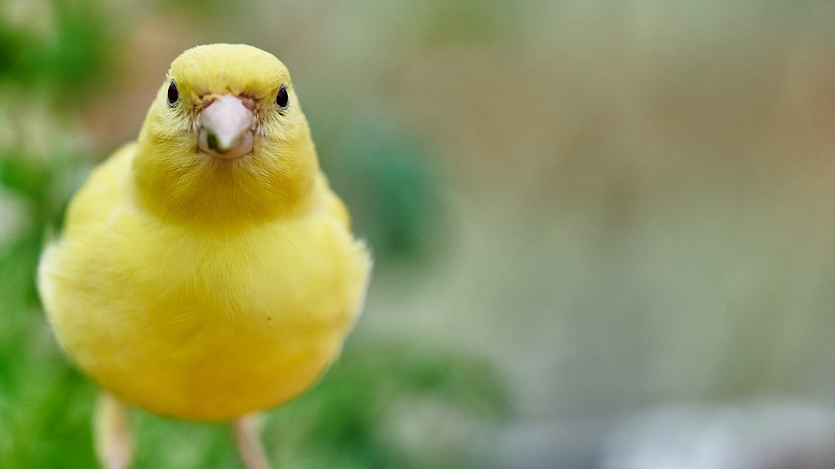
Some ecosystems are more sensitive than others, acting like an early warning system.
Did you know.. Canaries were once used to warn miners of danger.
No attribution necessary https://pixabay.com/photos/bird-canary-bird-eat-treehouse-3386323/

Slide 12
Climate change
Some regions of the arctic have warmed by as much as 4ºC.
Your teacher may ask you to carry out an investigation.
https://www.youtube.com/watch?v=XntO9a-NpeM
Notes:
Find worksheet in “Resource” section.

Slide 13
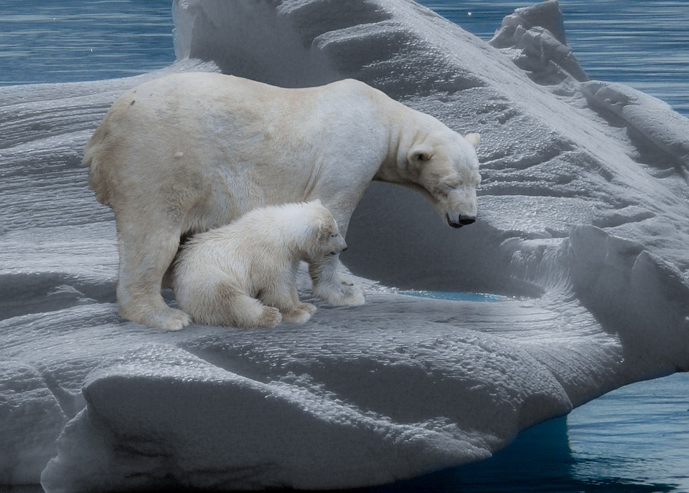
Climate change
Changes in the amount of sea ice in the Arctic Ocean between 1980 and 2009.
Describe the pattern shown.
What effect could this have on biodiversity in the Arctic?
No attribution necessary https://pixabay.com/photos/polar-bear-polar-bears-predator-709682/
Source: National Snow and Ice Data Center
Creative commons https://www.cbd.int/gbo3/?pub=6667&section=6833

Slide 14
Why did Noah put the animals in the ark?
Notes:
https://pixabay.com/de/photos/religion-tiere-noah-arche-2278279/

Slide 15
Gene banks are modern day arks
https://www.youtube.com/watch?v=G5VYHC9YftQ

Slide 16
Gene banks are modern day arks
Write a paragraph explaining what a gene bank is. Explain whether you think saving individual species like this is a good idea?
https://www.youtube.com/watch?v=YkTey9vkFB4&t=83s

Slide 17
Encouraging biodiversity-Build a bug house.
No attribution necessary https://pixabay.com/photos/insect-house-nature-conservation-1778906/

Slide 19
World Class Teaching project has been funded with support from the European Commission. The contents of these actions are the sole responsibility of the contractor and can in no way be taken to reflect the views of the European Union.

