Slide 1
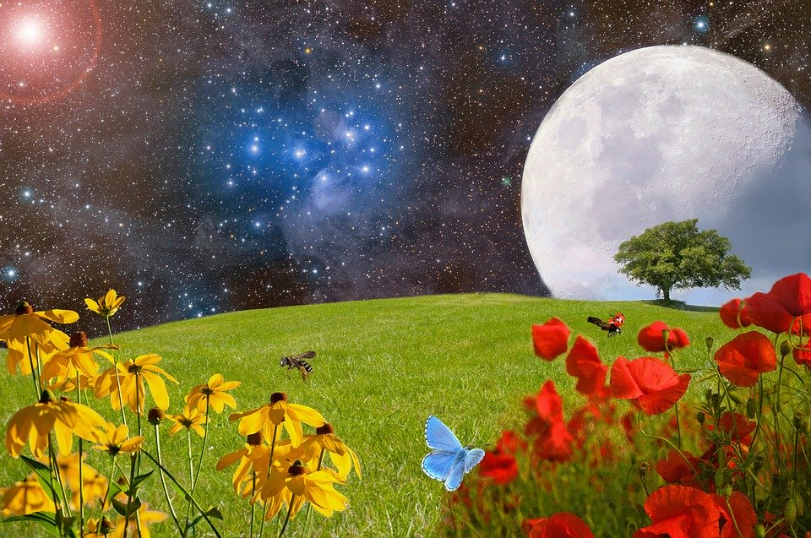
Stewardship of Creation
Notes:
Photo: https://pixabay.com/da/photos/eng-gr%C3%B8n-eng-blumenwiese-gr%C3%A6s-2401931/

Slide 2
Notes:
Eve - the citizenship outcome and the second RE outcome need to be removed please.

Slide 4
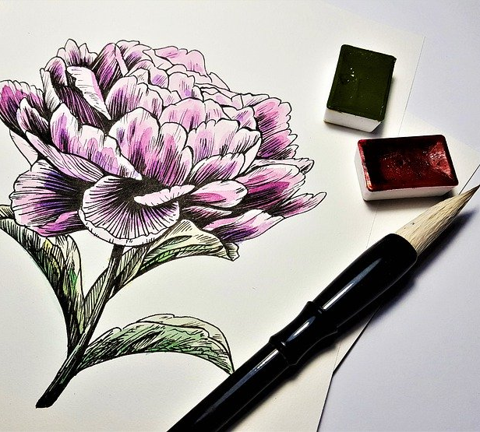
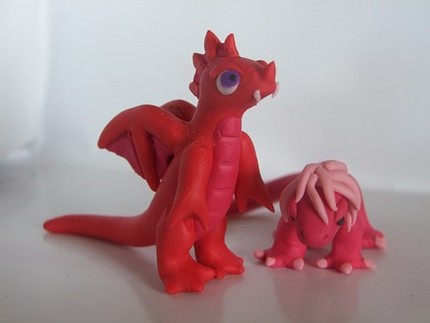
Create…anything!
10 minutes to make a creation as intricate and beautiful as you can, this might be a drawing, playdough model, origami etc.
Once finished, give it to the person sitting next to you to look after carefully.
Notes:
This creation will be destroyed later in the lesson, consider this with vulnerable students
Pic ref flowers: https://pixabay.com/da/photos/maleri-tegning-kunst-blomst-3074489/
Pic ref dragon: https://pixabay.com/photos/toys-plasticine-play-dough-354594/
Pic ref origami: https://pixabay.com/vectors/origami-paper-folding-artistic-156627/

Slide 5
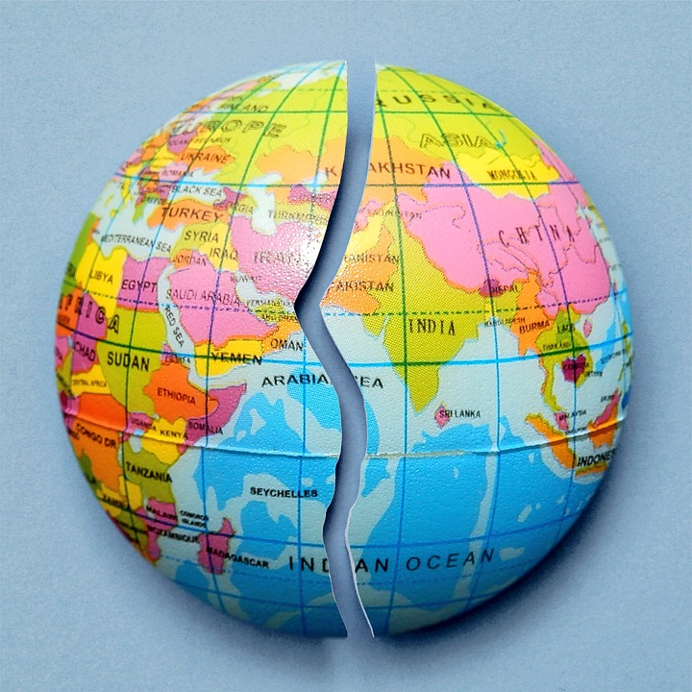
2 minute chat – Talk to your partner for 2 minutes about the problems that we are facing with the environment today.
Notes:
Pic ref: https://pixabay.com/illustrations/broken-heart-love-relationship-1739135/

Slide 6
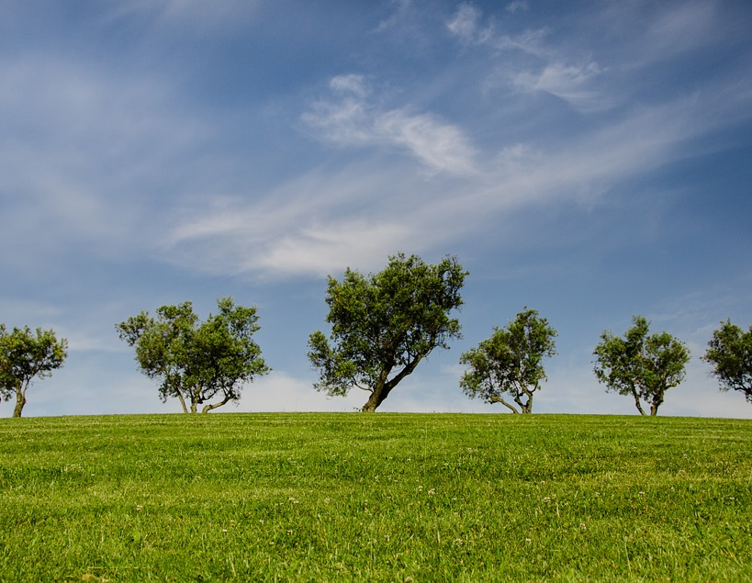
What do you know?
What does global warming mean?
What is the cause of climate change?
Give 3 possible solutions to climate change.
Why is waste generated by humans a problem?
Identify 3 fossil fuels
Identify 3 renewable resources
Identify 2 solutions to the problem of scarce natural resources that are not renewable energy
How do Christians believe that the world began?
How does Question 8 link to the other questions?
Notes:
Students either complete individually or in pairs. Next few slides provide answers for students to self mark.
Pic ref: https://pixabay.com/da/photos/tr%C3%A6er-bakke-gr%C3%B8n-bl%C3%A5-natur-park-790220/

Slide 7
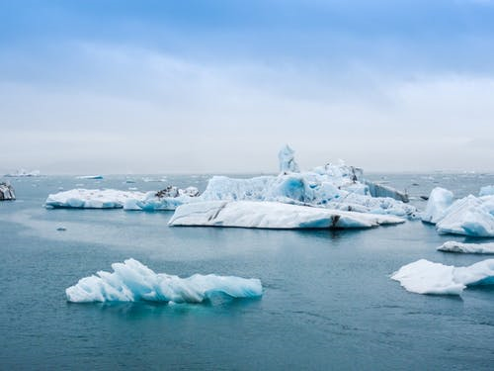
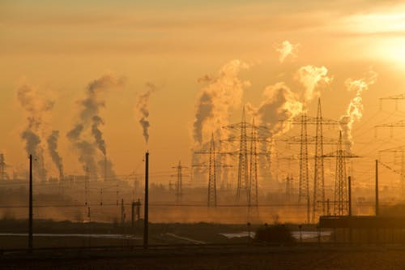
Climate Change
Global Warming:
Increase in global temperatures.
Cause:
Emissions of greenhouse gases
e.g. CO2 produced by human
activity e.g. burning fossil fuels.
Greenhouse effect leads to
rising global temperatures.
Notes:
Iceberg pic ref: https://www.pexels.com/photo/icebergs-2229887/
Pollution pic ref: https://www.pexels.com/photo/air-air-pollution-climate-change-dawn-221012/

Slide 8
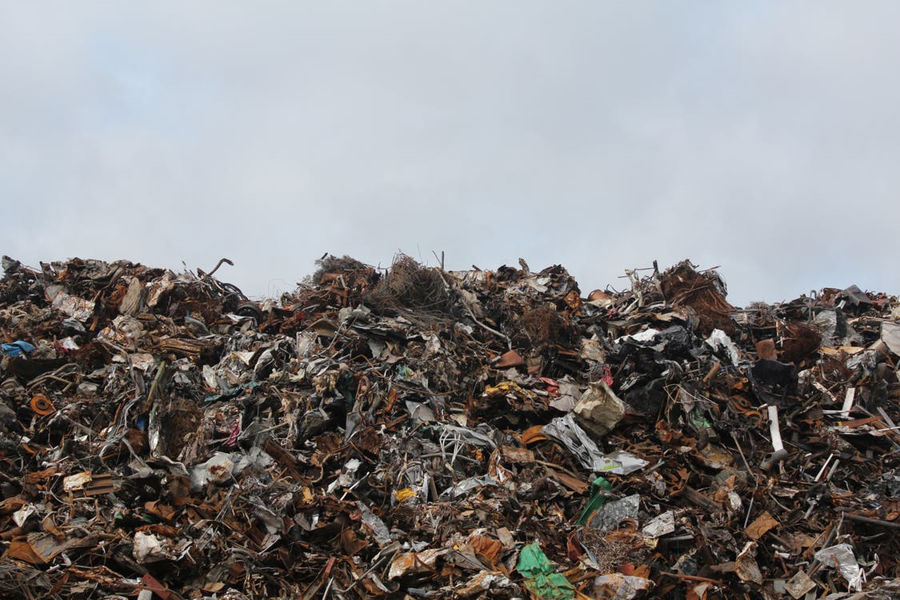
Waste
Disposing of waste has huge environmental impacts and can cause serious problems. In the UK much is buried in landfill sites . Some waste will eventually rot, but not all, and in the process it may smell, or generate methane gas, which contributes to the greenhouse effect.
Notes:
Environmental impacts
Pic ref: https://www.pexels.com/photo/scrap-metal-trash-litter-scrapyard-128421/

Slide 9
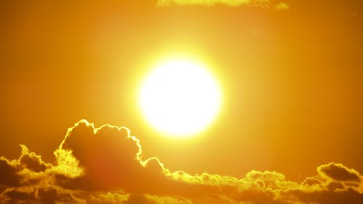
Natural Resources
Non-renewable
Renewable
These are resources
that will disappear
once they are used
One day they will run out
These are resources which humans can use over and over again
They renew themselves
Notes:
Pic ref coal: https://pixabay.com/da/photos/kul-k%C3%A5l-br%C3%A6ndt-br%C3%A6ndstof-sort-842468/
Pic ref sun: https://https://pixabay.com/da/photos/sol-lyse-gul-solnedgang-himmel-1953052/.com/da/photos/sol-lyse-gul-solnedgang-himmel-1953052/
9

Slide 10
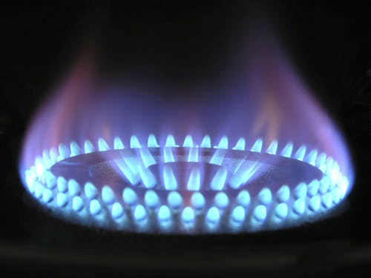
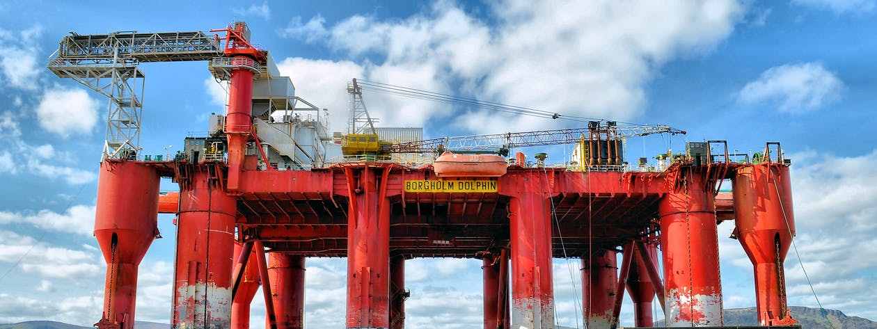
Natural gas
Coal
Non-Renewable
resources
Oil
Notes:
Pic ref gas: https://images.pexels.com/photos/266896/pexels-photo-266896.jpeg?auto=compress&cs=tinysrgb&h=350
Pic ref oil: https://images.pexels.com/photos/414936/pexels-photo-414936.jpeg?auto=compress&cs=tinysrgb&dpr=1&w=500

Slide 11
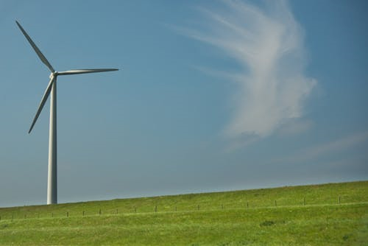
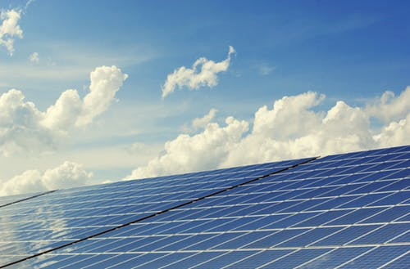
Renewable
resources
Wind power
Hydro
Power
Solar Power
Notes:
Wind pic ref: https://images.pexels.com/photos/407078/pexels-photo-407078.jpeg?auto=compress&cs=tinysrgb&dpr=1&w=500
Hydro pic ref: https://pixabay.com/da/photos/d%C3%A6mning-flod-milj%C3%B8-elektricitet-880097/
Solar Power pic ref: https://images.pexels.com/photos/356036/pexels-photo-356036.jpeg?auto=compress&cs=tinysrgb&dpr=1&w=500

Slide 12
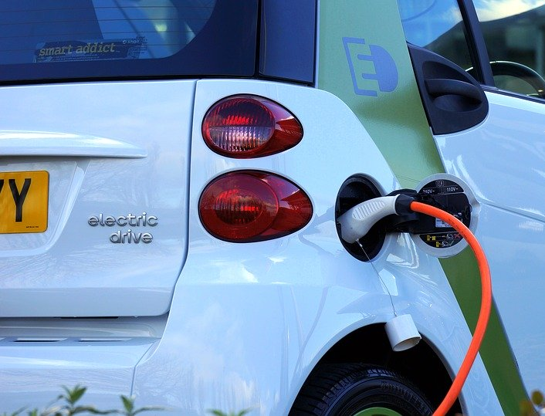
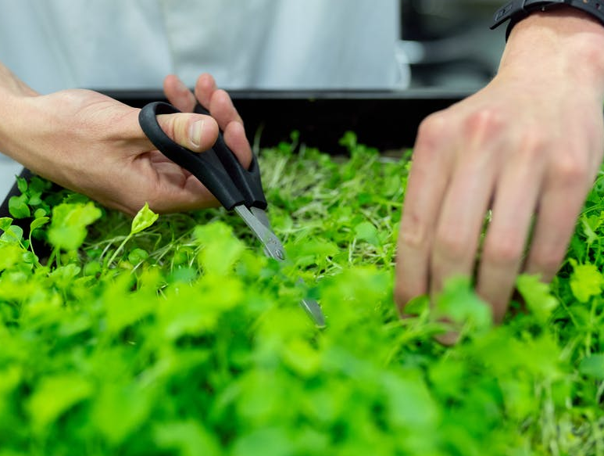
Chemicals from plants
to make plastic
Different fuel for cars
Recycling
Notes:
Car pic: https://pixabay.com/da/photos/elbil-bil-elektrisk-k%C3%B8ret%C3%B8j-magt-1458836/
Plant ref: https://www.pexels.com/photo/person-holding-black-scissors-3912947/
Recycling pic: https://www.pexels.com/photo/person-holding-red-and-white-disposable-bottle-1933386/

Slide 13
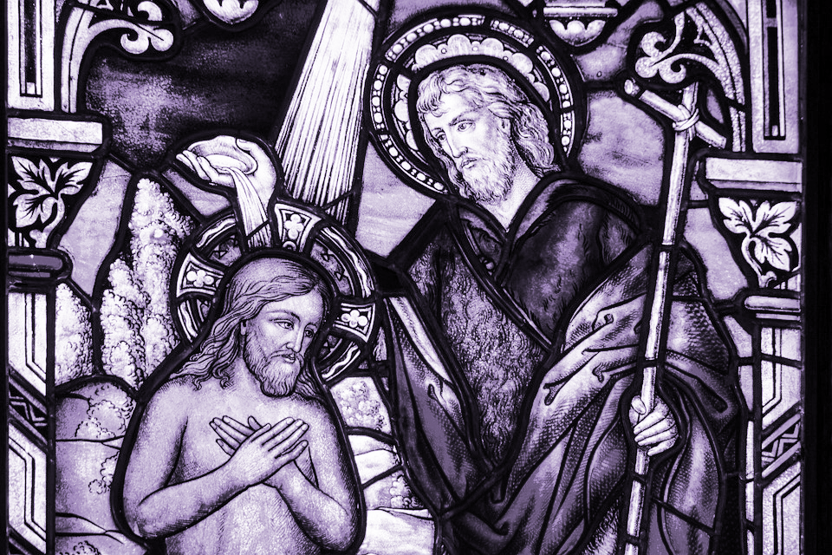
How does this link to Christianity?
Notes:
Pic ref: https://images.pexels.com/photos/33591/church-window-baptism-sacrament-glass-window.jpg?h=350&auto=compress&cs=tinysrgb

Slide 14
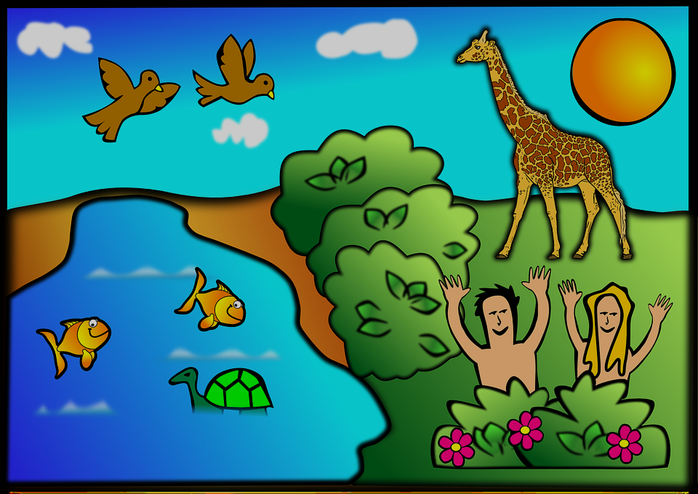
How well can you remember the Christian creation story?
Notes:
Recap with students, this could be done as a recall activity where students try and write down the main points from Genesis.
Pic ref: https://cdn.pixabay.com/photo/2012/05/07/01/37/creation-47473_960_720.png

Slide 15
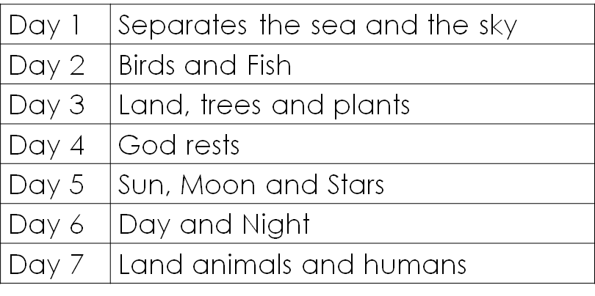

Slide 16
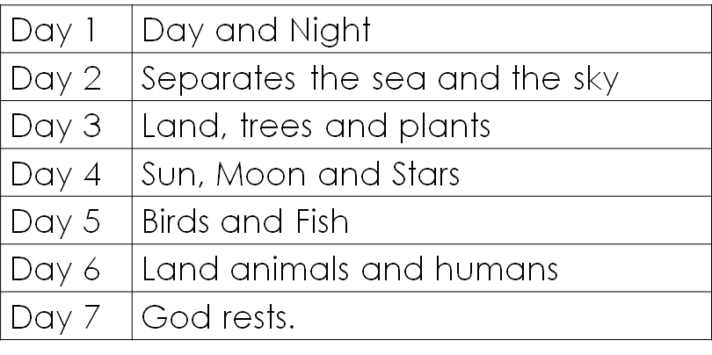

Slide 17
Take your partner’s creation you’ve been given to look after. Then destroy it!
How does it feel to see your creation being destroyed?
Notes:
For the best impact, discreetly tell one student what you are going to do and then destroy their creation without warning. Ask them how they feel etc.

Slide 18
Like a greenhouse without fans, the Earth is heating up.
Glaciers in the Arctic and Antarctic are melting faster than all predictions.
Species of plants and animals are becoming extinct as they lose habitat or food sources.
Droughts and floods are becoming more frequent.
Low-lying areas may become permanently flooded.
https://easyscienceforkids.com/all-about-climate-change/
Notes:
Scientific facts about global warming to discuss with students, what would the impact be? What is happening to Gods creation?
Pic ref: https://cdn.pixabay.com/photo/2017/02/01/12/23/cartoon-2030061_640.png

Slide 19
If we fail to look after the world in which we live, are we destroying God’s creation?

Slide 20
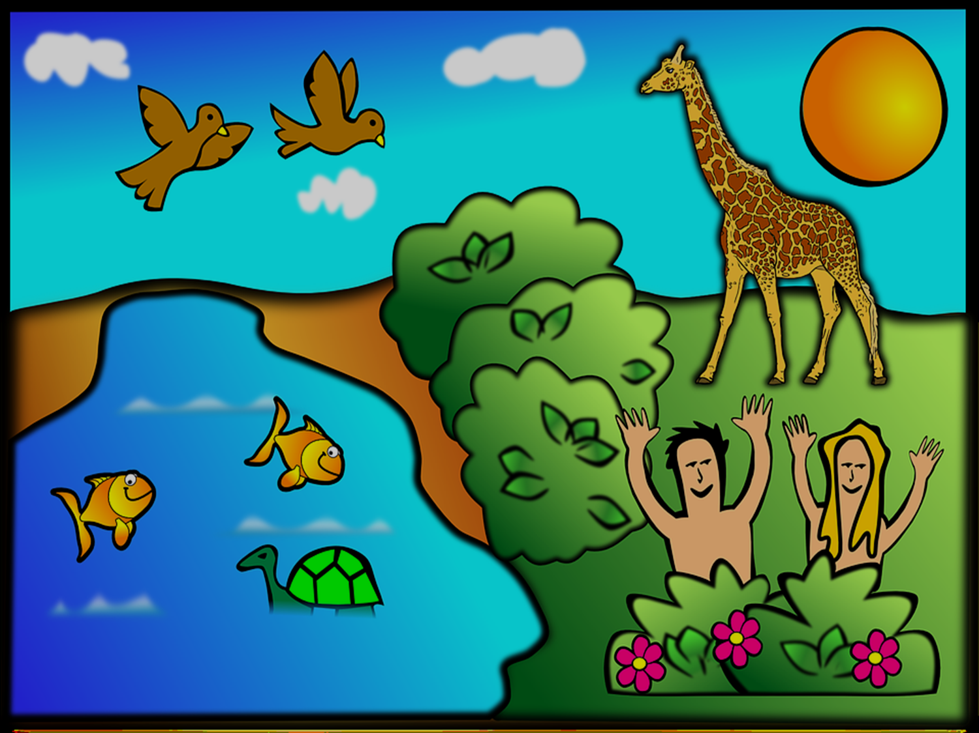
“So God created Human beings, making them to be like himself. He created the male and female, blessed them, and said, ‘have many children, so that your descendants will live all over the earth and bring it under their control. I am putting you in charge of the fish, the birds, and all the wild animals. I have provided all kinds of grain and all kinds of fruit for you to eat; but for all the wild animals and birds I have provided grass and leafy plants for food – and it was done…the Lord God placed the man in the Garden of Eden to cultivate it and guard it.” (Genesis 1 & 2)
This idea is called Stewardship. Just like stewards at a football match, we are responsible for looking after God’s creation.

Slide 21
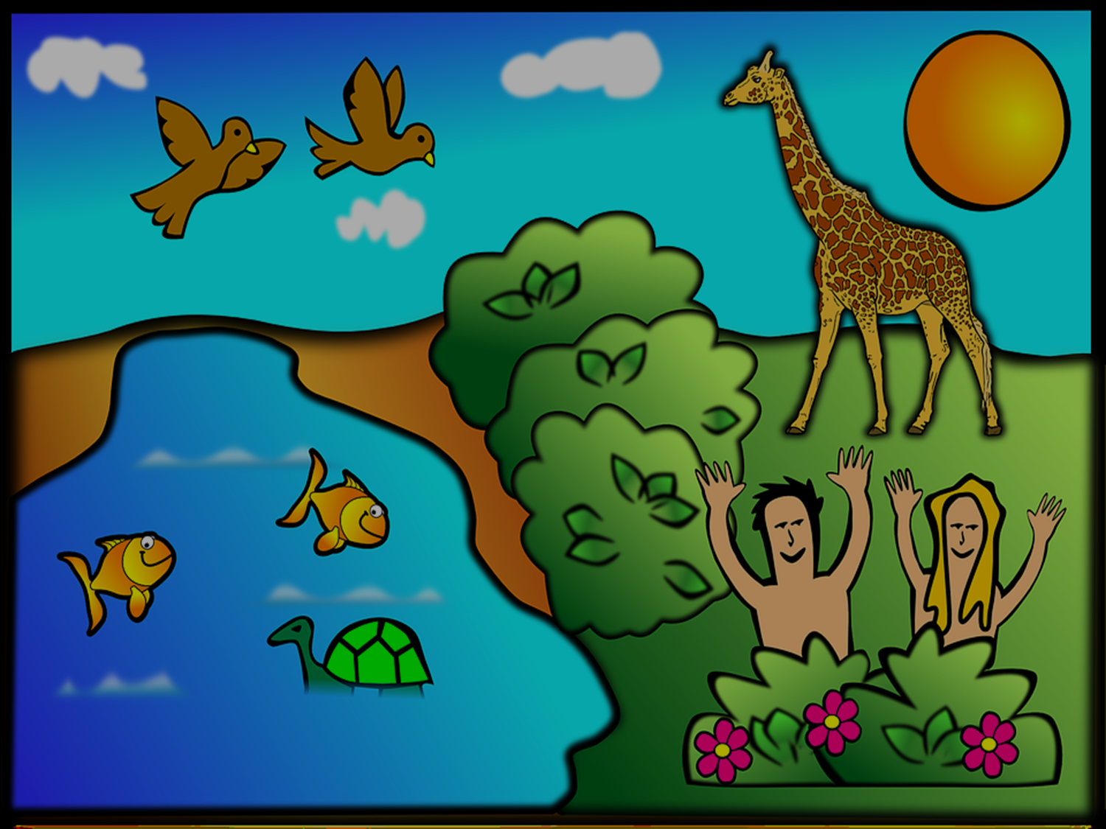
The Old Testament teaches that Christians have the right to rule over the earth which means they have responsibilities to look after it
Are we meeting this responsibility, both for us and future generations?

Slide 23
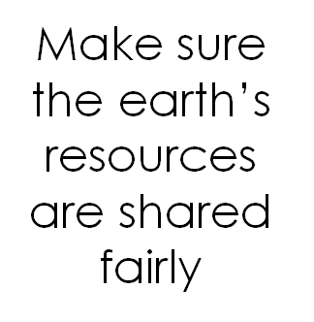
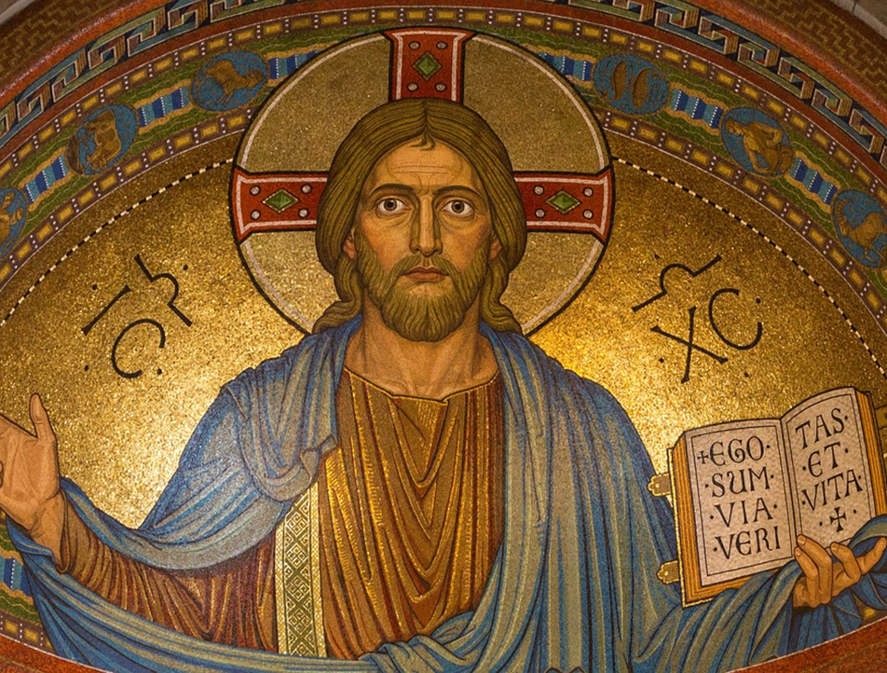
Notes:
Pic ref: https://cdn.pixabay.com/photo/2015/08/21/00/12/christ-898330_1280.jpg

Slide 24
‘Christians should be leading the way in looking after the environment’
Do you agree? Give reasons for your opinion.
Give reasons why someone would disagree with you.
Answer this question using examples and key terms:
Genesis, stewardship, climate change
Challenge: Give a quote that would support your arguments.

Slide 25
Final reflection
Are you a good steward?
How can we become better stewards?

Slide 27
World Class Teaching project has been funded with support from the European Commission. The contents of these actions are the sole responsibility of the contractor and can in no way be taken to reflect the views of the European Union.

