Slide 1
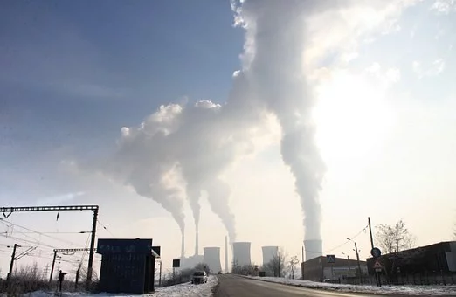
"El cambio climático"
Lesson 4
Notes:
https://pixabay.com/static/uploads/photo/2013/03/01/18/30/pollution-87684__180.jpg

Slide 4
Task: project/ proyecto
In groups, you are going to research the impacts of climate change in various Latin American countries. Then, you need to design posters to present the information you have researched. This can be done in English.
En grupos, vais a encontrar información sobre los impactos del cambio climático en países de Latinoamerica. Después, tenéis que diseñar posters para presentar la información que habéis encontrado. Lo podéis hacer en inglés.
Extension:
You can include some Spanish phrases and vocabulary that you have learned in the last few lessons.

Slide 5
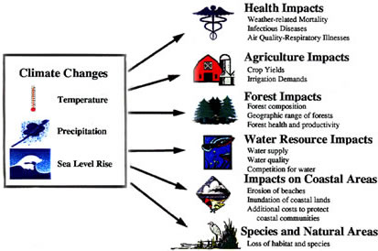
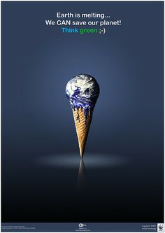
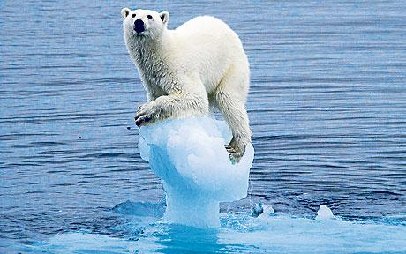
Some poster ideas for you…
Notes:
https://www.flickr.com/photos/axeasy/2437464990 http://images.slideplayer.es/1/79551/slides/slide_27.jpg
https://images.squarespace-cdn.com/content/5c2ae014b27e39387714641f/1577396020330-N0Z8CMKTS14TFV8KJA36/climate-change.jpg?content-type=image%2Fjpeg

Slide 6
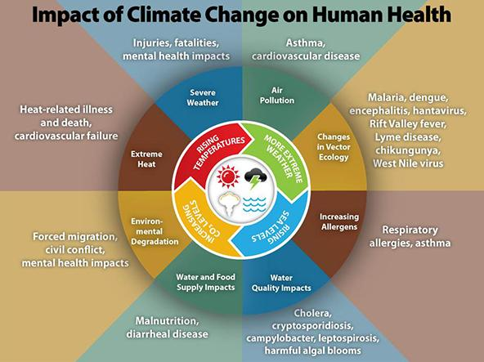
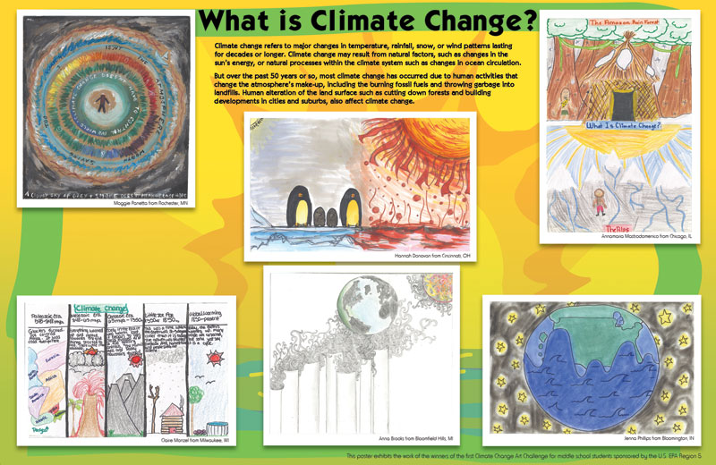
Notes:
https://toolkit.climate.gov/sites/default/files/styles/featured/public/climate_change_health_impacts600w.jpg?itok=mXSuLyVU
https://www.epa.gov/sites/production/files/styles/large/public/2015-09/climatechange_art_poster.jpg

Slide 7
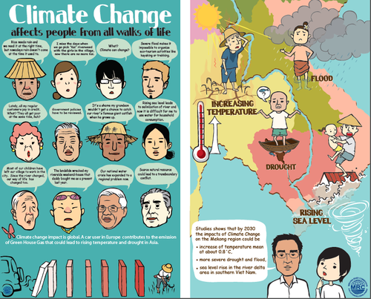
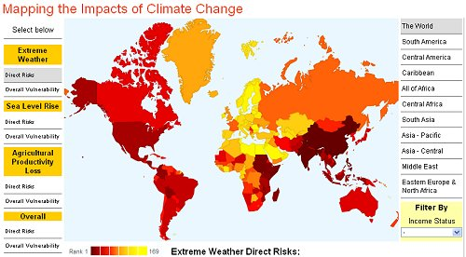
Notes:
https://blog.richmond.edu/geog250/files/2016/02/Geography1.png http://www.mrcmekong.org/assets/Graphics-Maps/CCAI/_resampled/resizedimage200162-Poster1.JPG

Slide 11
World Class Teaching project has been funded with support from the European Commission. The contents of these actions are the sole responsibility of the contractor and can in no way be taken to reflect the views of the European Union.
Adapted from original material by Jana Reinecke- Kaiser, Marcel- Breuer School, Berlin

