Slide 1
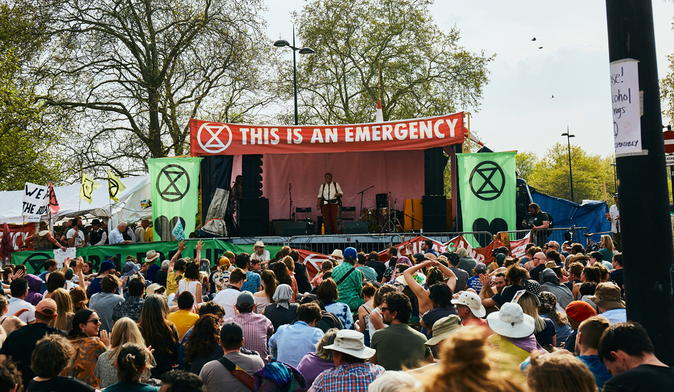
Climate change
The cycling of carbon and the effect of human activity.
Photo from extinction rebellion free to share https://drive.google.com/drive/folders/1E7NN8GpJpRTE8RU116xrWQvfVpOsw4x5

Slide 4
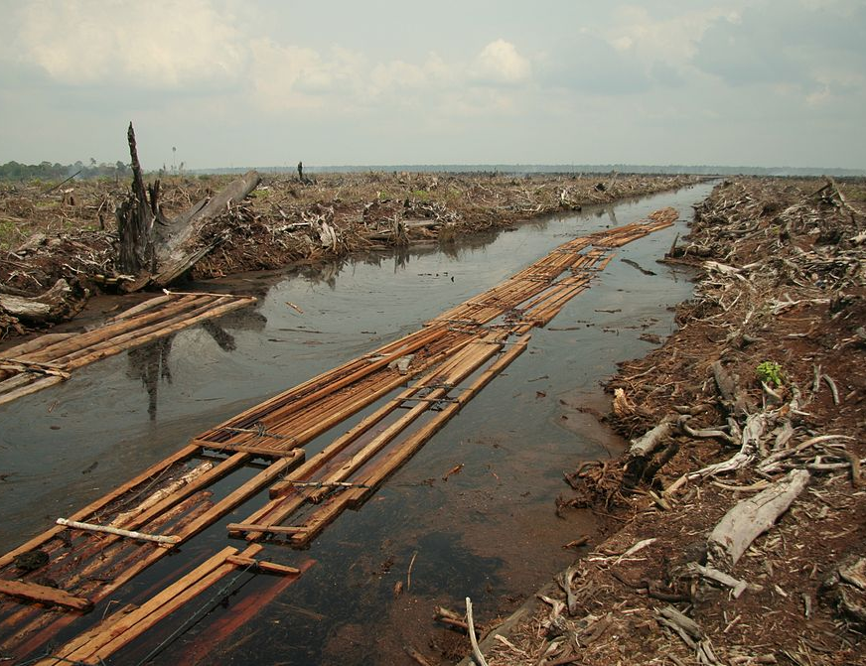
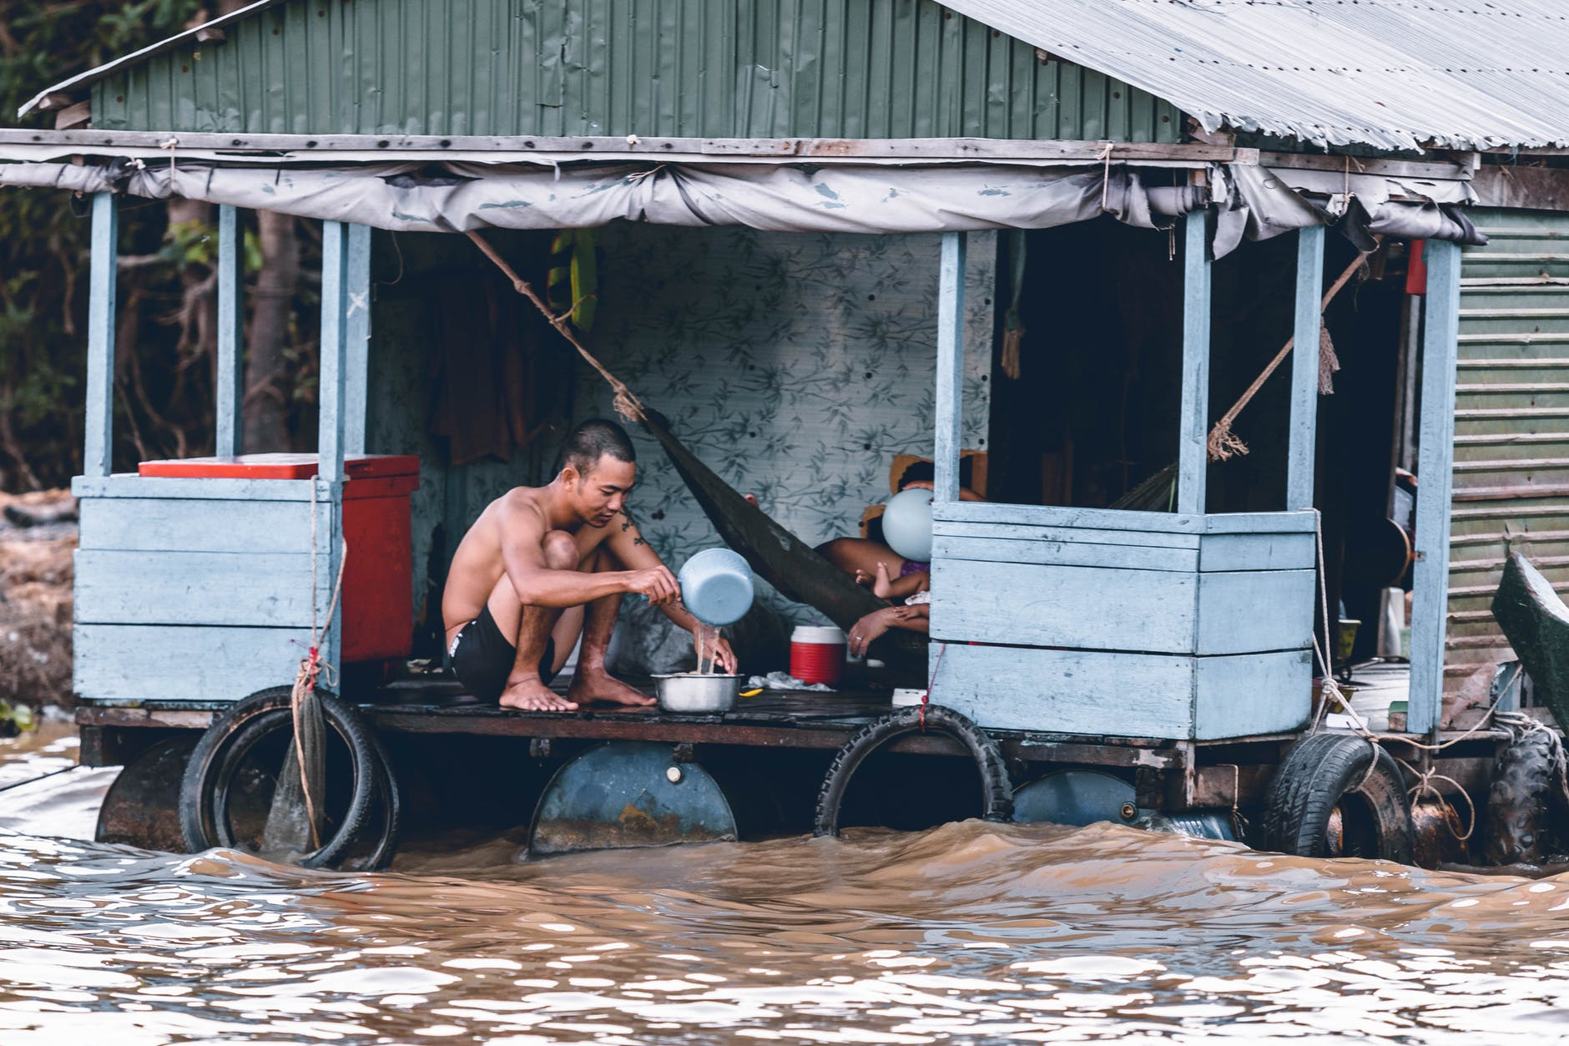
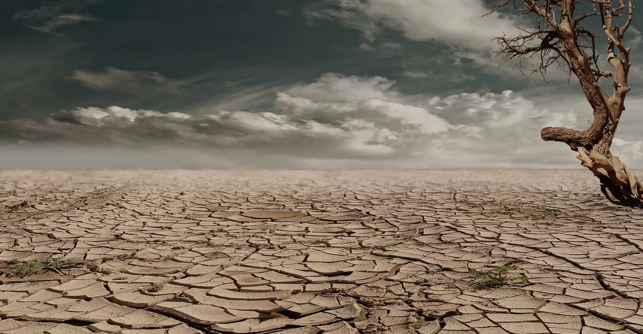
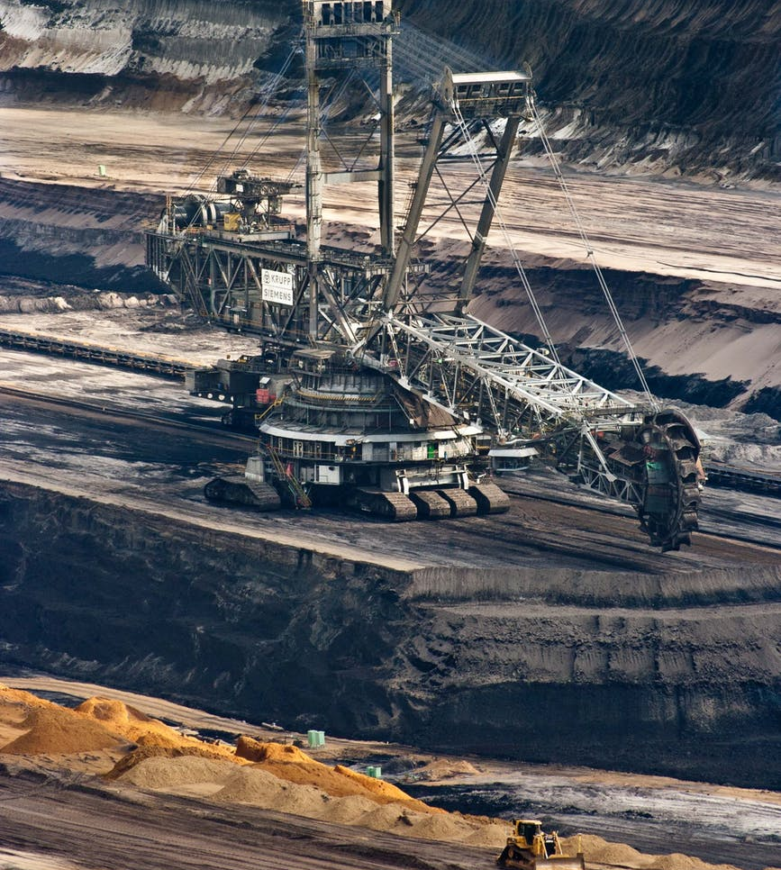
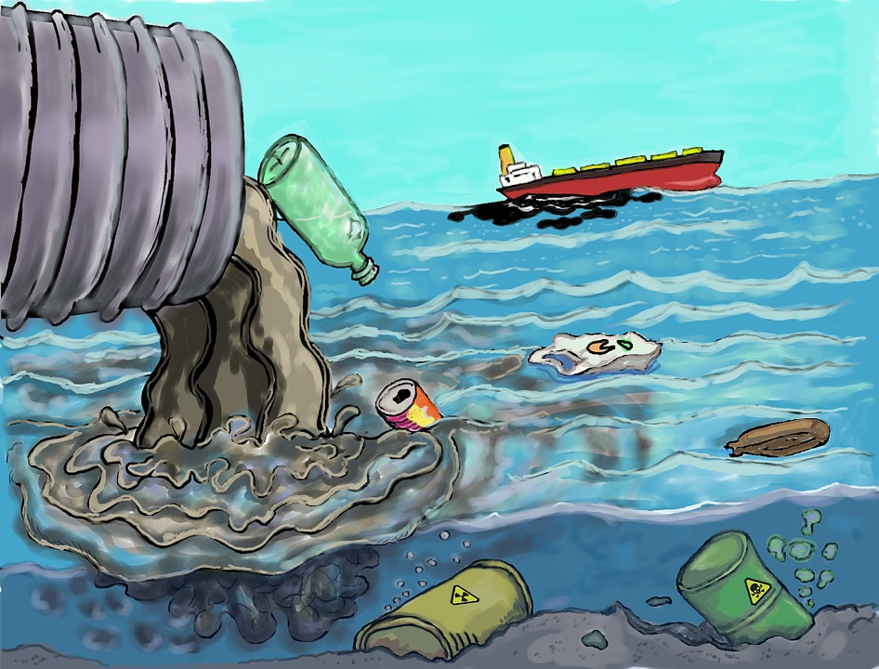
Are we looking after the environment?
Aidenvironment, 2006 - flickr:Riau flickr user:Wakx, CC BY-SA 2.0, https://commons.wikimedia.org/w/index.php?curid=10605283
https://www.pexels.com/photo/man-pouring-water-from-dipper-on-blue-and-grey-house-1739855/
https://pixabay.com/photos/skyscraper-houses-city-america-450793/
https://www.pexels.com/search/desert/
https://www.pexels.com/photo/silver-steel-mining-crane-on-black-rocky-soil-during-daytime-60008/
https://pixabay.com/illustrations/pollution-trash-degradation-1603644/

Slide 5
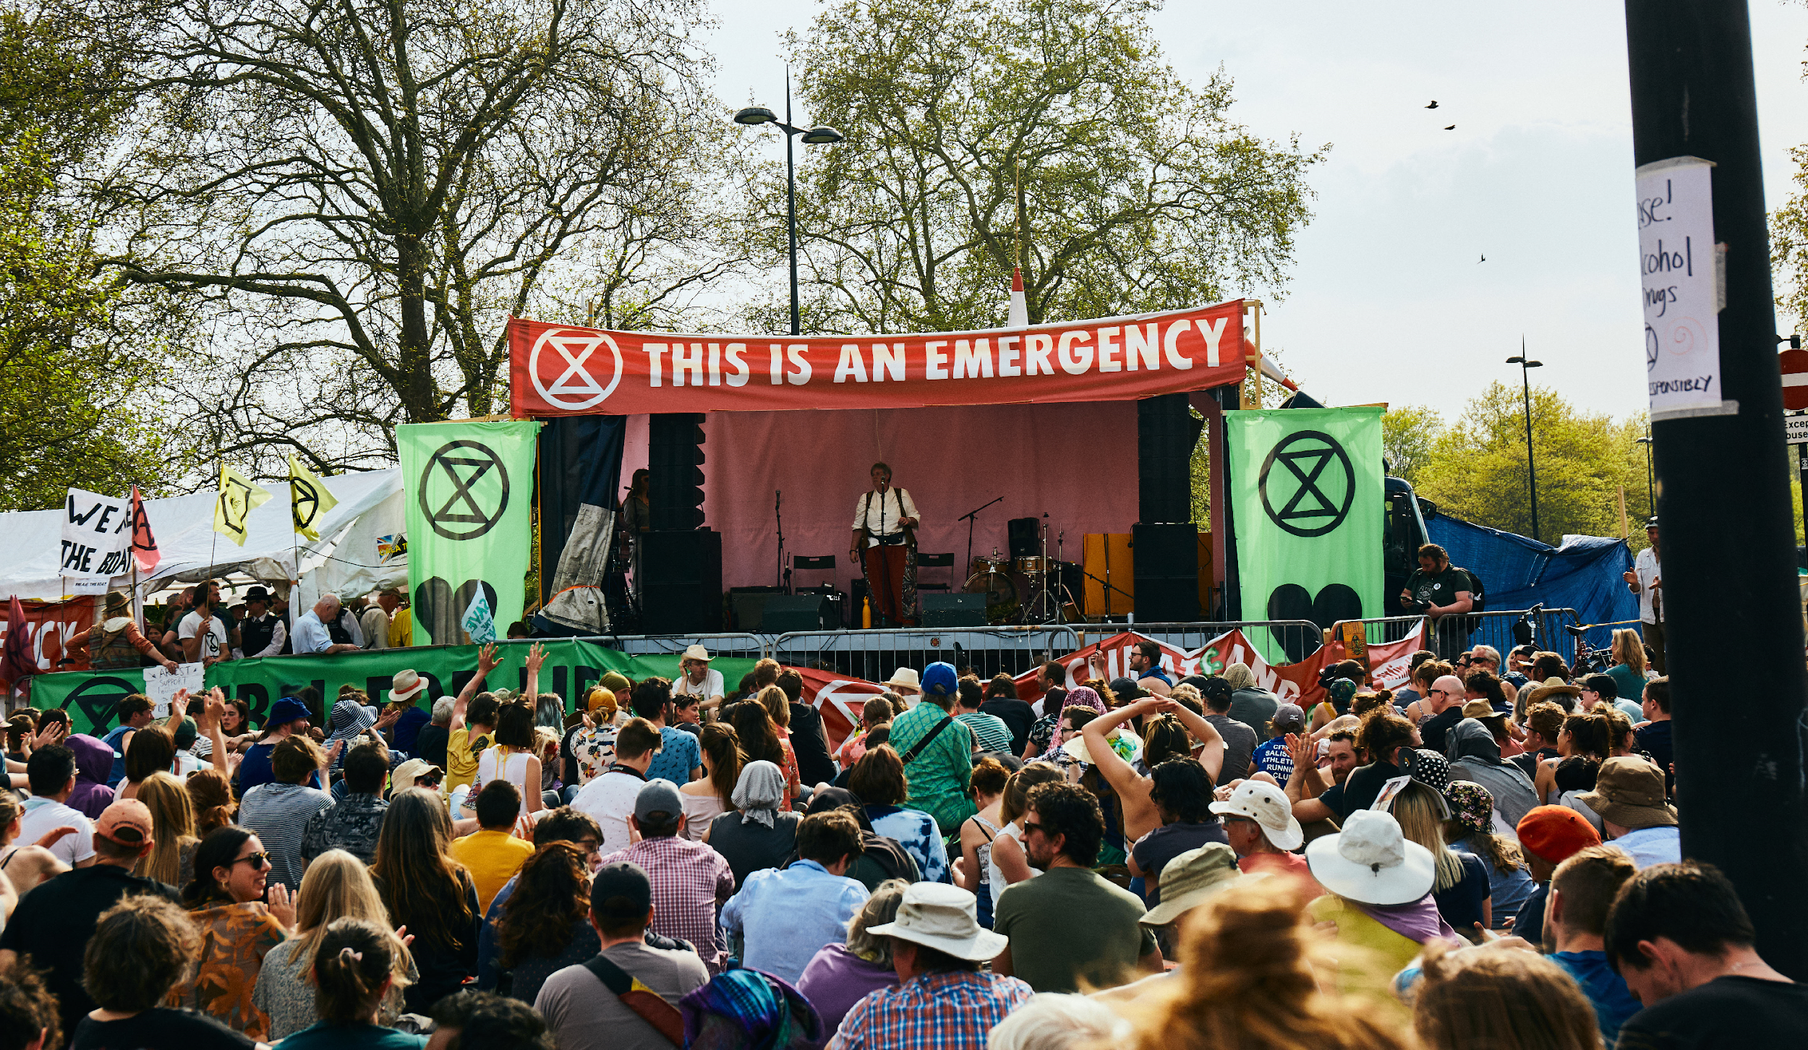
What do you think these people are talking about?
“We are in a planetary emergency” Prof. James Hansen, former Director of the NASA Goddard Institute for Space Studies
“Climate change is a medical emergency…It thus demands an emergency response…” Prof. Hugh Montgomery, director of the University College London Institute for Human Health and Performance, Lancet Commission Co-Chair
“This is an emergency and for emergency situations we need emergency action.” – Ban Ki-Moon, former UN Secretary General
“Act now to save our planet and our future from the climate emergency.” Antonio Guterres UN Secretary-General
Photo from extinction rebellion free to share https://drive.google.com/drive/folders/1E7NN8GpJpRTE8RU116xrWQvfVpOsw4x5

Slide 6
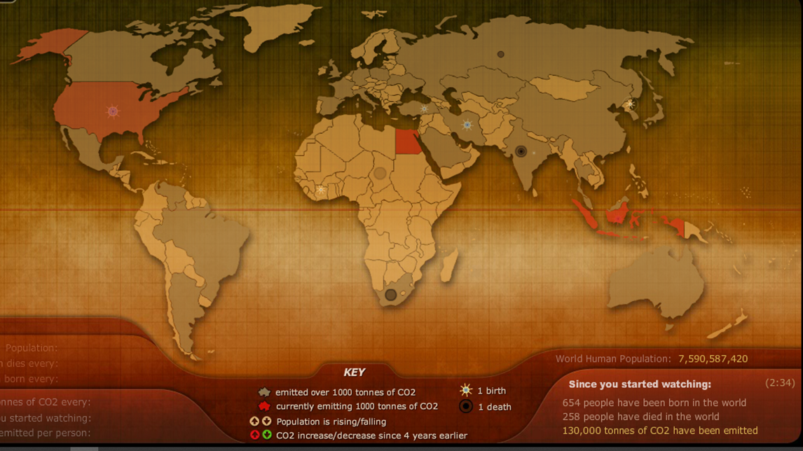
Many scientists consider climate change to be the most serious environmental challenge facing our planet.
Identify 2 things that increase whilst you watch the animation.
http://breathingearth.net/
https://www.worldof7billion.org/wp-content/uploads/2014/08/generating-heat.pdf

Slide 7
Label a diagram to show how carbon is recycled in the environment.
Teachers can use their own resources. This one is probably ok in public domain but not 100% sure. See CO2_cycle.jpg Author Fung Burr at https://www.uen.org/lessonplan/view/43207

Slide 8
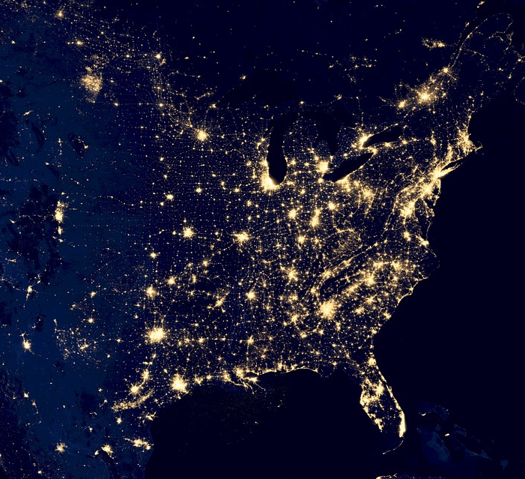
How might the number of people on the planet affect the amount of carbon dioxide (CO₂) in the atmosphere?
https://pixabay.com/photos/usa-city-lights-space-night-532939/

Slide 9
Draw a graph to show the annual CO₂ produced by a child in Malawi and a child born in Australia.
THE CO₂ PRODUCED BY A CHILD BORN IN MALAWI IS 0.1 TONNE /YR .
AN AUSTRALIAN CHILD PRODUCES 30 TONNES/YR
WHAT IS THE INDEPENDENT VARIABLE?
WHAT IS THE DEPENDENT VARIABLE?
EXPLAIN WHY A BAR GRAPH IS THE BEST SORT OF GRAPH TO USE TO SHOW THIS DATA.

Slide 10
Sort the cards into activities which increase or decrease the amount of CO₂ in the atmosphere
INCREASE | DECREASE
Respiration | Photosynthesis
Forest fires | Planting forests
Cutting down forests (deforestation) | Eating a plant based diet
Consuming more manufactured goods
Flying
Warming the oceans
Building with cement
Which of these things might explain why the amount of CO₂ produced by Australians is so much higher than that produced by people in Malawi?

Slide 11
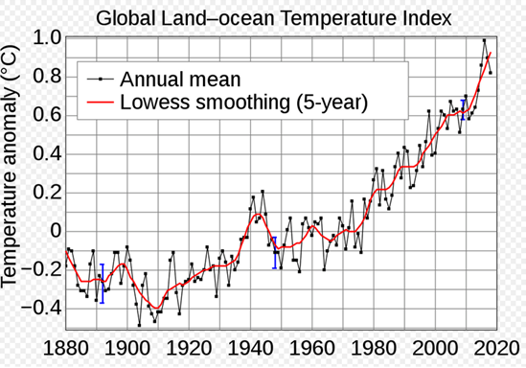
What do you see when you compare levels of CO₂ in the atmosphere and global temperatures?
Image created by GRID Arundel https://www.grida.no/resources/5500
https://commons.wikimedia.org/wiki/File:Global_Temperature_Anomaly.svg#/media/File:Global_Temperature_Anomaly.svg

Slide 12
Does a link always mean that one thing caused another? Each of these statements is true.
1 A, children’s shoe size is linked to B, their reading ability, the bigger the shoe size the higher the reading ability.
2 A, the number of ice creams sales is linked to B, deaths by drowning the higher the number of ice creams sold, the higher the number of drownings.
3 Since the 1950s, both A, the atmospheric CO₂ level and B, obesity levels, have increased sharply.
4 Since the industrial revolution both A, the atmospheric CO₂ level and B, global temperatures, have increased.
In each example do you think A caused B?
Can you think of another thing, C which might have caused both A and B?
A
B
OR
C
A
B

Slide 13
Does a link always mean that one thing caused another? Each of these statements is true.
1 A, children’s shoe size is linked to B, their reading ability, the bigger the shoe size the higher the reading ability. They both increase with C, age.
2 A, the number of ice creams sales is linked to B, deaths by drowning the higher the number of ice creams sold, the higher the number of drownings. They both increase with C, hot weather.
3 Since the 1950s, both A, the atmospheric CO₂ level and B, obesity levels, have increased sharply. They both increase with C, increased car ownership.
4 Since the industrial revolution both A, the atmospheric CO₂ level and B, global temperatures, have increased. Scientists can think of no other cause of an increase in global warming they conclude that rising CO2 levels are causing global warming.
A
B
OR
C
A
B

Slide 14
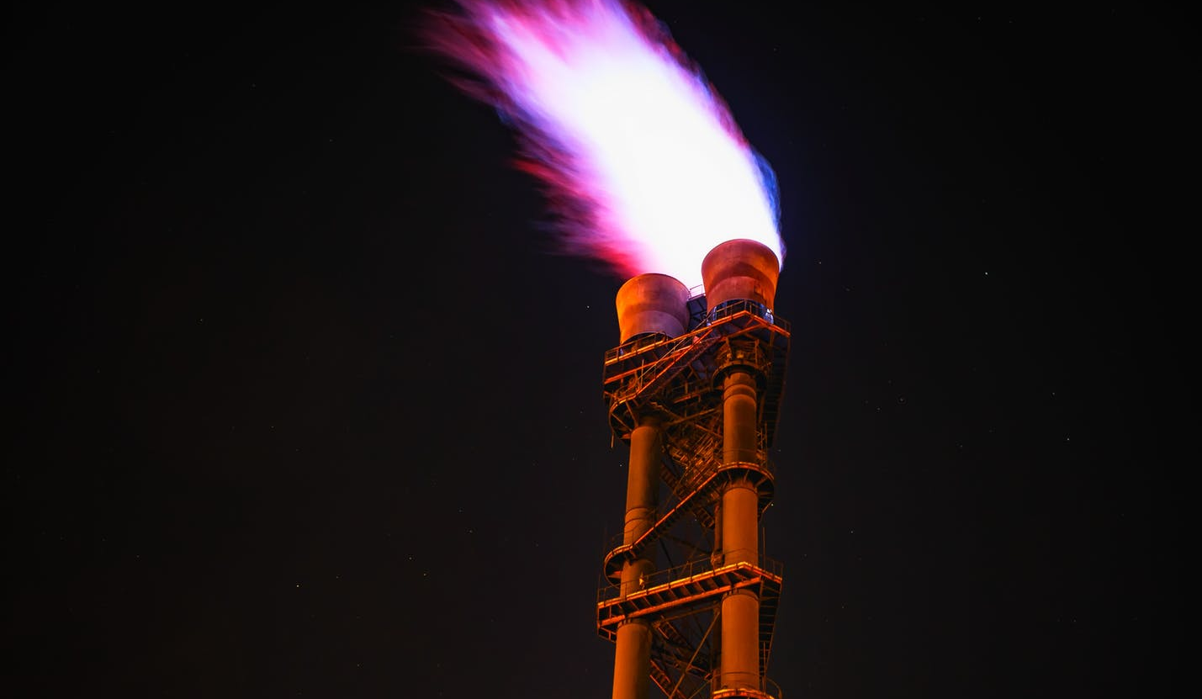
The link between burning fossil fuels to produce carbon dioxide and rising temperatures is very strong.
97% of scientists think the increase in CO2 due to human activity has caused global warming.
https://www.pexels.com/photo/low-angle-view-of-illuminated-tower-against-sky-at-night-327041/

Slide 15
Watch Greta Thunberg address the United Nations in 2018.
https://youtu.be/VFkQSGyeCWg

Slide 16
Call to action. The UK government and many local councils have declared a climate emergency.
Something you can do personally.
Eg calculate how much CO₂ you add (your carbon footprint) https://www.carbonfootprint.com/calculator.aspx
Find out about collective action eg #YouthStrike4Climate
Let decision makers know your thoughts and ideas.
Find your local councillor here https://www.gov.uk/find-your-local-councillors
And your MP here
https://www.mysociety.org/wehelpyou/who-is-your-mp/
Find out about widening participation in decision making through citizens assemblies. https://www.involve.org.uk/resources/blog/opinion/citizens-assembly-climate-change-how-would-it-work

Slide 18
World Class Teaching project has been funded with support from the European Commission. The contents of these actions are the sole responsibility of the contractor and can in no way be taken to reflect the views of the European Union.

