Slide 1
Carbon footprint
KS4 Climate Change

Slide 4
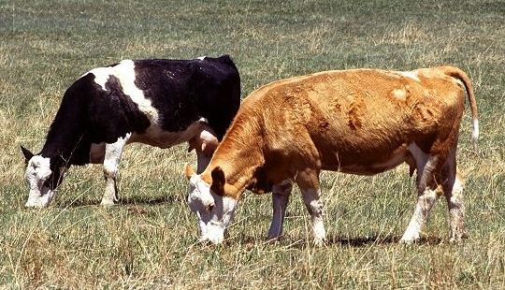
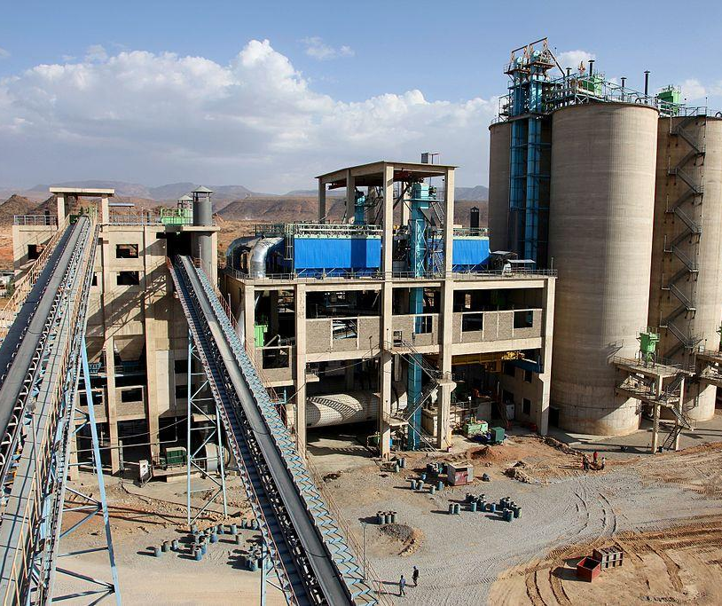
Carbon footprint
https://en.wikipedia.org/wiki/Environmental_impact_of_meat_production
Public Domain, https://commons.wikimedia.org/w/index.php?curid=1215074
We use this term as a sort of shorthand to measure the impact on greenhouse gas emissions over the full life cycle of something.
Name 2 greenhouse gases.
So here “Carbon” is shorthand for any greenhouse gases.
“Footprint” is a metaphor for the total impact that something has.
https://en.wikipedia.org/wiki/Cement
By Gavin Houtheusen/Department for International Development,
CC BY 3.0, https://commons.wikimedia.org/w/index.php?curid=30786775

Slide 5
watch here
https://en.wikipedia.org/wiki/Carbon_footprint
Title: Carbon Footprint simple-explanation EN.webm Author: simpleshow creative commons license

Slide 6
Place the countries in order of the size of their carbon footprint per person.
UK
Luxembourg
China
Nepal
United states
Ethiopia
Bangladesh
India
Argentina
Zambia
Australia
Image source https://commons.wikimedia.org/wiki/Maps_of_the_world#/media/File:BlankMap-World-v2.png

Slide 7
Can you name these countries? Place the countries in order of the size of their carbon footprint per person.
U
L
C
N
U
E
B
I
A
Z
A
Image source https://commons.wikimedia.org/wiki/Maps_of_the_world#/media/File:BlankMap-World-v2.png

Slide 8
Who emits the most?
country | metric tonnes of carbon dioxide
 | 26.28
 | 20.58
 | 19.78
 | 9.66
 | 4.58
 | 4.06
 | 1.16
 | 0.29
 | 0.23
 | 0.11
 | 0.07
Sort the country cards your teacher has given you in the order of most to least emissions.
Source https://www.theguardian.com/environment/datablog/2009/sep/02/carbon-emissions-per-person-capita

Slide 9
country | metric tonnes of carbon dioxide
Luxembourg | 26.28
Australia | 20.58
United States | 19.78
UK | 9.66
China | 4.58
Argentina | 4.06
India | 1.16
Bangladesh | 0.29
Zambia | 0.23
Nepal | 0.11
Ethiopia | 0.07
Source https://www.theguardian.com/environment/datablog/2009/sep/02/carbon-emissions-per-person-capita

Slide 10
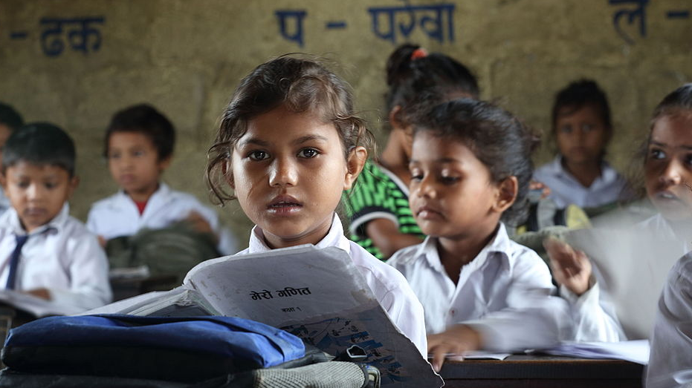
Agree or disagree
“A country like Nepal shows the way for other countries as its low emissions are due to its excellent energy efficiency programmes.”
Agree or disagree? Explain your reasons.
https://en.wikipedia.org/wiki/Gender_inequality_in_Nepal
By Department of Foreign Affairs and Trade - Sahara Bal Primary School, Grade 1, Pokhara, Nepal.,
CC BY 2.0, https://commons.wikimedia.org/w/index.php?curid=32165520

Slide 11
Agree or disagree
“The USA could easily reduce its carbon emissions, they are twice as high as the UK which means they must be using more than they need.”
Agree or disagree? Explain your reasons
https://en.wikipedia.org/wiki/Passenger_vehicles_in_the_United_States
By Coolcaesar, CC BY-SA 3.0, https://commons.wikimedia.org/w/index.php?curid=2117556

Slide 12
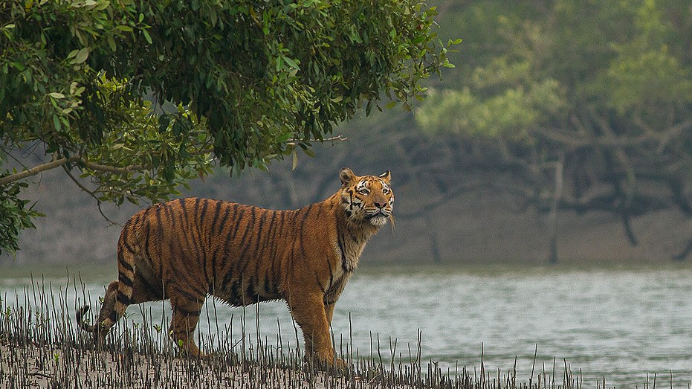
Agree or Disagree
The impact of global warming on Bangladesh is expected to be great. Rising sea levels will drown a huge amount of land from the southern coast; as a result about 20 million people will be forced to migrate from there by the year 2050. This will cause serious humanitarian problems in the country.
“The global community should provide the money to help Bangladesh to adapt to climate change locally (eg building disaster resilient homes and floating gardens)and act in agreement with the Paris accord to reduce emissions to mitigate the effects of future warming. “
Agree or disagree? Explain your reasons.
https://en.wikipedia.org/wiki/Bangladesh
By Soumyajit Nandy - Own work, CC BY-SA 4.0,
https://commons.wikimedia.org/w/index.php?curid=62034651

Slide 13
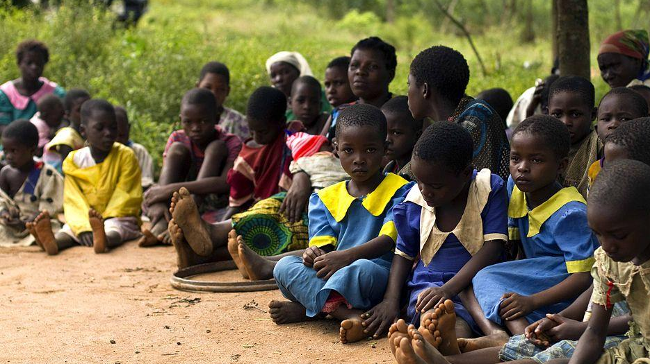
Agree or disagree
The carbon footprint of a child born in Malawi is 0.1 tonne /yr.
An Australian child has a carbon footprint of 30 tonnes/yr.
“Economically developed countries should aim to reduce their populations, this is not important for less economically developed countries.”
Agree or disagree? Give your reason.
https://en.wikipedia.org/wiki/Malawi By Swathi Sridharan (ICRISAT) - https://www.flickr.com/photos/swathi-icrisat-esa/5531799828/, CC BY-SA 2.0
, https://commons.wikimedia.org/w/index.php?curid=14888149

Slide 14
What would you need to include if you calculated the size of your carbon footprint?
Carbon footprint

Slide 15
Life cycle carbon footprint
Why do manufacturers want you to upgrade your phone every few years?
How would keeping the same phone help you reduce your carbon footprint?
Apple estimate the lifetime carbon footprint of an iphone 6 to be 95kg of CO2
85% production
11% customer use
3% transport
1% recycling
An estimated 80 million iphone 6 have been sold.
https://commons.wikimedia.org/wiki/IPhone#/media/File:IPhone6_silver_frontface.png User:Rayukk

Slide 16
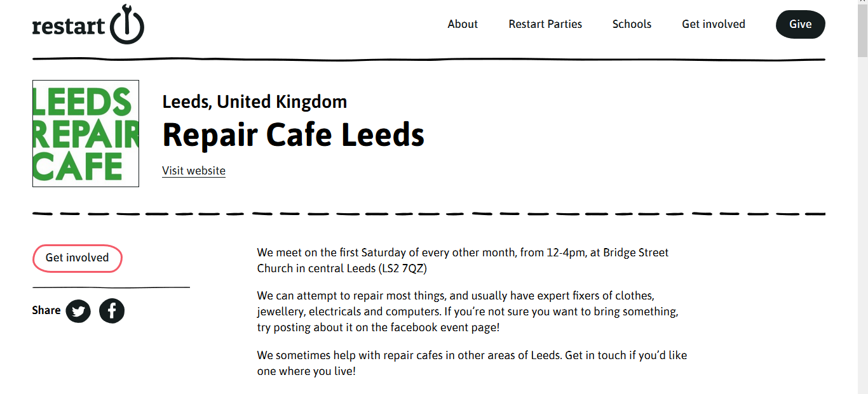
Repair cafes in schools and cities across the UK help you learn how to mend things including phones.
https://therestartproject.org/parties/?country=United%20Kingdom

Slide 17
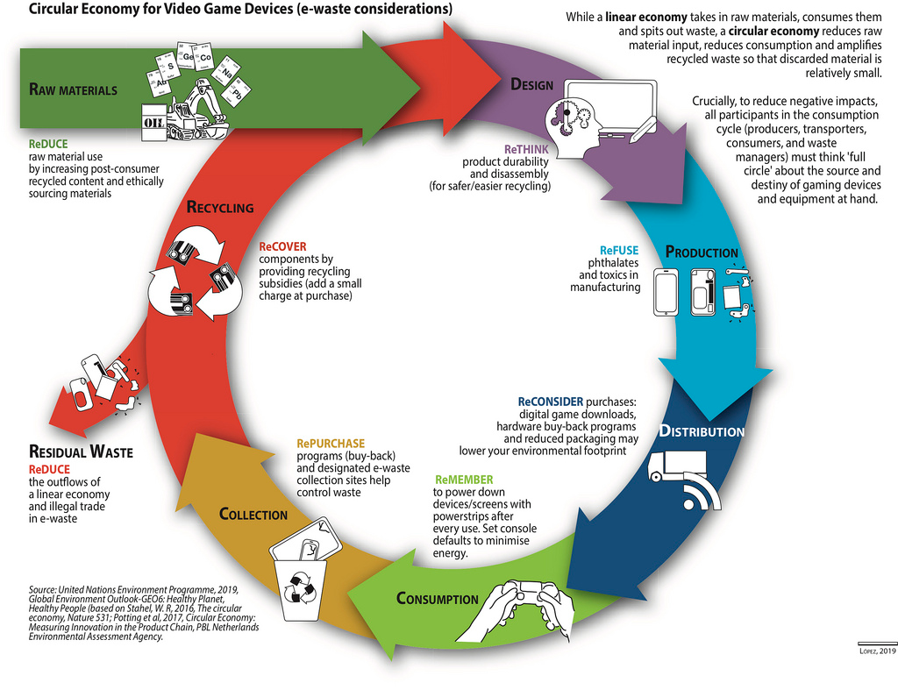
Free to use attributed to Nieves Lopez http://www.grida.no/resources/13200

Slide 18
Reflection
Name 5 things that have a carbon footprint.
Name 4 stages in a products lifecycle that contribute to its carbon footprint.
Name 3 things that make it hard to reduce global carbon footprint.
Name 2 greenhouse gases.
Name 1 thing you do to reduce your carbon footprint.

Slide 19
The best way to reduce my footprint is..
eating less
using less
buying smart
mending my stuff
Explain your answer drawing on examples.

Slide 21
World Class Teaching project has been funded with support from the European Commission. The contents of these actions are the sole responsibility of the contractor and can in no way be taken to reflect the views of the European Union.

