Slide 1
Climate Change; interrogating the evidence.
https://www.pexels.com/search/desert/

Slide 4
97% of scientists think the increase in CO₂ due to human activity has caused global warming.
These scientists think there is lots of Scientific Evidence. Look at the 10 pieces of evidence and choose the best pieces of evidence that support this idea. Be prepared to explain why you think that is good evidence.

Slide 5
A small number of scientists disagree that human activity is the cause of global warming. Select one piece of evidence that they could use to support their argument.
On balance do you think the evidence suggests we should carry on as usual or act to reduce emissions of greenhouse gases?

Slide 6
Use the writing frame and selected pieces of evidence to build a reasoned argument around the claim that there is a causal link between human activity, atmospheric CO₂ levels and global warming.

Slide 7
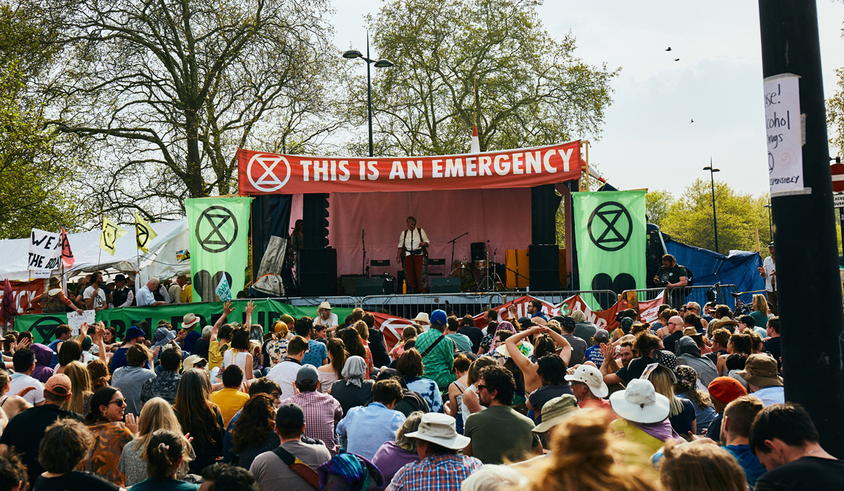
In May 2019 the UK became the first country in world to declare a Climate Emergency.
Find out about local responses to the climate emergency.
Make a personal action plan in response to the climate emergency.
Photo from extinction rebellion free to share https://drive.google.com/drive/folders/1E7NN8GpJpRTE8RU116xrWQvfVpOsw4x5

Slide 9
World Class Teaching project has been funded with support from the European Commission. The contents of these actions are the sole responsibility of the contractor and can in no way be taken to reflect the views of the European Union.

