Slide 1
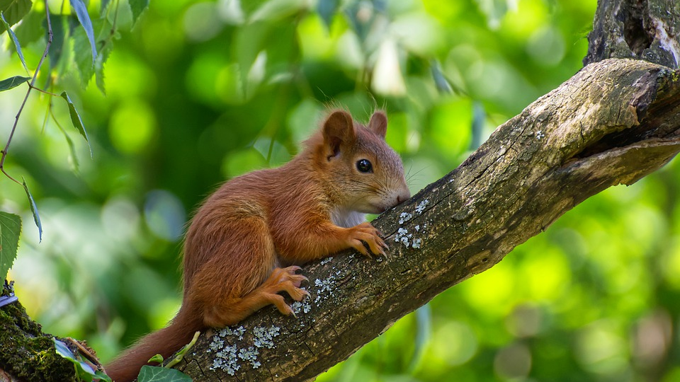
Humans v Ecosystems? positive and negative human interactions with ecosystems
https://pixabay.com/photos/squirrel-young-young-animal-mammal-4310069/

Slide 4
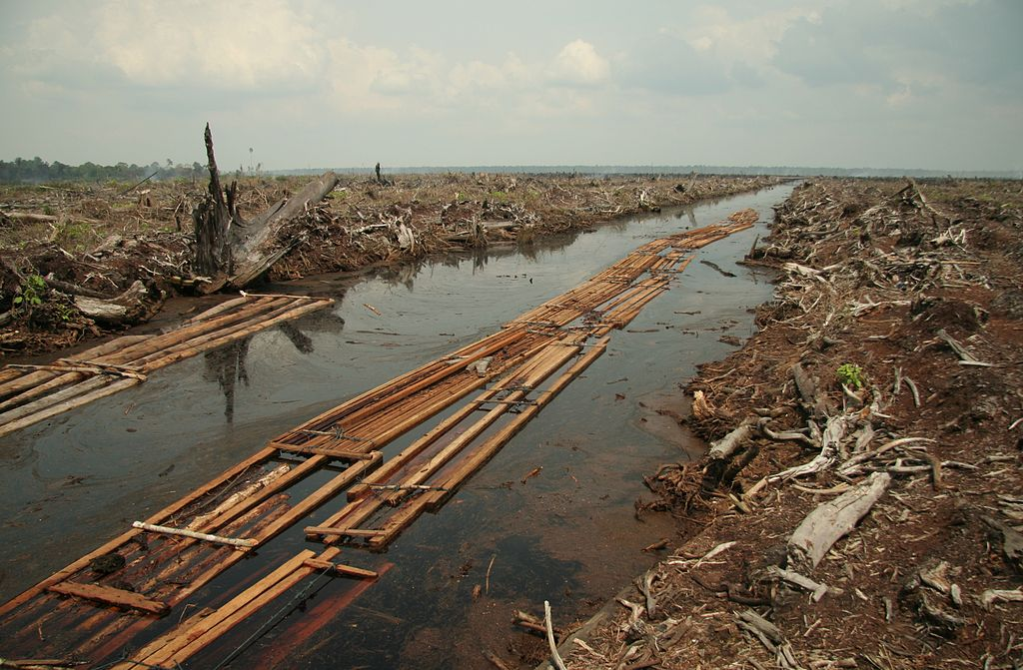
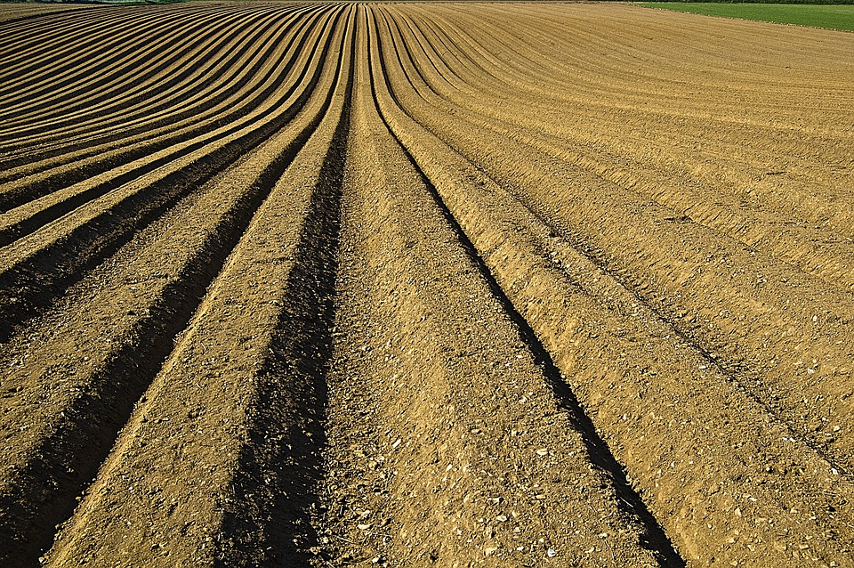
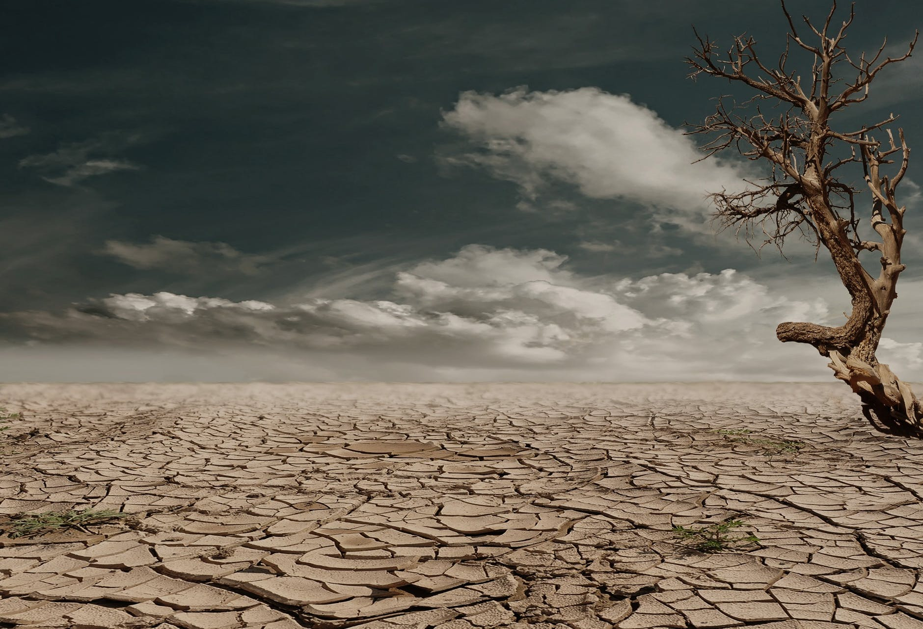
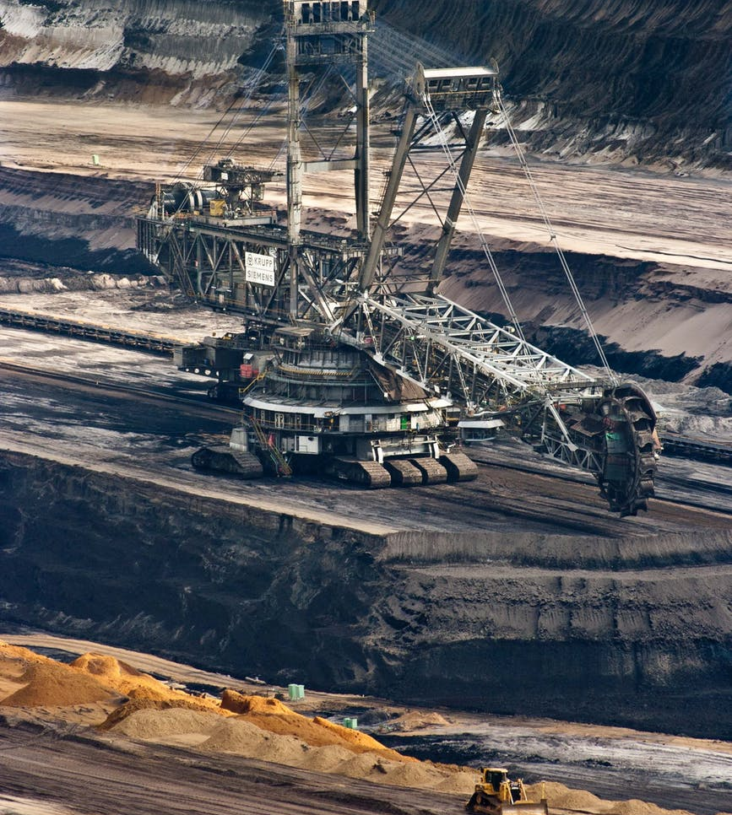
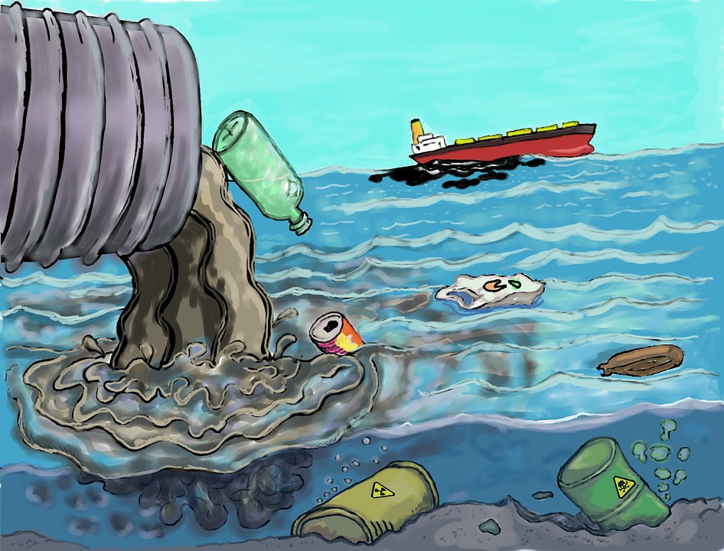
Humans vs Ecosystems?
Aidenvironment, 2006 - flickr:Riau flickr user:Wakx, CC BY-SA 2.0, https://commons.wikimedia.org/w/index.php?curid=10605283
/
https://pixabay.com/photos/skyscraper-houses-city-america-450793/
https://www.pexels.com/search/desert/
https://pixabay.com/photos/crop-furrows-soil-seeds-1149914/
https://www.pexels.com/photo/silver-steel-mining-crane-on-black-rocky-soil-during-daytime-60008/
https://pixabay.com/illustrations/pollution-trash-degradation-1603644/

Slide 5
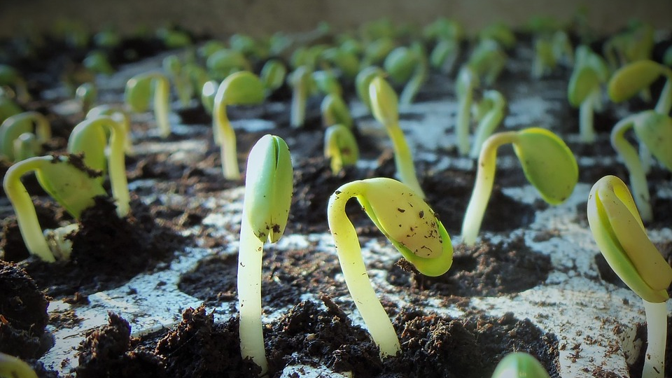
You might know peat as something sold in plastic bags as garden compost. There’s much more to peat than that.
https://pixabay.com/photos/plants-soybean-soy-nature-1331667/

Slide 6
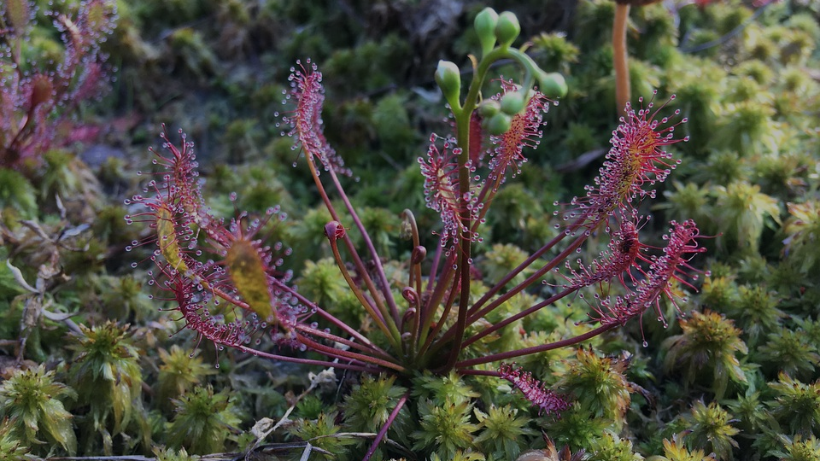
Peatlands are among the world’s underappreciated natural treasures.
These waterlogged ecosystems are one of the most important carbon reservoirs on the planet - holding twice as much carbon as all the world's forests.
Why is it important to maintain the world’s carbon reservoirs?
https://pixabay.com/photos/sundew-peat-moss-moor-nature-2783310/

Slide 7
Name;
5 countries which emit more than 10 Mt CO₂/yr and
2 countries which emit over 100 Mt CO₂/yr from their peatlands.
https://www.grida.no/resources/12537
creator credit Nieves Lopez Izquierdo

Slide 8
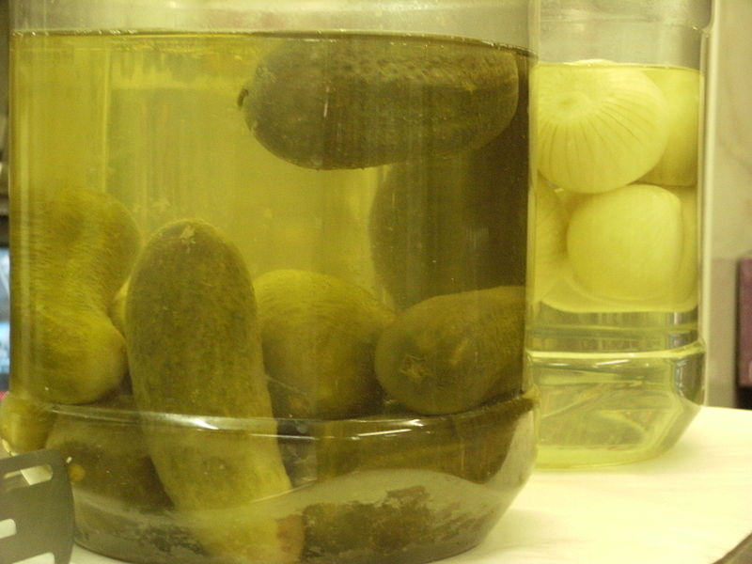
“Peatlands are like a jar of pickles,” “If you remove the water, the remaining material rots away.
Hans Joosten from the University of Greifswald
Why does the peat only rot when the water is drained away?
What happens to the carbon stored in the peat when the peat begins to rot?
https://www.youtube.com/watch?v=1C7ecAoXav0
The story of how mass extraction of resources affects the natural world.
https://en.wikipedia.org/wiki/Pickled_cucumber phot credit Liz Sullivan

Slide 9
Peatlands are important to human societies around the world. They contribute significantly to climate change mitigation and adaptation through carbon capture and storage, biodiversity conservation, water regime and quality regulation, and the provision of other ecosystem services that support livelihoods.
https://pixabay.com/photos/peat-potting-soil-1263431/

Slide 10
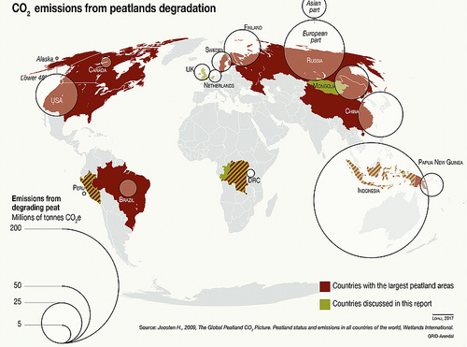
Which country has the highest CO₂ emissions from peatland degradation?
(NB degradation includes draining and deforestation.)

Slide 11
What drives deforestation in Indonesia?
A study of greenhouse gas emissions from palm oil expansion in Indonesia's Riau Province between 2000 and 2012 assessed carbon dioxide emissions at 5.2 million tons annually, with about 70 percent coming from areas with peat soils.
Peat swamp forests that are home to high densities of orangutans are often targeted for oil palm plantations. Palm oil is found in around 50% of products in your supermarket.

Slide 12
Palm oil is planted because its fruits have a very high oil content. An even bigger area would need to be planted for a lower yielding crop. Agree or disagree “Consumption is the problem.”

Slide 13
Environmental and social impacts of peatland drainage.
https://www.grida.no/resources/12536
Cartographer: Nieves Lopez Izquierdo

Slide 14
Everything is connected should be the first law of ecology!
Arrange the hexagon cards in such a way that where one card touches another you can explain a link between them.
Eg if we arranged these 3 hexagons
Increased CO₂ levels
The link here can be increased global sea temperature caused by greenhouse effect
Coral killed
The link here can be more CO2 dissolves creating higher conc. of carbonic acid
Acidified sea water
The link here can be acid sea dissolves calcium carbonate skeleton

Slide 15
In the last 10 years an area of Indonesian peatland rainforest size of half of England has disappeared.
Give three negative impacts that this will have on the environment.
1
2
3
Source https://en.wikipedia.org/wiki/Orangutan Photo credit Eleifert

Slide 16
Loss of biodiversity- Over 100,000 wild Bornean orangutans have been lost between 1999 and 2015, that’s a 50% fall .
We share 97% of our DNA with orangutans.
Source https://en.wikipedia.org/wiki/Orangutan Photo credit Eleifert

Slide 17
This species has the right to life.
Its sad but that’s evolution, it’s the survival of the fittest, some species go extinct.
Lets talk about it.
We share 97% of our DNA with orangutans. That makes it worse that we are causing their extinction.
The livelihoods of people in poor communities is more important than preserving peatland forest .
People have always used peat in their gardens, you need it to grow seeds.
Source https://en.wikipedia.org/wiki/Or angutanPhoto credit Eleifert

Slide 18
What is the best way to preserve biodiversity and secure the future of endangered orangutans? Sort the cards into 2 groups., things that are Threats to biodiversity and things that are opportunities to preserve biodiversity.
Some parts of Borneo are conservation areas where no logging or hunting are permitted.
Some local people have been trained to work in forest conservation .
Breed orangutans in zoos around the world.
Whilst a lot of timber is exported, the demand in Indonesia for domestic timber exceeds the legal limit for logging.
Palm oil, grown on drained peat is used as biofuel to reduce fossil fuel use in developed countries.
Rescue centres have been set up to raise orphan orangutans and return them to the wild.
Areas which were deforested have been planted with oil palms .
Logging companies employ armed guards.
Palm oil is used as a healthy oil in 1 in 10 supermarket products.
Laws can be made in consumer countries against
imports of illegally harvested timber.
Fires set to clear forest illegally have spread across Borneo as the peat swamps have dried out
Young orangutans are captured and sold abroad.
Source Last stand of the orangutan
https://gridarendal-website-live.s3.amazonaws.com/production/documents/:s_document/240/original/orangutan-full.pdf?1487684008

Slide 19
What is the best way to preserve biodiversity and secure the future of endangered orangutans? Threats and opportunities.
Some parts of Borneo are conservation areas where no logging or hunting are permitted.
Some local people have been trained to work in forest conservation .
Breed orangutans in zoos around the world.
Whilst a lot of timber is exported, the demand in Indonesia for domestic timber exceeds the legal limit for logging.
Palm oil, grown on drained peat is used as biofuel to reduce fossil fuel use in developed countries.
Rescue centres have been set up to raise orphan orangutans and return them to the wild.
Areas which were deforested have been planted with oil palms .
Logging companies employ armed guards.
Palm oil is used as a healthy oil in 1 in 10 supermarket products.
Laws can be made in consumer countries against
imports of illegally harvested timber.
Fires set to clear forest illegally have spread across Borneo as the peat swamps have dried out
Young orangutans are captured and sold abroad.
Source Last stand of the orangutan
https://gridarendal-website-live.s3.amazonaws.com/production/documents/:s_document/240/original/orangutan-full.pdf?1487684008

Slide 20
Action
To find out which palm oil products have got the green go-ahead, and which to completely avoid, read the Ethical Consumer Guide.
Notes:
https://www.ethicalconsumer.org/palm-oil/palm-oil-free-list

Slide 21
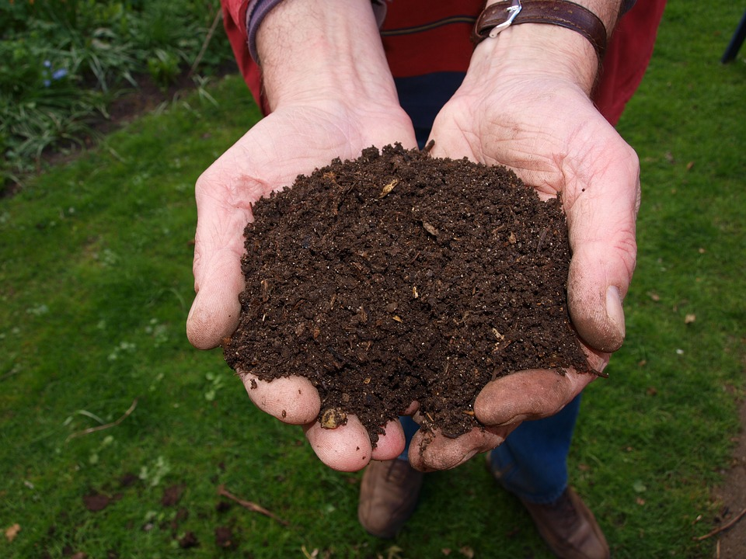
Action
Peat is on sale in garden centres, DIY stores, supermarkets and online. In the UK it's a £5 billion business.
Since 2012, however, progress on ending peat use has stalled. Peat consumption has been rising despite government targets to phase it out. Write to your MP and demand action to limit peat use in compost.
Only buy clearly labelled “peat-free” compost.
Find out how to make home made compost.

Slide 23
World Class Teaching project has been funded with support from the European Commission. The contents of these actions are the sole responsibility of the contractor and can in no way be taken to reflect the views of the European Union.

