Slide 1
Sustainable Food production
Lesson 2/2
https://pixabay.com/photos/apricot-tree-regenerative-agriculture-3384306/
Notes:
https://pixabay.com/de/photos/aprikose-baum-3384306/

Slide 4
Identify one change which you could undertake to make your diet more sustainable.

Slide 5
Data on the environmental impact of foods

Slide 6
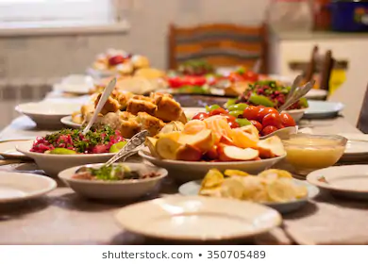
A new report argues that this is the solution.
The EAT-Lancet commission says people around the world need to radically change the way they eat, moving to diets that emphasize plant foods.
A planetary diet for 2050
Notes:
https://www.shutterstock.com/image-photo/table-full-homemade-food-350705489?irgwc=1&utm_medium=Affiliate&utm_campaign=Pixabay+GmbH&utm_source=44814&utm_term=https%3A%2F%2Fpixabay.com%2Fde%2Fimages%2Fsearch%2Ftable%2520food%2F

Slide 7
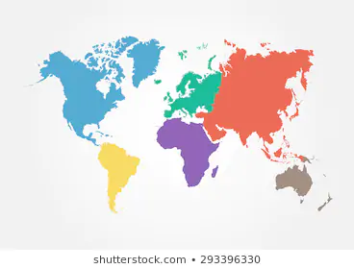
What would the new diet mean to people around the world?
Summarise the changes which must be made in each of these regions.
North America
Sub-Saharan Africa
South Asia
Write 3 sentences describing what changes the planetary diet would mean to your own diet. What would help you make these changes?
Click here to see the infographic
Notes:
Link to infographic: https://conscienhealth.org/wp-content/uploads/2019/01/Lancet-EAT-Commission-Infographic.jpg
https://www.shutterstock.com/image-vector/vector-world-map-continent-different-color-293396330?irgwc=1&utm_medium=Affiliate&utm_campaign=Pixabay+GmbH&utm_source=44814&utm_term=https%3A%2F%2Fpixabay.com%2Fde%2Fimages%2Fsearch%2Fcontinents%2F

Slide 8
Policy from the evidence
North Americans have the highest meat consumption on the planet. The planetary diet requires them to cut their consumption by 5/6. They will also have to reduce consumption of eggs by 2/3 and poultry by more than 1/2. They can increase their consumption of vegetables, legumes (beans and lentils), grains and nuts.
People in Sub-Saharan Africa currently eat a level of meat which would be sustainable for the whole planet. They have the highest consumption of starchy vegetables in the world and need to cut this to 1/6th of current levels. The planetary diet would allow people in Sub Saharan Africa to eat more of every other food group.
People in South Asia generally eat less than the planetary diet would provide, only in starchy vegetables do they slightly exceed the recommended levels. South Asia has the highest proportion of legumes (beans and lentils) in the diet. Adopting the planetary diet would increase consumption in all the other food groups.

Slide 9
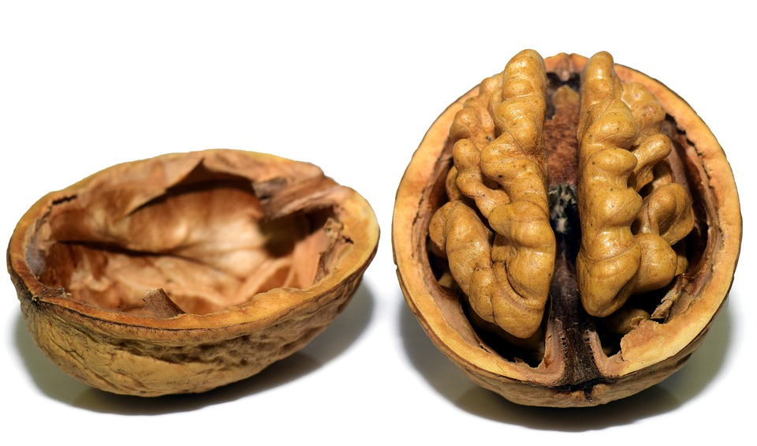
In a nutshell..
Sum up the proposed planetary diet.
Source https://pixabay.com/photos/walnut-nut-shell-nutshell-open-3072681/ no attribution needed

Slide 10
How can nuts help us limit global warming to under 2ºC as agreed in the Paris agreement?
no attribution necessary https://pixabay.com/photos/walnut-nut-shell-nuts-brown-tasty-970451/

Slide 11
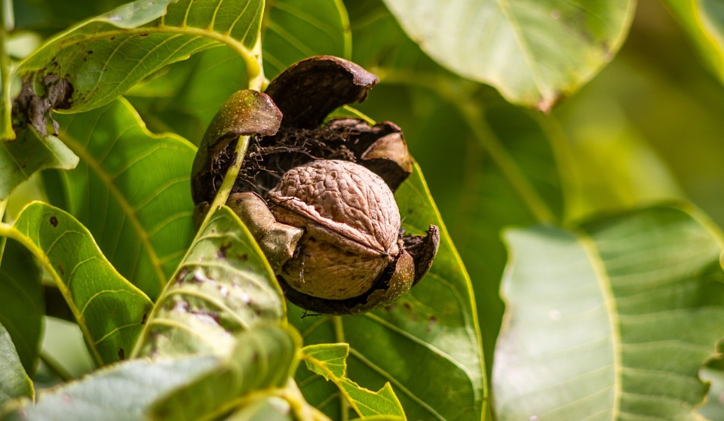
Limiting global warming to well below 2°C, aiming for 1·5°C, is not possible by only decarbonising the global energy system. Moving to food systems that can function as a major carbon sink instead of a major carbon source is required to reach this goal.
What do we mean by carbon sources and carbon sinks?
How does growing nuts create a carbon sink?
Agree or disagree
Planting nut trees is caring for future generations.

Slide 12
Changes necessary to produce the diet
reducing yield gaps on cropland,
radical improvements in the efficiency of fertiliser
and water use,
recycling phosphorus,
redistributing global use of nitrogen and phosphorus,
implementing climate mitigation options,
including changes in crop and feed management,
enhancing biodiversity within agricultural systems.

Slide 13
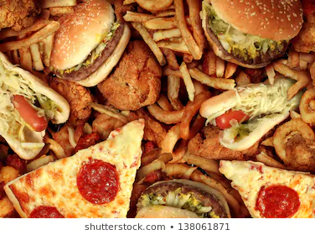
A win : win diet?
Click here to see the infographic
Lose: lose diets ie, unhealthy and environmentally unsustainable, are often characterised as being high in calories, added sugars, saturated fats, processed foods, and red meats.
Make a justified argument that adopting this diet across the globe will be a win:win situation for people and the planet.
Notes:
Link to infographic:
https://conscienhealth.org/wp-content/uploads/2019/01/Lancet-EAT-Commission-Infographic.jpg
(x-axis in %)
https://www.shutterstock.com/image-photo/fast-food-concept-greasy-fried-restaurant-138061871?irgwc=1&utm_medium=Affiliate&utm_campaign=Pixabay+GmbH&utm_source=44814&utm_term=https%3A%2F%2Fpixabay.com%2Fde%2Fimages%2Fsearch%2Funhealthy%2520food%2F

Slide 14
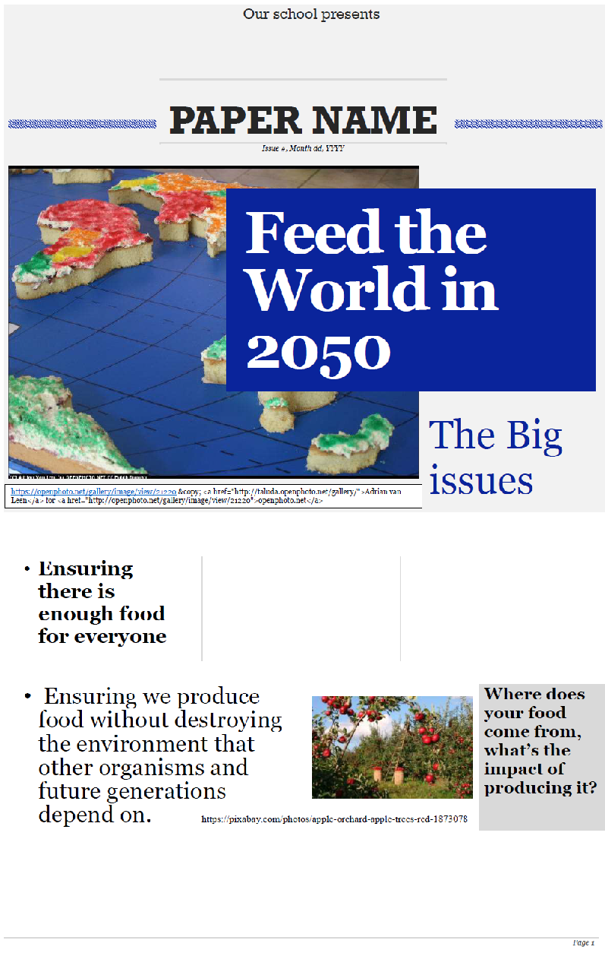
Choose one of the headlines and write an article for the class paper.

Slide 15
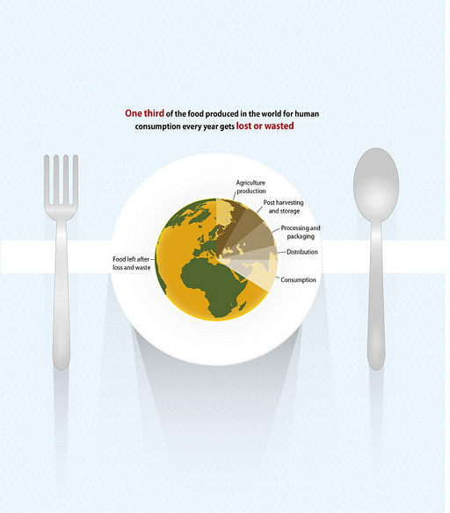
Action
At least halve food losses and waste, in line with global sustainable development goals.
Find out about projects like the Real Junk food project.
Find out about the 2015 Paris climate agreement.
free to use Riccardo Pravettoni www.grida.no/resources/8181

Slide 17
World Class Teaching project has been funded with support from the European Commission. The contents of these actions are the sole responsibility of the contractor and can in no way be taken to reflect the views of the European Union.

