Slide 1
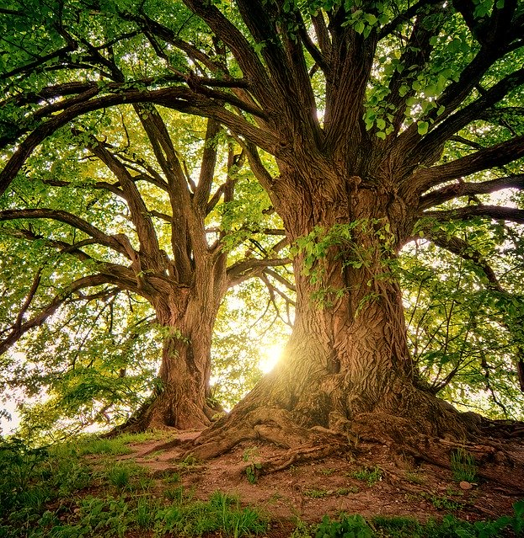
Christian
Creation Beliefs
Notes:
Photo: https://pixabay.com/da/photos/tr%C3%A6-natur-solnedgang-lys-blade-3822149/

Slide 4
Starter Activity: Draw the relationship between ‘me’, ‘other people’ and ‘the environment’.
Don’t spend too long on this, just be creative - there is no right or wrong answer!
Notes:
With minimum input, ask the students to draw a diagram to show the relationship between ‘Me, Other people, The Environment’. Don’t show them an example yet as this will spoil the activity and encourage them not to look at each others’ until they’re finished. If a student is really stuck for a starting point, suggest a venn diagram, but try not to guide them. Once they are drawn, compare them. Are they all the same? What are the differences? Focus on the relationships between the 3 elements – is one seen as more important, more central? Show and compare some different ways of drawing the relationship on the following slides. Do the students think the differences are significant? Why?

Slide 5
Does your picture look like this?
Me
Other people
The Environment

Slide 6
… or this?
Me
Other People
The Environment

Slide 7
… or this?
The Environment
Other People
Me

Slide 8
… or this?
The Environment
Other People
Me

Slide 9
...or even like this?
Other People
Me
The Environment

Slide 10
Starter Activity: Does your picture have any similarities with any of these or is it completely different?
Other People
Me
Other people
The Environment
The Environment
Me
Me
Other People
The Environment
Other People
The Environment
Me
Other People
Me
The Environment

Slide 11
Dominion
Genesis 1:28 -
[God told humans to] Fill the earth and subdue it… have dominion over…every living thing that moves upon the Earth.
Use your inference skills to work out what this quote is telling Christians.
Notes:
Input: Introduce the 3 different ‘mindsets’ using the slides. As you go through, ask the students how they might draw the relationship between humans and the rest of the planet for each of them as a venn diagram.

Slide 12
Dominion
Genesis 1:28 -
[God told humans to] Fill the earth and subdue it… have dominion over…every living thing that moves upon the Earth.
Humans are above nature and have the God-given right to use nature’s resources as we see fit for our own purposes.
We are owners / consumers of what God has provided for us.
Write a definition of dominion.
Notes:
Input: Introduce the 3 different ‘mindsets’ using the slides. As you go through, ask the students how they might draw the relationship between humans and the rest of the planet for each of them as a venn diagram.

Slide 13
Stewardship
Genesis 2:15 -
The Lord God put the man in the Garden of Eden to take care of it and to look after it.
Use your inference skills to work out what this quote is telling Christians.

Slide 14
Stewardship
Genesis 2:15 -
The Lord God put the man in the Garden of Eden to take care of it and to look after it.
Humans are separate from nature but have a God-given responsibility to look after the rest of God’s Creation.
We recognise that Creation is God’s and we have to care for the Earth, its plants, animals and ecosystems because God loves them.
Write a definition of stewardship

Slide 15
All creatures together
Genesis 2:7- Then the Lord God took some soil from the ground and formed a man out of it.
Genesis 1:31 - And God saw everything that He had made, and behold, it was very good.
Use your inference skills to work out what this quote might be telling Christians that’s a bit different from both ‘dominion’ and ‘stewardship’.

Slide 16
All creatures together
Genesis 2:7- Then the Lord God took some soil from the ground and formed a man out of it.
Genesis 1:31 - And God saw every thing that He had made, and behold, it was very good.
Humans are part of God’s creation along with all the other creatures: plants, animals, ecosystems…
Creation doesn’t belong to humans, we, along with the rest of Creation, are God’s. We and the rest of Creation are part of one system, we depend on each other. If we destroy our environment, we destroy ourselves.

Slide 17
1) Dominion 2) Stewardship 3) All creatures together
Which of the 3 mindsets does your diagram / picture fit with?
Can you match your diagrams to one of the 3 mindsets or do you think they come from a completely different viewpoint?
Notes:
Match the individual diagrams members of your group have drawn to the 3 different mindsets – or is there another completely different mindset that they would match to?

Slide 18
Anthropocentric or Ecocentric?
Anthropocentric means focused first on humans – humans are the most important and the environment is there for humans. Care for the environment is for the sake of the humans who depend on it.
Eco-centric means focused first on the whole of the environment – humans are just one more part of the ecosystems that exist on our planet. Care for the environment is for its own sake.
Which of the 3 mindsets do you think is Anthropocentric, and which is Eco-centric?
Notes:
Extension discussion

Slide 19
Dominion / Stewardship / All creatures together
Can you match any of these diagrams to one of the 3 mindsets, or do you think you think they come from a completely different viewpoint?
Which ones are more Anthropocentric and which ones are Eco-centric?
Other People
Me
Other people
The Environment
The Environment
Me
Me
Other People
The Environment
Other People
The Environment
Me
Other People
Me
The Environment

Slide 20
Dominion / Stewardship / All creatures together
Is your own diagram / picture anthropocentric or eco-centric?
Which of the 3 mindsets do you think it matches best with?
What about the pictures and diagrams from other people in your group?
Can you match them to one of the 3 mindsets, or do you think you think they come from a completely different viewpoint?
Notes:
Extension discussion

Slide 21
Your decision matters!
Notes:
In groups, ask students to read their ‘scenario’ and make a decision - what would they / do they realistically do in this situation? Write down their choice. Then give them the environmental impact information to explore in groups (information to read, clips to watch). Once they have explored it, ask them to revisit their decision in the light of what they have found out. Has their decision changed at all?
Group work (use the links in the following slides: information on 3 slides per group)
Clothes buying
Data –use – streaming/ phones/ internet
Drinks packaging
Transport

Slide 22
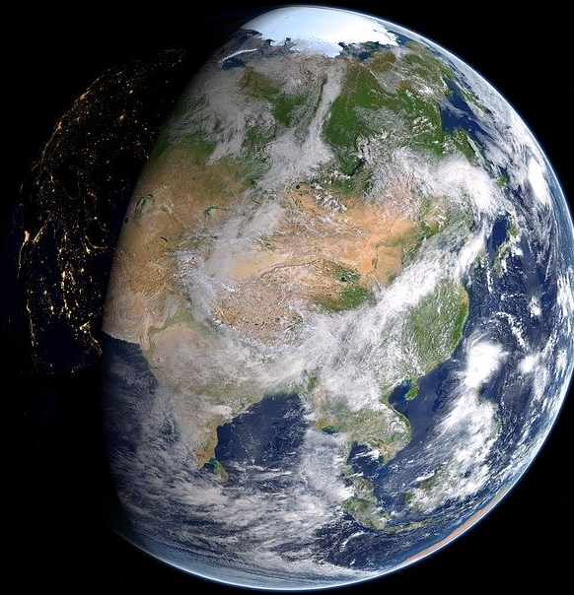
Decisions, Decisions, Decisions…
As global citizens, we all have to make decisions about:
how we live on this planet as a community
what we can/should do, so that future human generations and all life forms also have a good life on this planet
Notes:
Photo: https://pixabay.com/da/photos/jord-asien-rusland-kina-kort-2294995/

Slide 23
Decisions, Decisions, Decisions…
In your group, look at your scenario and choose an option.
The important thing is:
BE HONEST!
Then complete the tasks in bold

Slide 24
Group 1 Clothes shopping: options
You want to buy / get new clothes to go out with your mates. Do you …?
Go to Primark and buy a whole outfit for £19
Go to charity shop and buy second hand
Look your wardrobe and decide you can actually do with the things you already have
Buy the latest trends from a fashion shop like Zara, Top Man, River Island , JD Sports etc…
Look on the internet for environmentally-friendly, fairtrade clothes
Buy from a fashion shop (like Primark, Zara etc) but also contact the shop saying you’d like to buy environmentally-friendly clothes
Write the choice you’ve made in your books. Why have you made these choices?
Do your choices reflect stewardship / dominion / all creatures together?
Are your choices more anthropocentric or ecocentric?

Slide 25
Clothes shopping: the environmental impacts
Did you know?
The textile industry produces more greenhouse gas emissions than the aviation and shipping industries combined, uses a huge amount of water and is extremely polluting. Watch clip at https://www.youtube.com/watch?v=ECkLgq2W9RU
The huge amount of water needed to produce cotton has damaged many ecosystems around the world, for example, the Aral Sea which has been largely replaced by desert. 2 min clip from Environmental Justice Foundation: https://www.youtube.com/watch?v=JLsQ0Ruby40 and Stacey Dooley discusses water use for cotton used in the fashion industry with high street shoppers https://www.youtube.com/watch?v=zOe_M3GutdY (3 minute clip)
Cotton is not the only problem fabric. Washing of polyester clothes is one of the main causes of microplastic pollution in the oceans. 3 minute animated clip from Story of Stuff: https://storyofstuff.org/movies/story-of-microfibers/

Slide 26
Clothes shopping: review your choices
Unless we go naked we have to wear something!
400% more clothes are produced now compared to 20 years ago. ‘Fast fashion’ has massively increased, meaning that the clothes we buy are often very cheap but not made to last. Do you mend clothes? How long do your clothes last?
As a group, summarise what you have learned about the environmental impacts of the fashion industry.
Might your choices change, knowing what you know now?
Explain why / why not. Use as many key terms as you can in your work: Genesis / Dominion / Stewardship / All creatures together / Anthropocentric / Eco-centric

Slide 27
Group 2 Data use: options
You are on your device(s). Do you …?
Make sure you close any windows on your device(s) when you aren’t using them
Chat to friends on a WhatsApp group whilst sharing photos on Instagram and watching your favourite series on Netflix at the same time
Limit your use of devices to one at a time
Take a series of videos with your friends and share them on social media. You’ll probably never want to look at them again but it was fun at the time
Write the choice you’ve made in your books. Why have you made these choices?
Do your choices reflect stewardship / dominion / all creatures together?
Are your choices more anthropocentric or ecocentric?

Slide 28
Data use: the environmental impacts
When you use the internet in any way, share data on social media or stream content, it can feel like what you’re doing doesn’t have any impact in the ‘real world’ – all you’re doing is looking at your screen.
But the internet is powered by thousands upon thousands of computer servers, which store the data that makes up the internet. And those servers aren’t powered by magic, they’re powered by electricity. If that electricity is produced by fossil fuel sources like coal or natural gas - our magical cloud may leave a very dirty footprint. “It’s staggering for most people, even people in the industry, to understand the numbers, the sheer size of these systems. A single data centre can take more power than a medium-size town.” [Data centre designer]
In simple terms, data centers are numerous computers stacked together. Because these computers are working hard nonstop they get extremely hot. Cooling systems need to be put in place to ensure they do not overheat and that they continue to keep working. Cooling down these copious amounts of computers uses energy and burns fossil fuels, which in turn also adds more carbon emission. From https://www.colocationamerica.com/blog/data-center-environmental-impacts
Data centres now have the same carbon footprint as the airline industry. In 2015 all the world’s data centres used 416.2 Terawatt hours of electricity far higher than the whole of the UK’s total consumption. To make matters worse, energy used by Data Centres is doubling every four years. . https://www.information-age.com/a-perfect-storm-the-environmental-impact-of-data-centres-123474834/
Watch clip on the carbon footprint of data centres - https://www.youtube.com/watch?v=vqKWMfB_lJ0 from 1:47 – 4:47
Watch 2 minute clip at https://www.youtube.com/watch?v=EH7TJL1fic4 up to 2:03 (This is an advert for a carbon offset company)

Slide 29
Data use: review your options
The internet is an amazing thing which can bring many benefits in our lives.
But using data has an environmental cost which is bigger than we might imagine.
It takes 23 trees to suck up the carbon required for just one second of google use.
As a group, summarise what you have learned about the environmental impacts of data use.
Might your choices change, knowing what you know now? Explain why / why not. Use as many key terms as you can in your work: Genesis / Dominion / Stewardship / All creatures together / Anthropocentric / Eco-centric

Slide 30
Group 3 Drinks packaging: options
You are out and about, or at school, and you feel thirsty. Do you …?
Pick up a nice cold drink in a plastic bottle from the fridge in the nearest shop / vending machine and remember to take the plastic bottle home with you if you can’t find somewhere to recycle it
Pick up a nice cold drink in a plastic bottle from the fridge in the nearest shop / vending machine and carefully put it in a bin when you’ve finished (you don’t want to litter)
Grab a hot drink to take away from the nearest café and when you’ve finished, carefully put the cup in a bin (you don’t want to litter)
Choose a café you know gives a discount for bringing your own cup and get out the reusable cup you carry around with you
Take out the drink you remembered to bring with you in a reusable container and when you’ve finished, put the bottle back in your bag to take home
Write the choice you’ve made in your books. Why have you made these choices?
Do your choices reflect stewardship / dominion / all creatures together?
Are your choices more anthropocentric or ecocentric?

Slide 31
Drinks packaging: the environmental impact
Plastic drinks bottles are a huge problem in the world’s oceans. When plastic starts to breakdown, it turns to “microplastics” containing toxic chemicals which are dangerous for animals and have found their way into the human food chain. Watch 1 minute clip at https://www.theguardian.com/environment/2017/jun/28/a-million-a-minute-worlds-plastic-bottle-binge-as-dangerous-as-climate-change and scroll down for Plastic Ocean 2 min clip at https://www.headstuff.org/topical/science/plastic-bottle-oceans/
7 million disposable coffee cups are used everyday in the UK – 2.5 billion every year. Many people think that disposable coffee cups are recyclable, as often seen in adverts. However, the truth is that only 1% of all these cups in the UK are actually recycled. Watch 2 minute clip at https://www.independent.co.uk/environment/disposable-coffee-cups-how-big-problem-environment-landfill-recycling-incinerate-export-rubbish-a8142381.html

Slide 32
Drinks packaging: review your options
A single use plastic bottle or cup is useful for minutes while we drink the contents, but can cause problems that will last beyond our own lifetime.
As a group, summarise what you have found out about the environmental impacts of plastic drinks packaging.
Might your choices change, knowing what you know now?
Explain why / why not. Use as many key terms as you can in your work: Genesis / Dominion / Stewardship / All creatures together / Anthropocentric / Eco-centric

Slide 33
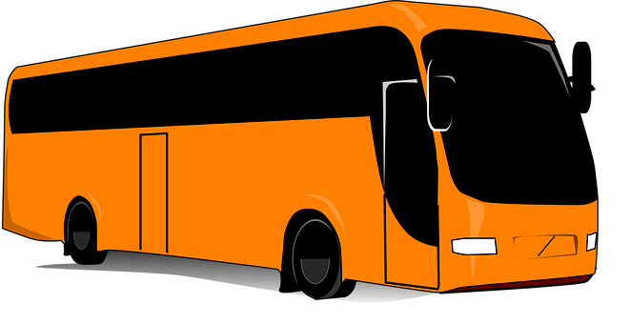
Group 4 Transport: options
You want to get to an event / activity a few miles from your house. Do you …?
Get a member of your family to drive you
Share a lift with a friend who lives nearby
Set out in plenty of time and walk
Take a bus / walk one way but arrange to be picked up for a lift home
Get on the bus
Cycle
Write the choice you’ve made in your books. Why have you made these choices?
Do your choices reflect stewardship / dominion / all creatures together?
Are your choices more anthropocentric or ecocentric?

Slide 34
Transport: the environmental impacts
It’s hard not to be aware of the negative effects of pollution from cars: outdoor air pollution from carbon monoxide emissions kills more than 3.5 million people across the world every year, and causes health problems from asthma to heart disease for many more. Car use is a major contributor to climate change: 15% of global CO2 emissions are caused by the transport sector.
For many families in the UK swapping a car for walking, cycling, public transport etc. would be the single most effective action they could take to avoid greenhouse gas emissions, saving an average of 2.4 tonnes of CO2 a year. Read: https://inews.co.uk/news/environment/families-tackle-climate-change-car-transport-vegan-diet-497256
Watch 4 minute clip from Canada https://www.youtube.com/watch?v=JKySf0PWwOE
Discuss – if we know this already, why do people keep on using cars so much? Do you or anyone you know make transport choices for environmental reasons? How does that affect their lifestyle?

Slide 35
Transport: review your options
Car use is a massive cause of pollution, both leading to health problems and contributing hugely to climate change.
As a group, summarise what you have found out and discussed about the environmental impacts of using a car.
Explain why / why not. Use as many key terms as you can in your work: Genesis / Dominion / Stewardship / All creatures together / Anthropocentric / Eco-centric.

Slide 36
Decisions, Decisions, Decisions…
In your groups, explain to the rest of the class what your choice was and what you’ve learned. Anything surprising?
Which of the 3 mindsets
Dominion
Stewardship
All creatures together
Do you think was influencing you as you made your decision?
Did you change your mind after learning more?

Slide 37
“The Genesis story has very little relevance to our lives today.”
Complete the table with arguments for and against the statement, referring to the teachings we looked at, examples we discussed and the 3 mindsets:
‘Dominion, Stewardship, All creatures together’

Slide 38
Follow up homework project
Exploring the impact of my choices on the environment.
Choose one or more choices you make in your day about how you do things (that impact on the environment).
Research the impacts of that choice.
Think about which mindset you are acting from when you make the choice about how you do things. Are you happy with that mindset? Is it the mindset you believe in? Are you acting according to your beliefs? Are there any contradictions?
Is there anything you would change about your decisions? Are there any difficulties with actually making the change?
Then choose one small simple thing to change.
Change it over the course of a week.
Take a note of how it affects you / how you feel / how others react. Be ready to explain what happened in the next lesson.

Slide 39
My mindset and my decisions homework project
At the start of the week
One thing I will change this week:
What difference will it make to the planet?
When making this change, which ‘mindset’ am I acting from?(Dominion / Stewardship / All Creatures Together / Other)
Am I happy with that mindset? Is it the mindset I believe in? Am I acting according to my beliefs?
At the end of the week
Was it easy or difficult to make the change? Why?
Will you carry on with it? Will you change anything else?
How did making the change make you feel?
How did other people react?

Slide 40
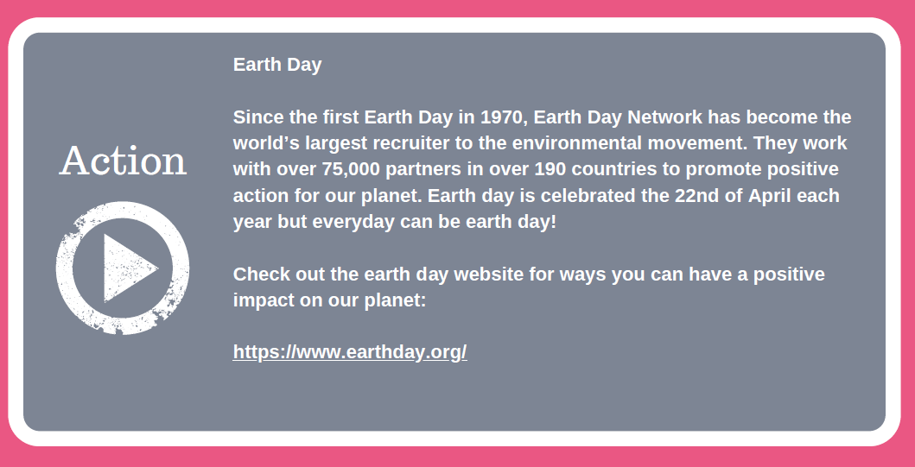

Slide 41
World Class Teaching project has been funded with support from the European Commission. The contents of these actions are the sole responsibility of the contractor and can in no way be taken to reflect the views of the European Union.

