Slide 1
Functional Skills:
Energy
Notes:
Photo: https://www.pexels.com/photo/five-bulb-lights-1036936/

Slide 4
What bills do we need to pay to run a house?

Slide 5
What bills do we need to pay to run a house?
TV licence
Water bill
Electric bill
Internet/phone line
Gas bill
Council tax
Home insurance
Which of these have an impact on the environment as well as our bank balances?

Slide 6
Today we will look at the things that some home-owners do, and the impact of these choices on their lives, their bills, and the environment.
Calculate the cost of running a home for a year on your worksheet.
These figures have been taken as an average for a family of 4 living in a house somewhere in Leeds.
How would each of the following impact on the overall cost of running a house:
the number of people who live in the house
the location of the house
if one of the adults works from home
if one of the people in the house is a baby
if the house is very old and poorly insulated
if everyone in the house is environmentally aware
if the adults in the house are very concerned about money
Can you think of any other factors that could affect the cost of running a home?

Slide 7
Extension version
Cost of running a home (2 people, 2 children, somewhere in Leeds)
TV licence
A colour TV licence costs £150.50 for a year.
Electric bill
This household pays its energy charges quarterly (every 3 months). The average electricity bill is £105 per quarter
Water bill
Water and sewerage charges are different in different regions. This household pays £33 per month.
Internet/phone line
This household pays £26 per month for a phone line and broadband.
Gas bill
This household pays its energy charges quarterly (every 3 months). The average electricity bill is £150 per quarter.
Home insurance
To be able to have a mortgage, householders are required to have home insurance. The cost of this can vary. This household pays £140 per year for insurance.
Council tax
The council works out which band your house belongs in according to its size and value, and charges you the appropriate amount. This household pays £650 per year for council tax.

Slide 8
Standard version
Cost of running a home (2 people, 2 children, somewhere in Leeds)
Water bill
TV licence
Water and sewerage charges are different in different regions. This household pays £33 per month.
A colour TV licence costs £150.50 for a year.
Electric bill
This household pays its energy charges monthly. The average electricity bill is £35 per month.
Gas bill
This household pays its energy charges monthly. The average electricity bill is £50 per month.
Internet/phone line
This household pays £26 per month for a phone line and broadband.
Council tax
The council works out which band your house belongs in according to its size and value, and charges you the appropriate amount. This household pays £650 per year for council tax.
Home insurance
To be able to have a mortgage, householders are required to have home insurance. The cost of this can vary. This household pays £140 per year for insurance.

Slide 9
Support version
Cost of running a home (2 people, 2 children, somewhere in Leeds)
Electric bill
TV licence
This household pays its energy charges monthly. The average electricity bill is £35 per month.
Multiply by 12 to find the yearly cost for electricity.
A colour TV licence costs £150.50 for a year.
Water bill
Water and sewerage charges are different in different regions. This household pays £33 per month.
Multiply by 12 to find the yearly cost for water.
Internet/phone line
This household pays £26 per month for a phone line and broadband.
Multiply by 12 to find the yearly cost for internet.
Gas bill
Council tax
This household pays its energy charges monthly. The average electricity bill is £50 per month.
Multiply by 12 to find the yearly cost for gas.
The council works out which band your house belongs in according to its size and value, and charges you the appropriate amount. This household pays £650 per year for council tax.
Home insurance
To be able to have a mortgage, householders need to have home insurance. This household pays £140 per year for insurance.
Total cost = water + tv licence + electric + internet + insurance + gas + tax
= _____ + ______ + ______ + ______ + ______ + _____ + ______
=

Slide 10
ANSWERS
Cost of running a home (2 people, 2 children, somewhere in Leeds)
Electric bill
£420 per year
Water bill
£396 per year
Internet/phone line
£312 per year
Gas bill
£600 per year
Total for the year: £2668.50
Home insurance
£140 per year
Council tax
£650 per year
TV licence
£150.50 per year

Slide 11
There are lots of different things that we can do to reduce our bills. For today we are going to focus on reducing our ENERGY AND WATER BILLS.
What steps can you think of to reduce these bills?
Why is reducing these bills also positive for the environment?
Notes:
Photo: https://www.pexels.com/photo/abstract-blackboard-bulb-chalk-355948/

Slide 12
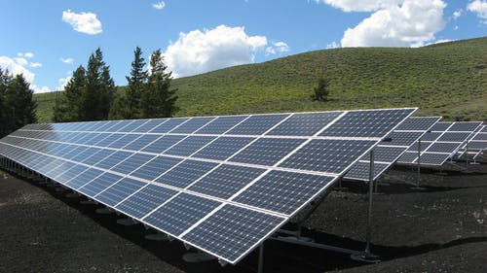
One way to dramatically reduce your electricity costs is to have solar panels installed on your roof.
In some cases, solar panels can be fitted for free, and it is possible to use less energy than the panels capture, which means you can sell your spare electricity to the energy company - instead of paying money to them, they have to pay money to you. The savings, in terms of money, are huge.
But what about measuring our savings in another way?
Notes:
Photo: https://www.pexels.com/photo/black-and-silver-solar-panels-159397/

Slide 13
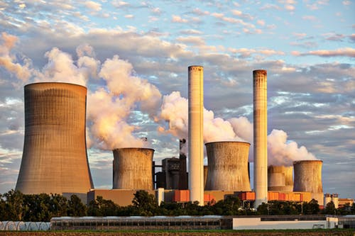
The electricity produced by solar panels is around 20 times cleaner than energy produced by burning fossil fuels.
Carbon dioxide is a greenhouse gas - it causes damage to the ozone layer and traps heat in the Earth’s atmosphere, contributing to climate change.
One kilowatt hour of electricity from a solar panel produces 50g of carbon dioxide, compared to 975g of carbon dioxide if it is produced by a coal power station.
In a year, the average household uses 3,100kWh of electricity.
How much carbon dioxide is produced if this comes from a coal power station?
How much carbon dioxide is produced if this comes from solar panels?
How much carbon dioxide is saved if an average household installs solar panels to provide their electricity?
Notes:
Photo: https://www.pexels.com/photo/air-air-pollution-chimney-clouds-459728/

Slide 14
One kilowatt hour of electricity from a solar panel produces 50g of carbon dioxide, compared to 975g of carbon dioxide if it is produced by a coal power station.
In a year, the average household uses 3,100kWh of electricity.
How much carbon dioxide is produced if this comes from a coal power station?
3,100 x 975 = 3,022,500g or 3,022.5kg
How much carbon dioxide is produced if this comes from solar panels?
3,100 x 50 = 155,000g or 155kg
How much carbon dioxide is saved if an average household installs solar panels to provide their electricity?
3,022.5kg – 155kg = 2,867.5kg

Slide 15
SUPPORT VERSION
How much can the family save on their bills using these measures?
Original cost: £2668.50
The family decide to have solar panels installed.
This will save the family £200 per year.
The family have a water meter fitted and start to save water when they can.
This will save the family £240 per year.
What steps can you take to save water?
The family has their insulation checked and improved.
This will save the family £250 per year.
The family replace their old boiler with a new, more efficient boiler.
This will save the family £200 per year.
The family have a smart meter fitted and start to reduce their electricity usage.
This will save the family £23 per year.
What steps can you take to save electricity and gas?
Which steps saved the family the most money?
How much has the family saved by taking all of these steps?
Comment on the reliability of these savings figures.

Slide 16
SUPPORT VERSION
How much can the family save on their bills using these measures?
Original cost: £2668.50
ANSWERS
The family decide to have solar panels installed.
This will save the family £200 per year.
The family have a water meter fitted and start to save water when they can.
This will save the family £240 per year.
What steps can you take to save water?
The family has their insulation checked and improved.
This will save the family £250 per year.
The family replace their old boiler with a new, more efficient boiler.
This will save the family £200 per year.
The family have a smart meter fitted and start to reduce their electricity usage.
This will save the family £23 per year.
What steps can you take to save electricity and gas?
Which steps saved the family the most money?
How much has the family saved by taking all of these steps?
Comment on the reliability of these savings figures.
Fix leaking taps, turn off taps while brushing teeth, make use the cold water you get while waiting for hot water, put a tub in the sink for washing up (reduces how much water you put in), lower the float in the toilet cistern, hand- wash cars, use watering cans rather than hose pipes, reduce showering time, only put the washing on when you have a full load.....
Turn off devices you're not using them, turn lights off when you leave a room, don't leave devices on standby, turn the heating down, don't put the heating on, reduce your shower time, use less water in your bath
Insulating the house was best, followed by having a water meter and an efficient boiler fitted.
In total, £913 (which is roughly a third of their bills)
How much you can save depends on how bad the situation is to start with. If you're already eco-aware and live in a house with a good boiler and insulation, it's hard to make further savings.

Slide 17
How much can the family save on their bills using these measures?
STANDARD VERSION
Original cost: £2668.50
The family decide to have solar panels installed.
This will save the family £200 per year on their energy bills.
The family have a water meter fitted and start to save water when they can.
This will save the family £20 per month on their water bill.
What steps can you take to save water?
The family has their insulation checked and improved.
This will save the family £250 per year on their energy bills.
The family replace their old boiler with a new, more efficient boiler.
This will save the family £200 per year on their energy bills.
The family have a smart meter fitted and start to reduce their electricity usage.
This will save the family £23 per year.
What steps can you take to save electricity and gas?
Which steps saved the family the most money?
How much has the family saved by taking all of these steps?
Comment on the reliability of these savings figures.

Slide 18
STANDARD VERSION
How much can the family save on their bills using these measures?
Original cost: £2668.50
ANSWERS
The family decide to have solar panels installed.
This will save the family £200 per year on their energy bills.
The family have a water meter fitted and start to save water when they can.
This will save the family £20 per month on their water bill.
What steps can you take to save water?
The family has their insulation checked and improved.
This will save the family £250 per year on their energy bills.
The family replace their old boiler with a new, more efficient boiler.
This will save the family £200 per year on their energy bills.
The family have a smart meter fitted and start to reduce their electricity usage.
This will save the family £23 per year.
What steps can you take to save electricity and gas?
Which steps saved the family the most money?
How much has the family saved by taking all of these steps?
Comment on the reliability of these savings figures.
Fix leaking taps, turn off taps while brushing teeth, make use the cold water you get while waiting for hot water, put a tub in the sink for washing up (reduces how much water you put in), lower the float in the toilet cistern, hand- wash cars, use watering cans rather than hose pipes, reduce showering time, only put the washing on when you have a full load.....
Turn off devices you're not using them, turn lights off when you leave a room, don't leave devices on standby, turn the heating down, don't put the heating on, reduce your shower time, use less water in your bath
Insulating the house was best, followed by having a water meter and an efficient boiler fitted.
In total, £913 (which is roughly a third of their bills)
In total, £913 (which is roughly a third of their bills)
How much you can save depends on how bad the situation is to start with. If you're already eco-aware and live in a house with a good boiler and insulation, it's hard to make further savings.

Slide 19
How much can the family save on their bills using these measures?
Original cost: £2668.50
EXTENSION VERSION
The family decide to have solar panels installed.
This costs £6000.
This will save the family £200 per year on their energy bills.
The family have a water meter fitted and start to save water when they can.
This is free.
This will save the family £20 per month on their water bill.
The family has their insulation checked and improved.
This costs £1300.
This will save the family £250 per year on their energy bills.
The family replace their old boiler with a new, more efficient boiler.
This costs £1600.
This will save the family £200 per year on their energy bills.
The family have a smart meter fitted and start to reduce their electricity usage.
This is free.
This will save the family £23 per year.
How much has the family saved in total?
How much has the family spent in total?
How long does it take for each step to break even? (How long does it take for the family's savings to make up for the cost?)
Comment on the reliability of these savings figures.

Slide 20
EXTENSION VERSION
How much can the family save on their bills using these measures?
Original cost: £2668.50
ANSWERS
The family decide to have solar panels installed.
This costs £6000.
This will save the family £200 per year on their energy bills.
The family have a water meter fitted and start to save water when they can.
This is free.
This will save the family £20 per month on their water bill.
The family has their insulation checked and improved.
This costs £1300.
This will save the family £250 per year on their energy bills.
The family replace their old boiler with a new, more efficient boiler.
This costs £1600.
This will save the family £200 per year on their energy bills.
The family have a smart meter fitted and start to reduce their electricity usage.
This is free.
This will save the family £23 per year.
How much has the family saved in total?
How much has the family spent in total?
How long does it take for each step to break even? (How long does it take for the family's savings to make up for the cost?)
Comment on the reliability of these savings figures.
30 years to break even (they should see if their council will give them a grant to install them!)
Only savings!
1.2 years to break even
8 years to break even
Only savings!
In total, £913 (which is roughly a third of their bills)
In total, £8900 (but their bills will be reduced EVERY YEAR from now on)
See above
How much you can save depends on how bad the situation is to start with.
If you're already eco-aware and live in a house with a good boiler and
insulation, it's hard to make further savings.

Slide 21
Further Extension / Class discussion
You have calculated the savings that one household could make if they implemented energy saving strategies.
How much would be saved if everyone in Leeds did the same ?(320,000 households)
How much would be saved if everyone in England did the same? (19.2 million households)
How much would be saved if everyone in the UK did the same? (27.6 million households)
You are not asked to estimate the following answers. That is deliberate. Can you think why?
How much would be saved if everyone in Europe did the same? Or everyone in the whole world?
These approximations would not always be accurate.
What factors would affect the amount of carbon and money saved?
The amount of carbon a household already uses - some people will already live in a very energy efficient way, so the difference made by these strategies will be smaller. In general, larger houses will use a lot of energy so a lot can be saved. Newer houses also tend to be built to be energy efficient, so will have fewer savings to make.
The differences between energy usage and energy needs around the world -for example, in warmer countries, less energy will be used for heating, so the savings that could be made are smaller.
The cost of energy - our numbers are based on UK prices, but in different countries, the charges for energy are handled differently.
Click for information on factors affecting carbon and money savings

Slide 22
We’re living beyond the limits of our planet!
Who is responsible?
In 2018, the world produced 4.97 tons of carbon dioxide per capita (this means if you divide the total amount of CO2 produced by the number of people).
Not all countries produced the same levels of pollution though….
At current rates of carbon emissions, we face catastrophe: “irreversible damage to the natural world and the collapse of our societies”.
Sir David Attenborough https://www.bbc.co.uk/news/science-environment-47976184
Country | CO2 Emissions per capita 2018
Uganda | 0.01
Brazil | 2.37
Sweden | 4.47
United States | 16.14
UK | 5.59
China | 7.95
Why do different countries produce different levels of CO2 pollution per person?
The UK 2018 figure is a reduction from the 2017 figure of 5.73. What might have brought it down?
Notes:
At the time of writing this lesson in 2020 this was the most recent available data - taken from the 2019 report from the Emissions Database for Global Atmospheric Research. https://edgar.jrc.ec.europa.eu/overview.php?v=booklet2019 Note: what brought down the UK CO2 emissions was a significant shift from coal fired power to renewables. See https://www.theguardian.com/business/2020/apr/28/britain-breaks-record-for-coal-free-power-generation for a very clear infographic on Britain’s recent shift from coal to renewables.
Photo: https://www.pexels.com/photo/blue-banner-sign-posters-3039036/

Slide 23
SMART meters and Water meters
A water meter measures how much water you are using, and bills you accordingly. If you do not have a water meter, the water company will estimate the usage based on the size of your house and you will pay a fixed amount. Generally, a large family uses more than the estimate, but a small family or a lone person uses a lot less.
A SMART meter is a device that measures how much energy you are using and tells you the cost of the energy you are using at that particular moment. The government wants every home in the UK to be fitted with a SMART meter by 2020.
How does having a water or SMART meter reduce your consumption?
It doesn't!
Meters encourage good habits. When a house is fitted with a water meter, the occupants are generally more aware of their water usage because they know they will pay more if they use more.
SMART meters show the amount of electricity you are using, but they rely on householders then changing their habits.
(This is much like a revision guide. Owning a Maths revision guide does not improve your grade. Using your Maths revision guide is what makes the difference!)
??????

Slide 24
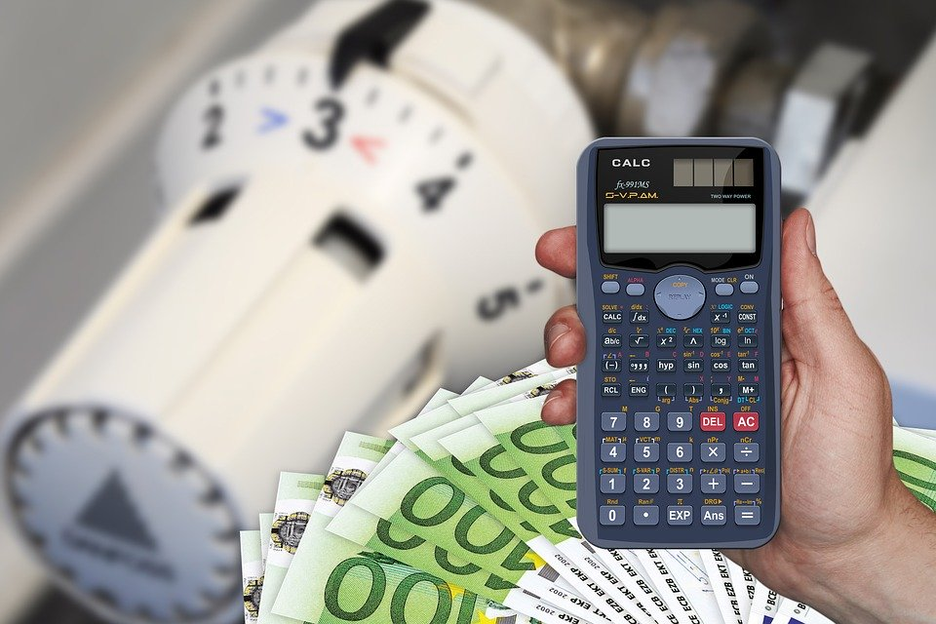
We know now that reducing our energy consumption will save us money on our household bills. It will also reduce our impact on the planet.
What if everyone made energy savings in their household?
Notes:
Photo: https://pixabay.com/photos/cost-calculator-euro-dollar-money-4164538/

Slide 25
Energy Saving Tips For Us All
Write down 5 tips for saving energy. For each one that is on the list below, you score 5 points. If you have others to share with the group, bonus points will be awarded depending on how good an idea it is.
To help us all save energy (and money), experts recommend:
???????
turn off the tap when you brush your teeth
turn the thermostat down by 1 degree
let your hair dry naturally instead of using a hair dryer
put on a jumper instead of turning on the heating
put a lid on the saucepan while you're cooking
turn off lights when you leave a room
keep doors shut to keep the heat in
turn off your TV when you're not watching it
make your shower 2 minutes shorter
switch appliances off, don’t leave on standby

Slide 26
Could you and your household save energy, money and carbon emissions?
Have a go at the homework tasks and talk to others in your household to see what might be possible!

Slide 28
World Class Teaching project has been funded with support from the European Commission. The contents of these actions are the sole responsibility of the contractor and can in no way be taken to reflect the views of the European Union.

