Slide 1
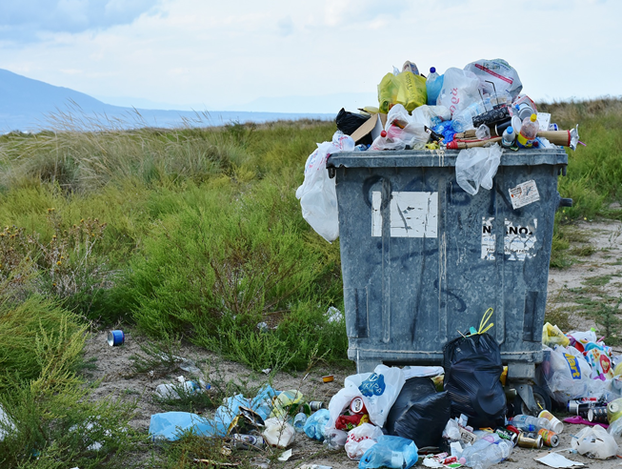
Inégalités réduites
Zéro gaspillage alimentaire
Notes:
https://cdn.pixabay.com/photo/2017/09/08/18/20/garbage-2729608_640.jpg

Slide 4
Qu’est-ce qui se passe?
Notes:
Picture prompt activity. Camels eating food waste from out of the waste bins in the UAE, 2019. (picture: Adam Ranson)

Slide 5
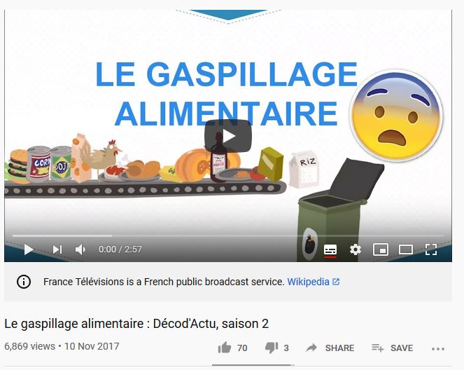
C’est quoi, le gaspillage alimentaire?
Notes:
Video: https://www.youtube.com/watch?v=fnwmdW_RnVQ; additional video: https://www.youtube.com/results?search_query=le+gaspillage+alimentaire

Slide 6
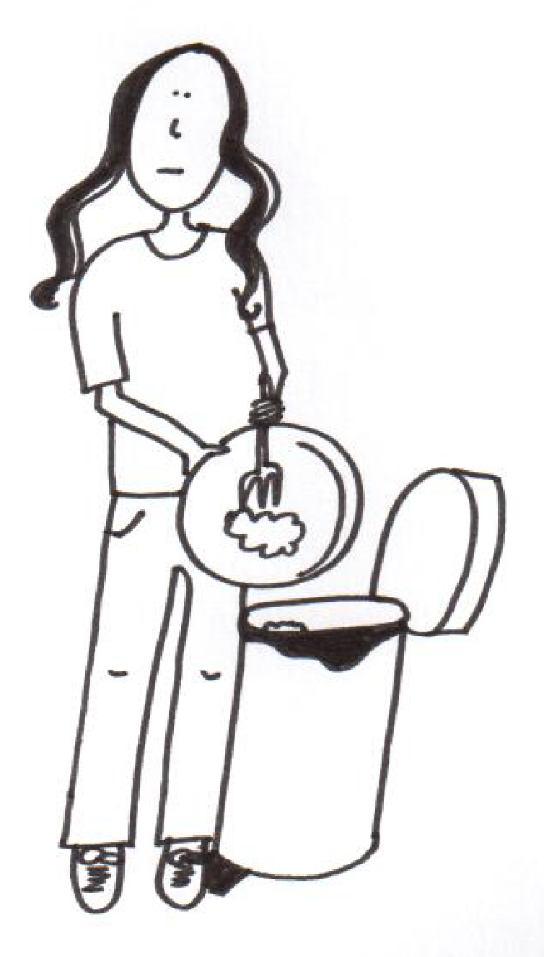
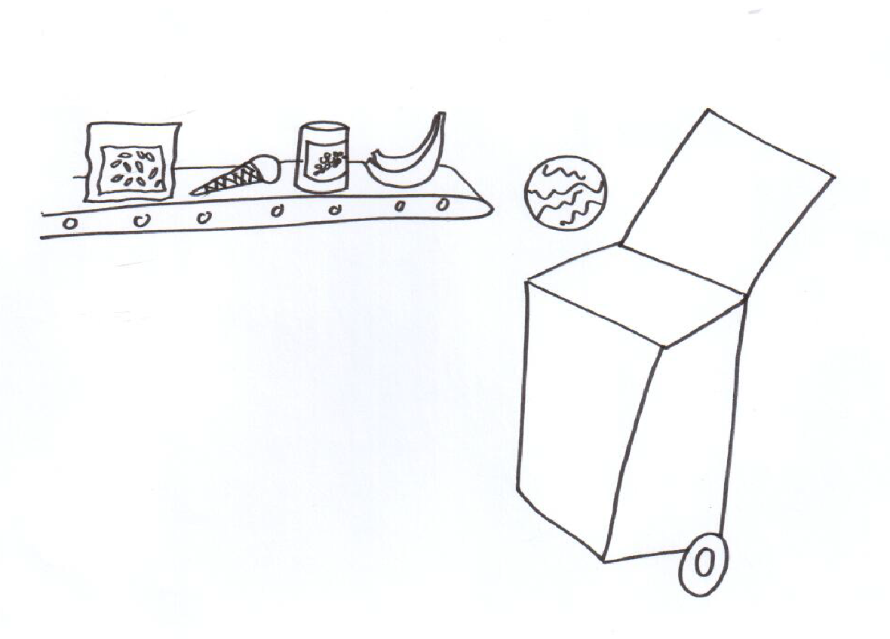
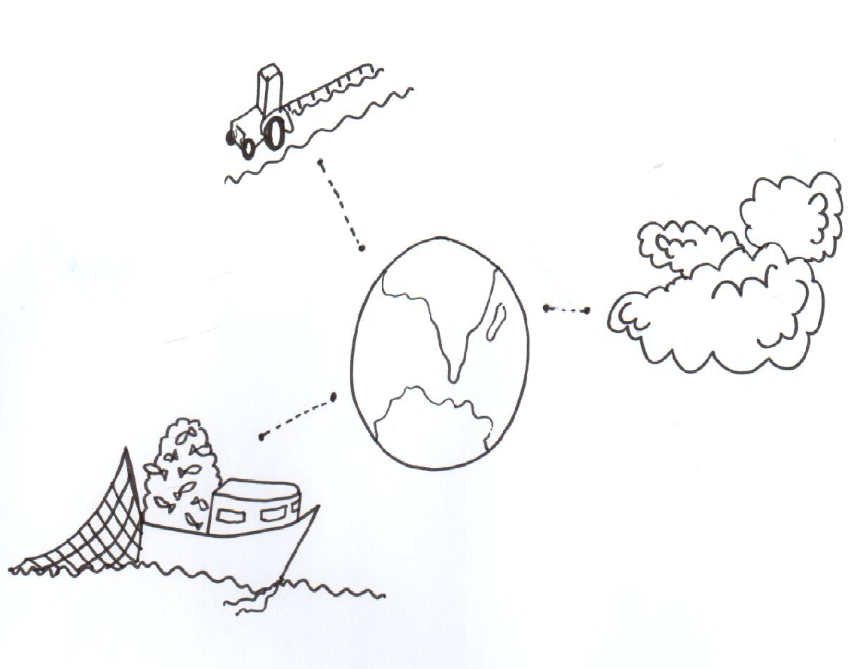
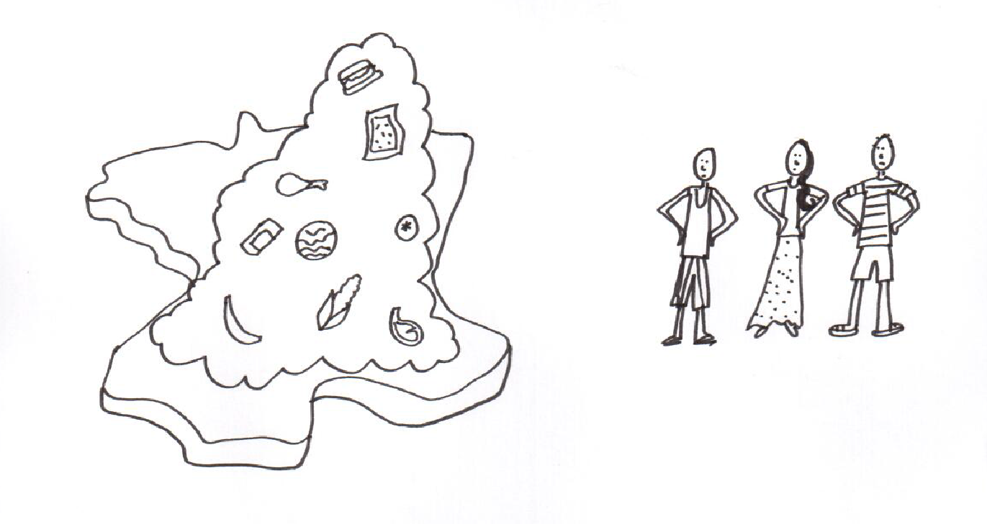
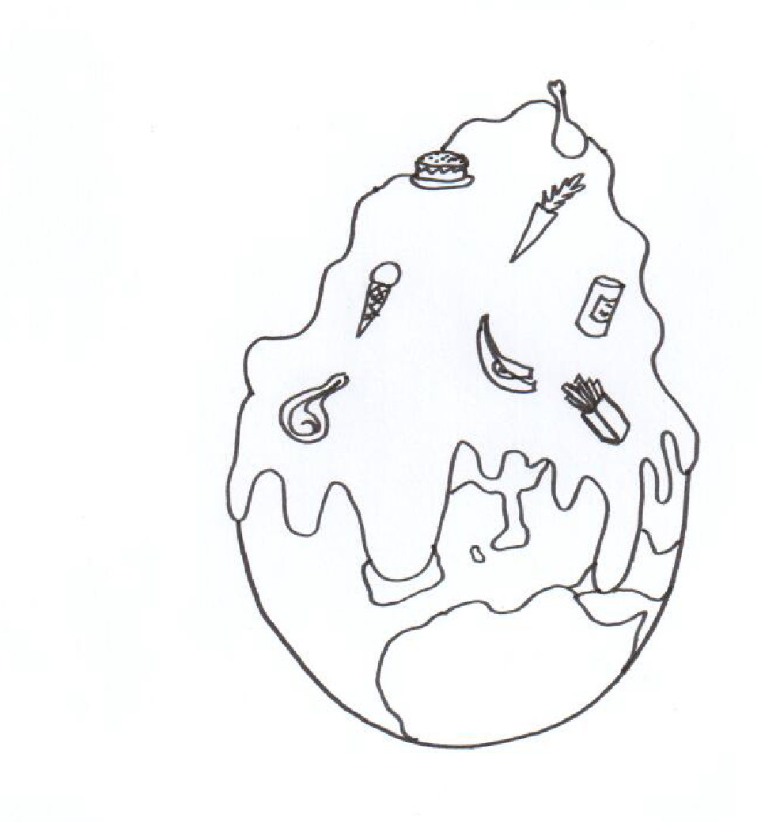
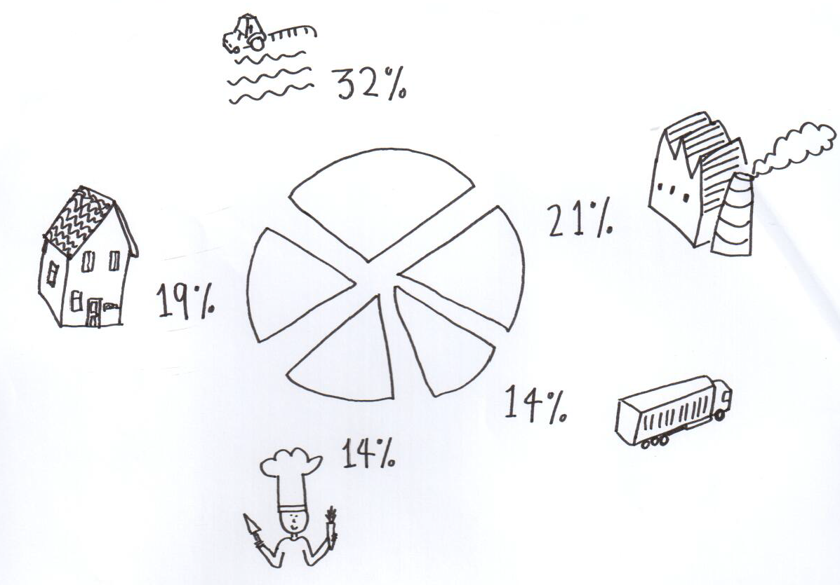
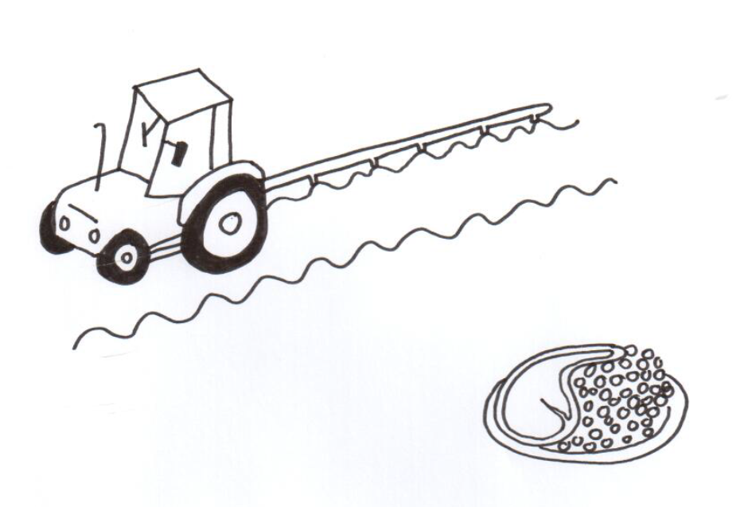
Match up activity: Find the picture to match the text and write the letter on your worksheet. *Extension task: Translate into English.
Notes:
Text and pictures based on video on PPT slide 6. Worksheet with 7 phrases provided; teacher version with English translations provided at the end of the document)

Slide 7
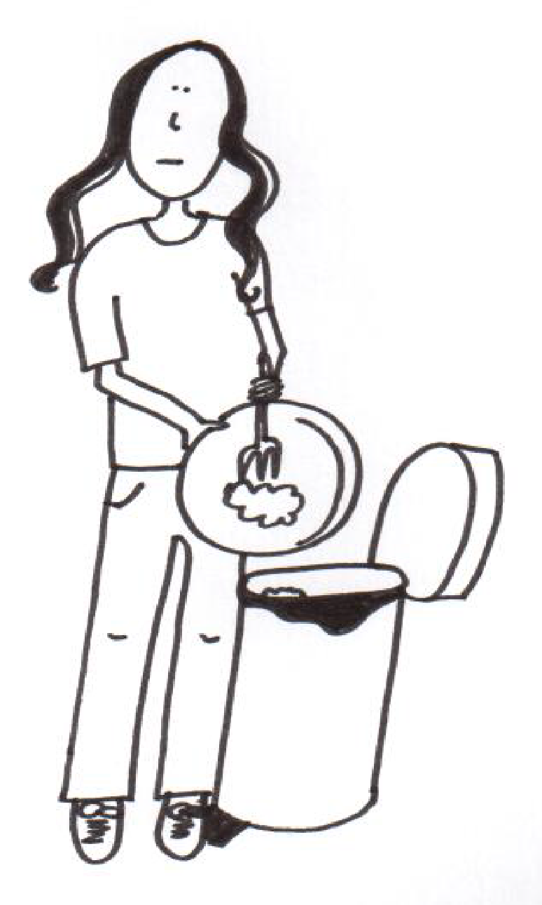
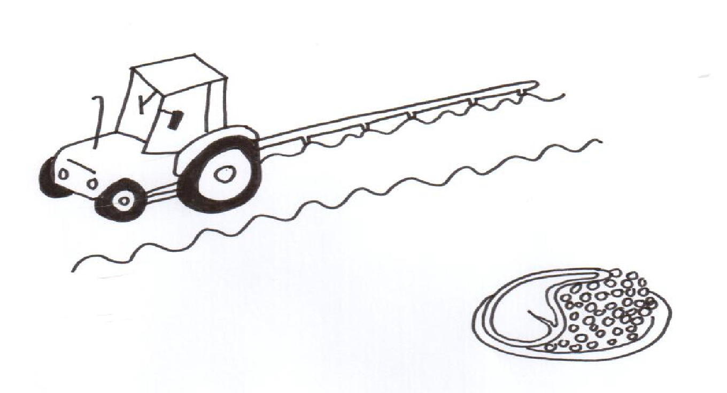
A
B
C
E
D
D
G
F
Notes:
Solutions:1C, 2A, 3F, 4G, 5D, 6B, 7E

Slide 8
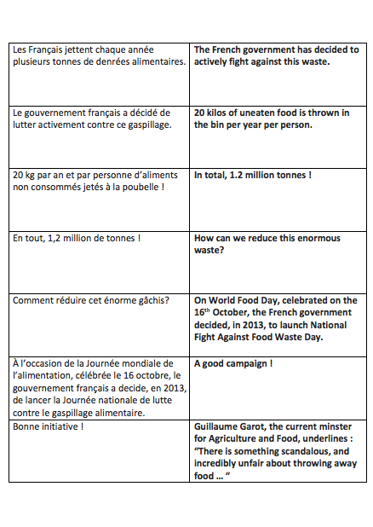
Le gaspillage alimentaire en France
Notes:
Word doc – dominoes game to establish main facts about food waste in France

Slide 9
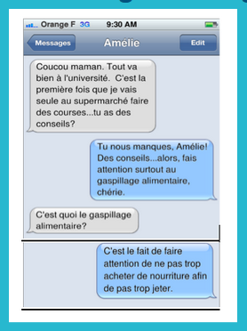
Zéro gaspillage alimentaire – Text message challenge
Notes:
Word doc
Pupils work in pairs and try to piece together the telephone conversation between Amélie (who has just started at University) and maman
Teacher cuts up the conversation and pops into envelopes and pupils have to piece it back together in the correct order
This could then be acted out as a role play and used as a comprehension activity to understand some of the ways we can cut down food waste
(graphics made by Suzi)

Slide 10
Le zéro déchet chez soi – 5 gestes simples
Notes:
https://www.facebook.com/VohitraEnvironnement/photos/bc.AboMhVNl4VAwSZgxz7GE9pqmKPL3upILeu-qn4vLlrdiKknUOK7-aOy4IQeOEOWXjprmrO4LfDrIQwu17wc4s2KtmVg8I2WszhX4ufxKFsBcrfvV4b1zxxcXMpgLP9K0j-bzGs4vzeVDsJs3KSXw_Sbu/535796286906196/?type=1&opaqueCursor=Abq6Vaf39vg5MHhsWq3LCX_9xcpMoNPbtuLa3zFuUNtRjSuY-_lnFkXyjbH9D8AVJPSR4ynicQCyIcfocPnI748Dh5MrVfFD4dSfujxPYW-Z2OB96pv6FK441lqBCaKuiHPhXsfkgOqZzueltJW-LJvzbw6MRQ61on7d4r0Hr0zNcetJ7cOfs9EuE8ruw-HbxoOAuYBB4RJsLy79vxGPhD1Rstma5gTpJstRegj7lEqDbhz-DkTi1FQGdnfd7A2SRUfrS6ML8B5HdO0iZmAUDmBPgJonZE4Cp1WCQpdzvQyCM56gCWxC5Rld2t2qX_X-63sNti61KgumEcOEUuziiU1ZTjNQjO5a7LT78p1bsozZL_T2rNOQicZ8MO1CW3Vs-eQxxZcuuVbFlDFsBBt_7Ag9lQB_u6wpw1gDQ_Z74Mu7kjED3wwxwuS8s2w2HKHjippLYQVODaG8VTnl_azMNa4SbpCHpog2RrynGEM88A2x6A&theater
Source Vohitra Consommation
Some further prompts for discussion around how to reduce our waste in more general terms

Slide 11
Présentation en groupes
Students work in small groups to summarise what they have learned in this unit of work. They should creatively present their work in one of the following 4 ways:
www.fodey.com
Newspaper article
iMovie
Short video clip
https://bubbl.us/
Create a mind map
Notes:
http://www.quirkyscience.com/wp-content/uploads/2013/10/Idea-Pixabay-by-OpenClips.jpg

Slide 13
World Class Teaching project has been funded with support from the European Commission. The contents of these actions are the sole responsibility of the contractor and can in no way be taken to reflect the views of the European Union.

