Slide 1
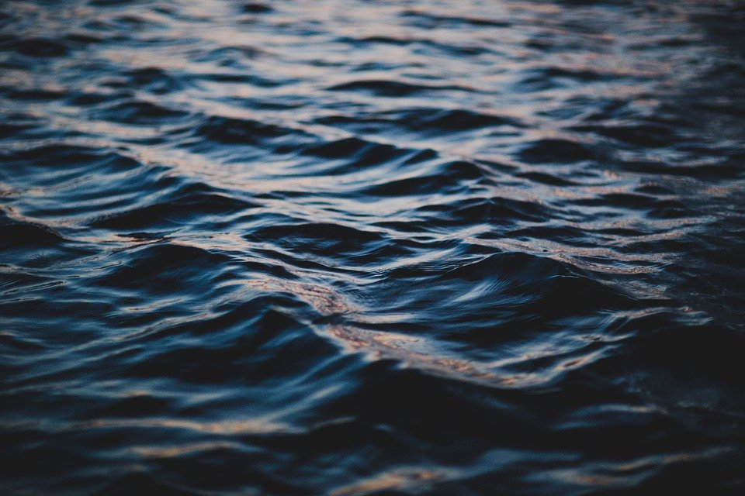
Volume:
Lake Chad
Notes:
Photos: https://pixabay.com/photos/ocean-waves-water-ripple-sea-1867447/

Slide 4
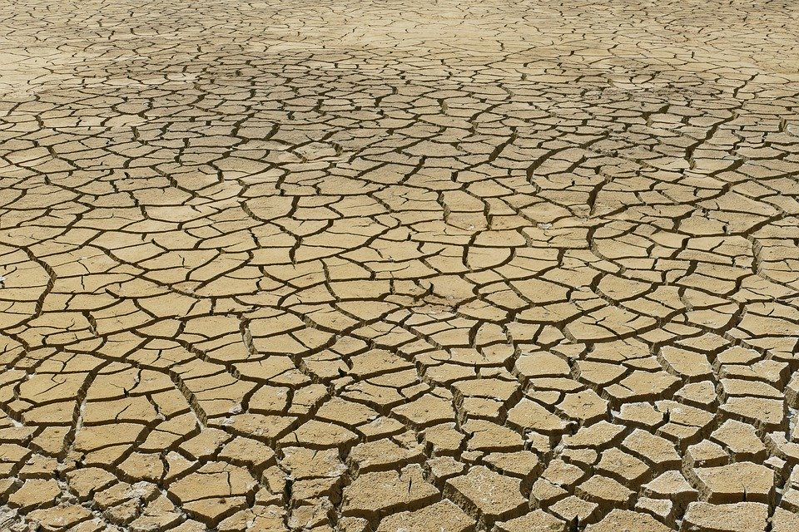
The Big Question:
How big an impact is climate change having on food supply?
Example:
Lake Chad and surrounding communities
Notes:
Photo: https://pixabay.com/photos/dry-dehydration-drought-rip-crack-4282884/

Slide 5
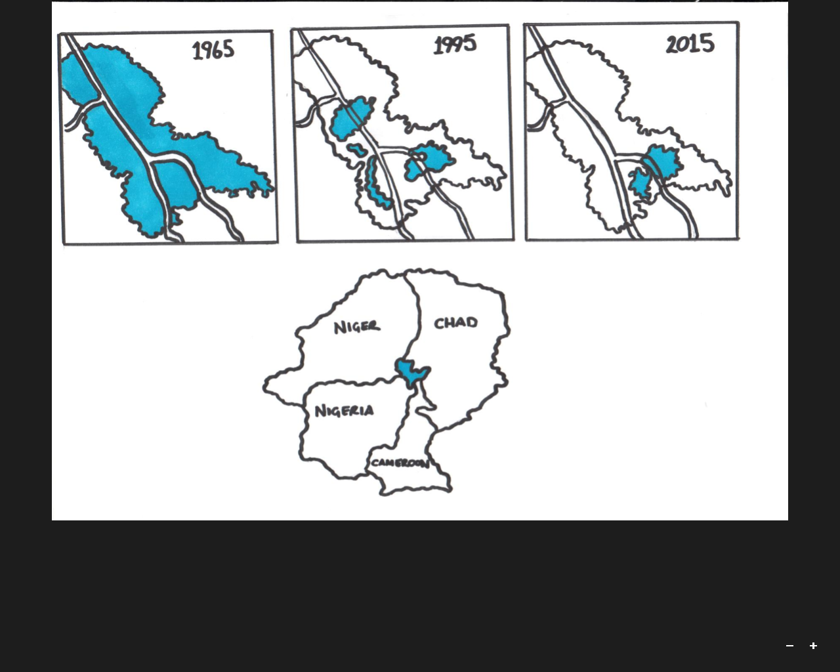
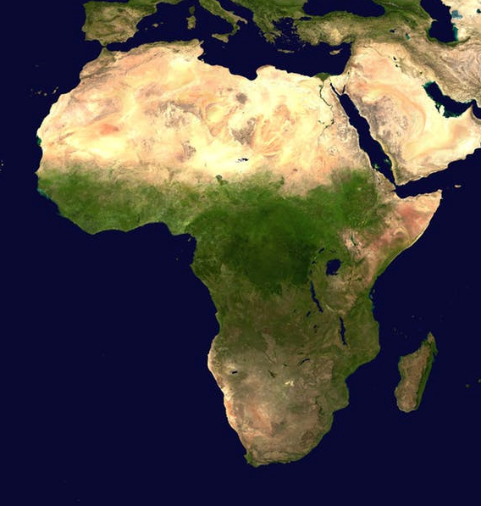
Lake Chad is bordered by Niger, Chad, Nigeria and Cameroon.
Over the last few decades, the lake has shrunk dramatically, partly due to the impact of climate change.
Notes:
Photo: www.pexels.com

Slide 6
It is very hard to accurately calculate the volume of water in a lake. Why?
Lakes are irregular shapes.
What solids can we use to ESTIMATE the amount of water in a lake?
Notes:
Photos: https://pixabay.com/photos/ocean-waves-water-ripple-sea-1867447/

Slide 7
Name each of these 3D solids
A
B
C
F
D
E
Volume of a prism = cross-section area x length
Which of these shapes are prisms?

Slide 8
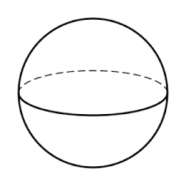
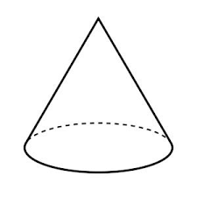
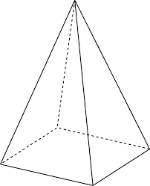
Volume Formulae
Sphere = 4 π r
3
Cone = 1 π r h
3
Pyramid= 1 x base area x height
3
3
2

Slide 9
Depth measurements....
The maximum depth of Lake Chad is 11m
The average depth of Lake Chad is 1.5m
Which of these numbers should we use as the depth measurement for a cuboid when estimating the volume of lake Chad?
1.5m is far more suitable, as an average takes into account the areas where the lake is deeper or shallower.
Using 11m would always give us an overestimate.
Should we use this figure as the depth measurement on all of our models?
We need to adjust our depth measurements depending on the shape we are using. The height of a cone is not the same as its average height, for example.

Slide 10
These shapes can be used to model Lake Chad
30km
35km
70km
50km
1.5m
50km
1m
1.5m
40km
30km
20km
50km
10km
40km
3m
3m
STANDARD SHEET, PRESENT DAY
Work out the volume of each shape to estimate how much water is in Lake Chad

Slide 11
These shapes can be used to model Lake Chad
30km
35km
70km
50km
3.6m
5.1m
50km
3.1m
3.6m
40km
30km
20km
50km
11km
40km
5.1m
STANDARD SHEET, PAST
Work out the volume of each shape to estimate how much water is in Lake Chad

Slide 12
Task A
Increase the depth measurement on each of your models by 2.1 metres.
Recalculate the volume of each, and find difference is volume shown by each model.
50 years ago, Lake Chad was much larger.
If Lake Chad was actually double the depth we have assumed, does the volume of each model double?
Why do you think Lake Chad's volume has changed so much over this time period?
Task B
If the volume of Lake Chad in 1969 was 72km calculate the depth that would give this volume for each of your models.
3
3
Notes:
Lake Chad has shrunk by 90% since the 1960s due to climate change and unplanned irrigation. See https://www.bbc.co.uk/news/world-africa-43500314 for a map comparing previous and current size of the lake.
Photo: https://pixabay.com/photos/lakes-drought-water-trees-soil-4915905/

Slide 13
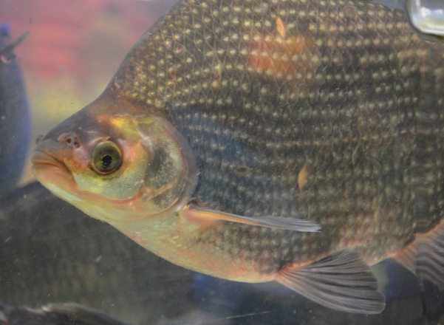
This fish is called a tilapia. Tilapia is a common fish used in cooking in Nigeria and other African countries. Fish are an important source of protein and income.
How do fish generate income?
An average tilapia fish would weigh 2kg and need an estimated 1400m of water to live comfortably.
Using this figure, estimate the weight of tilapia fish that
(a) used to live in Lake Chad
(b) currently live in Lake Chad
Why may these estimations be unreliable? What other factors could affect the number of tilapia fish in Lake Chad?
www.pixabay.com
https://pixabay.com/photos/fish-tilapia-cichlid-species-82985/
3

Slide 14
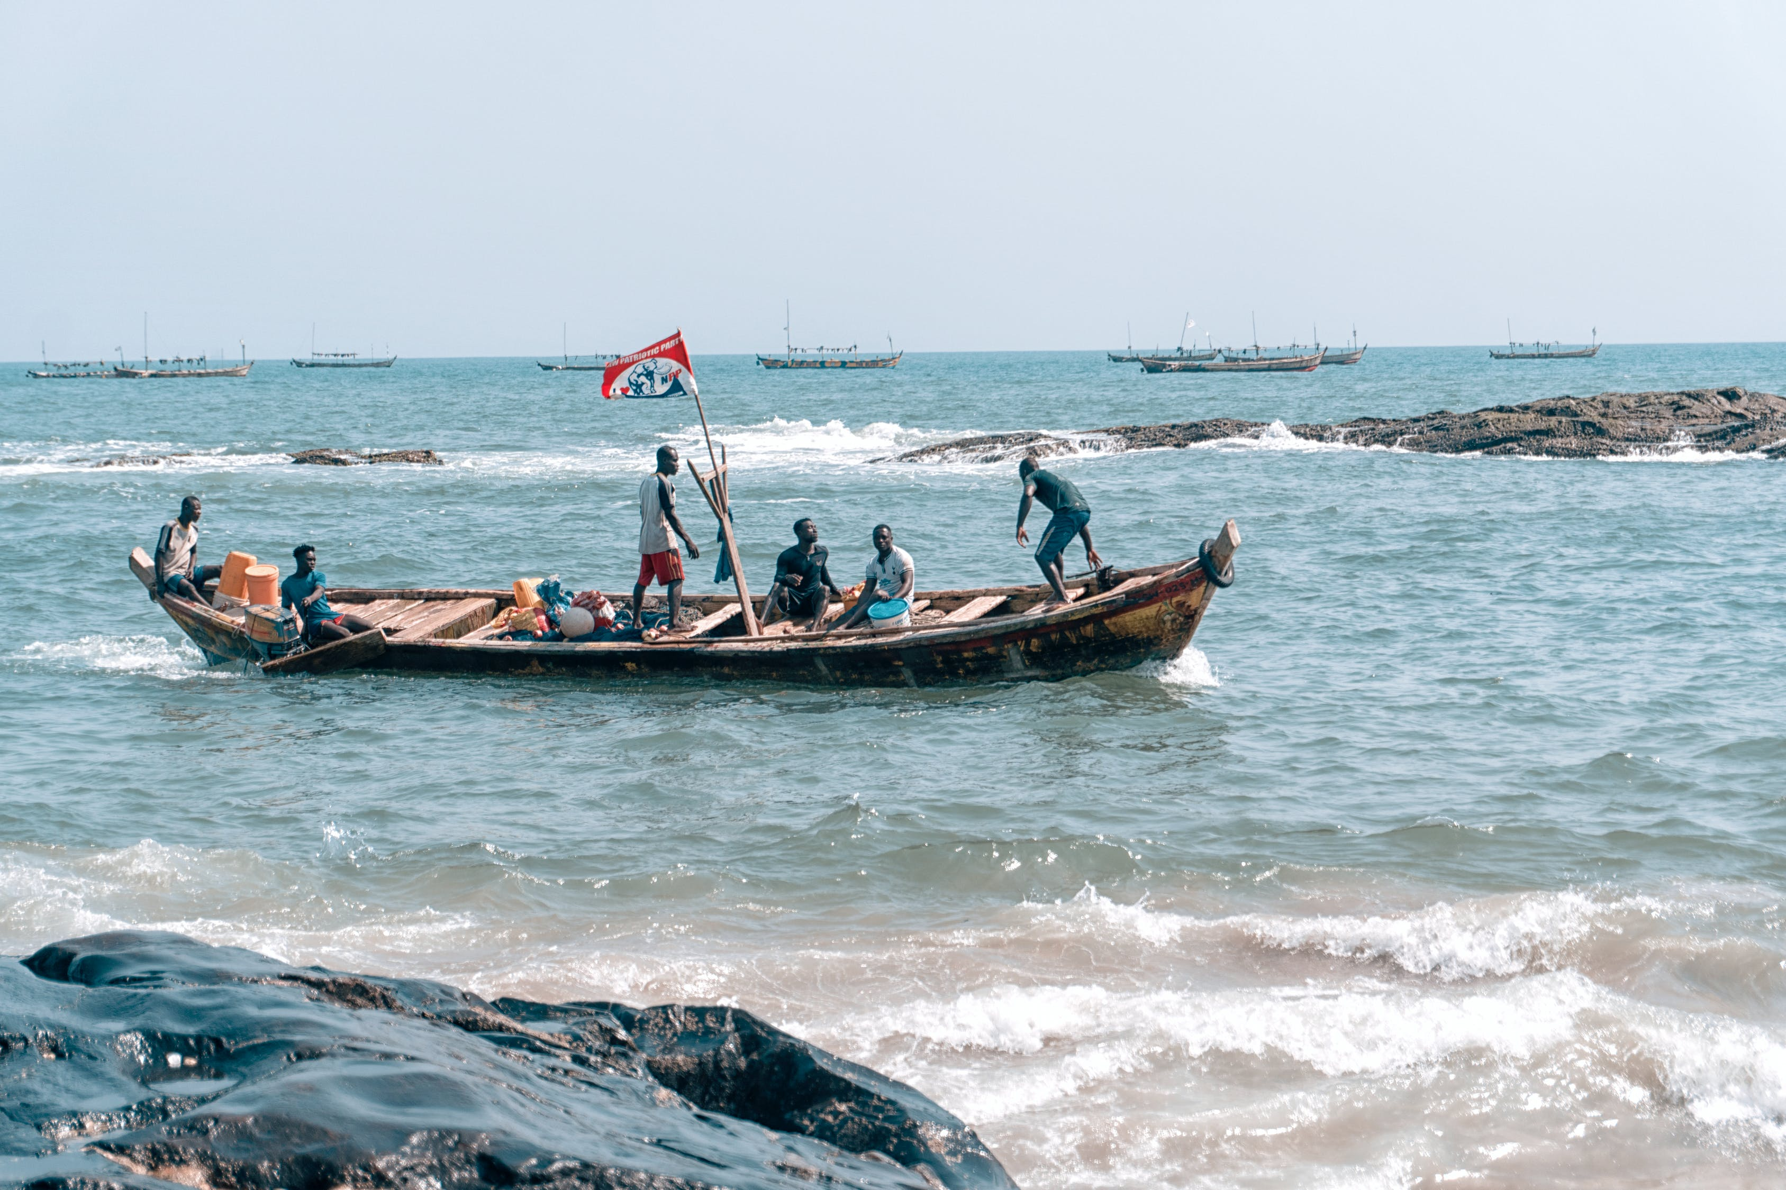
If surrounding communities rely on fishing for their livelihoods, what impact will the shrinkage of the lake have had on them?
Notes:
http://www.fao.org/3/a-i3037e.pdf The estimated 200 million population of the region are heavily dependent and inextricably linked to the natural resources of the basin for their livelihoods. 80 percent of the rural poor in the region are dependent on fish as the commonest and cheapest source of animal protein. Another pathway of climate change impacts is through agriculture. Higher temperatures and evaporation and reduced precipitation have reduced water availability and adversely affected not only fisheries, but agricultural practices in the region. Photo: https://www.pexels.com/photo/people-on-brown-boat-3561109/

Slide 15
“The lake is dying and we are all dying with it”
Muhammadu Bello (former fisherman on Lake Chad)
“Africa does not produce any significant amount of greenhouse gases, but it's our lakes and rivers that are drying up”
Jacob Nyanganji (University of Maiduguri)
Notes:
The quotes on this slide are from http://news.bbc.co.uk/1/hi/world/africa/6261447.stm
http://www.fao.org/3/a-i3037e.pdf “The estimated 200 million population of the region are heavily dependent and inextricably linked to the natural resources of the basin for their livelihoods. 80 percent of the rural poor in the region are dependent on fish as the commonest and cheapest source of animal protein. Higher temperatures and evaporation and reduced precipitation have reduced water availability and adversely affected not only fisheries, but agricultural practices in the region.”
Photo: https://www.pexels.com/photo/people-on-brown-boat-3561109/

Slide 16
These shapes can be used to model Lake Chad. Work out the volume of each shape to estimate how much water is in Lake Chad.
30
35
70
50
0.0015
50
0.001
0.0015
40
30
20
10
50
40
0.003
0.003
All measurements in km
SUPPORT SHEET

Slide 17
These shapes can be used to model Lake Chad. Work out the volume of each shape to estimate how much water is in Lake Chad.
30
35
70
50
0.0036
50
0.0031
0.0036
40
30
20
50
11
40
0.0051
0.0051
All measurements in km
SUPPORT SHEET
PAST

Slide 18
These shapes can be used to model Lake Chad. Work out the volume of each shape to estimate how much water is in Lake Chad.
30
35
70
50
?
50
?
40
?
30
20
50
40
?
?
All measurements in km
EXTENSION SHEET
PRESENT

Slide 19
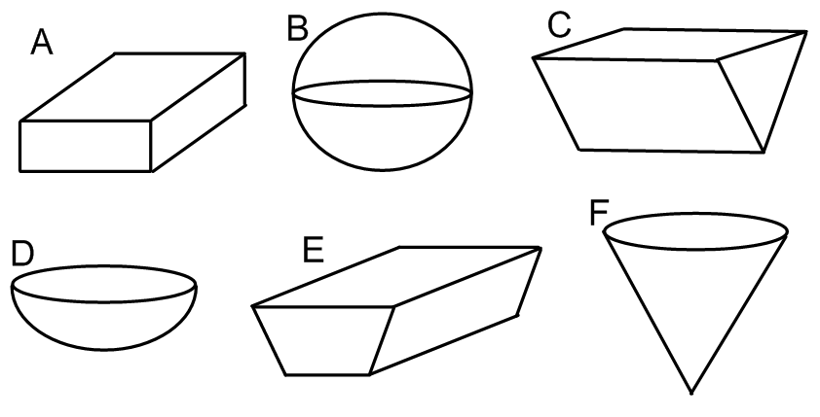
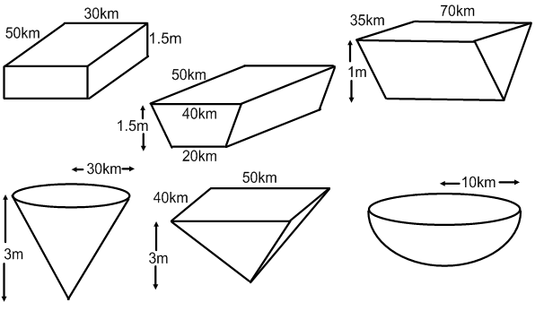
How big an impact is climate change having on food supply?
Lake Chad
Volume of 3D shapes
EXTENSION
Starter task: Name these 3D shapes. Circle the prisms.
A:
B:
C:
D:
E:
F:
Volume formulae: Fill in these important formulae.
Cuboid: Prism: Sphere:
Cone: Pyramid:
Volume calculations: Find the volume of each of these solids.

Slide 20
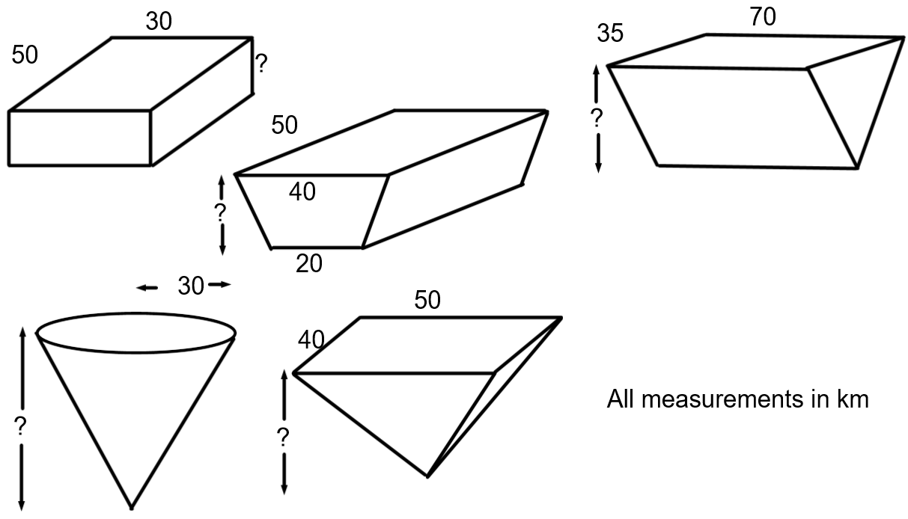
Reverse calculations: Find the missing lengths required to give a volume of 72km3
What factors have contributed to the shrinkage of Lake Chad over 50 years?
_________________________________________________________________ _________________________________________________________________ _________________________________________________________________
Conversion of units: Estimate the gallons of water and the total weight of fish in Lake Chad in the past and present using your pyramid models.
PRESENT
PAST
Explain the advantages and disadvantages of calculating the amount of fish in Lake Chad in this way.
_________________________________________________________________ _________________________________________________________________
What impacts would the change in fish stocks over the last 50 years have on local communities in the four surrounding countries?
_________________________________________________________________ _________________________________________________________________

Slide 21
How big an impact is climate change having on food supply?
Lake Chad
Volume of 3D shapes
STANDARD
Starter task: Name these 3D shapes. Circle the prisms.
A:
B:
C:
D:
E:
F:
Volume formulae: Fill in these important formulae.
Cuboid: Prism: Sphere:
Cone: Pyramid:
Volume calculations: Find the volume of each of these solids.

Slide 22
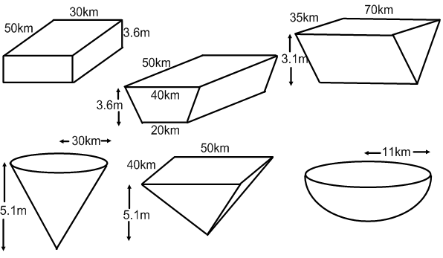
Comparison calculations: Calculate the volume of each solid.
What factors do you think have contributed to the shrinkage of Lake Chad over 50 years?
_________________________________________________________________ _________________________________________________________________ _________________________________________________________________
Conversion of units: Estimate the gallons of water and the total weight of fish in Lake Chad in the past and present using your pyramid models.
PRESENT
PAST
What impacts would the change in fish stocks over the last 50 years have on local communities in the four surrounding countries?
_________________________________________________________________ _________________________________________________________________ _________________________________________________________________

Slide 23
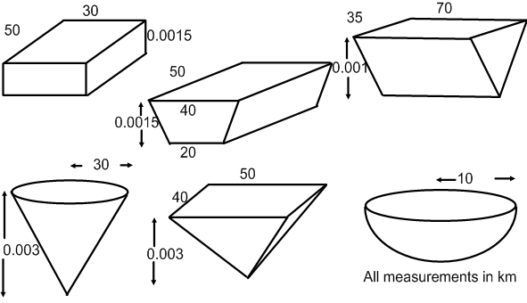
How big an impact is climate change having on food supply?
Lake Chad
Volume of 3D shapes
SUPPORT
Starter task: Name these 3D shapes. Circle the prisms.
A:
B:
C:
D:
E:
F:
Volume formulae: Fill in these important formulae.
Cuboid: Prism: Sphere:
Cone: Pyramid:
Volume calculations: Find the volume of each of these solids.

Slide 24
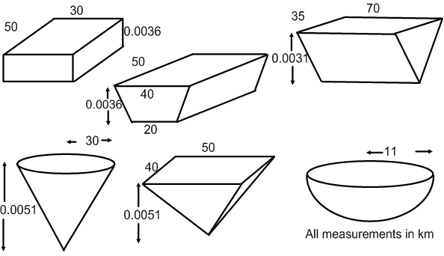
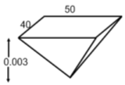
Comparison calculations: Calculate the volume of each solid.
What factors do you think have contributed to the shrinkage of Lake Chad over 50 years?
_________________________________________________________________ _________________________________________________________________ _________________________________________________________________
Conversion of units: Estimate the gallons of water and the total weight of fish in Lake Chad in the past and present using your pyramid models.
PRESENT
PAST
What impacts would the change in fish stocks over the last 50 years have on local communities in the four surrounding countries?
_________________________________________________________________ _________________________________________________________________ _________________________________________________________________

Slide 25
Notes:
Hyperlinked to: https://www.meatfreemondays.com/schools/

Slide 26
World Class Teaching project has been funded with support from the European Commission. The contents of these actions are the sole responsibility of the contractor and can in no way be taken to reflect the views of the European Union.

