Slide 1
Prophecy
Notes:
Photo: https://cdn.pixabay.com/photo/2014/04/05/11/40/chess-316657__340.jpg

Slide 2
Notes:
Eve - take off the citizenship outcome so this is just an RE lesson

Slide 4
A Prophet is…
A prophet is generally seen as a forecaster of the future. In many religions, however, the word prophet has a more precise meaning.
Many religions believe that prophets bring a message from God. They are inspired by a strong faith to speak to reveal the will of God. Prophets perceive the world ‘with God’s eyes’. They look around and see things going wrong in their own society, they see people not following the will of God, injustices being done. They perceive where this will lead if it continues.
Prophets need to have the courage to speak out about what they see. They tell people what is going wrong and warn about what will happen in the future if people continue to behave as they are - but also promising hope if people do change their ways and follow God’s will. This is often an unwelcome message and usually makes them very unpopular. Speaking out is often at great personal cost; sometimes prophets are even killed for proclaiming God’s message.
Notes:
Can students guess the missing words to complete the definition? Future / Message / God / Courage / Hope

Slide 5
A Prophet is…
A prophet is generally seen as a forecaster of the future. In many religions, however, the word prophet has a more precise meaning.
Many religions believe that prophets bring a message from God They are inspired by a strong faith to speak to reveal the will of God. Prophets perceive the world ‘with God’s eyes’. They look around and see things going wrong in their own society, they see people not following the will of God, injustices being done. They perceive where this will lead if it continues.
Prophets need to have the courage to speak out about what they see. They tell people what is going wrong and warn about what will happen in the future if people continue to behave as they are - but also promising hope if people do change their ways and follow God’s will. This is often an unwelcome message and usually makes them very unpopular. Speaking out is often at great personal cost; sometimes prophets are even killed for proclaiming God’s message.
Notes:
Can students guess the missing words to complete the definition? Future / Message / God / Courage / Hope

Slide 6
Break into groups, with each group looking at one of the key words from the Prophet definition, be ready to feed back.
God | Future | Courage
Does anyone truly know the will of God? How might someone who claims to ‘know the will of God’ be treated by others? Does everyone in society want to know the ‘will of God’? Who might be most interested / most angry? | Is it possible to see into the future? How are the predictions a prophet makes different from those of a fortune teller? Do you think most people would want to know the future? Even if they had to really change their behaviour to bring about a positive future? | Why might a prophet need courage? What problems might a prophet face when trying to proclaim the will of God? Which people might get particularly angry if a prophet said that society was unjust and was heading for disaster?
Message
How could a prophet be sure their message was from God ? In what ways might prophets try to get their message heard? Why might a prophet’s message be unpopular and who with?
Hope
Doom or hope - would people be likely to react in different ways to different kinds of messages from a prophet? What would it feel like to be a prophet who could see how bad / good things could be but not be listened to?
Notes:
The aim is to break apart the definition and analyse it in more detail. Students should begin to consider the positives and negatives of prophecy.

Slide 7
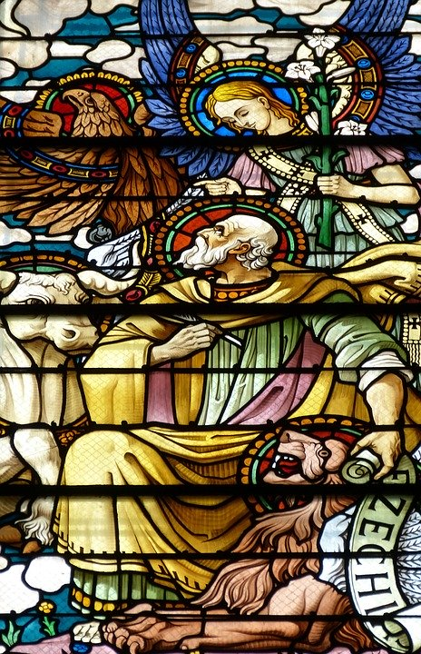
Ezekiel
Jews, Christians and Muslims believe Ezekiel
was a prophet. He lived in the 6th Century BC at a
time of war when Jerusalem was captured and the Jews were exiled in Babylon.
Ezekiel told the Jews that they weren’t following God’s rules: they were worshipping false gods and believing lies. He said that they were like people who built a flimsy wall, then whitewashed over it and expected it to stand up for ever. Ezekiel was very unpopular with the King. He prophesied the destruction of the city of Jerusalem, but also hope for the rebuilding of a
new Temple in a new Jerusalem.
Notes:
Photo: https://pixabay.com/da/photos/profet-ezekiel-ezechiel-lion-tyren-1602585/

Slide 8
Jesus
To Christians, Jesus is the Son of God. Christians believe that the Old Testament prophet Isaiah prophesied the coming of Jesus to earth, saying that he would not be believed in his time, and would be persecuted and killed for his teachings (Isaiah 53).
Is Isaiah 53 an accurate prophecy?
In Islam, Jesus is known as Eisa and is viewed as a very important prophet who brought the message about God’s will to the Jewish people.
Notes:
Photo: https://cdn.pixabay.com/photo/2015/10/31/23/31/church-window-1016443_1280.jpg

Slide 9
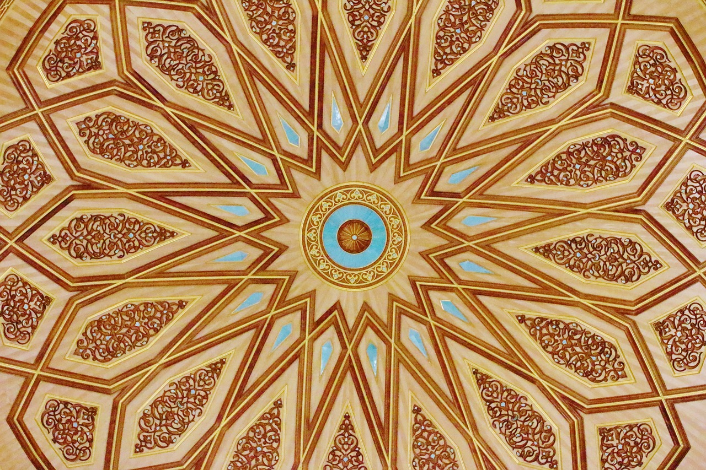
Prophet Muhammed
For Muslims, Prophet Muhammed (pbuh) is a very important figure. He taught Muslims how to follow the rules of Allah.
He was orphaned at a young age, never learning to read or write, but Allah chose him to receive His teachings and rules in the form of the Qur’an. Despite this, Muhammed was still persecuted in his home town of Mecca when he brought Allah’s message, and he had to flee to Medina, where he raised an army and took Mecca back, in the name of Allah.
Notes:
Photo: https://cdn.pixabay.com/photo/2017/04/21/19/47/prophet-2249733_960_720.jpg

Slide 10
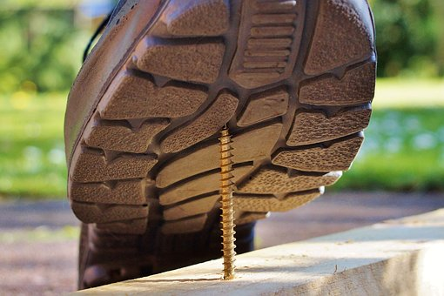
Prophets are often seen as being or wanting to be ahead of the curve. This could mean that they are admired by many, but could also mean that they are ridiculed and unpopular. They could be seen as bizarre or even crazy.
What prophets have to tell us might be uncomfortable. It might be something that we don’t want to hear or don’t want to take responsibility for. To admit that they could be right could be to admit that our current actions are wrong.
Notes:
Link this back to the examples discussed so far, ensure students understand that being a prophet is not always easy.

Slide 11
Draw an outline of a person. This picture will represent a prophet.
Inside the prophet make notes on how a prophet may feel.
Around the outside of your prophet make notes on how a prophet may be seen by others.

Slide 12
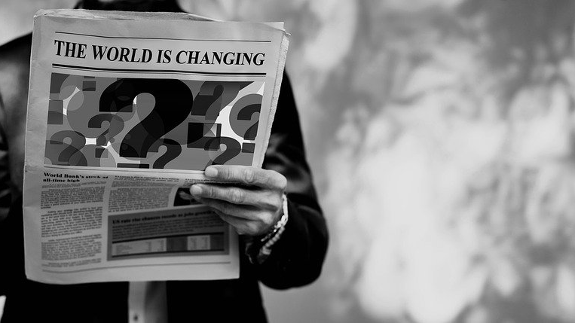
Looking around at our world today, what do you think a prophet might see as the ‘signs of the times’ for us?
What might a modern prophet warn us about? Where might they see hope?
Notes:
Make links to the main learning outcome. Can they add anything to their image?
Photo: https://pixabay.com/da/photos/%C3%A6ndring-verden-mand-avis-l%C3%A6se-4039486/

Slide 13
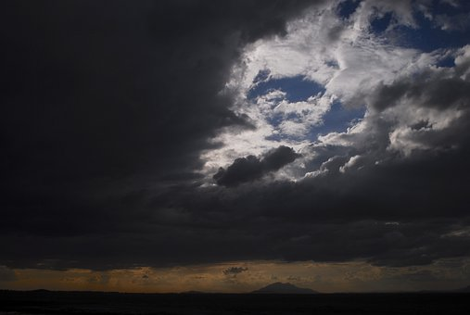
James Hansen
Thirty years ago, James Hansen testified to the US Congress about the dangers of human-caused climate change. In his testimony, Hansen showed the results of his 1988 study using a climate model to project future global warming under three possible scenarios, ranging from ‘business as usual’ heavy pollution in his Scenario A to ‘draconian emissions cuts’ in Scenario C, with a moderate Scenario B in between.
The actual 1988–2017 temperature increase was about 0.6°C. Hansen’s 1988 global climate model was almost spot-on.
https://www.theguardian.com/environment/climate-consensus-97-per-cent/2018/jun/25/30-years-later-deniers-are-still-lying-about-hansens-amazing-global-warming-prediction
Notes:
Make links to the main learning outcome. Can they add anything to their image?
Photo: https://cdn.pixabay.com/photo/2019/10/07/07/38/storm-4531945_640.jpg

Slide 14
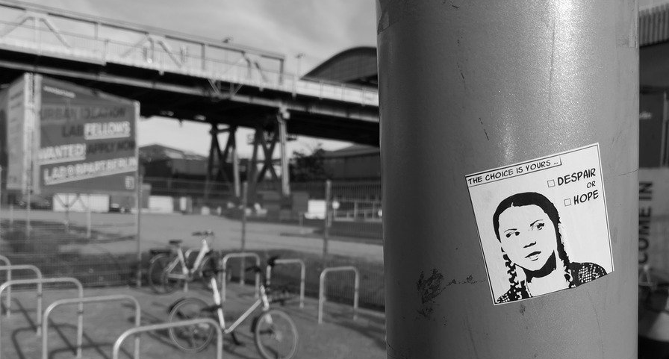
Greta Thunberg
Thunberg first became known when she began spending her school days, alone, outside the
Swedish parliament to call for stronger action on
global warming by holding up a sign saying "School strike for climate". Soon, other students engaged in similar protests in their own communities.
Together, they organised a school climate strike movement under the name Fridays for Future. After Thunberg addressed the 2018 United Nations Climate Change Conference, student strikes took place every week somewhere in the world. In 2019, there were a number of coordinated multi-city protests involving over one million students each.
https://en.wikipedia.org/wiki/Greta_Thunberg
Notes:
Make links to the main learning outcome. Can they add anything to their image?
Photo: https://pixabay.com/da/photos/fredagen-for-fremtiden-greta-thunberg-4759928/

Slide 15
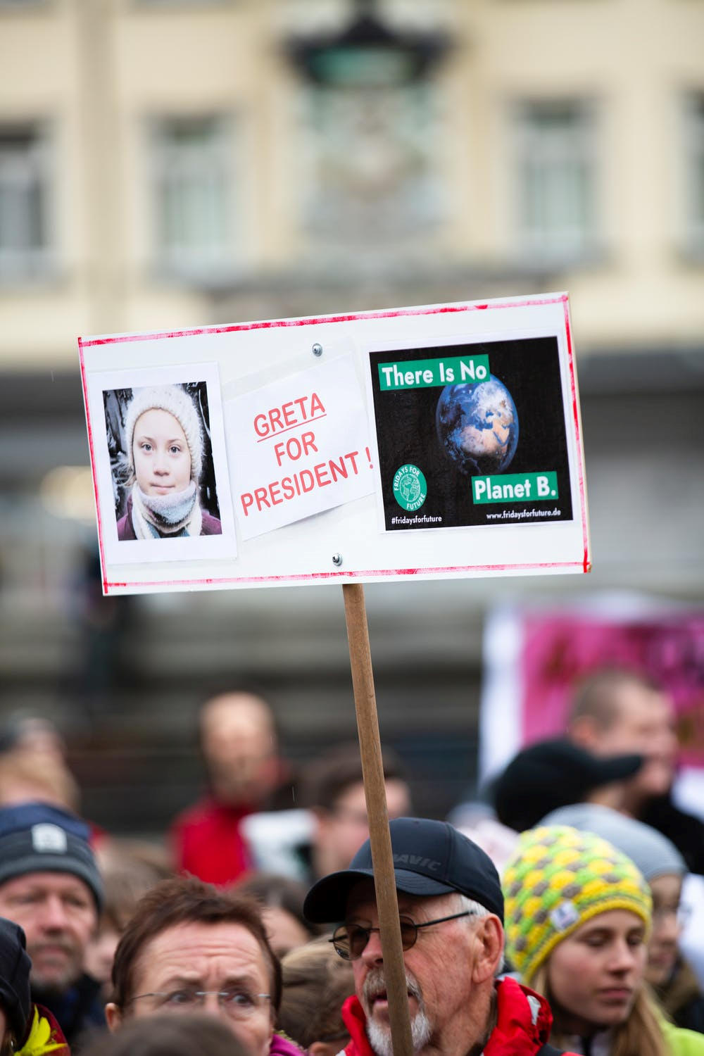
The movement that Greta has inspired has been a gradual and often lonely experience…
The inspiring images of activism do not tell the full story.
She has been criticised
She has been laughed at
She has faced the fury of grown men
She is a teenager
Would you like to be Greta Thunberg?
How about Ezekiel, Jesus or
Prophet Muhammed?
Why? Why not?
Notes:
Photo: pexels-photo-2058780.jpeg
https://cdn.pixabay.com/photo/2019/03/15/19/18/school-strike-4-climate-4057783_640.jpg

Slide 16
Could you imagine being a prophet?
Is being a prophet always easy?
Are prophets always believed?
Would you like to be a prophet?
Notes:
Discuss in small groups and then feedback as a whole

Slide 17
Red – No way
Amber – Maybe
Green – OK!
Following the example of prophets isn’t always simple.
How likely/easy is it to speak out in the following examples?
Challenging a teacher who you see throwing their plastic bottle in the bin.
Boycotting shops that may encourage ‘throw away fashion’ due to very cheap prices e.g. Primark
Challenging a friend who makes a sexist joke (even though others are laughing)
Speaking to your family about the environmental impact of consuming meat, with the intention of persuading them to go meat free for a day each week
Informing a teacher when, via social media, you are sent a doctored photo of another student, clearly meant to embarrass them.
Using social media to share political and environmental messages, even when feedback from your friends suggests this is making you ‘look weird’.
Notes:
Students shade in the column accordingly. They should then move around the room comparing their answers before feeding back as a whole class.

Slide 18
What do I / could I do to be a prophet now?
What challenges might I face and how could I overcome them?
Notes:
Final reflection
Photo: https://cdn.pixabay.com/photo/2014/04/05/11/40/chess-316657__340.jpg

Slide 20
World Class Teaching project has been funded with support from the European Commission. The contents of these actions are the sole responsibility of the contractor and can in no way be taken to reflect the views of the European Union.

