Slide 1
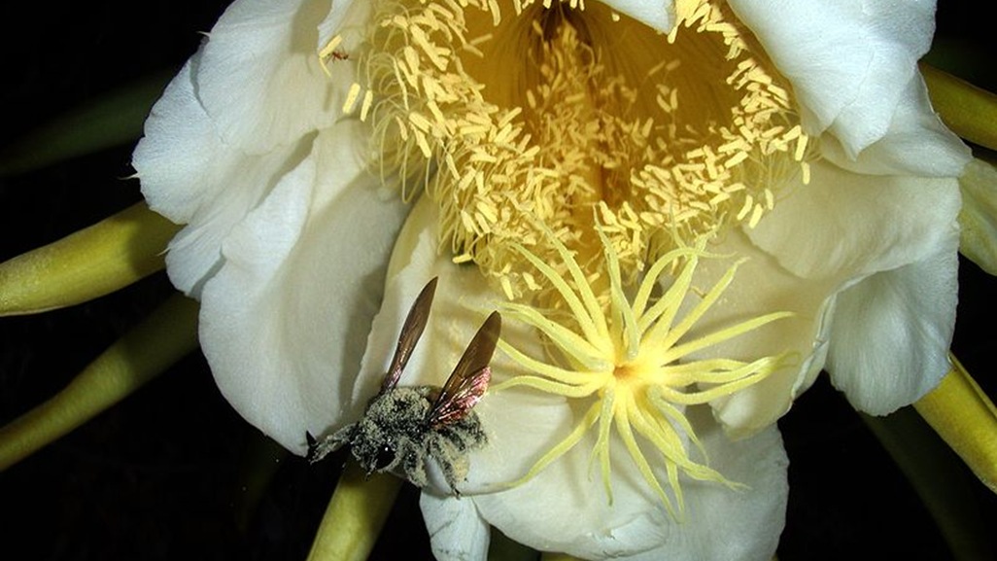
KS3
Interdependence: The role of pollinators in human food supply
Lesson 1 of 2
Attributed to Brocken Inaglory - Own work, CC BY-SA 3.0, https://commons.wikimedia.org/w/index.php?curid=2763658

Slide 4
Can you find some connections?
BEES
CLIMATE CHANGE
MIGRATION

Slide 5
Flowers are the reproductive organs of plants
ttps://pixabay.com/photos/ornamental-onion-flower-flowers-1403937/ Pixabay license no attribution necessary

Slide 6
Flowers have parts that make male sex cells, parts that make female sex cells and parts that grow the plant embryo (seed).

Slide 7
Filament
Petal
Sepal
Pollen
edited from : By Mariana Ruiz LadyofHats - Own work, Public Domain, https://commons.wikimedia.org/w/index.php?curid=2273307Public domain https://en.wikipedia.org/wiki/Flower#/media/File:Mature_flower_diagram.svg

Slide 8
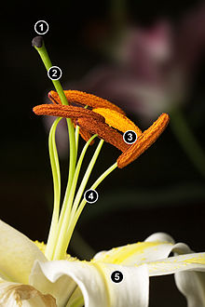
Name the parts of this Lily flower. 1 2 3 4 5
Photo by JJ Harrison https://en.wikipedia.org/wiki/Flower

Slide 9
Male sex cells – Pollen.
https://en.wikipedia.org/wiki/Pollen
By JJ Harrison https://commons.wikimedia.org/wiki/File:Tulip_Stamen_Tip.jpg

Slide 10
Female sex cells – eggs, are inside the ovules.
https://en.wikipedia.org/wiki/OvuleBy The original uploader was Tameeria at English Wikipedia. - Transferred from en.wikipedia to Commons., CC BY-SA 3.0, https://commons.wikimedia.org/w/index.php?curid=3784140

Slide 11
Fertilization happens after male pollen is transferred to the stigma. This transfer is called pollination
Can you see which animal is pollinating the flower?
Attributed to Brocken Inaglory - Own work, CC BY-SA 3.0 https://commons.wikimedia.org/w/index.php?curid=2763658

Slide 12
Fruits form around fertilised seeds.
Attribution not necessary https://pixabay.com/photos/tomatoes-red-salad-food-fresh-769999/

Slide 13
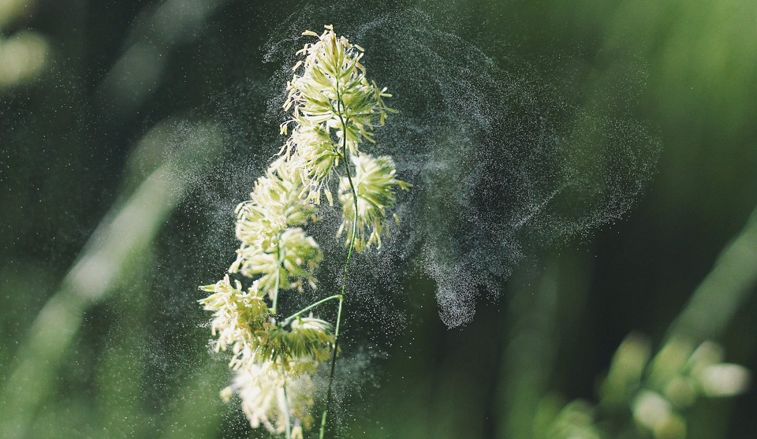
Some plants are pollinated by the wind
How else could pollen get from one plant to another?
No attribution necessary https://pixabay.com/photos/plant-pollen-pollination-flower-692141/

Slide 14
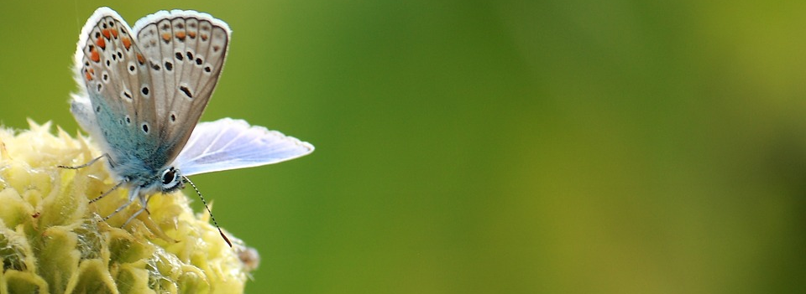
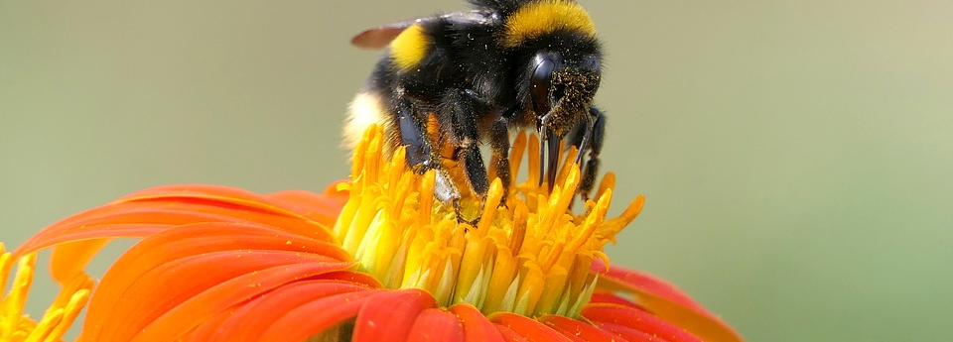
Many plants can not be pollinated by wind, instead they attract pollinating insects such as bees and butterflies.
Why do you think the insects go to the flowers?
What would happen if the number of bees and butterflies dropped?
No attribution necessary all on pixabay eg https://pixabay.com/images/search/nectar/

Slide 15
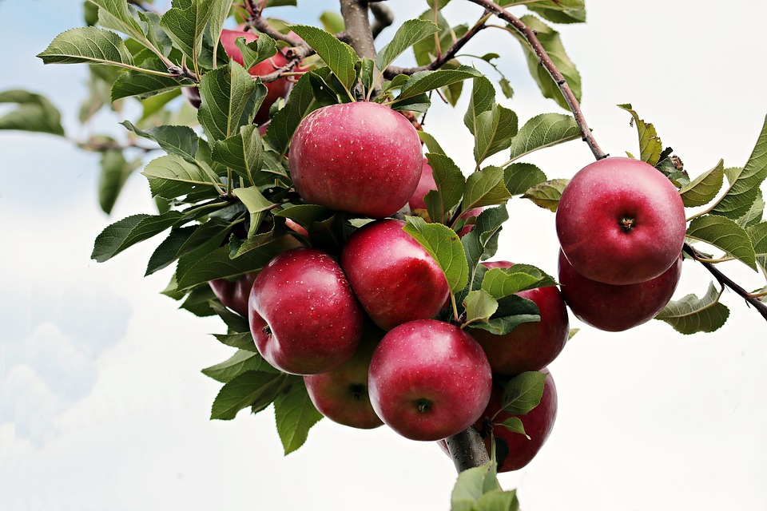
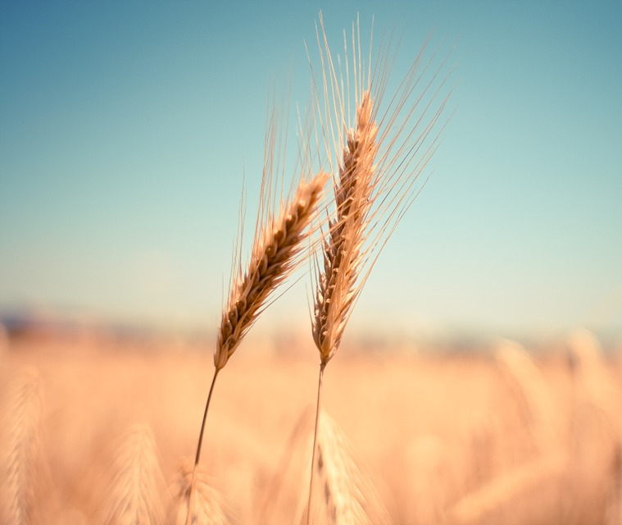
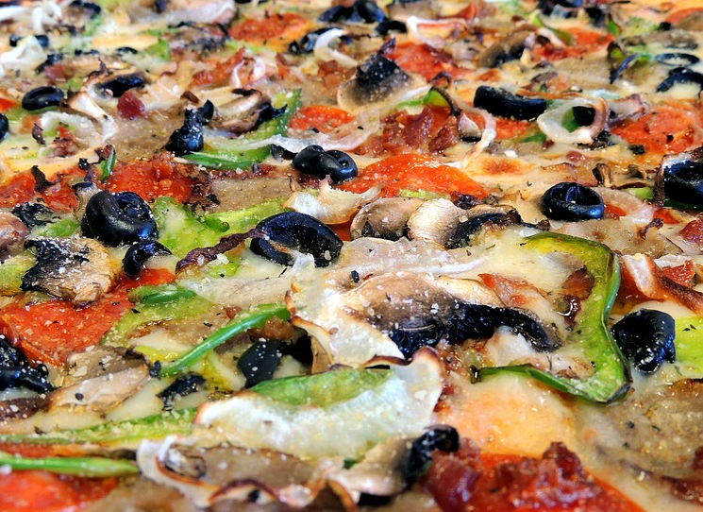
Plants feed the world.
87 of the world’s leading food crops depend upon animal pollination.
Attribution not necessary eg https://pixabay.com/photos/apple-red-red-apple-apple-orchard-2788599/

Slide 16
Design a great pizza choose from these ingredients: wheat flour base, tomato sauce, olives, mushrooms, cheese, peppers, aubergine, onion, salt, oregano.

Slide 17
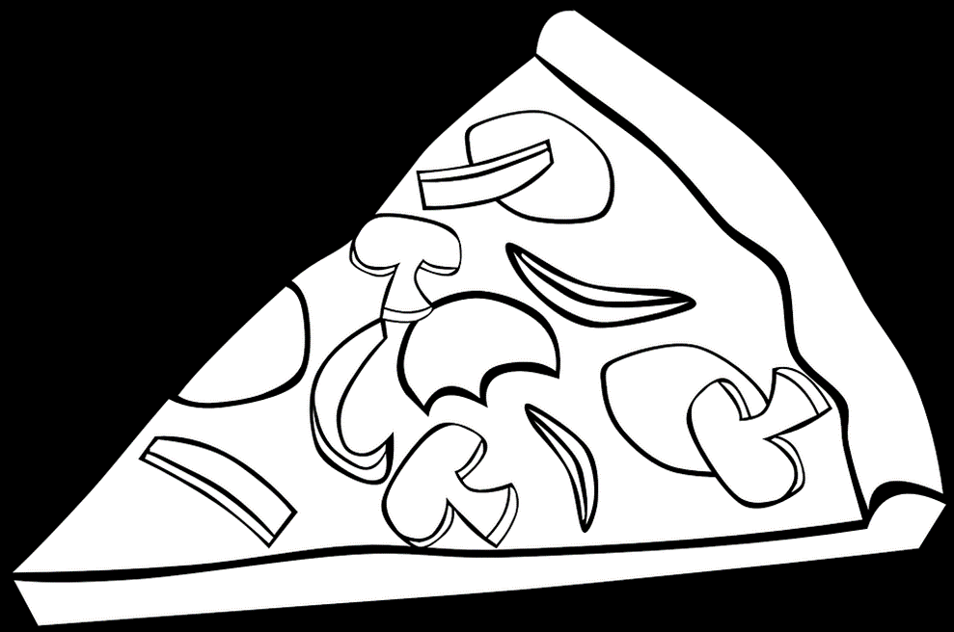
What would your pizza be like if there were no insect pollinators?

Slide 18
Label the parts of your pizza which depend on bees and other insects.

Slide 19
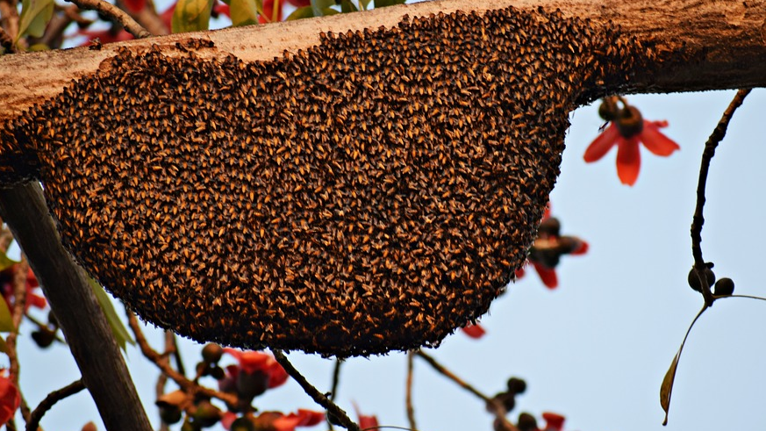
Does this matter?
2007
Since 2007 about 30% of honey bee colonies across much of North America have died each winter.
No attribution necessary https://pixabay.com/photos/honeybees-beehive-bee-beekeeping-4013742/
https://doi.org/10.1016/j.cois.2015.04.004

Slide 20
5,4,3,2,1
5
4
3
2
1
Name 5 food plants which depend on bees and other insects.
Name 4 parts of a flower.
Name 3 ways plants can be pollinated.
Name 2 two types of insect pollinators.
Name 1 male sex cell in plants.

Slide 22
World Class Teaching project has been funded with support from the European Commission. The contents of these actions are the sole responsibility of the contractor and can in no way be taken to reflect the views of the European Union.

