Slide 1
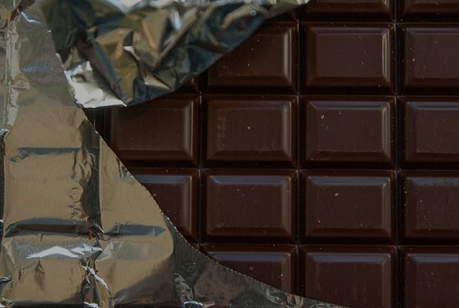
Pie Charts:
Fairtrade
Chocolate
Notes:
Image: https://cdn.pixabay.com/photo/2016/04/06/19/05/chocolate-1312524_960_720.jpg

Slide 4
?
On average each person in the UK spends …...
£98.80
...a year on chocolate!
?
Write your guess on your whiteboard!
Notes:
According to https://pressreleases.responsesource.com/news/92627/brits-spend-more-a-month-on-chocolate-than-they-would/ Brits on average spend £98.80 a year on chocolate ( in 2017)

Slide 5
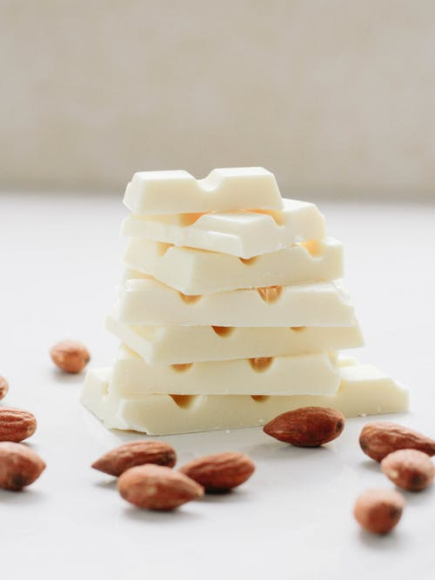
Exercise:
Can you figure out what the chocolate bars are by looking at pie charts of their ingredients?
Flake - Bounty - Milky Way - Rolo - Twix - Dairy Milk Fruit and Nut - Mars - Picnic - KitKat - Daim - Boost - Double Decker - Toffee Crisp
Need a hint? Click the box to see all of the answers in a random order
Notes:
Information from sainsburys.co.uk
Image: https://images.pexels.com/photos/1854664/pexels-photo-1854664.jpeg?auto=compress&cs=tinysrgb&dpr=1&w=500

Slide 6
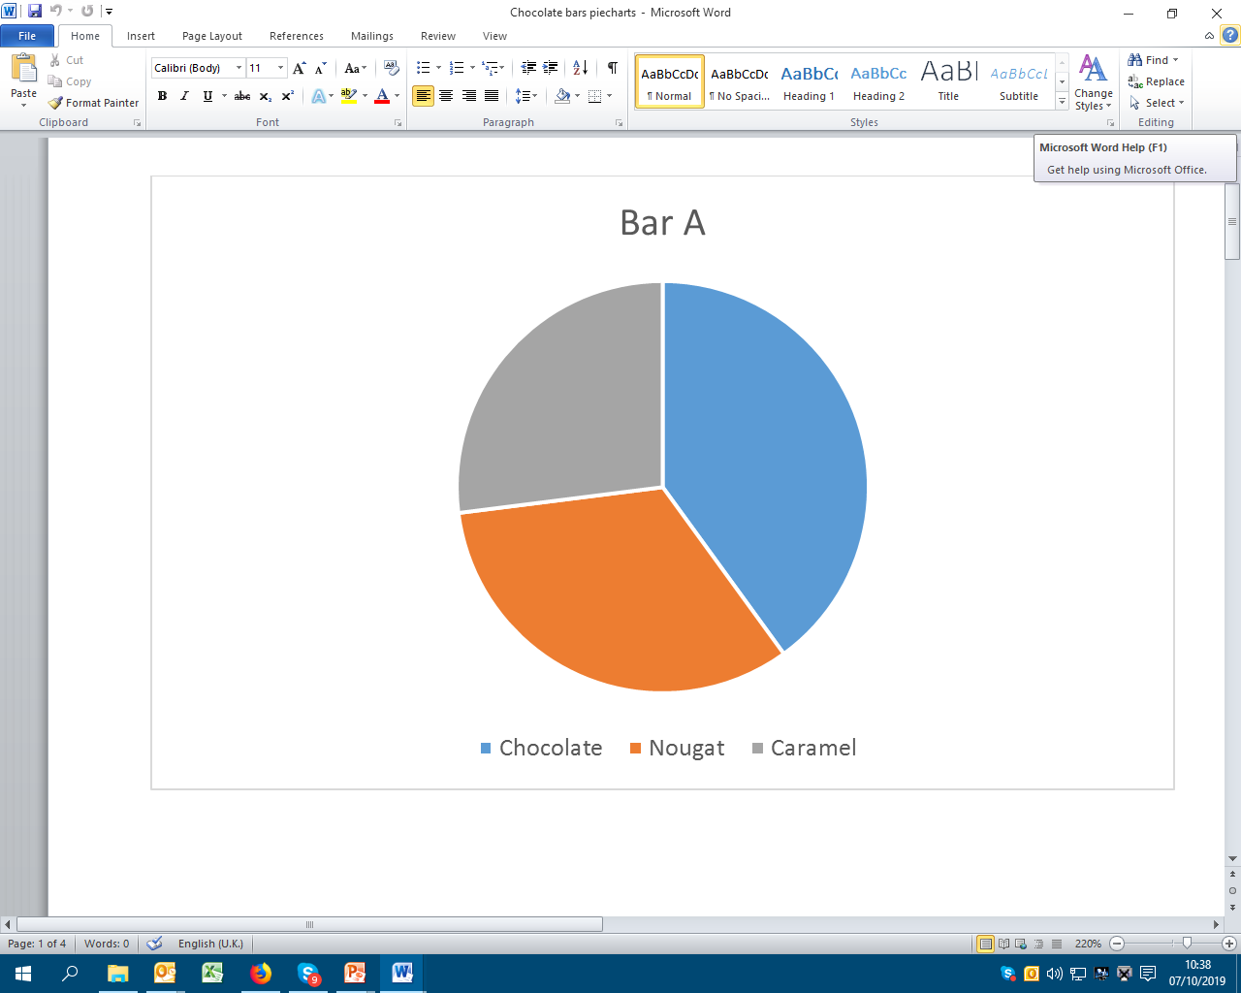
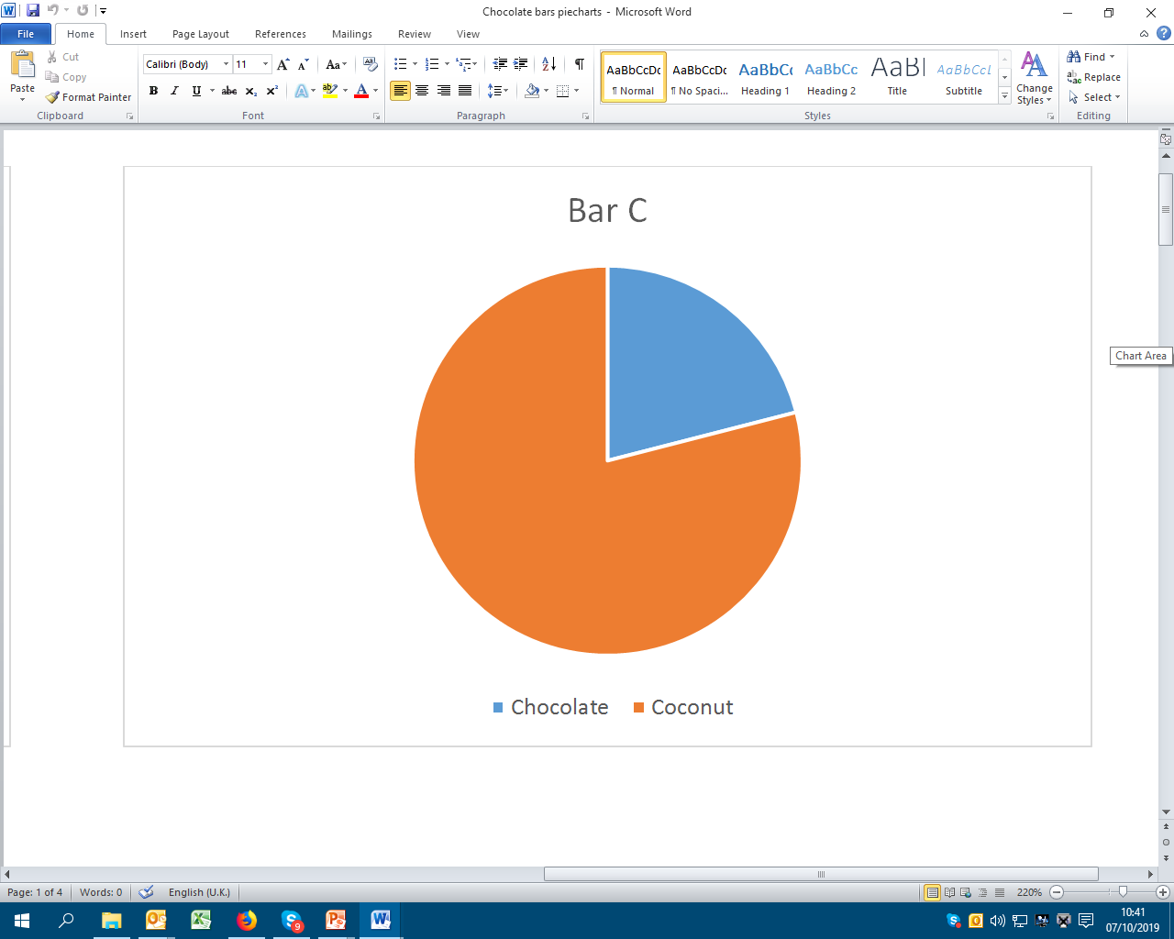
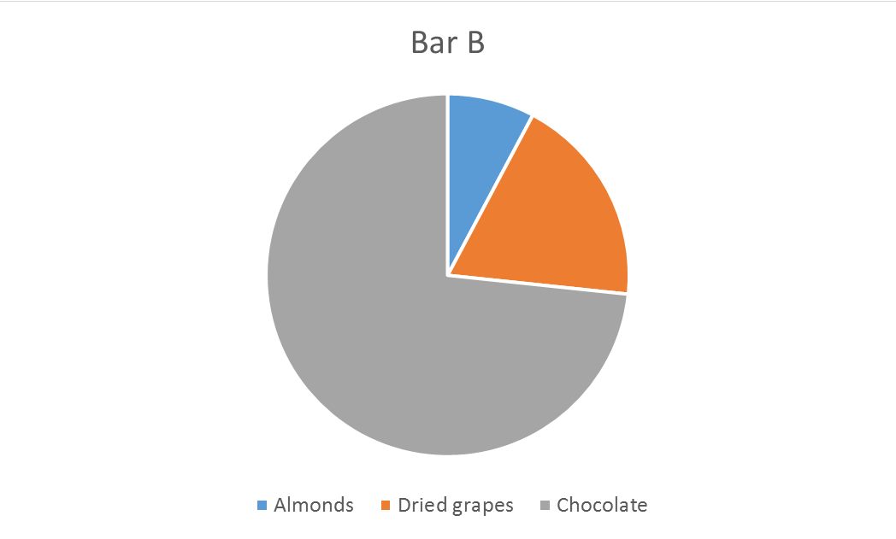
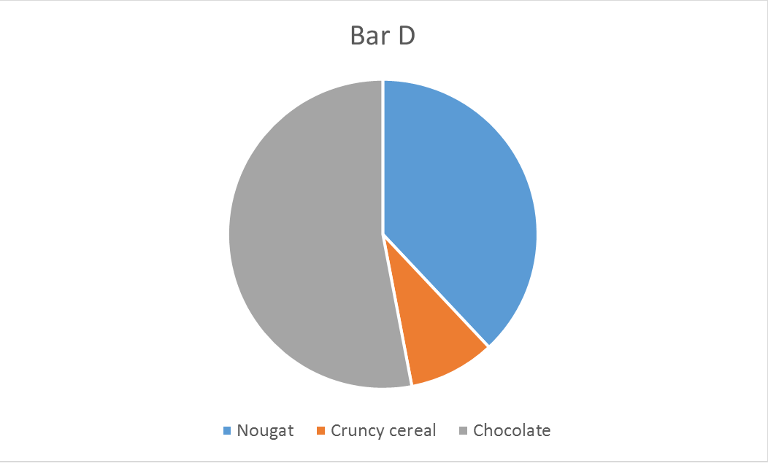

Slide 7
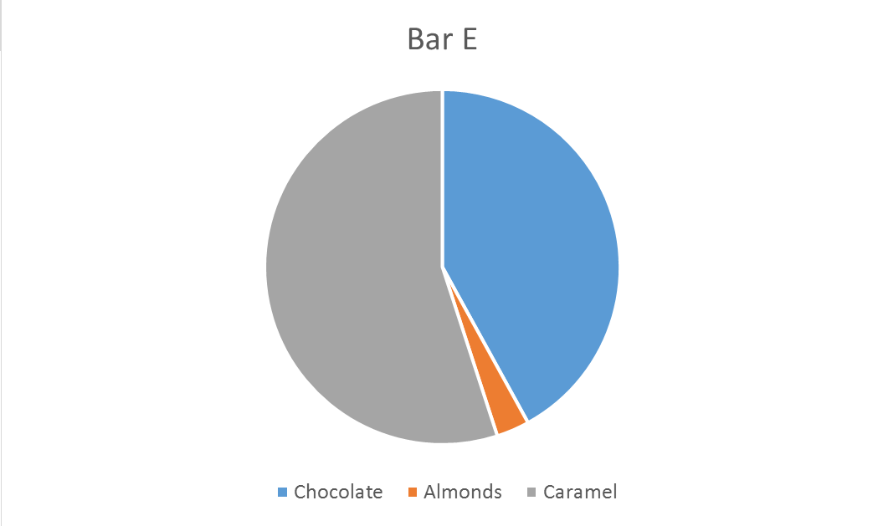
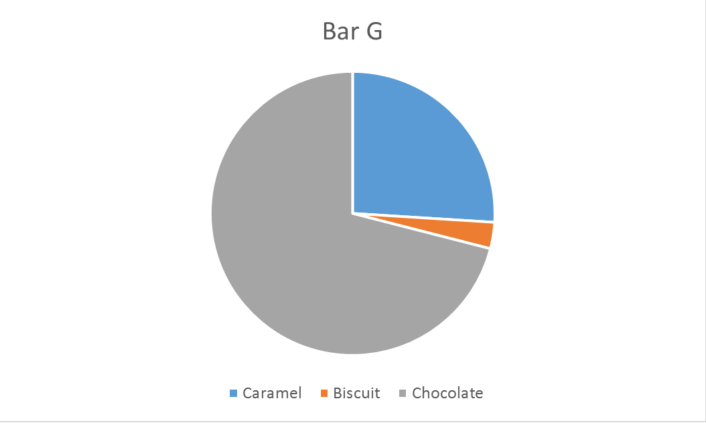
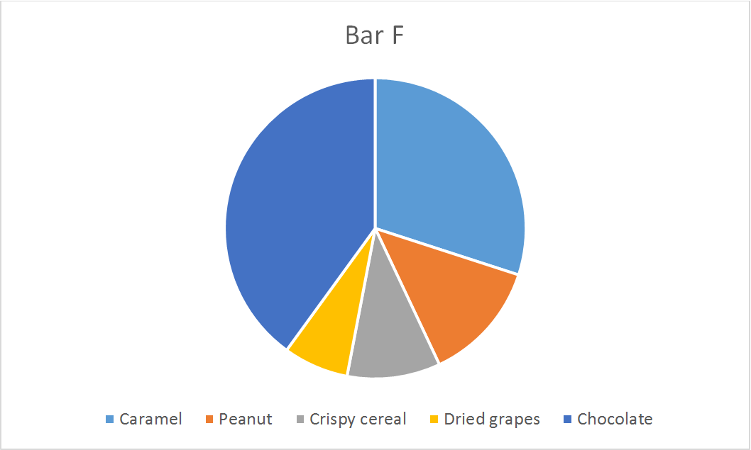
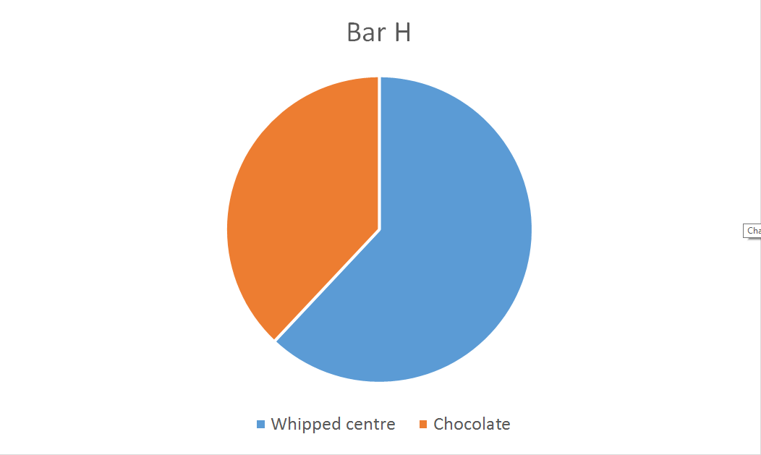

Slide 8
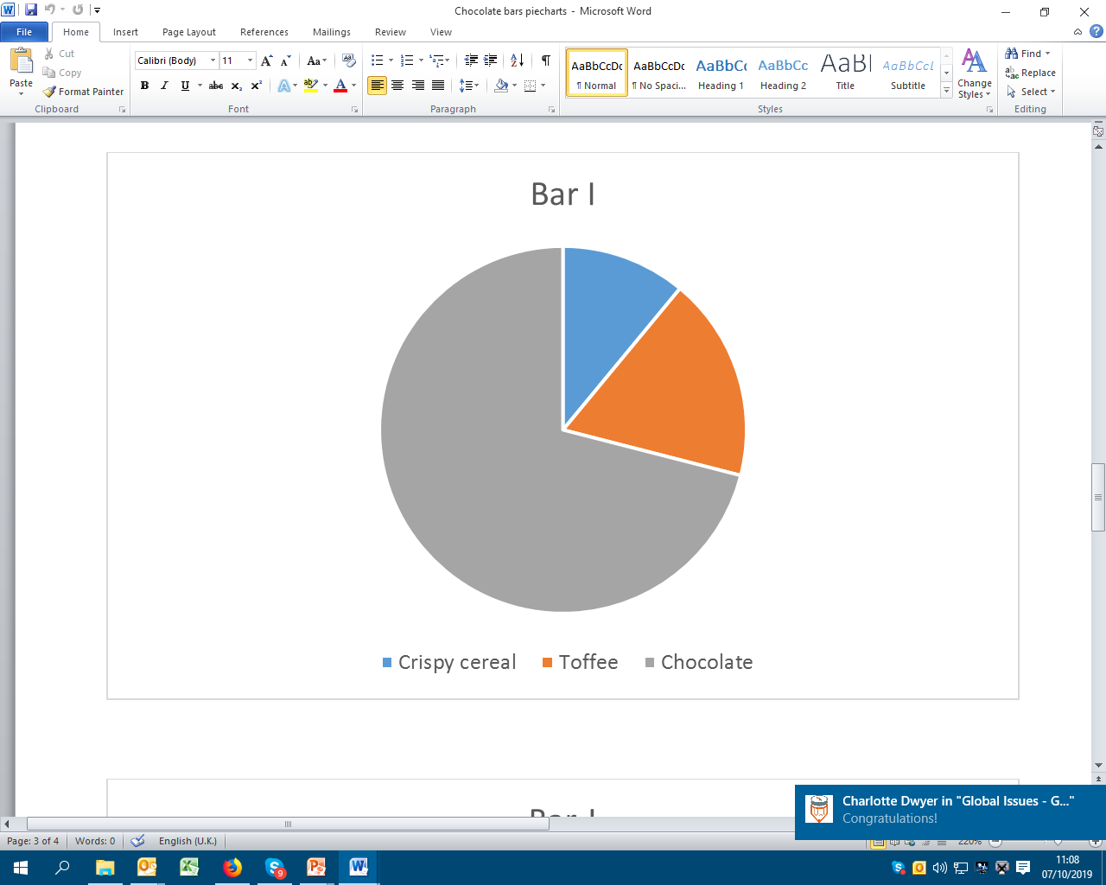
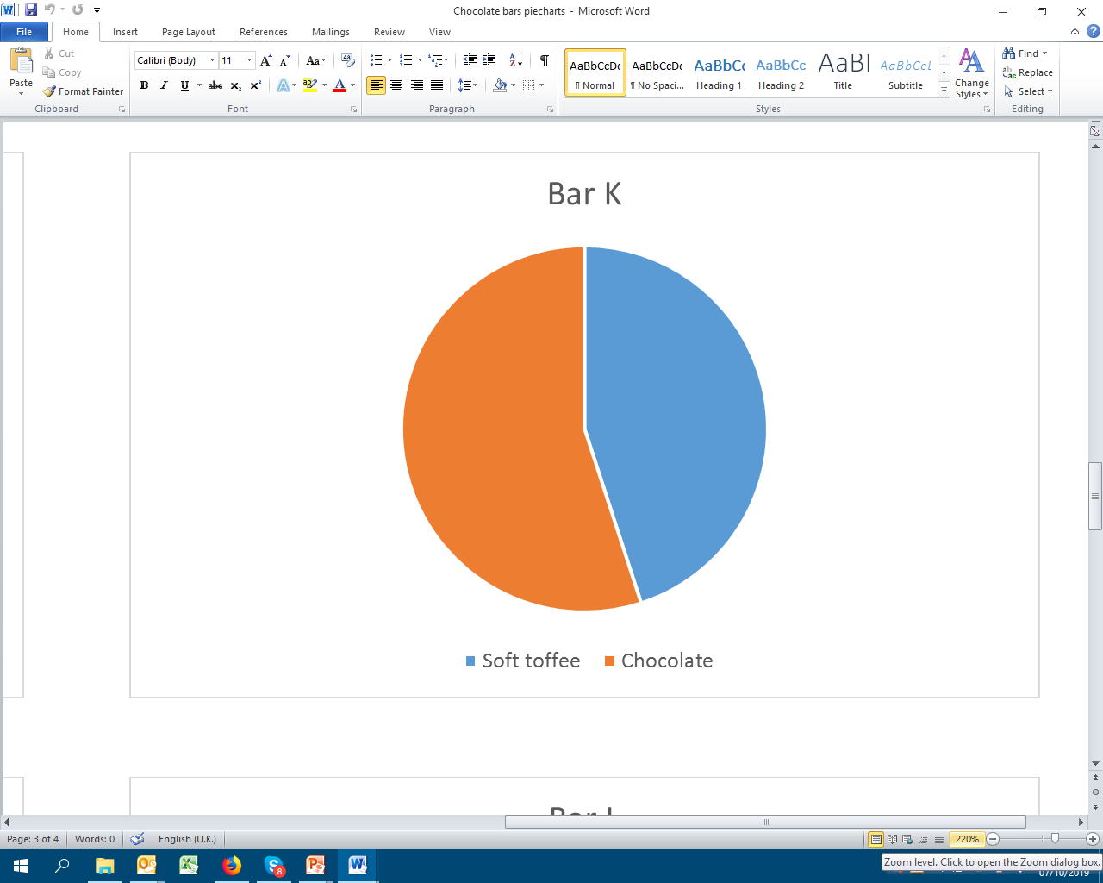
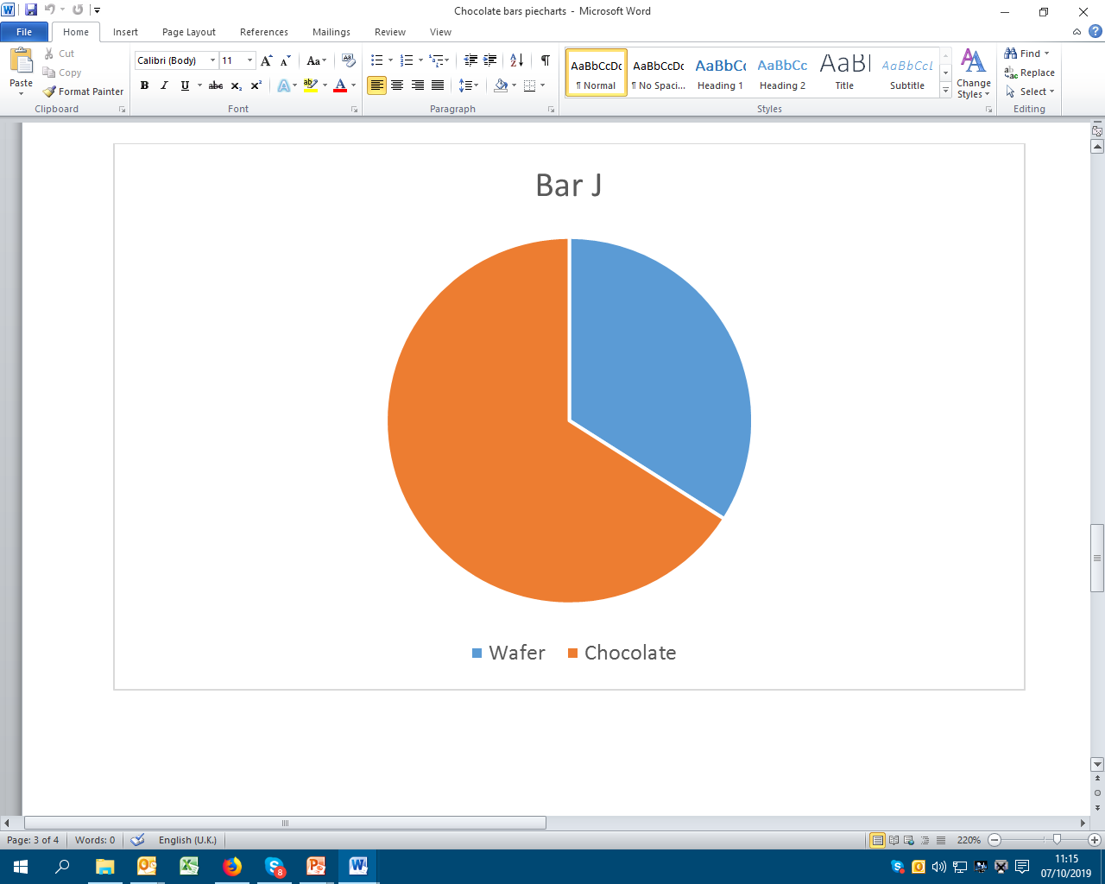
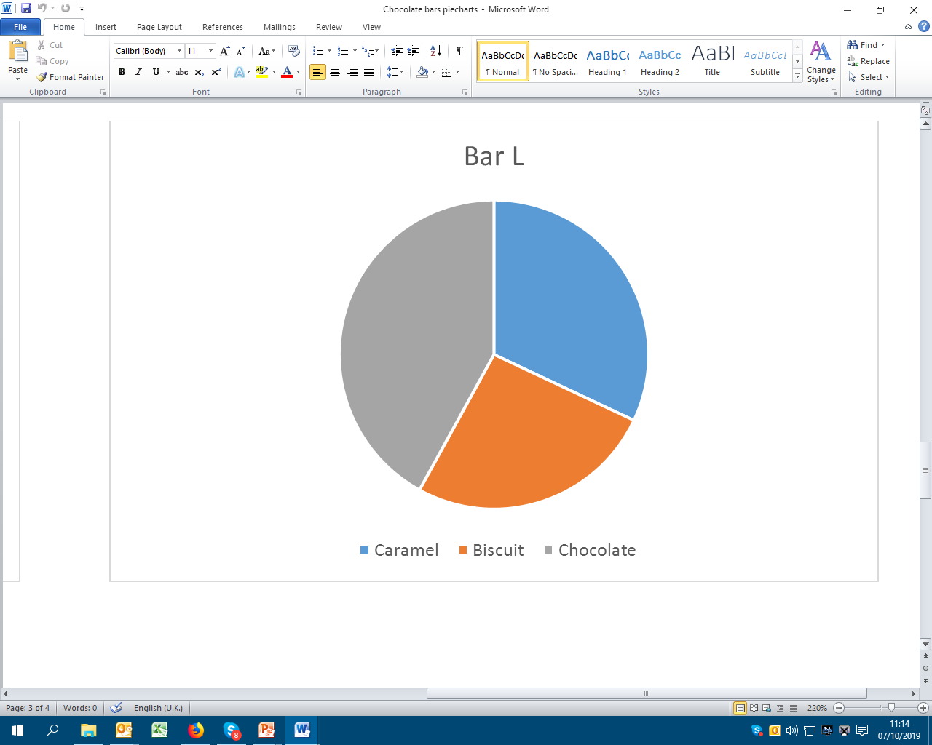

Slide 9
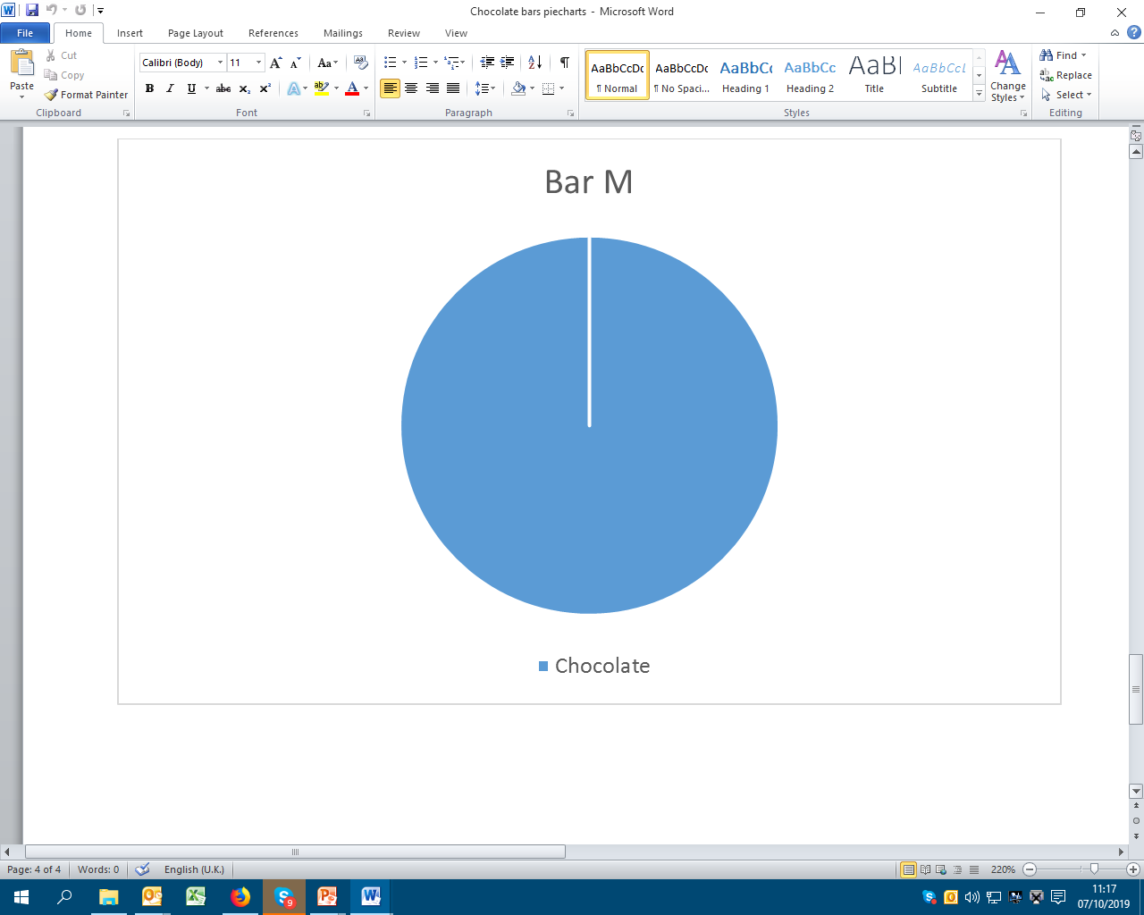

Slide 10
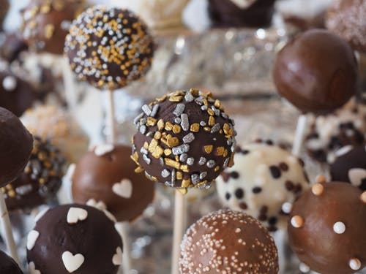
A: Mars
B: Dairy Milk Fruit and Nut
C: Bounty
D: Double Decker
E: Daim
F: Picnic
G: Boost
H: Milky Way
I: Toffee Crisp
J: KitKat
K: Rolo
L: Twix
M: Flake
Answers
Notes:
Image: https://images.pexels.com/photos/33715

Slide 11
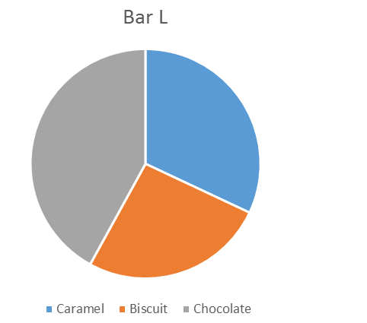
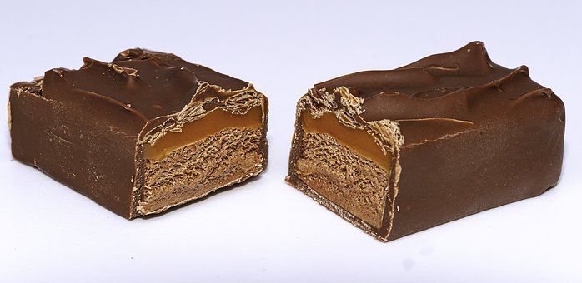
How can you tell which pie chart went
with which chocolate bar?
Mars
Twix
Write a sentence in your book to explain.
Notes:
Images: https://cdn.pixabay.com/photo/2017/04/04/17/06/chocolate-2202144__340.jpg
https://cdn.pixabay.com/photo/2017/11/03/01/02/candy-bar-2913055__340.jpg

Slide 12
Drawing a pie chart - example
%
Angle
11
18
71
Cereal
Toffee
Chocolate
How do you work out how to draw the angles?
100% 360º
1% 3.6º
^{Angle = Percentage x 3.6}
^{Or}
^{Angle = Amount x 360}
^{Total}

Slide 13
Drawing a pie chart - example
How did you work it out?
11 x 3.6 =
Or
11 x 360 =
100
%
Angle
11
18
71
Cereal
Toffee
Chocolate
39.6º
64.8º
255.6º

Slide 14
Draw your own pie chart for one of the chocolate bars shown here:
Dairy Milk Caramel
Dairy Milk Oreo
Dairy Milk Medley
Chocolate 31.5g
Caramel 13.5g
Chocolate 60g
Biscuit 14.4g
Vanilla filling 45.6g
Chocolate 365.5g
Choc creme 391g
Biscuit 38.25g
Choc chips 38.25g
Fudge 17g
See below for the ingredients in percentages, for an easier task:
Dairy Milk Caramel
Dairy Milk Oreo
Dairy Milk Medley
Chocolate 70%
Caramel 30%
Chocolate 50%
Biscuit 12%
Vanilla filling 38%
Chocolate 43%
Choc creme 46%
Biscuit 4.5%
Choc chips 4.5%
Fudge 2%

Slide 15
Dairy Milk Caramel
Chocolate 70% 252º
Caramel 30% 108º
Dairy Milk Oreo
Chocolate 50% 180º
Biscuit 12% 43º
Vanilla filling 38% 137º
Dairy Milk Medley
Chocolate 43% 155º
Choc creme 46% 166º
Biscuit 4.5% 16º
Choc chips 4.5% 16º
Fudge 2% 7º

Slide 16
Market shares of GLOBAL chocolate sales since 2012
Mars 19%
Mondelex 17.6%
Nestle 14.6%
Hersheys 7%
Ferrero 6%
Lindt 3.5%
Storck 2.6%
Other
Why is there an "other" category?
How can you calculate the "other" percentage?
Which companies have you heard of?
What products does each company make?
Mars makes a lot of different products, not just Mars bars (M&Ms, Bounty, Maltesers, Wrigley's gum, Snickers.....)
Mondelex is the company that owns Cadbury, Toblerone and Oreos.
100% 360º
1% ?º
Draw a pie chart to show the market share
of global chocolate sales
Notes:
Information from makechocolatefair.org

Slide 17
Task A:
Draw a pie chart to show how many people in your class have eaten chocolate so far today.
Task B: Find as many things wrong with this pie chart answer as you can
%
degrees
5
90
Pie chart to show the number of people who like chocolate
Don't like
Like
5
90
Task C: This pie chart shows people's favourite type of chocolate. I surveyed 540 people. How many people like each type?
White
Don't like any
60º
Dark
Be ready to explain how you worked out your answers!
Milk
Notes:
Note to teachers: This is designed as a feedback task between lessons 1 and 2. This slide gives three different tasks for students to complete which are aimed to suit responsive marking policies - students can be given one of the three to work on: Task A is intended to give further practice; Task B is intended to develop critical evaluation skills; Task C is intended to extend learning and develop reasoning skills.

Slide 18
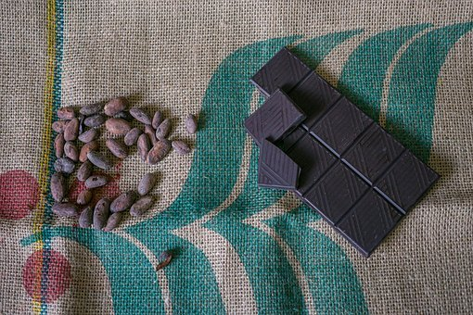
Where does the chocolate we eat come from?
And when you buy a chocolate bar, where does the money
go?
Notes:
Image: https://cdn.pixabay.com/photo/2017/07/05/19/39/chocolate-2475759__340.jpg

Slide 19
Who is involved in producing and bringing you your chocolate bar?
List all the people you can think of who are involved in producing your chocolate bar and getting it to you.

Slide 20
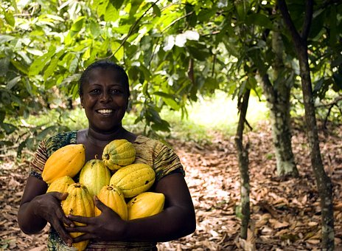
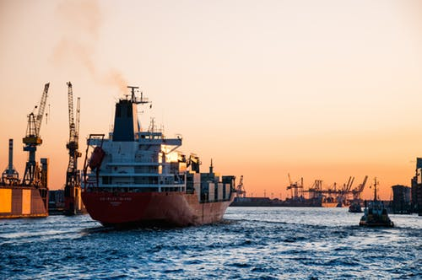
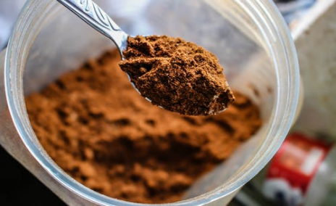
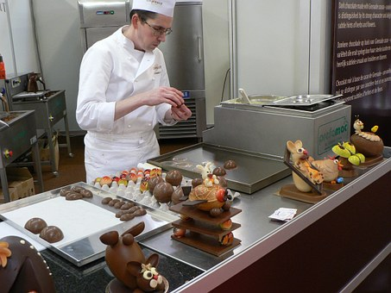
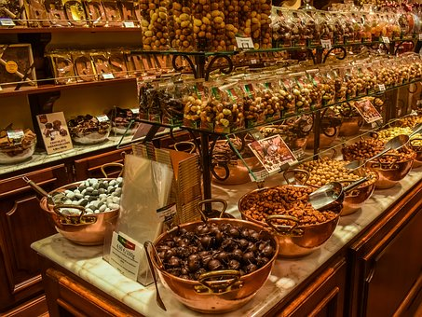
The chocolate production process – from bean to bar
Cocoa farmer
Transporter
Processor
Manufacturer
Retailer
You!!!
Notes:
Images:
Farmer - https://cdn.pixabay.com/photo/2018/03/21/17/08/fruit-3247447_1280.jpg
Transporter - https://images.pexels.com/photos/799091/pexels-photo-799091.jpeg?auto=compress&cs=tinysrgb&dpr=1&w=500
Processor - https://images.pexels.com/photos/1212845/pexels-photo-1212845.jpeg?auto=compress&amp%3Bcs=tinysrgb&amp%3Bfit=crop&amp%3Bh=1200&amp%3Bw=800
Manufacturer - https://cdn.pixabay.com/photo/2014/12/13/03/19/chocolatier-566199_1280.jpg
Retailer - https://cdn.pixabay.com/photo/2018/08/07/20/07/chocolaterie-3590622_1280.jpg

Slide 21
When you pay money for the chocolate, where does that money go?
Who gets a share of the money that you pay for your chocolate?

Slide 22
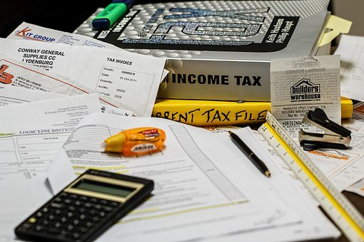
Where does your money go when you buy a chocolate bar?
Cocoa farmer
Transporter
Processor
Manufacturer
Retailer
Government
taxes
Your cash

Slide 23
Draw a pie chart to show what proportion of the money you pay for a chocolate bar
you think each group gets.
Role in the ‘cocoa chain’
Percentage of the cost of the chocolate bar
Retailer
Processors & grinders
Manufacturer
Taxes & marketing board
Transportation & traders
Cocoa farmers
?
This is just a guess. Don't worry about it being wrong, just have a go!

Slide 24
Who do you think gets the money?
Role in the ‘cocoa chain’
Percentage of the cost of the chocolate bar
Pie chart
angle
Retailer
Processor
Manufacturer
Taxes
Transporter
Cocoa farmer

Slide 25
What did your pie chart look like?
Retailer
Processor
Manufacturer
Taxes
Transporter
Cocoa farmer

Slide 26
How much money do you think each player in the cocoa chain should get?
In your group, take one of the six roles in the production of a chocolate bar.
Decide what your percentage share of the money should be and write a short paragraph to argue why.
Do you work the hardest? Do you provide something no one else can?
Review your ideas and see if you can make a more persuasive argument before you feed back to the class.
Retailer
Processor
Manufacturer
Taxes
Transporter
Cocoa farmer
Notes:
Note for teachers: Split the class into 6 groups and assign one role per group.

Slide 27
Negotiate until you are happy that the split of the money is fair for everyone
Role in the ‘cocoa chain’
Fair percentage of the cost of the chocolate bar
Retailer
Processor
Manufacturer
Taxes
Transporter
Cocoa farmer
Notes:
Note for teachers: If you can reach a class consensus, great. If not, it’s fine because each student will complete their own pie chart based on what they themselves think a fair split of the money is.

Slide 28
Now draw a second pie chart to show
what YOU think a fair split of the money
from a chocolate bar is.
Role in the ‘cocoa chain’
Fair percentage of the cost of the chocolate bar
Pie chart angle
Retailer
Processor
Manufacturer
Taxes
Transporter
Cocoa farmer
This is what YOU think a fair split is. There is no right or wrong answer!

Slide 29
Do you want to know the actual percentage each group gets?
Retailer
Processors
Manufacturer
Taxes
Transporter
Cocoa farmer
44%
7%
35%
6%
2%
6%
Now draw a third pie chart showing this information.
Compare your three pie charts. What do they show you?
Is the truth similar to what you thought? Did anything surprise you?
Notes:
info from makechocolatefair.org (These are approximations and vary over time and in different countries / countries / types of chocolate etc.)

Slide 30
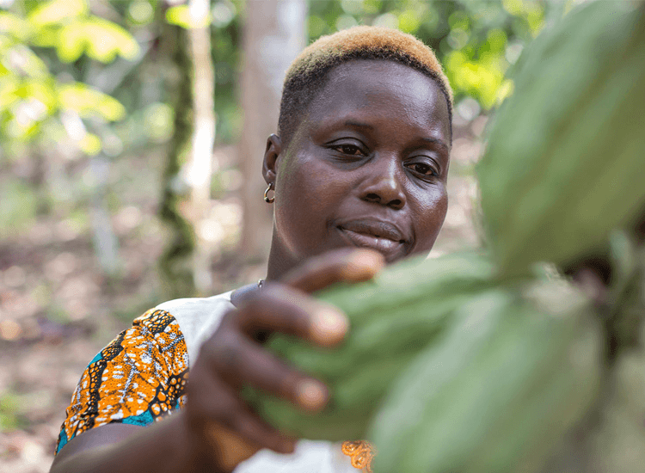
Compare your 3 pie charts. Do you think the actual split of the money is fair?
What does this mean in real life for cocoa farmers?
How much do you think a cocoa farmer in Ghana earns on average
per year?
Write your guess on your whiteboard.
£325
Notes:
Photo of cocoa farmer Rosine Bekoin courtesy of Fairtrade Foundation https://www.fairtrade.org.uk/Farmers-and-Workers/Cocoa/Rosine-Bekoin

Slide 31
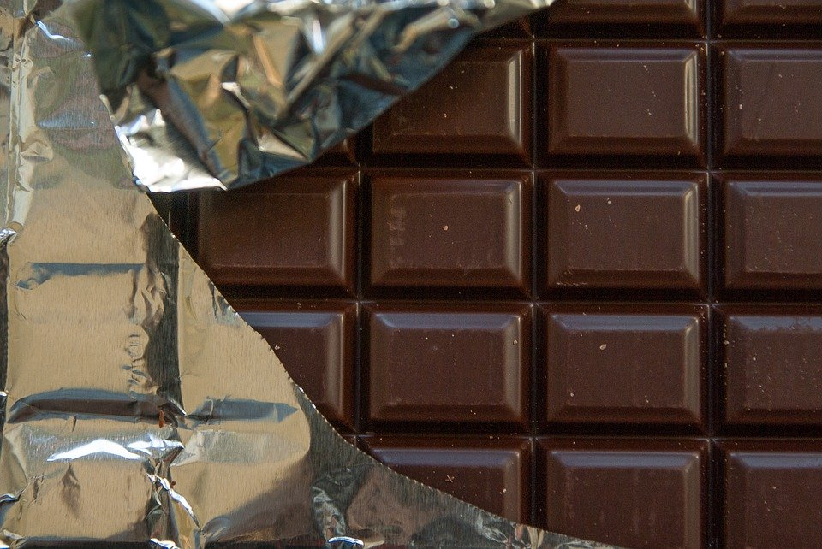
A cocoa farmer in Ghana earns on average £325 per year.
What does the cocoa farmer need to buy with that money?
Can you
remember how much the average person in the UK spends just on chocolate per year?
£98.80

Slide 32
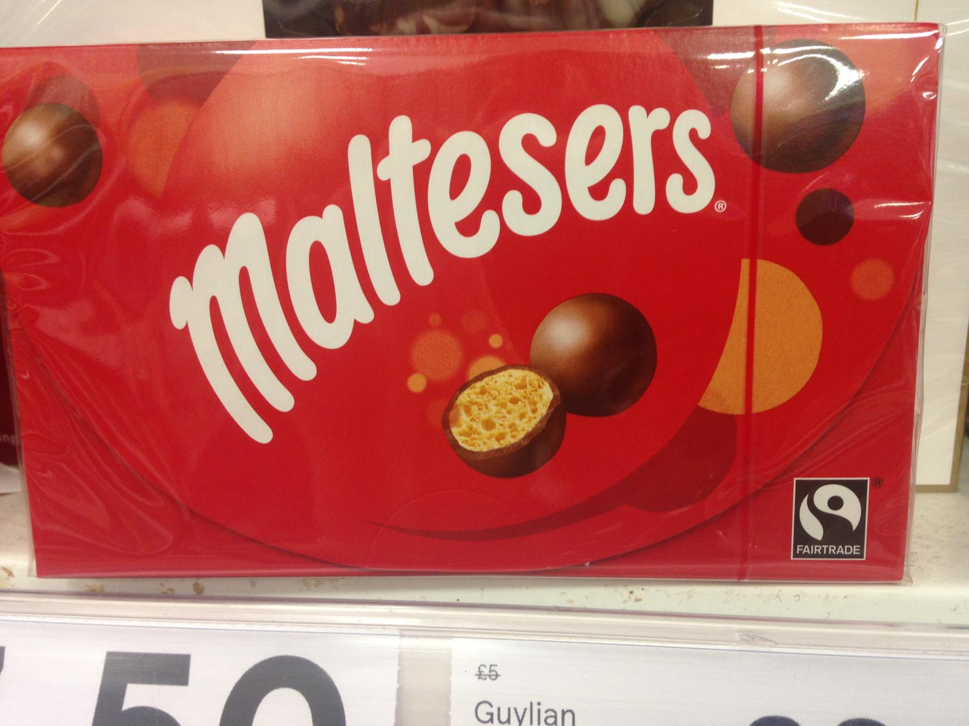
Have you seen chocolate with the Fairtrade Mark in
the shops?
Can chocolate eaters really make a difference to the lives of cocoa farmers?
If you buy chocolate with the Fairtrade Mark, it means the farmer has got paid a fair price for their produce.
Notes:
Image: courtesy of Hannah Langdana

Slide 33
Consumer Power
Imagine you are opening a chocolate shop with space for 30 bars to display, how many white chocolate, milk chocolate or dark chocolate bars would you display?
Draw a pie chart to show this.

Slide 34
Consumer Power
Imagine you are opening a chocolate shop with space for 30 bars to display, how many white chocolate, milk chocolate or dark chocolate bars would you display?
Before you start stocking your shop, you need to conduct some market research - ask people for their opinions so you can make sure that your shop actually sells what consumers want.

Slide 35
Consumer research: ask the class which type of
chocolate they would choose to buy.
votes
Milk
Dark
White
Now draw another pie chart to show what you would
sell based on your consumer research.

Slide 36
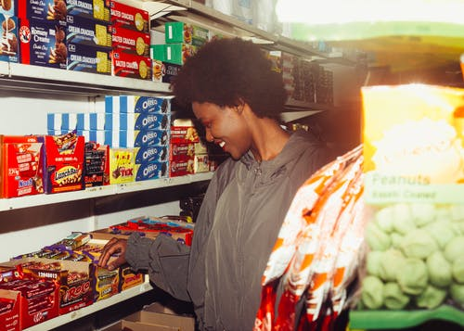
What do your two pie
charts show you about the
power of consumers?
Did the consumer research information change your decision about what you would sell in your shop?
Why do you think retailers conduct consumer surveys?
What difference can consumers make?
Who puts the
money into the chocolate industry?
Who controls where that money goes?
What can we do about it if we don't like where the money goes?
Notes:
Image: https://images.pexels.com/photos/4177835/pexels-photo-4177835.jpeg?auto=compress&cs=tinysrgb&dpr=1&w=500

Slide 37
Task
Research Fairtrade so that you can explain what it is, how it works and how people benefit from it.
Produce a poster about the chocolate industry / Fairtrade. Your poster should be as informative as possible, your sources should be given and you should include as many graphs as you can (bonus marks for making pie charts!)

Slide 39
World Class Teaching project has been funded with support from the European Commission. The contents of these actions are the sole responsibility of the contractor and can in no way be taken to reflect the views of the European Union.

