Slide 1
Human Rights
Notes:
Photo: https://images.pexels.com/photos/1645634/pexels-photo-1645634.jpeg?auto=compress&cs=tinysrgb&fit=crop&h=627&w=1200

Slide 4
Human Rights - What do you know already?
Brainstorm in small groups
Top tip - think about the key words:
Universal
Declaration
Human
Rights
Notes:
In books or on paper, students brainstorm anything they know about Human Rights. If their knowledge is lacking they should try and define the key words.

Slide 5
What do you know already?
Brainstorm in small groups.
Top tip - think about the key words:
Universal
Declaration
Human
Rights

Slide 6
Universal
Human Rights are universal. This means they should be visible and apply to every single country in the world.
Notes:
Photo: https://images.pexels.com/photos/346885/pexels-photo-346885.jpeg?auto=compress&amp%3Bcs=tinysrgb&amp%3Bfit=crop&amp%3Bh=1200&amp%3Bw=800

Slide 7
Declaration
A formal or explicit statement or announcement. When the UDHR was created, global leaders made a statement that they would work towards its shared goals.
Notes:
Photo: https://images.pexels.com/photos/164829/pexels-photo-164829.jpeg?auto=compress&amp%3Bcs=tinysrgb&amp%3Bfit=crop&amp%3Bh=627&amp%3Bw=1200

Slide 8
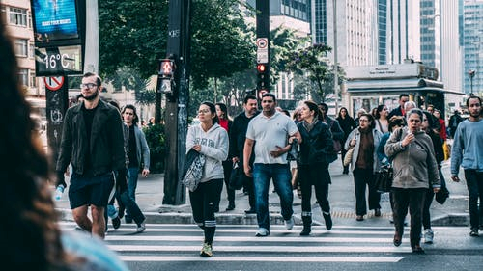
Human
Human Rights apply to every single person on the planet, simply because they are human. This is regardless of age, gender, sexual orientation, ethinicity, nationality, disability or any other status. They are ours just by virtue of our being human.
Notes:
Photo: https://images.pexels.com/photos/109919/pexels-photo-109919.jpeg?auto=compress&cs=tinysrgb&fit=crop&h=627&w=1200

Slide 9
Rights
Things that all humans should legally or morally have. Things they should expect so that they can lead healthy, safe and happy lives e.g. right to an education
Notes:
Photo: https://images.pexels.com/photos/1720186/pexels-photo-1720186.jpeg?auto=compress&amp%3Bcs=tinysrgb&amp%3Bdpr=3&amp%3Bh=750&amp%3Bw=1260

Slide 10
Universal Declaration of Human Rights (UDHR)
An explicit global statement, that all humans, from every country in the world should be able to live a healthy, safe and happy life.
Click the photo to watch a video. How does it develop your understanding of Human Rights?
Notes:
Hyperlink to 10 min video. Key message is about the fact that Human Rights are long fought and not yet universal, students will need to consider WHY they are not yet universal. https://youtu.be/6XXGF_V8_7M

Slide 11
Why is the
UDHR not yet
fully
successful?
Discuss with the
person next
to you (3 mins)
Think about
It (2 mins)
Consider the key question. First independently, then with a partner. Be ready to feedback.
Notes:
Think, pair, share

Slide 12
Discuss with the
person next
to you (3 mins)
Why is the
UDHR not yet
fully
successful?
Think about
It (2 mins)
Notes:
Think, pair, share

Slide 13
Inconsistencies of the UDHR
When the UDHR was created it was a declaration, not a legal obligation.
Therefore, its success is dependent on individual governments and global partnerships.
Notes:
Link this back to the video, you may wish to play the last 3 mins again.

Slide 14
Use this link to recap on the Universal Declaration of Human Rights.
Can you remember any from the video clip?
https://www.youthforhumanrights.org/what-are-human-rights/universal-declaration-of-human-rights/articles-1-15.html
Notes:
Picture: https://pixabay.com/static/uploads/photo/2015/01/12/10/08/right-597133_640.jpg

Slide 15
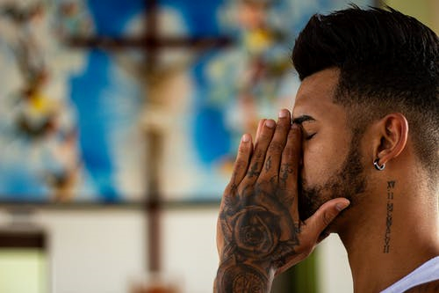
Articles
Can you guess the Human Rights?
Notes:
Students use the picture prompts to try and guess the Human Rights.
Photos: https://images.pexels.com/photos/935869/pexels-photo-935869.jpeg?cs=srgb&amp%3Bdl=aerial-aerial-view-care-935869.jpg&amp%3Bfm=jpg
https://images.pexels.com/photos/159823/kids-girl-pencil-drawing-159823.jpeg?auto=compress&cs=tinysrgb&dpr=1&w=500
https://images.pexels.com/photos/1266015/pexels-photo-1266015.jpeg?cs=srgb&dl=hands-people-men-1266015.jpg&fm=jpg
https://images.pexels.com/photos/1309052/pexels-photo-1309052.jpeg?auto=compress&amp%3Bcs=tinysrgb&amp%3Bfit=crop&amp%3Bh=627&amp%3Bw=1200
https://cdn.pixabay.com/photo/2017/07/10/23/49/club-2492011_960_720.jpg
https://images.pexels.com/photos/432604/pexels-photo-432604.jpeg?auto=compress&cs=tinysrgb&h=650&w=940

Slide 16
Articles
Healthcare
Education
Thought & expression
Religion
Fair & just law
Free from slavery
Look at these UDHR articles. Are they successful? Where are the inconsistencies?
Notes:
Students use their own knowledge to discuss how successful these are e.g. does everyone have access to healthcare? Encourage students to think about what they have seen on the news.

Slide 17
UK success? How successful is each article? Draw a line to the place on the arrow that you feel is most justified. Try to use real life examples when justifying your choice.
Notes:
A3 printed. One per group. Students draw a line to rank each right (UK) they can make notes on the paper if they wish or each group could present their ideas.

Slide 18
UK success? How successful is each article? Draw a line to the place on the arrow that you feel is most justified. Try to use real life examples when justifying your choice.
Notes:
A3 printed. One per group. Students draw a line to rank each right (UK) they can make notes on the paper if they wish or each group could present their ideas.

Slide 19
https://www.amnesty.org/en/countries/asia-and-the-pacific/afghanistan/report-afghanistan/
https://www.amnesty.org/en/countries/africa/botswana/report-botswana/
https://www.amnesty.org/en/countries/asia-and-the-pacific/china/report-china/
https://www.amnesty.org/en/countries/africa/eritrea/report-eritrea/
https://www.amnesty.org/en/countries/africa/sierra-leone/report-sierra-leone/
https://www.amnesty.org/en/countries/europe-and-central-asia/united-kingdom/
Global success?
You will now work in 6 groups. Each group will look at a different report, creating a brainstorm highlighting how successful/unsuccessful the UDHR has been in that particular country. You will then feedback to the rest of the class.
Notes:
Hyperlinked to printable mini reports. Each group looks at a different country and summarises what is happening. If they can, they should link back to the articles that have been introduced so far.

Slide 20
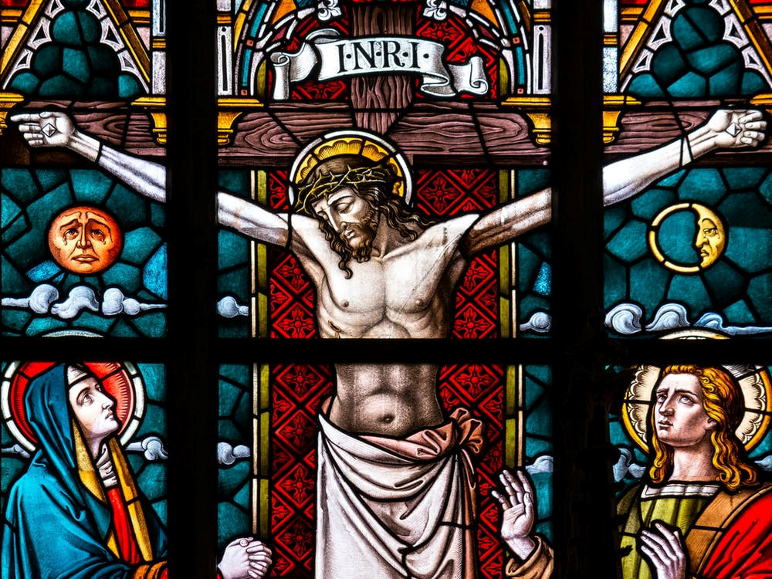
Christian perspective – Human Rights
Christians believe that all humans are made in the image of God and therefore should have equal opportunities and the same rights. They also believe that all life is special as it belongs to God so the ‘right to life’ is a fundamental Christian belief. Freedom of thought and expression is also very important so that Christians can share their beliefs with others and meet to worship.
A teaching to support this would be Genesis:
“God made man in His own image, and breathed the breath of life into him”.
Notes:
Photo: https://images.pexels.com/photos/208216/pexels-photo-208216.jpeg?auto=compress&cs=tinysrgb&fit=crop&h=627&w=1200

Slide 21
Christian perspective – Human Rights (challenges)
Some Christians believe that homosexuality is a sin and therefore might struggle with the right to family (civil partnerships/gay marriage).
People who hold this belief might cite Bible references such as Leviticus:
“If a man lies with a male as with a woman, both of them have committed an abomination; they shall surely be put to death; their blood is upon them.”
Notes:
Photo: https://images.pexels.com/photos/208216/pexels-photo-208216.jpeg?auto=compress&cs=tinysrgb&fit=crop&h=627&w=1200

Slide 22
Muslim perspective – Human Rights
Muslims believe that human beings have a
right to dignity and equality. This is stated in the Qur’an, because Muslims believe all people are created equal by Allah and that all life is precious gift. A strong sense of social justice is important for creating a more equal society and Islam promotes equality and personal religious freedom.
Muslims might be inspired by verses from the Qur’an such as 5:32:
“We decreed upon the Children of Israel that whoever kills a soul – it is as if he had slain mankind entirely. And whoever saves one –
it is as if he had saved mankind entirely.”
Notes:
Photo: https://pixabay.com/photos/persian-art-tradiotional-islamic-809945/

Slide 23
Muslim perspective – Human Rights
(challenges)
Some Muslims might have problems following the
UDHR in all instances because of Shari’ah Law.
Shari’ah law is the Islamic religious law that should be
held in addition to other laws, but where they contradict, Shari’ah Law should be followed.
This might mean that Muslims would struggle with the right to family, as homosexuality is a sin in Islam, and is condemned in the Qur’an: “Indeed, you approach men with desire, instead of women. Rather, you are a transgressing (rule breaking) people.”
Muslims might also struggle with the right to religious freedom, as some Muslims interpret Shari’ah Law to mean that you shouldn’t convert from Islam to another religion.
Notes:
Photo: https://pixabay.com/photos/persian-art-tradiotional-islamic-809945/

Slide 24
Religion | Perspective on Human Rights | Teaching to support this perspective | Challenges of following the UDHR | Teaching to support this challenge | Are these reasons strong or weak, and why?
Christianity |  |  |  |  | Support
 |  |  |  |  | Challenges
Islam |  |  |  |  | Support
 |  |  |  |  | Challenges
Notes:
Students use the information on slides 20 – 23 and their own knowledge and opinions to complete this sheet.

Slide 25
The UK is viewed as being a follower of Human Rights. In 1998 the Human Rights Act was passed, turning human rights into legal rights. If UK citizens feel as though their basic human rights are being denied, they have the right to take the alleged offender to court.
Therefore…
Should religious leaders do more
to promote Human Rights?
Notes:
Pose this question to the students. They should support their points with religious examples.
Images: https://upload.wikimedia.org/wikipedia/commons/thumb/f/f9/Allah_logo.svg/1024px-Allah_logo.svg.png
Photo: https://www.pexels.com/photo/audio-england-great-britain-headphone-3084/

Slide 26
“The Universal Declaration of Human Rights is unrealistic for religious believers to support.”
Refer to beliefs from different religions, giving arguments for and against the statement.
Use sources of authority in your work, and arrive at a justified conclusion.

Slide 27
Should citizens, whatever their religious beliefs, do more to promote Human Rights?
How can you defend
Human Rights?
Notes:
Encourage students to brainstorm, discuss.

Slide 28
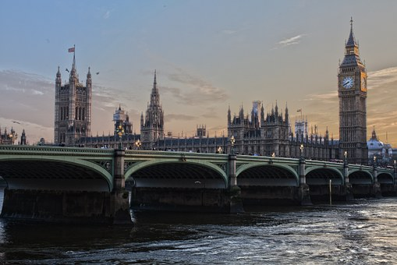
I am a supporter of Human Rights
Personal
On an individual level, I will
National
As someone who lives in the UK, I will
Global
As a global citizen, I will
Notes:
Students that have a range of ideas can fill in this sheet (A4 printed)
Photos: https://images.pexels.com/photos/1114897/pexels-photo-1114897.jpeg?auto=compress&cs=tinysrgb&fit=crop&h=627&w=1200
https://images.pexels.com/photos/258117/pexels-photo-258117.jpeg?auto=compress&cs=tinysrgb&h=350
https://pixabay.com/static/uploads/photo/2016/04/02/21/01/world-1303628_640.png

Slide 29
I am a supporter of Human Rights
Personal
On an individual level, I will
Notes:
Students that have ideas limited to PERSONAL can fill in this (A4 printed)

Slide 30
I am a supporter of Human Rights
National
As someone who lives in the UK, I will
Notes:
Students that have ideas limited to NATIONAL can fill in this (A4 printed)

Slide 31
I am a supporter of Human Rights
Global
As a global citizen, I will
Notes:
Students that have ideas limited to GLOBAL can fill in this (A4 printed)

Slide 32
Ideas and suggestions
Personal
Think about my responsibilities in relation to rights e.g. not impacting people right to an education.
Treating people equally and with respect.
Following the law.
Not being a bystander.
Educate my friends/family about the UDHR.
National
Joining national social media groups/following #HumanRights to be better informed.
Researching the Human Rights Act 1998 to be better informed.
Lobby your MP about Human Rights issues that concern you.
Educate others about the Human Rights Act.
Global
Be globally informed by reading/watching the news.
Lobby your MP about global Human Right concerns.
Look on https://www.amnesty.org.uk/get-involved to find out how you can get involved.
Ask your headteacher if you can organise a Global Rights information stall.
Notes:
Teacher support and/or resource to encourage ideas and suggestions for final activity.

Slide 33
Notes:
https://www.amnesty.org/en/get-involved/write-for-rights/

Slide 34
World Class Teaching project has been funded with support from the European Commission. The contents of these actions are the sole responsibility of the contractor and can in no way be taken to reflect the views of the European Union.

