Slide 1
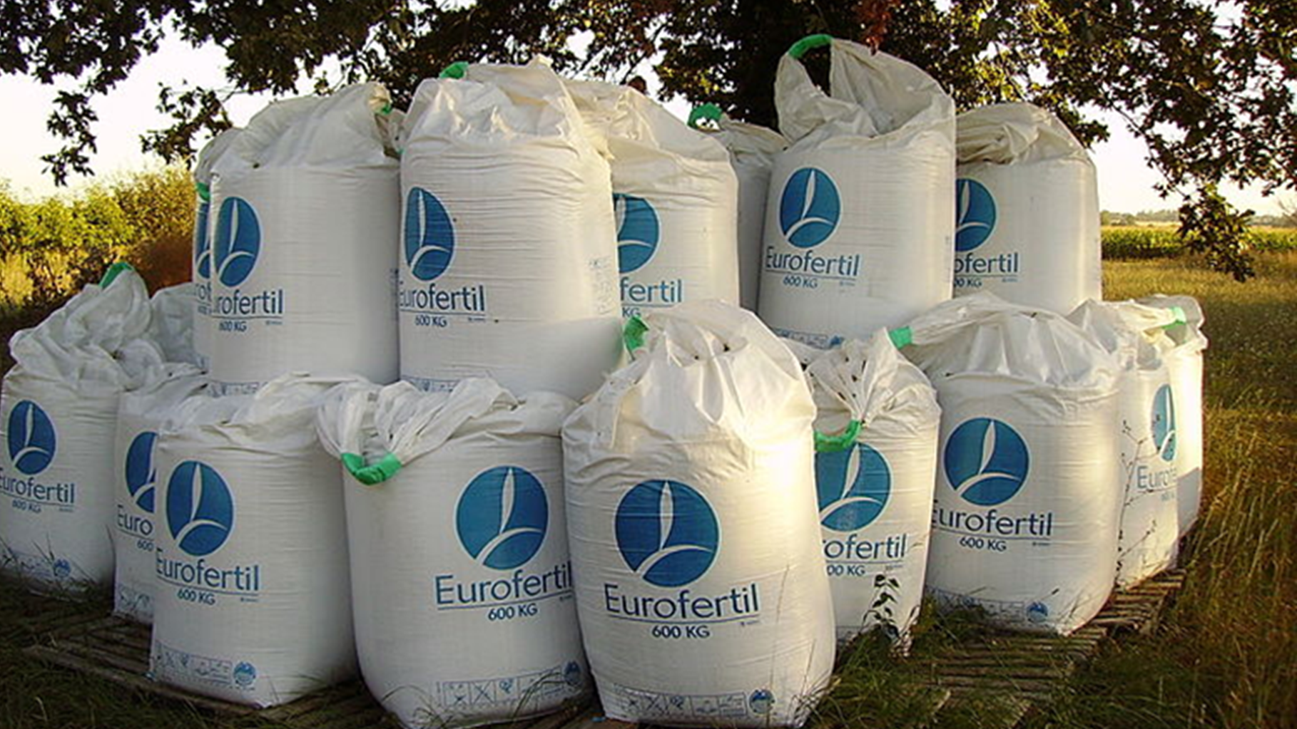
Phosphate fertilisers
Photo credit Cjp24 https://commons.wikimedia.org/wiki/File:Flexible_intermediate_bulk_containers-Fertilizer.jpg

Slide 4
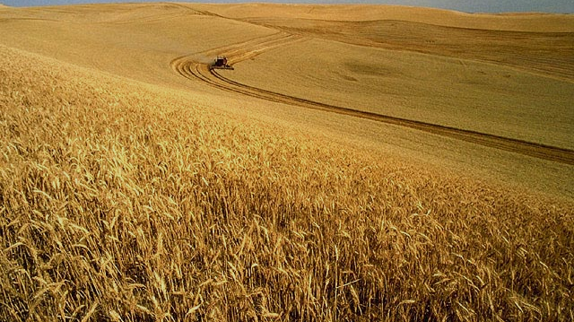
What if …
The yield of crop plants across the world dropped by at least 30%...
https://en.wikipedia.org/wiki/Wheat
By Unknown - ars.usda.gov - Image Number K1441-5,
Public Domain, https://commons.wikimedia.org/w/index.php?curid=16012

Slide 5
Modern food production is highly dependent on fertilisers …
Photo credit Cjp24 https://commons.wikimedia.org/wiki/File:Flexible_intermediate_bulk_containers-Fertilizer.jpg

Slide 6
Fertilisers contain soluble compounds so they can be absorbed by the root hair cells:
-Ammonium ions, NH4+, and nitrate ions, NO3-, are sources of soluble nitrogen.
-Phosphate ions, PO43-, are a source of soluble phosphorus.
-All common potassium compounds dissolve in water to produce potassium ions, K+.
this work is in the public domain
https://commons.wikimedia.org/wiki/File:NSRW_Root-Tip.png

Slide 7
Fertilisers contain soluble compounds so they can be absorbed by the root hair cells:
-Ammonium ions, NH4+, and nitrate ions, NO3-, are sources of soluble ---------------.
-Phosphate ions, PO43-, are a source of soluble -------------------.
-All common potassium compounds dissolve in water to produce -------------- ions, K+.
this work is in the public domain
https://commons.wikimedia.org/wiki/File:NSRW_Root-Tip.png

Slide 8
Global agriculture relies on a linear system for the supply of the minerals in fertiliser. The chain starts at the earth’s crust and finishes in the oceans.
extraction
production
distribution
consumption
disposal
Can you think of some problems that are associated with depending on a linear system? What alternatives can you suggest?

Slide 9
From mine to ocean a phosphate card sort
Notes:
Please find the card sort in our resource section.

Slide 10
From Mine to Ocean
extraction
production
distribution
consumption
disposal/pollution
Phosphate rock is mined, it is a finite non-renewable resource.
3 countries, China, Morocco and USA produce 70% of the world’s phosphate rock

Slide 11
From Mine to Ocean
extraction
production
distribution
consumption
disposal/pollution
Phosphate rock is mined, it is a finite non-renewable resource.
Insoluble phosphate rock reacts with acid to produce soluble salts
Phosphate rock reacts with… | Compound(s) produced
Nitric acid | Calcium nitrate and phosphoric acid (which is neutralised with ammonia to make ammonium phosphate).
Sulfuric acid | Single superphosphate (a mixture of calcium sulfate and calcium phosphate).
Phosphoric acid | Triple superphosphate (calcium phosphate).
Important.. learn it!

Slide 12
What soluble salts are produced?
Phosphate rock
Phosphate rock
Phosphate rock
Nitric acid
Sulfuric acid
Phosphoric acid

Slide 13
Phosphate rock
Phosphate rock
Phosphate rock
Nitric acid
Sulfuric acid
Phosphoric acid
ammonium phosphate
calcium phosphate
calcium phosphate

Slide 14
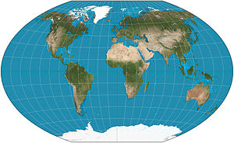
From Mine to Ocean
extraction
production
distribution
consumption
Disposal/pollution
Phosphate rock is mined, it is a finite non-renewable resource.
Insoluble phosphate rock reacts with acid to produce soluble salts.
The fertiliser is transported to countries with a high NPK use.
Can you think of any disadvantages to this?
Poor farmers growing on phosphorous deficient soils eg Sub Saharan Africa have little control over the availability and cost of fertilisers.
Currently 55.5% of phosphate is used in 3 countries, China, India and USA.
Photo The world on Winkel tripel projection Daniel R. Strebe
Creative commons https://en.wikipedia.org/wiki/World_map#/media/File:Winkel_triple_projection_SW.jpg

Slide 15
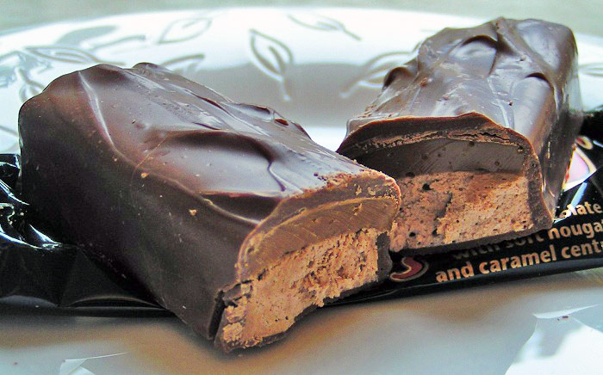
From Mine to Ocean
extraction
production
distribution
consumption
disposal/pollution
Just look at the transport of ingredients for one chocolate bar.
Phosphate rock is mined, it is a finite non-renewable resource.
Insoluble phosphate rock reacts with acid to produce soluble salts.
The fertiliser is transported to countries with a high NPK use.
Plants absorb phosphate and use it in molecules such as DNA. Many agricultural crops are fed to animals. Food may be transported some distance from where it was produced.
Palm oil from Southeast Asia.
Milk from the EU.
Sugar from the Caribbean.
Cocoa from South America.
By Original uploader was Sannse at en.wikipedia - Originally from en.wikipedia; description page is/was here., CC BY-SA 3.0, https://commons.wikimedia.org/w/index.php?curid=2519441

Slide 16
From Mine to Ocean
extraction
production
distribution
consumption
disposal/pollution
Phosphate rock is mined, it is a finite non-renewable resource.
Insoluble phosphate rock reacts with acid to produce soluble salts.
The fertiliser is transported to countries with a high NPK use.
Plants absorb phosphate and use it in molecules such as DNA. Food may be transported some distance from where is was produced.
Disposal/ pollution
Mining losses
Soil erosion
Food waste
Agricultural run-off
Sewage/ human waste
What if… we could prevent this loss?
11 Mt /yr going into the ocean ¹
Notes:
1 Schlesinger 2009; Carpenter & Bennett 2011; Townsend & Porder 2011; Ragnarsdottir, Sverdrup & Koca 2011; UNEP 2011; Ulrich, Malley & Voora 2009; Vaccari 2010.

Slide 17
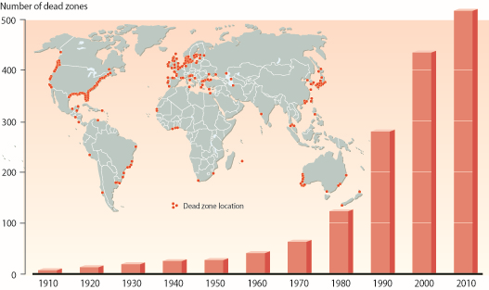
The number of observed “dead zones”, coastal areas where water oxygen levels have dropped too low to support most marine life.
Many are near the estuaries of major rivers, and are caused when nutrients from agricultural fertilizers are washed into watercourses.
The nutrients promote the growth of algae that die and decompose on the seabed, depleting the water of oxygen and threatening fisheries, livelihoods and tourism. Source: Updated from Diaz and Rosenberg (2008). Science
Creative commons https://www.cbd.int/gbo3/?pub=6667&section=6833

Slide 18
Re-thinking the linear system
As an advisor to UN you have been asked to advise them on re-thinking the linear pathway of phosphate use.
Re-imagine the linear process as a circular one. Include a labelled diagram of your proposed system. Explain why a circular pathway is an essential part of securing food for our growing human population, regenerating soil and preserving marine life.

Slide 19
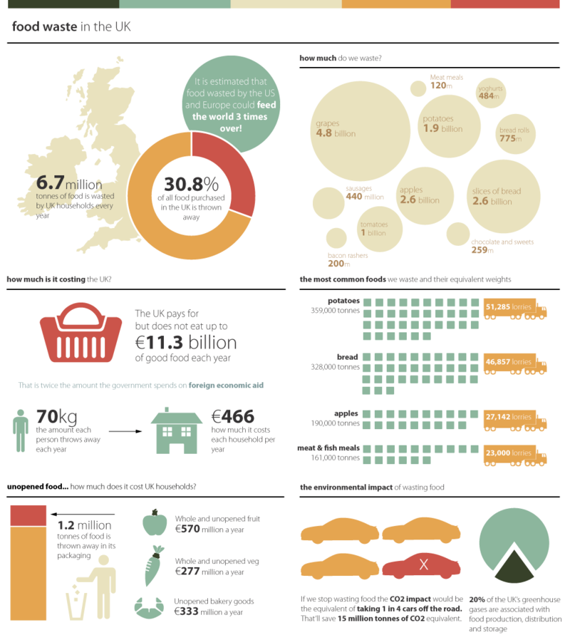
Actions
Stop food waste
Describe 3 actions you could take to reduce food waste and so reduce the loss of phosphates to the oceans.
https://en.wikipedia.org/wiki/Food_waste_in_the_United_Kingdom
Source https://www.flickr.com/photos/gdsdigital/4138675384/in/dateposted/ Author Tiffany Farrant

Slide 21
World Class Teaching project has been funded with support from the European Commission. The contents of these actions are the sole responsibility of the contractor and can in no way be taken to reflect the views of the European Union.

