Slide 1
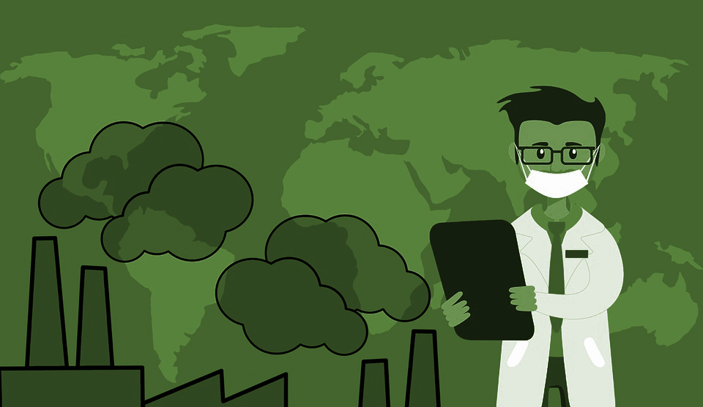
KS3
Respiratory Health
https://pixabay.com/illustrations/air-pollution-global-warming-mask-4017183/

Slide 4
A Right to Health.
What is health?
What do we need to be healthy?
In what ways are our lives more or less healthy than people in the UK 150 years ago ?
In what ways are our lives more or less healthy than people living in rural areas in low income countries?
The UN has stated that a right to health and medical care is a human right. What does this mean?
Why do people across the world die from preventable disease?

Slide 5
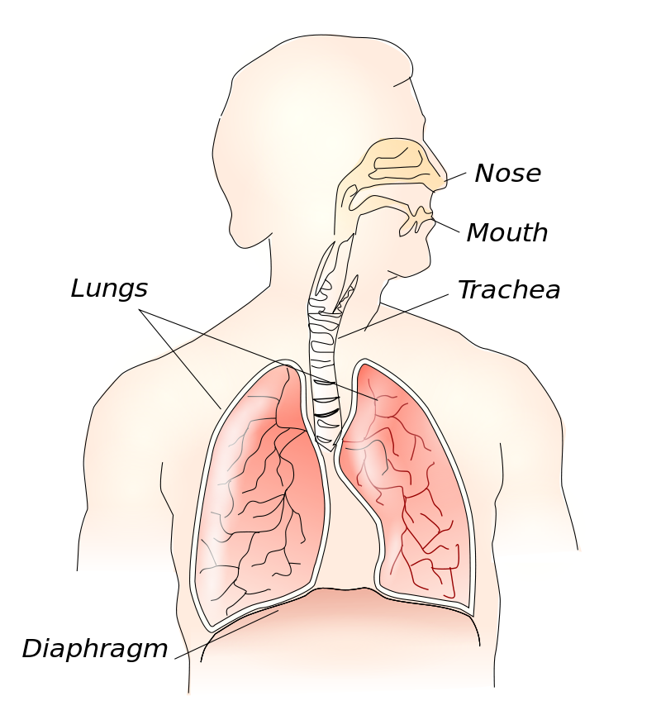
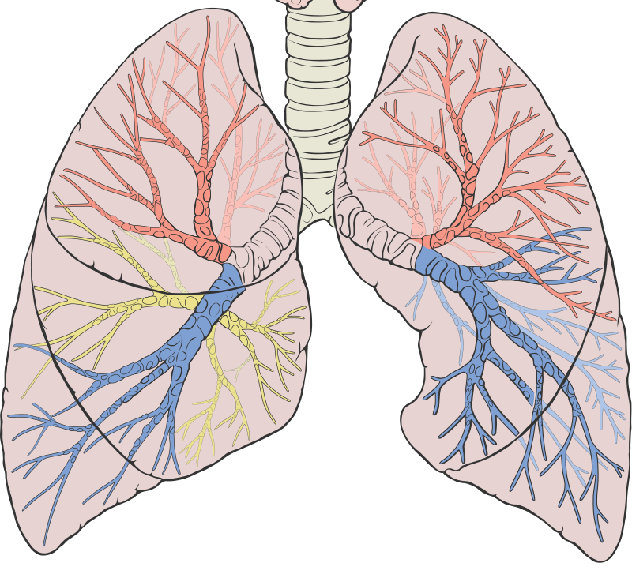
Author Theresa Knott creative commons https://en.wikipedia.org/wiki/Thoracic_diaphragm
Patrick J. Lynch, medical illustrator creative commons https://en.wikipedia.org/wiki/Lung

Slide 6
Author Theresa Knott creative commons https://en.wikipedia.org/wiki/Thoracic_diaphragm
Patrick J. Lynch, medical illustrator creative commons https://en.wikipedia.org/wiki/Lung

Slide 7
Trachea
Bronchioles
Bronchi
Author Theresa Knott creative commons https://en.wikipedia.org/wiki/Thoracic_diaphragm
Patrick J. Lynch, medical illustrator creative commons https://en.wikipedia.org/wiki/Lung

Slide 8
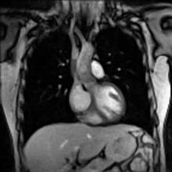
Watch how the diaphragm moves during breathing. https://upload.wikimedia.org/wikipedia/commons/transcoded/d/dd/Real-time_MRI_-_Thorax.ogv/Real-time_MRI_-_Thorax.ogv.360p.vp9.webm
Author Biomedizinische NMR Forschgs GmbH source http://www.biomednmr.mpg.de/
creative commons https://en.wikipedia.org/wiki/Thoracic_diaphragm

Slide 9
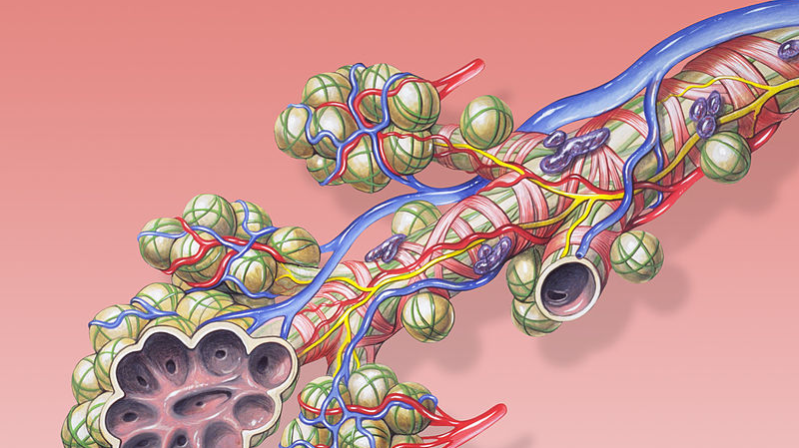
Air sacs (alveoli)
Bronchiole

Slide 10
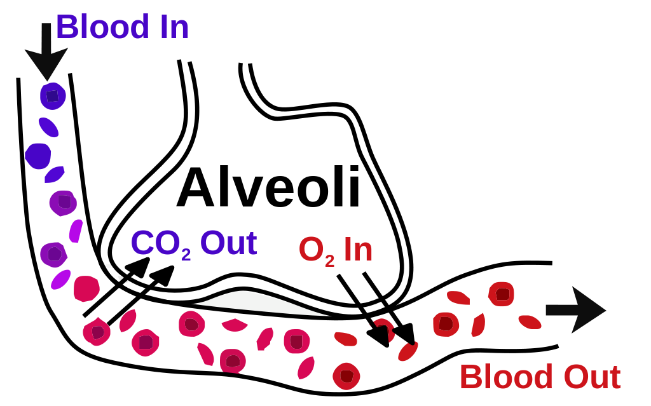
Bronchiole
capillary
Adapted from author helix84 creative commons https://en.wikipedia.org/wiki/Pulmonary_alveolus

Slide 11
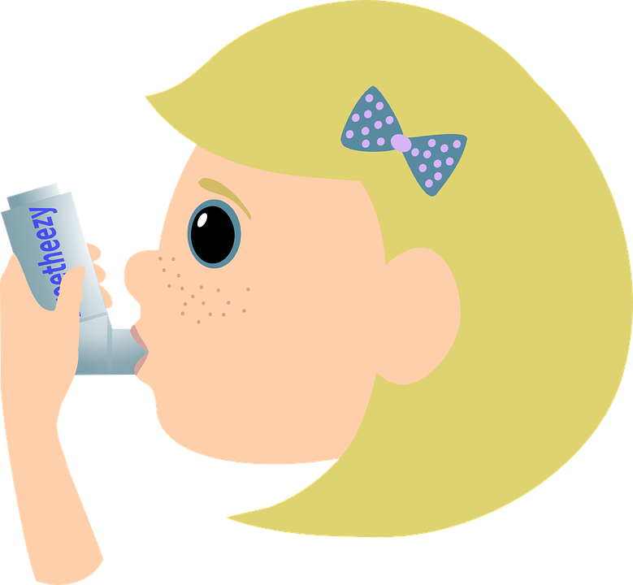
Did you know….Asthma is the most common chronic disease amongst children.
If you have asthma you might be able to describe to your classmates what it feels like to have asthma.

Slide 12
Asthma is the most common chronic disease amongst children.
During an asthma attack, the lining of the bronchi swell, causing the airways to narrow, reducing the flow of air to the lungs.

Slide 13
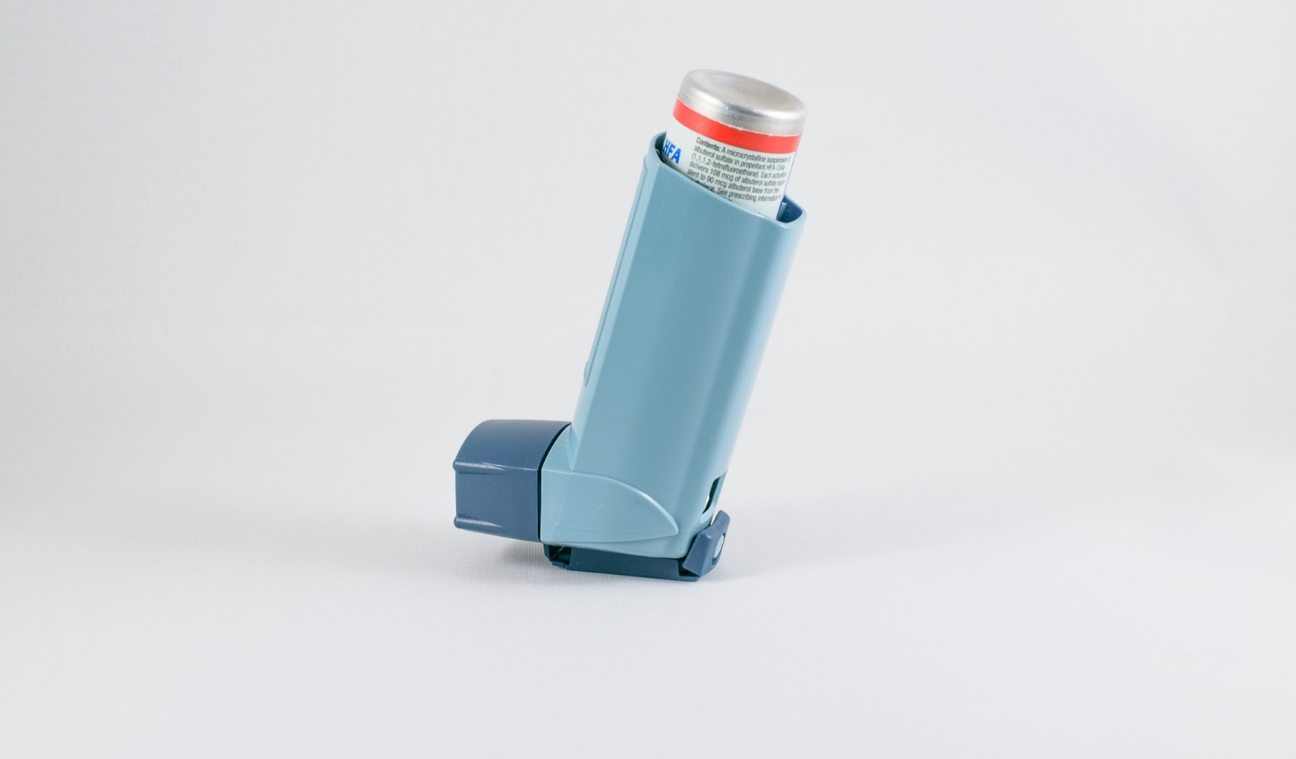
Asthma is a serious life threatening disease and needs to be treated with appropriate medicine. WHO estimates that 235 million people currently suffer from asthma.
Author M.Maggs, no attribution needed Pixabay https://pixabay.com/photos/cigarettes-kelloggs-tin-graphic-1267474/
Not everyone can access the effective modern medicine they need.
Author Bob Williams no attribution needed https://pixabay.com/photos/inhaler-breath-asthma-breathing-2520471/

Slide 14
Let's find out what can be done across the world to make sure everyone can breathe freely.
Treating asthma……. Find out what article 25 of the UN declaration on Human Rights states.
Dennis Larson no attribution necessary https://pixabay.com/photos/tree-canopy-forest-nature-natural-1440731/

Slide 15
Treating asthma across the world.
Examples of success… doing things together.
In Rajasthan in India, the state gives free asthma medication to everyone who needs it. By buying medicine for all the 70 million people of Rajasthan, the government could negotiate a cheaper price.
The NHS in the UK also provides universal health coverage which means everyone, including the poorest, can always get treatment for their asthma.
Dennis Larson no attribution necessary https://pixabay.com/photos/tree-canopy-forest-nature-natural-1440731/

Slide 16
but its not good news everywhere…
Barriers:
In some countries, insufficient training and resources for staff mean asthma is often not diagnosed.
In some countries there is a social stigma to having asthma and people may hide their symptoms and only take medicine in an emergency.
Poverty and inequality mean many people can’t afford medicines which are available to others.
Dennis Larson no attribution necessary https://pixabay.com/photos/tree-canopy-forest-nature-natural-1440731/
What solutions can we think of?

Slide 17
Yes lets!
https://pixabay.com/illustrations/children-silhouette-cheers-globe-1499267/

Slide 18
Preventing asthma across the world.
The causes of asthma are not yet fully understood but are thought to be in part genetic and in part due to things we breathe in from the environment.
Dennis Larson no attribution necessary https://pixabay.com/photos/tree-canopy-forest-nature-natural-1440731/

Slide 19
What would a world look like where everyone could breathe freely?
Tobacco smoke (including second hand smoke) and air pollution are the main avoidable risk factors.
What does this mean?
Dennis Larson no attribution necessary https://pixabay.com/photos/tree-canopy-forest-nature-natural-1440731/

Slide 20
What do we need to do to prevent and treat asthma?
Tobacco smoke (including second hand smoke) and air pollution are the main avoidable risk factors.
What are the obstacles to achieving this across the world?
Can you think of things which will improve human health and improve the health of the planet?

Slide 21
Improve human health and improve the health of the planet.
 | Tobacco (including second hand smoke) | Car transport | Indoor smoke
Impact on health.
Impact on the environment. | Growing tobacco uses chemicals such as pesticides and fertilisers. It causes loss of forests, soil and biodiversity. | Burning petrol in cars causes climate change. Microplastics from car tyres are a major source of the microplastics that enter the earth’s water. | Burning wood on indoor fires causes air pollution and loss of forests, in turn this leads to soils being washed away and a loss of biodiversity.
A better way.

Slide 23
World Class Teaching project has been funded with support from the European Commission. The contents of these actions are the sole responsibility of the contractor and can in no way be taken to reflect the views of the European Union.

