Slide 1
Proportional
Representation
Notes:
Photo: https://www.pexels.com/photo/administration-adults-agreement-black-and-white-1181344/

Slide 4
Practice with proportion, ratio and percentages
Find 25% of 180
2) Convert 32 out of 200 to a percentage
20% of all workers in a factory are male. What is the ratio of female to male workers?
One year I had 14 apples on my tree. The next year I had 21. What is the percentage increase?
5) Find 27% of 84
6) Convert 45 out of 130 to a percentage
7) 24% of all workers were female. What is the ratio of male to
female workers?
8) One year I ate 247 skittles. The year after I ate 279. Work out the
percentage change.

Slide 5
Practice with proportion, ratio and percentages
Find 25% of 180 45
2) Convert 32 out of 200 to a percentage 16%
20% of all workers in a factory are male. What is the ratio of female to male workers? 80:20 = 4:1
One year I had 14 apples on my tree. The next year I had 21. What is the percentage increase? 50%
5) Find 27% of 84 0.27 x 84= 22.68
6) Convert 45 out of 130 to a percentage 34.6%
7) 24% of all workers were female. What is the ratio of male to
female workers? 76:24= 38:12= 19:6
8) One year I ate 247 skittles. The year after I ate 279. Work out the
percentage change. 13%

Slide 6
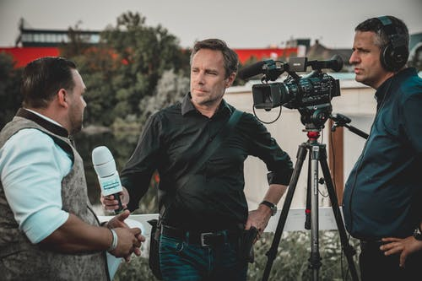
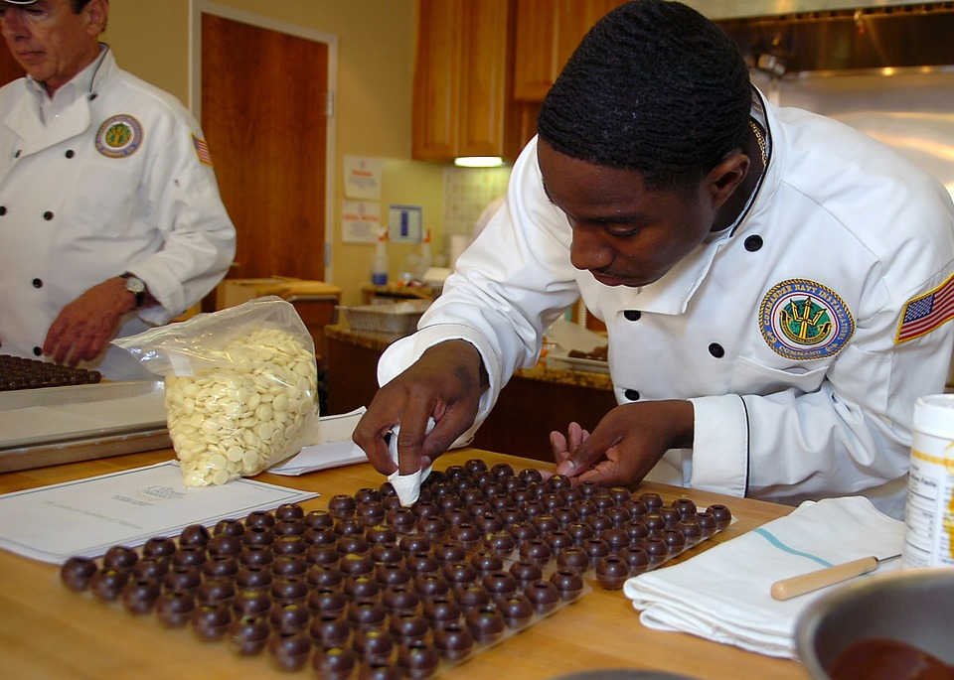
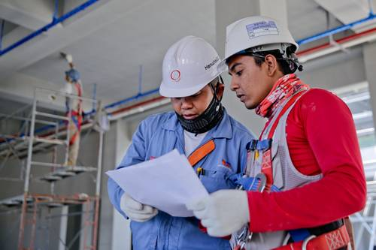
Who might use skills with percentage, ratio and proportion in their job?
Notes:
… Most professions really!
Photos: https://pixabay.com/photos/chef-culinary-dessert-chocolate-713682/ https://images.pexels.com/photos/1216589/pexels-photo-1216589.jpeg?auto=compress&cs=tinysrgb&dpr=1&w=500 https://www.pexels.com/photo/photo-of-people-using-laptop-3740173/ https://www.pexels.com/photo/man-holding-microphone-while-talking-to-another-man-2872418/ https://images.pexels.com/photos/241544/pexels-photo-241544.jpeg?auto=compress&cs=tinysrgb&dpr=1&w=500 https://images.pexels.com/photos/1080865/pexels-photo-1080865.jpeg?auto=compress&amp%3Bcs=tinysrgb&amp%3Bdpr=1&amp%3Bw=500%201x%2C%20https%3A//images.pexels.com/photos/1080865/pexels-photo-1080865.jpeg?auto=compress&amp%3Bcs=tinysrgb&amp%3Bdpr=2&amp%3Bw=500%202x

Slide 7
Who might use skills with percentage, ratio and proportion in their job?
…Journalist…Construction worker…Statistician…Chef…Reporter…
...and lots, lots more...
Notes:
… Most professions really!
Photos: https://pixabay.com/photos/chef-culinary-dessert-chocolate-713682/ https://images.pexels.com/photos/1216589/pexels-photo-1216589.jpeg?auto=compress&cs=tinysrgb&dpr=1&w=500 https://www.pexels.com/photo/photo-of-people-using-laptop-3740173/ https://www.pexels.com/photo/man-holding-microphone-while-talking-to-another-man-2872418/ https://images.pexels.com/photos/241544/pexels-photo-241544.jpeg?auto=compress&cs=tinysrgb&dpr=1&w=500 https://images.pexels.com/photos/1080865/pexels-photo-1080865.jpeg?auto=compress&amp%3Bcs=tinysrgb&amp%3Bdpr=1&amp%3Bw=500%201x%2C%20https%3A//images.pexels.com/photos/1080865/pexels-photo-1080865.jpeg?auto=compress&amp%3Bcs=tinysrgb&amp%3Bdpr=2&amp%3Bw=500%202x

Slide 8
Proportional representation
The full diversity of a population being represented within a particular group (such as the government or the film industry).
For example if 20% of the population of a country is ethnically Asian, in order for the government to be proportionally representative of the population, around 20% of the government would be Asian.
Is proportional representation important?
Why / why not?
What does proportional representation look like in the real world?

Slide 9
Is proportional representation important?
Why / why not?
What does proportional representation look like in the real world?
In order to answer this, we will have to analyse statistics using our mathematical skills.
Notes:
Photo:https://cdn.pixabay.com/photo/2017/11/06/08/42/personal-2923048__340.jpg

Slide 10
Proportional representation on the big screen (USA)
Notes:
Photo: https://cdn.pixabay.com/photo/2019/11/07/20/48/cinema-4609877__340.jpg

Slide 11
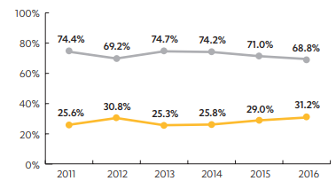
Proportional representation of women in film
By rounding each percentage to the nearest 10, work out an approximate ratio of female to male leads.
2) "In 2016 there is the highest proportion of female leads, therefore
there is a general positive trend in the proportion of female
leads." Do you agree?
Notes:
Graph courtesy of UCLA Hollywood Diversity Report
https://socialsciences.ucla.edu/wp-content/uploads/2019/02/UCLA-Hollywood-Diversity-Report-2019-2-21-2019.pdf Lots more graphs and information available here.

Slide 12
Proportional representation of women in film
ANSWERS
By rounding each percentage to the nearest 10, work out an approximate ratio of female to male leads. 7:3
2) "In 2016 there is the highest proportion of female leads, therefore
there is a general positive trend in the proportion of female
leads." Do you agree? The percentage of leads that are female
went down from 2012 to 2013 so the trend has not always been
positive. However, the proportion of leads that are female is on a
general upwards trend.
Notes:
Graph courtesy of UCLA Hollywood Diversity Report

Slide 13
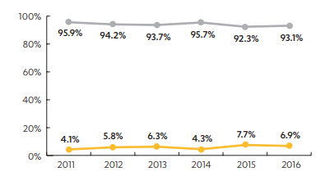
Proportional representation of women in film
3) Assuming that in 2016 there were 180 directors, how many of these were female?
4) How many more female directors should there have been to achieve proportional representation (50%)?
Notes:
Graph courtesy of UCLA Hollywood Diversity Report

Slide 14
Proportional representation of women in film
ANSWERS
3) Assuming that in 2016 there were 180 directors, how many of these were female? 180 x 0.069 = 12.42 or 12
4) How many more female directors should there have been to achieve proportional representation (50%)? 90 - 12 = 78
Notes:
Graph courtesy of UCLA Hollywood Diversity Report

Slide 15
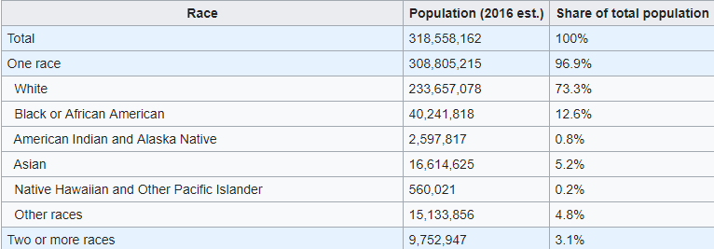
The population of the USA by ethnicity
Note: People of Hispanic / Latino origin may be of any ethnicity, so are included in applicable categories but comprise 18.5% of the population of the USA.
5) Work out what’s behind the boxes
Amount
Total
x 100
Tip
Notes:
Information taken from the United States Census Bureau

Slide 16
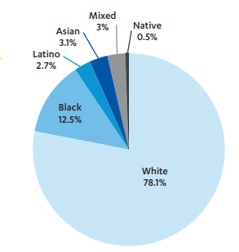
6) According to the demographic of the
USA, are different ethnicities represented proportionally in film roles?
Do you think it matters?
Note: People of Hispanic / Latino origin may be of any ethnicity, so are included in applicable categories but comprise 18.5% of the population of the USA.
Notes:
Graph courtesy of UCLA Hollywood Diversity Report

Slide 17
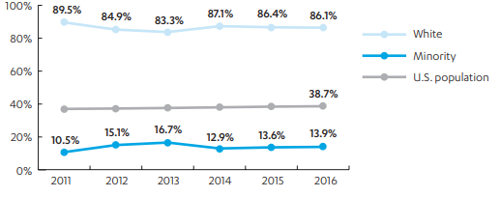
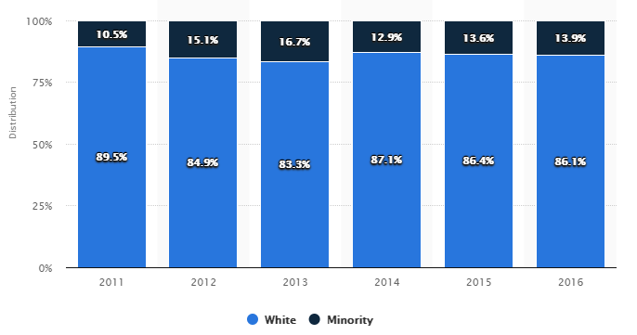
Is it any different when it comes to leading roles?
7) Describe the trend in leads by race as shown by the graph between 2011 – 2016.
Do you notice any
discrepancies with the
information on the previous slide?
What might account for
this?
9) Which graph do you
find more useful?
(% of Minorities in
the population)
Notes:
Information courtesy of the UCLA Hollywood Diversity Report

Slide 18
Do you think proportional representation matters?
The UCLA Hollywood Diversity report, where this data comes from, concludes:
“women and people of color have been significantly underrepresented as leads in Hollywood films and television shows over the years”.
Why do you think it matters if women and people of colour are underrepresented in lead roles in film and TV in the USA?
Diverse audiences don’t see stories that reflect themselves on the screen. The stories of those in power (white males) are reaffirmed and repeated.
The fact that women and people of colour are underrepresented in producer and director roles makes this worse.
#oscarssowhite #metoo #timesup
Notes:
https://socialsciences.ucla.edu/wp-content/uploads/2019/02/UCLA-Hollywood-Diversity-Report-2019-2-21-2019.pdf

Slide 19
Proportional representation in politics (UK)
Notes:
Photo courtesy of Parliament under a Creative Commons Licence. https://www.flickr.com/photos/uk_parliament/48710693167/
Parliamentary copyright images are reproduced with the permission of Parliament

Slide 20
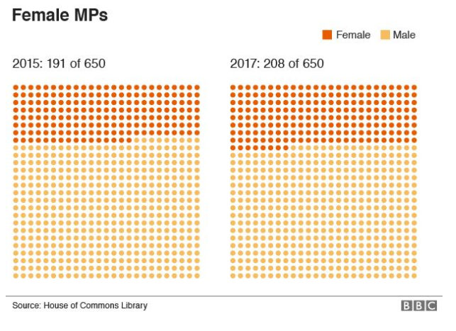
1) What was the percentage change in female MPs between
2015 and 2017?
After the 2017 election, how many female MPs would the UK need to hit the UN target of 50%?
Notes:
Information from https://www.bbc.co.uk/news/election-2017-40232272

Slide 21
What is the percentage change in female MPs between
2015 and 2017? 8.9%
2) After the 2017 election, how many female MPs was the UK
off the UN target of 50%? 325 – 208 = 117
Notes:
Information from https://www.bbc.co.uk/news/election-2017-40232272

Slide 22
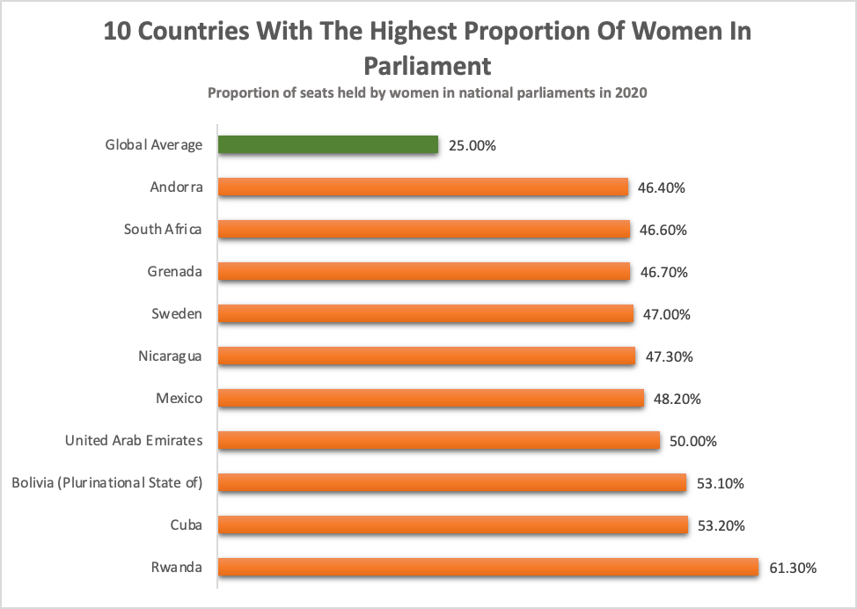
3) Where does the UK fit on this graph according to the 2017 election results?
Notes:
Information from:
https://data.ipu.org/women-ranking?month=6&year=2020
https://data.ipu.org/women-averages?month=6&year=2020

Slide 23
3) Where does the UK fit on this graph according to the 2017 election results?
Below Andorra but above the global average.
Notes:
Information from:
https://data.ipu.org/women-ranking?month=6&year=2020
https://data.ipu.org/women-averages?month=6&year=2020

Slide 24
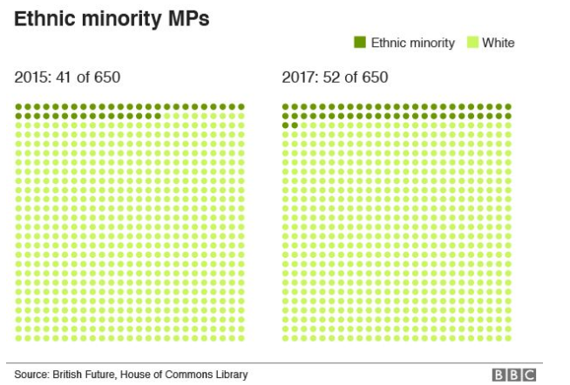
4) What percentage of MPs were of an ethnic minority as of the 2017 election?
5) Approximately 13% of the British population belong to an ethnic minority. How many more MPs would have had to be elected in the following election in order for Parliament to be proportionally representative of this?
Notes:
Information from https://www.bbc.co.uk/news/election-2017-40232272

Slide 25
4) What percentage of MPs were of an ethnic minority as of the 2017 election? 52/650 x 100 = 8%
5) Approximately 13% of the British population belong to an ethnic minority. How many more MPs would have had to be elected in the following election in order for Parliament to be proportionally representative of this? 0.13 x 650 = 84.5 84.5 – 52 = 32.5 or 33
Notes:
Information from https://www.bbc.co.uk/news/election-2017-40232272

Slide 26
Does proportional representation matter
in UK politics?
"It's got to be good for politics that gradually Parliament is getting closer to looking a bit more like the electorate that it serves.” Steve Ballinger, British Future
Do you agree?
Members of Parliament are elected specifically to represent the views of their constituents in government. Many ask how they can do this if they do not understand the wishes, problems or needs of a diverse population.
Notes:
Election results 2017: The most diverse Parliament yet BBC https://www.bbc.co.uk/news/election-2017-40232272
Election 2019: Britain’s most diverse Parliament https://www.bbc.co.uk/news/election-2019-50808536

Slide 27
Extension: Have a look at the 2019 Election results – redo some of the questions for these results. How much progress was made from the 2017 election?
Notes:
Election results 2017: The most diverse Parliament yet BBC https://www.bbc.co.uk/news/election-2017-40232272 Images of Marsha de Cordova courtesy of Cllr Tony Belton and Justine Greening courtesy of the Conservative Party.
Election 2019: Britain’s most diverse Parliament https://www.bbc.co.uk/news/election-2019-50808536 Image courtesy of BBC

Slide 28
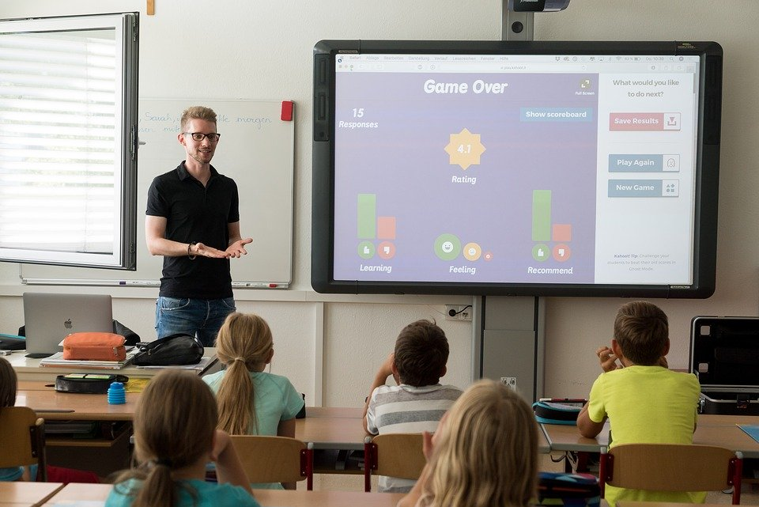
Proportional representation in schools (UK)
Notes:
Photo: https://pixabay.com/photos/teacher-property-plant-and-teaching-3765909/

Slide 29
In 1985, the government was concerned about how white the teaching profession was and commissioned a report:
“We do not believe that a situation in which groups of children are taught exclusively by teachers of the same ethnic group is desirable from the point of view of the children, the minority community or society as a whole…
…the under-representation of ethnic minorities in the teaching profession is a matter of great concern…
… Careers teachers and careers officers… should encourage ethnic minority youngsters to consider the possibility of entering teaching…”
The Swann Report (1985)
Notes:
The Swann Report http://www.educationengland.org.uk/documents/swann/swann1985.html

Slide 30
Progress since the Swann Report?
Department for Education (DfE) figures for 2016 show:
Of 510,000 state-funded teachers, 68,000 were drawn from an ethnic minority background.
Of these teachers, only 26% were male.
What percentage of state-funded teachers were from an ethnic minority background?
2) How many female teachers of an ethnic minority background
were there in 2016?
3) 27% of all students in the UK are from an ethnic minority
background. How many more teachers from an ethnic minority
background were needed in 2016 to be proportionally
representative?
Notes:
Information from https://www.bbc.co.uk/news/uk-england-40568987

Slide 31
Progress since the Swann Report?
Department for Education (DfE) figures for 2016 show:
Of 510,000 state-funded teachers, 68,000 were drawn from an ethnic minority background.
Of these teachers, only 26% were male.
What percentage of state-funded teachers were from an ethnic minority background? 68000/510000 x 100 = 13.3%
2) How many female teachers of an ethnic minority background
were there in 2016? 100 – 26 = 74%
0.74 x 68000 = 50320
3) 27% of all students in the UK are from an ethnic minority
background. How many more teachers from an ethnic minority
background were needed in 2016 to be proportionally
representative? 0.27 x 510000 = 137700
137700 - 68000 = 69700
Notes:
Information from https://www.bbc.co.uk/news/uk-england-40568987

Slide 32
Progress since the Swann Report.
Percentage of teachers who are BAME
2004 | 2.7%
2008/9 | 6%
2016 | 13%
2018 | 14.1%
Notes:
Information from UK government https://www.ethnicity-facts-figures.service.gov.uk/workforce-and-business/workforce-diversity/school-teacher-workforce/latest
Quotes reproduced courtesy of Teach First https://www.bbc.co.uk/news/uk-england-40568987

Slide 33
Progress since the Swann Report?
Percentage of teachers who are BAME
Department for Education (DfE) figures for 2016 show:
Of 510,000 state-funded teachers, 68,000 were drawn from an ethnic minority background.
2004 | 2.7%
2008/9 | 6%
2016 | 13%
2018 | 14.1%
4) Between 2016 and 2018 there was an increase in teachers from an ethnic minority background in the UK of 5,610 teachers. Assuming the total number of teachers is still the same, what was the percentage in 2018?
Notes:
Information from https://www.bbc.co.uk/news/uk-england-40568987
Information from UK government https://www.ethnicity-facts-figures.service.gov.uk/workforce-and-business/workforce-diversity/school-teacher-workforce/latest

Slide 34
Analysing the data on a local level
Region | Percentage of BME pupils 2015 | Percentage of BME teachers 2015
North East | 9.4% | 1.2%
North West | 19.9% | 3.3%
Yorkshire and the Humber | 23.3% | 5%
East Midlands | 20.8% | 5.1%
West Midlands | 32.2% | 9.7%
East of England | 21.8% | 5.1%
Inner London | 81.1% | 26%
Outer London | 64.7% | 21.5%
South East | 21.1% | 4.3%
South West | 11.9% | 1.6%
Your school?
Notes:
Information from Runnymede Trust Visible Minorities Invisible Teachers https://www.runnymedetrust.org/uploads/Runnymede%20ReportNEW.pdf

Slide 35
Region | Percentage of BME pupils 2015 | Percentage of BME teachers 2015
North East | 9.4% | 1.2%
North West | 19.9% | 3.3%
Yorkshire and the Humber | 23.3% | 5%
East Midlands | 20.8% | 5.1%
West Midlands | 32.2% | 9.7%
East of England | 21.8% | 5.1%
Inner London | 81.1% | 26%
Outer London | 64.7% | 21.5%
South East | 21.1% | 4.3%
South West | 11.9% | 1.6%
Your school?
5) Which region has the most proportional representation in respect to BME teachers?
How will you work this out?
TIP
Calculate the ratio of % BME teachers to % BME students
Notes:
Information from Runnymede Trust Visible Minorities Invisible Teachers https://www.runnymedetrust.org/uploads/Runnymede%20ReportNEW.pdf

Slide 36
5) Which region has the most proportional representation in respect to BME teachers?
Region | Percentage of BME students 2015 | Percentage of BME teachers 2015 | Ratio of % BME teachers to % BME students
North East | 9.4% | 1.2% | 1:7.8
North West | 19.9% | 3.3% | 1:6.0
Yorkshire and the Humber | 23.3% | 5% | 1:4.7
East Midlands | 20.8% | 5.1% | 1:4.1
West Midlands | 32.2% | 9.7% | 1:3.3
East of England | 21.8% | 5.1% | 1:4.3
Inner London | 81.1% | 26% | 1:3.1
Outer London | 64.7% | 21.5% | 1:3.0
South East | 21.1% | 4.3% | 1:4.9
South West | 11.9% | 1.6% | 1:7.4
Outer London has the ratio 1:3 BME teachers to students, meaning there are proportionally 3 times more BME students than teachers which is the most proportional ratio of all the regions.
Notes:
Information from Runnymede Trust Visible Minorities Invisible Teachers https://www.runnymedetrust.org/uploads/Runnymede%20ReportNEW.pdf

Slide 37
Brett Wigdortz, founder and chief executive of Teach First, said: “It is a real loss that the profession is missing out on talented classroom leaders because a huge pool of people are being put off by misconceptions about teaching.
“Young people need role models from all backgrounds to unlock their potential and aspiration, and to help them understand the world.”
Why does it matter?
Notes:
https://www.bbc.co.uk/news/uk-england-40568987
https://www.bbc.co.uk/news/education-37552056
Quotes reproduced courtesy of Teach First: https://www.bbc.co.uk/news/uk-england-40568987

Slide 38
Notes:
https://www.malala.org/join

Slide 39
World Class Teaching project has been funded with support from the European Commission. The contents of these actions are the sole responsibility of the contractor and can in no way be taken to reflect the views of the European Union.

