Slide 1
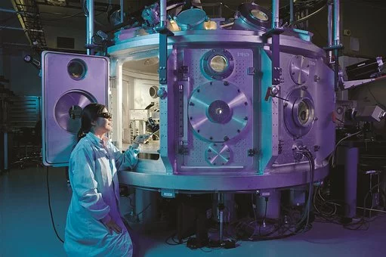
Looking at scientists
Notes:
https://cdn.pixabay.com/photo/2017/02/05/18/04/scientific-2040795__340.jpg

Slide 4
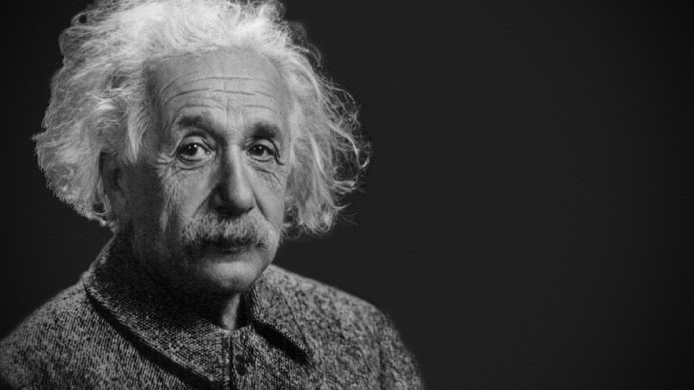
Time to draw…
A scientist doing real life science.
Notes:
https://pixabay.com/de/photos/albert-einstein-portr%C3%A4t-1933340/

Slide 5
We are more likely to think of scientists as male.
True or False?
 | Drawn by
Gender of the scientist | Girls | Boys | Total
Male
Female
Describe the results. Do you think there is a real difference
between the number of drawings which show male scientists and the number which show female scientists? Can you explain the results?

Slide 6
To compare your results with those from other sources we need to convert your results into percentages.
Percentage of drawings which showed a female scientist =
Number of females drawn X 100
Total number of drawings 1
Now calculate the percentage of the class’s drawings which showed a male scientist.
Converting results into percentages. When is this a useful thing to do?

Slide 7
Girls are rubbish at science. Agree or Disagree?
Girls do at least as well as boys in science subjects at GCSE and A level.
52% of male undergraduates were enrolled on a science course compared to 40% of females.
Only 13% of science and engineering workers are female.

Slide 8
gender
race
class
Are these barriers to science?
Can they be overcome?

Slide 9
Scientist or not?
Sue Black was out of school at 16, had three children at 23 and was living as a single mother in a domestic violence refuge by 25.
Victoria Foster had cancer when she was aged eight.

Slide 10
Sue Black Out of school at 16, three children at 23 and living as a single mother in a domestic violence refuge by 25 | this force of nature challenged all odds to become an internationally-reputed computer scientist…well done Sue
Victoria Foster had cancer when she was aged eight | she went on to become a cancer researcher. Let's hear it for Victoria!
Sue and Victoria are scientists.

Slide 11
Scientist or not?
Maggie Aderin-Pocock grew up in a council flat in London and struggled with dyslexia.
Krasimira Tsaneva-Atanasova left Bulgaria aged 30, boarding a plane for the first time with her seven-year-old daughter.

Slide 12
Maggie Aderin-Pocock, who grew up in a council flat in London and struggled with dyslexia. | She is an honorary researcher in UCL’s Department of Physics and Astronomy, talking giant telescopes and space instrumentation….wow that’s cool.
Krasimira Tsaneva-Atanasova left Bulgaria aged 30, boarding a plane for the first time with her seven-year-old daughter. | She is one of UK’s only female maths professors.
Maggie and Krasimira are scientists.

Slide 13
Scientist or not?
Mae C. Jemison is an African-American woman who grew up in Chicago, she has a real fear of heights. Her father was a joiner.
Tabassum Mumtaz lives in Bangladesh, she went to the Bangladesh airforce school.

Slide 14
Mae C. Jemison is an African-American woman who grew up in Chicago, she has a real fear of heights. Her father was a joiner. | After first Bachelor of Science degree in chemical engineering and then training as a GP, Mae decided to become an astronaut. In 1992, she flew into space aboard the Endeavour, becoming the first African-American woman in space.
Tabassum Mumtaz lives in Bangladesh, she went to the Bangladesh airforce school. | Dr. Mumtaz cultivates bacteria that can turn wastewater and food waste, such as waste from palm oil production, into environmentally friendly bioplastics.
Mae and Tabassum are scientists.

Slide 15
Scientist or not?
Uduak Okomo was born and lives in the Gambia, the smallest country on the African mainland.
Bina Shaheen Siddiqui is a Muslim Pakistani woman.

Slide 16
Uduak Okomo was born and lives in the Gambia, the smallest country on the African mainland. | Dr. Okomo’s work has led to a decrease in preventable deaths from infections in newborn babies.
Bina Shaheen Siddiqui is a muslim Pakistani woman. | Professor Dr Bina Shaheen Siddiqui holds a PhD in Organic Chemistry from the University of Karachi. She has made significant contributions to medicine and agriculture through her study and classification of indigenous plant materials.
Uduak and Bina are scientists.

Slide 17
Aisha Elsafty is an Egyptian woman living in the UK .
Rim Al Turkmani is a Syrian woman, she says that growing up she drew inspiration for her study of the Qur’an.

Slide 18
Aisha Elsafty is an Egyptian woman living in the UK | Dr Elsafty is a Computer Scientist at the University of Cambridge. She specialises in wireless technology that is used to establish networks in disaster areas.
Rim Al Turkmani is a Syrian woman, she says that growing up she drew inspiration from her study of the Qur’an | Dr Turkmani has a PhD in astrophysics and works on the physics of the solar flares.
Aisha and Rim are scientists.

Slide 19
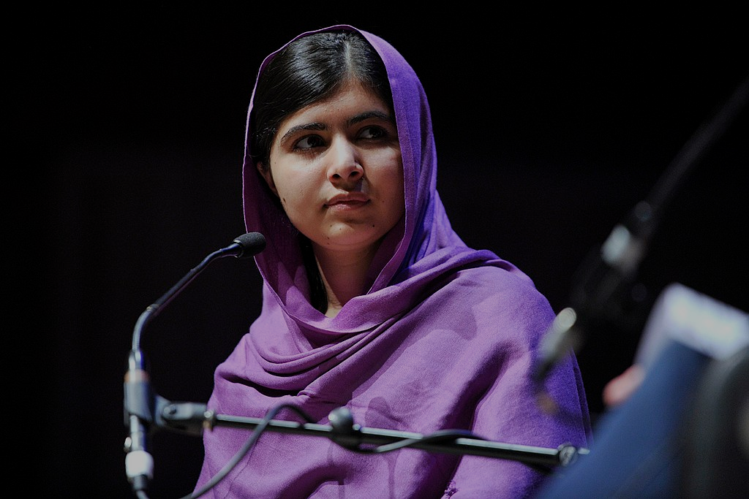
A long struggle has taken place to establish the right of girls to be educated. Feminism is the promotion of women’s rights on the grounds of equality.
“We can gain peace, grow economies, improve our public health and the air that we breathe. Or we can lose another generation of girls.” — Education activist Malala Yousafzai, speech to Canadian Parliament, 2017.
By Jonathan Cardy - Own work, CC BY-SA 3.0, https://commons.wikimedia.org/w/index.php?curid=33155369
By Southbank Centre - https://www.flickr.com/photos/southbankcentre/13008430294/, CC BY 2.0, https://commons.wikimedia.org/w/index.php?curid=37229900

Slide 20
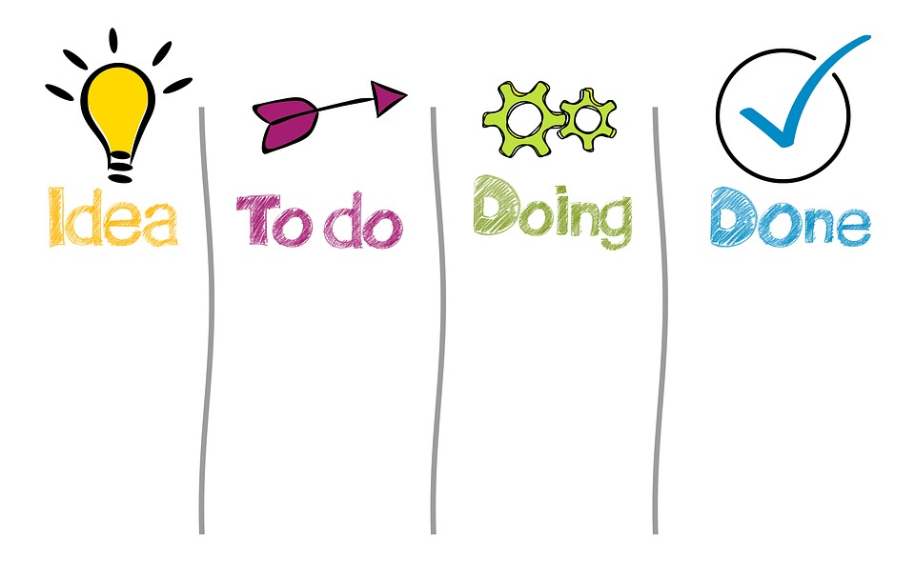
We need everyone’s ideas
If you were a scientist what would you do to make the world a better place for all the people and other living beings on the planet?
No attribution needed https://pixabay.com/photos/work-work-process-organize-business-4051777/

Slide 21
Women are great at science.
Level 1
Level 2
Level 3
Draw a poster celebrating the contributions of these women to science.
Write a paragraph about the work of one of the women you have learnt about.
Imagine some of the challenges which the women may have had to overcome to get to where they are. Write a short account about this.

Slide 23
World Class Teaching project has been funded with support from the European Commission. The contents of these actions are the sole responsibility of the contractor and can in no way be taken to reflect the views of the European Union.

