Slide 1
Notes:
https://pixabay.com/de/photos/thermometer-w%C3%A4rme-40-wetter-693852/ (top right)
https://www.shutterstock.com/image-photo/satellite-view-hurricane-florence-over-atlantics-1183493674?irgwc=1&utm_medium=Affiliate&utm_campaign=Pixabay+GmbH&utm_source=44814&utm_term=https%3A%2F%2Fpixabay.com%2Fde%2Fimages%2Fsearch%2Fhurrican%2F (Middle right)
https://pixabay.com/de/photos/rosa-sandd%C3%BCnen-utah-65310/ (top left)
https://pixabay.com/de/photos/erde-d%C3%BCrre-boden-trockenheit-3355931/ (bottom
left)
https://www.pexels.com/photo/rock-formation-near-calm-body-of-water-1450079/ (bottom right)

Slide 2
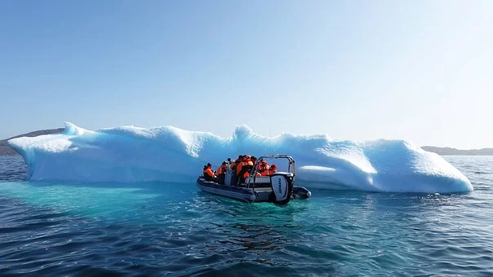
"El cambio climático" Lesson 1
Notes:
https://pixabay.com/de/photos/eisberg-eis-gr%C3%B6nland-tourismus-4614041/

Slide 3
.

Slide 5
Español
"El cambio climático"

Slide 6
The environmental and social impacts of climate change

Slide 7
Ecological consequences of climate change
Español
Vocabulario | Vocabulary
(la) desertificación (las) lluvias fuertes (la) subida del nivel del mar los) corrimientos de tierra (las) condiciones metereológicas extremas (la) disminución de biodiversidad (las) tempestades (las) inundaciones (las) sequías (los) incendios forestales (las) olas de calor (el) derretimiento de glaciares | Desertification Heavy rain(s) Sea level rise Landslide(s) Extreme meteorological conditions Decrease in biodiversity Storm(s) Flood(s) Drought(s) Forest fire(s) Heat wave(s) Glacial melting
Inglés

Slide 8
Social consequences of climate change
Vocabulario | Vocabulary
(la) pobreza (el) desempleo (la) escasez de agua potable (las) malas cosechas (la) migración (las) guerras (las) víctimas mortals (el) aumento de personas sin hogar (el) hambre (las) pérdidas económicas (las) enfermedades (p.ej. Malaria) | Poverty Unemployed A drinking water shortage Poor harvest Migration War(s) Fatalities Increasing homelessness Hunger Economic losses/crisis Diseases (e.g. Malaria)
Español
Inglés

Slide 9
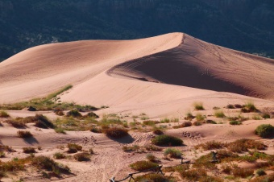
Tarea / Task 1
Match the photo with the correct Spanish word
For example:
(la) desertificación 🡪
Desertification Migration
(Ecological) (Social) (la) migración 🡪

Slide 10
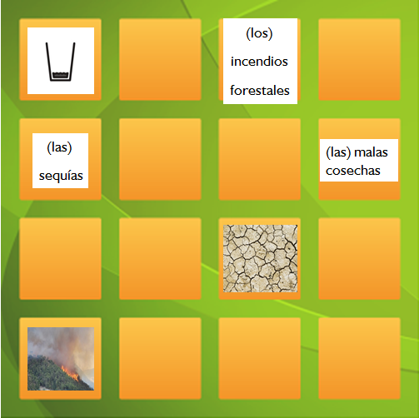
Tarea 2:
Comprobad vuestras soluciones.
Cortad las casillas con las imágenes y los términos españoles y jugad un juego de memoria.
Task 2:
Check your answers
Cut out the boxes and play a memory game.
Español
Inglés

Slide 11
Extensión:
Crea un póster con las 6 consequencias más impotantes para ti del cambio climático y sus imágenes.
Extension:
Create a poster with the 6 most important consequences of climate change and their images.
Español
Inglés
Consecuencias del cambio climático
la migración
la desertificación

Slide 15
World Class Teaching project has been funded with support from the European Commission. The contents of these actions are the sole responsibility of the contractor and can in no way be taken to reflect the views of the European Union.
Adapted from original material by Jana Reinecke- Kaiser, Marcel- Breuer School, Berlin

