Slide 1
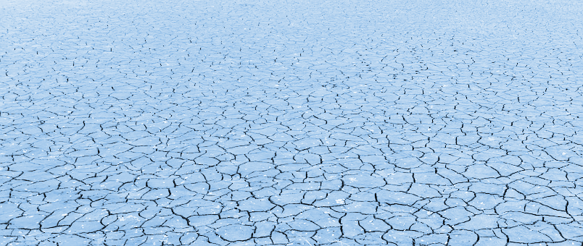
"El cambio climático" Lesson 2

Slide 4
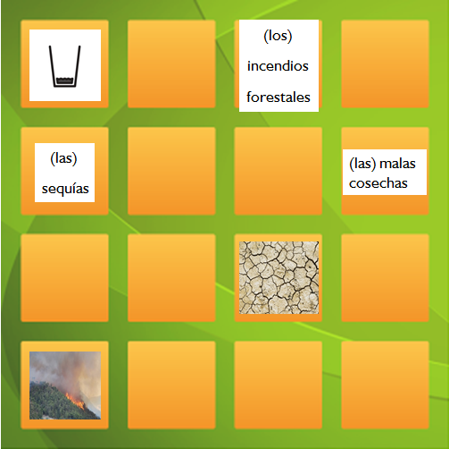
Starter activity
Task: Play a memory game (e.g. pairs) with the cards from last lesson

Slide 5
Tarea / Task: Create a mind map
Instructions:
Take turns to choose a Spanish term and stick it onto the mind map
Draw lines between different terms to show the relationships between the different social and environmental impacts of climate change
Using the new vocabulary and the help box annotate your mind map to explain the relationships
Remember to speak lots of Spanish!
Extension:
Write a paragraph in Spanish using the help sheet. You can use it to explain your mind map to the rest of the class at the end of the lesson!

Slide 6
Así puedes indicar en español causas y consecuencias de un problema / Indicate the causes and consequences of a problem in Spanish
…es una consecuencia de… | ...is a result of...
…tiene varias consecuencias, por ejemplo… | ...it has several consequences, for example. …
...se debe a... | …is due to …
…causa… | ….cause…
…lleva a … / …da lugar a… | …it leads to / ...results in…
…también afecta a… | …it also affects…
…tiene que ver con… | ...it is related to...
…a causa de…/ debido a…/ por… | ...because of.../due to...
Otro efecto de… es… | Another effect of ...is...
Ejemplos: / Examples 1) Una sequía lleva a la falta de agua potable. / A drought leads to a lack of drinking water. 2) Las olas de calor tienen varias consecuencias, por ejemplo malas cosechas. / Heatwaves have several consequences , for example poor harvests. 3) Debido a las malas cosechas, mucha gente tiene que sufrir hambre. / Due to poor harvests, many people have to suffer hunger.
Español
Inglés

Slide 10
World Class Teaching project has been funded with support from the European Commission. The contents of these actions are the sole responsibility of the contractor and can in no way be taken to reflect the views of the European Union.
Adapted from original material by Jana Reinecke- Kaiser, Marcel- Breuer School, Berlin

