Slide 1
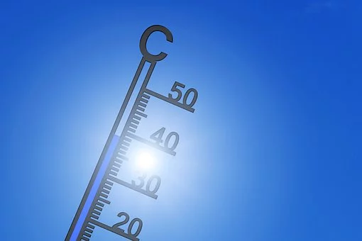
"El cambio climático" Lesson 3
Notes:
https://pixabay.com/de/illustrations/thermometer-sommer-heiss-hitze-4353318/

Slide 4
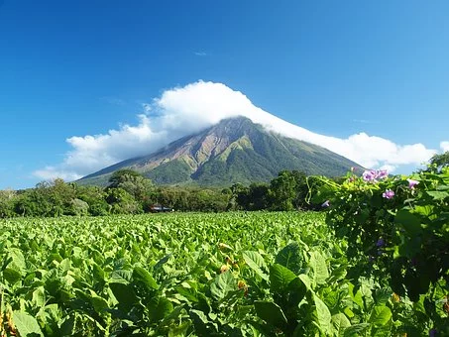
Lesson 3: Case Study -The impact of climate change on coffee farmers in Nicaragua
Notes:
https://pixabay.com/de/photos/vulkan-nicaragua-concepcion-ometepe-2259249/

Slide 5
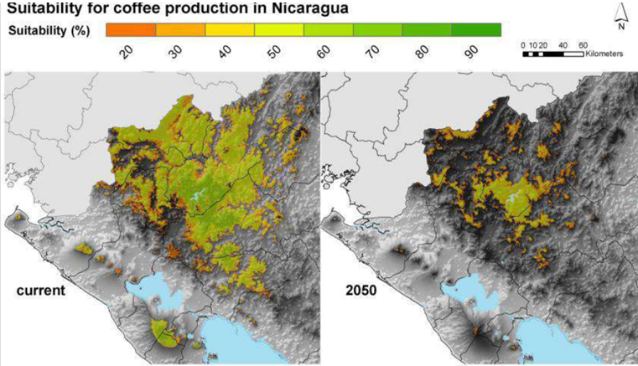
The impact of climate change on coffee farmers in Nicaragua
Source: Zelaya 2015.
Aptitud de las áreas de producción de café en Nicaragua
2015

Slide 6
The impact of climate change on coffee farmers in Nicaragua
Aptitud de las áreas de producción de café en Nicaragua
Explain what these maps show.
Los mapas representan/ muestran/ analizan..
2015
más de – more
menos de- less
Source: Zelaya 2015.

Slide 7
Karla en su finca de café

Slide 8
La finca de Karla
La familia de Karla trabaja en una finca de café cerca de Matagalpa, Nicaragua.
2015
Source: Zelaya 2015.

Slide 9
Escuchad a Karla hablando
de su finca de café.
Video 1 - Karla
Video 2 - Karla’s family farm
Video 3 - Climate Change and coffee
Video 4 - Coffee producing zones
Video 5 - The future
**Access videos here - http://leedsdec.flywheelsites.com/mfl-spanish-social-environmental-consequences-3/

Slide 10
Write down 3 sentences to describe how climate change affects people’s lives in Nicaragua.

Slide 14
World Class Teaching project has been funded with support from the European Commission. The contents of these actions are the sole responsibility of the contractor and can in no way be taken to reflect the views of the European Union.
Adapted from original material by Jana Reinecke- Kaiser, Marcel- Breuer School, Berlin

