Slide 1
Educación de calidad
Lesson 2
Notes:
https://pixabay.com/de/photos/klassenzimmer-schule-bildung-lernen-2093743/

Slide 4
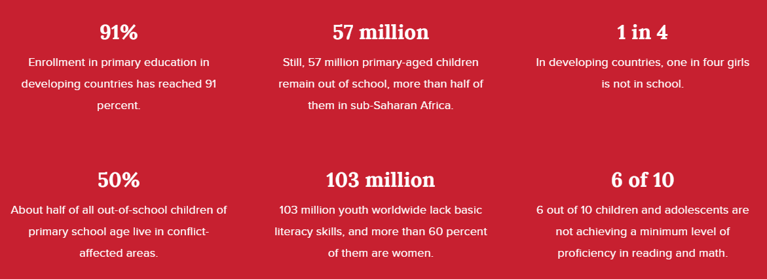
Quality education: Facts and Figures https://www.undp.org/content/undp/en/home/sustainable-development-goals/goal-4-quality-education.html
Notes:
Cut up the 12 statements (6 Spanish and 6 English and match them – follow on with a discussion in English
Question prompts: Is this fair? Are they surprised? Shocked? Saddened? What are the possible consequences of these statistics?

Slide 5
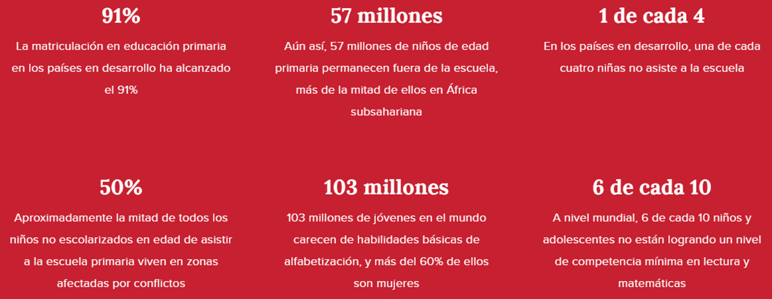
Educación de calidad: Facts and Figures https://www.undp.org/content/undp/es/home/sustainable-development-goals/goal-4-quality-education.html
Notes:
Cut up the 12 statements (6 Spanish and 6 English and match them – follow on with a discussion in English
Question prompts: Is this fair? Are they surprised? Shocked? Saddened? What are the possible consequences of these statistics?

Slide 6
Parallel text - English
1 Since 2000, considerable progress has been made towards achieving the universal 2 primary education target. The overall enrolment rate in developing regions 3 reached 91 per cent in 2015, and the number of out-of-school children globally 4 fell by almost half. There is also a dramatic increase in the literacy rate, and the 5 enrolment rate of girls has never been higher.
6 But these successes face great challenges in developing regions, due to high 7 levels of poverty, armed conflict and other emergencies. While sub-Saharan 8 Africa has made the largest progress among all developing regions in primary 9 school enrolment - from 52 percent in 1990 to 78 percent in 2012 - large 10 disparities remain. Children from the most disadvantaged homes are four times 11 less educated than those from the richest households. Similarly, disparities 12 between rural and urban areas remain.
13 Quality education for all is one of the most solid and proven pillars of 14 sustainable development. This goal ensures that all girls and boys complete a full 15 cycle of free primary and secondary education by 2030. It also aims to provide 16 equal access to vocational education and to eliminate inequalities between 17 genders and incomes, in order to allow all to access higher education.
Notes:
Find the Spanish for…the main facts and figures – 2 versions – easy with clues in the form of the text line number and harder with no clues

Slide 7
Parallel text – Español -
1 Desde el año 2000, ha habido un progreso considerable para 2 lograr el objetivo universal de la educación primaria. La tasa de escolarización en regiones en desarrollo 3 alcanzó el 91% en 2015, y el número de niños no escolarizados universalmente 4 decreció por casi la mitad. También ha habido un incremento dramático en la tasa de alfabetización, y 5 la tasa de escolarización de las niñas nunca ha sido tan alta.
6 Pero este éxito se enfrenta a 7 grandes retos en las regiones en desarrollo debido a los altos niveles de pobreza, conflictos armados y otras emergencias. 8 Mientras que África Subsahariana ha progresado en todas las regiones de desarrollo en 9 la escolarización en primaria –del 52% en 1990 al 78% en 2012- 10 todavía hay disparidades. Niños de los hogares más desfavorecidos son cuatro veces 11 menos educados que los niños de hogares más ricos. Similarmente, 12 quedan disparidades entre las zonas urbanas y rurales.
13 La educación de calidad para todos es uno de los pilares más sólidos y comprobados para 14 un desarrollo sostenible. Este objetivo asegura que los niños y las niñas 15 logren completar gratuitamente el ciclo de la educación primaria y segundaria para el 2030. También aspira a proveer 16 acceso igualitario a la formación profesional y eliminar las desigualdades 17 de género e ingresos, para que todos accedan a la educación superior.
Notes:
Find the Spanish for…the main facts and figures – 2 versions – easy with clues in the form of the text line number and harder with no clues

Slide 8
Find the Spanish for …
Inglés | Español
exemple: Since 2000 | Desde el año 2000
1 considerable progress
2 the enrolment rate
3 fell by almost half
4 great challenges
5 developing regions
6 large disparities remain
7 the richest households
8 rural and urban areas
9 Quality education for all
10 eliminate inequalities
Notes:
Harder version no clues

Slide 9
Find the Spanish for … Respuestas
Inglés | Español
exemple: Since 2000 | Desde el año 2000
1 considerable progress 1
2 the enrolment rate 2
3 fell by almost half 4
4 great challenges 7
5 developing regions 7/8
6 large disparities remain 12
7 the richest households 11
8 rural and urban areas 12
9 Quality education for all 13
10 eliminate inequalities 16
Notes:
Easier version – clues in the form of text line

Slide 10
Find the Spanish for … *the text line is given to help you
Inglés | Español
exemple: Since 2000
1 considerable progress 1
2 the enrolment rate 2
3 fell by almost half 4
4 great challenges 7
5 developing regions 7/8
6 large disparities remain 12
7 the richest households 11
8 rural and urban areas 12
9 Quality education for all 13
10 eliminate inequalities 16
Desde el año 2000
un progreso considerable
la tasa de escolarización
decreció por casi la mitad
grandes retos
las regiones en desarrollo
quedan disparidades
los niños de hogares más ricos
las zonas urbanas y rurales
la educación de calidad
eliminar las desigualdades
Notes:
Answers

Slide 11
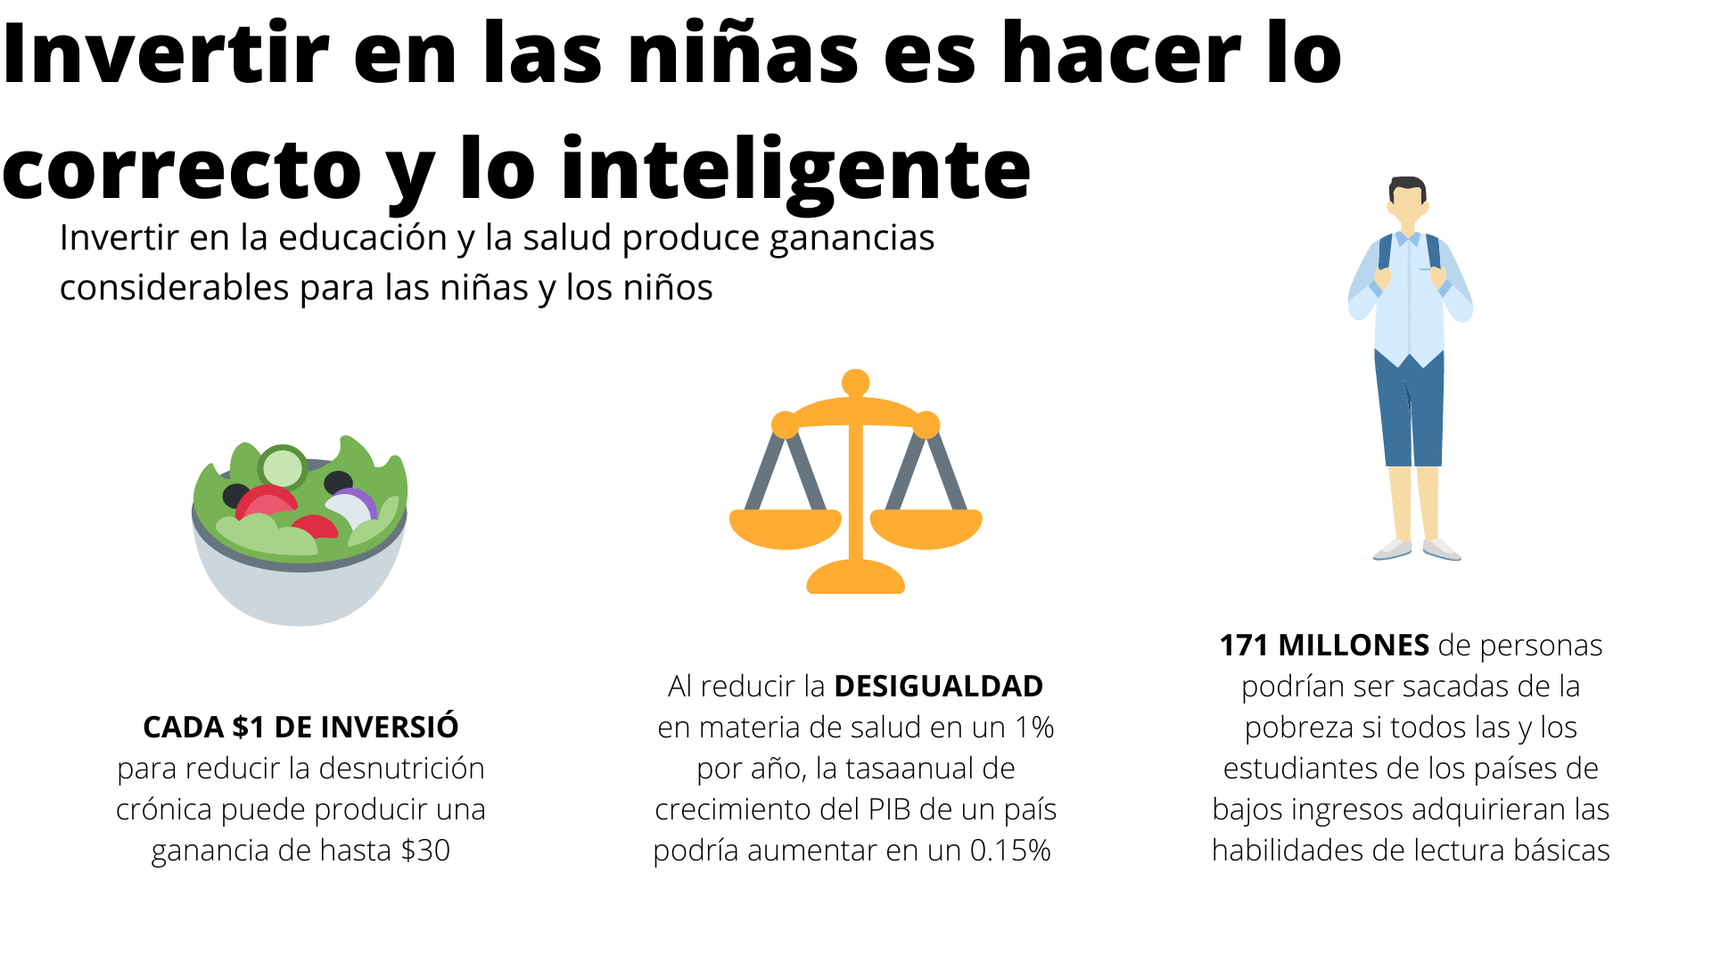
Source: https://visual.ly/community/Infographics/human-rights/invertir-en-las-niñ-es-hacer-lo-correcto-y-lo-inteligente
Notes:
Infographic taken from https://visual.ly/community/Infographics/human-rights/invertir-en-las-ni%C3%B1-es-hacer-lo-correcto-y-lo-inteligente
Why it is important to invest in girls
Explore the attitudes as a class
https://visual.ly/community/Infographics/human-rights/invertir-en-las-niñ-es-hacer-lo-correcto-y-lo-inteligente

Slide 12
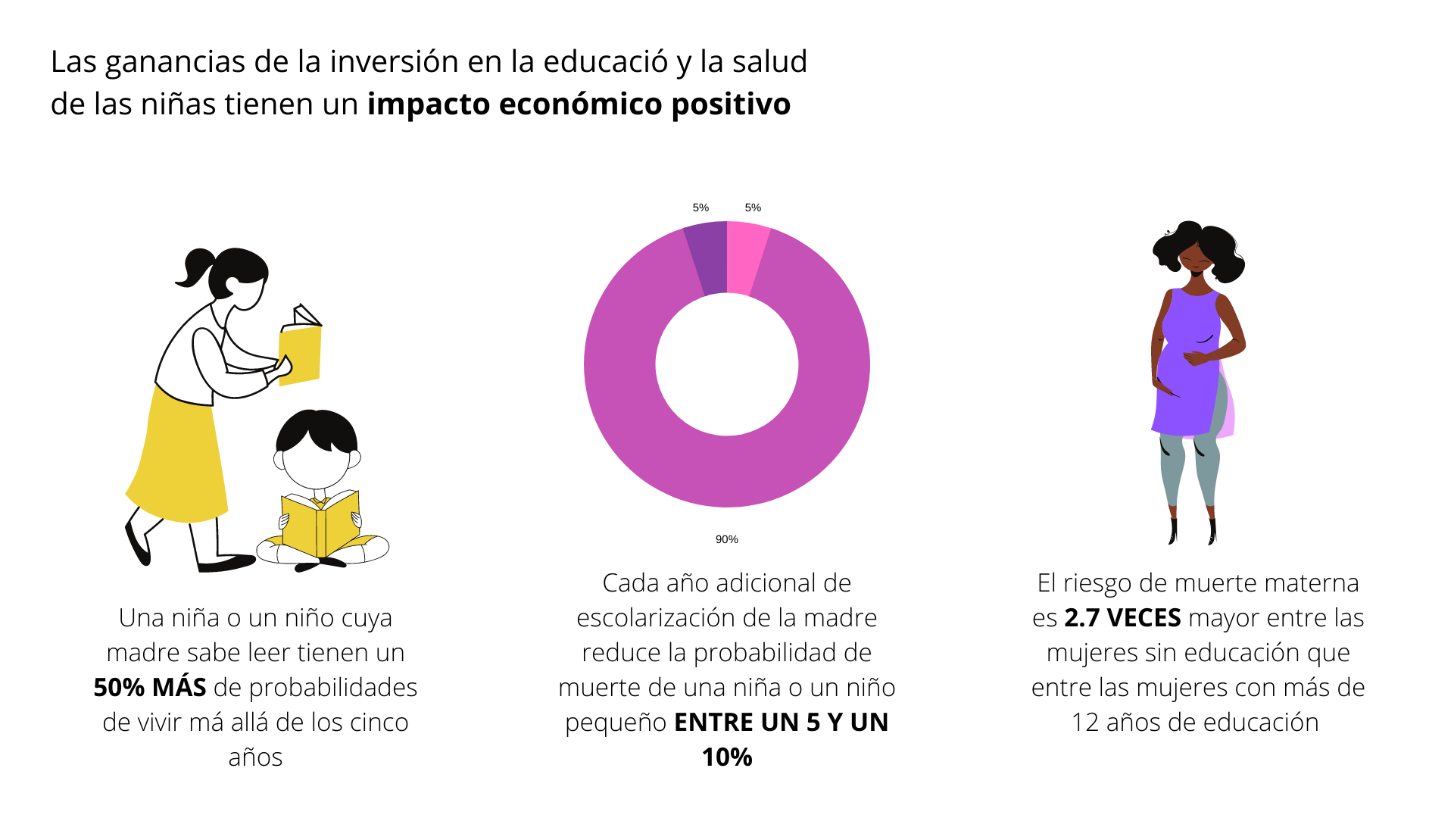
Source: https://visual.ly/community/Infographics/human-rights/invertir-en-las-niñ-es-hacer-lo-correcto-y-lo-inteligente
Notes:
Infographic taken from https://visual.ly/community/Infographics/human-rights/invertir-en-las-ni%C3%B1-es-hacer-lo-correcto-y-lo-inteligente
Why it is important to invest in girls
Explore the attitudes as a class

Slide 13
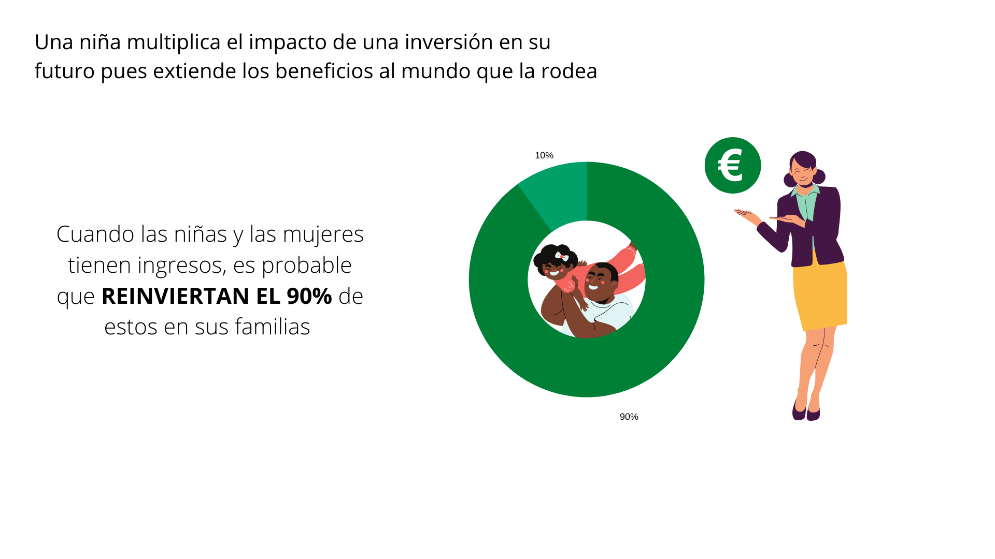
Source: https://visual.ly/community/Infographics/human-rights/invertir-en-las-niñ-es-hacer-lo-correcto-y-lo-inteligente
Notes:
Infographic taken from https://visual.ly/community/Infographics/human-rights/invertir-en-las-ni%C3%B1-es-hacer-lo-correcto-y-lo-inteligente
Why it is important to invest in girls
Explore the attitudes as a class

Slide 14
Notes:
El Drecho a la Educación de las Personas con Discapacidad Image from Canva

Slide 16
World Class Teaching project has been funded with support from the European Commission. The contents of these actions are the sole responsibility of the contractor and can in no way be taken to reflect the views of the European Union.

