Slide 1
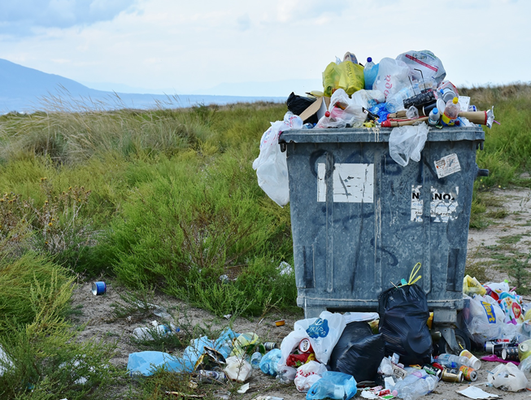
Desigualdades, reducción,
cero desperdicio de alimentos

Slide 4
¿Qué pasa en la foto?
Notes:
Picture prompt activity. Camels eating food waste from out of the waste bins in the UAE, 2019.

Slide 5
¿Qué es el desperdicio de alimentos?
https://www.youtube.com/watch?v=yRTpzmivp6M&t=20s
Notes:
Video: https://www.youtube.com/watch?v=yRTpzmivp6M&t=20s
additional video: https://www.youtube.com/watch?v=eLq3GzSDnZc

Slide 6
Comer a conciencia
Preguntas
What fraction of food in the world is wasted each year?
How many tons of food are wasted each year?
How many millions are starving in the world today?
Describe how consumers in developed countries act with food waste?
What could governments do to help the situation?
What could restaurants do to help food waste?
Notes:
There is a transcript of the video available to download as an additional support, in the resource section of the website.

Slide 7
Comer a conciencia
Respuestas
What fraction of food in the world is wasted each year?
How many tons of food are wasted each year?
How many millions are starving in the world today?
Describe how consumers in developed countries act with food waste?
What could governments do to help the situation?
What could restaurants do to help food waste?
one third
1 300 million
2 000 million
Irresponsibly
Changing state policy defining waste standards, introducing fines, create public awareness campaigns.
Serve smaller portions

Slide 8
Desperdicio de alimentos en España

Slide 9
Cero desperdicio de comida Text message challenge
Hola Mamá. Todo va bien en la universidad.
Hoy es la primera vez que voy sola al supermercado para hacer las compras… ¿Tienes algún consejo?
Un abrazo,
Amelia
¡Te extrañamos Amelia!
Un consejo… Ten mucho cuidado con el desperdicio de alimentos.
Besos,
Mamá
Notes:
Word doc
Pupils work in pairs and try to piece together the telephone conversation between Amelia (who has just started at University) and mamá
Teacher cuts up the conversation and pops into envelopes and pupils have to piece it back together in the correct order
This could then be acted out as a role play and used as a comprehension activity to understand some of the ways we can cut down food waste

Slide 10
Cero desperdicio en casa - 3 gestos simples
Notes:
https://www.facebook.com/VohitraEnvironnement/photos/bc.AboMhVNl4VAwSZgxz7GE9pqmKPL3upILeu-qn4vLlrdiKknUOK7-aOy4IQeOEOWXjprmrO4LfDrIQwu17wc4s2KtmVg8I2WszhX4ufxKFsBcrfvV4b1zxxcXMpgLP9K0j-bzGs4vzeVDsJs3KSXw_Sbu/535796286906196/?type=1&opaqueCursor=Abq6Vaf39vg5MHhsWq3LCX_9xcpMoNPbtuLa3zFuUNtRjSuY-_lnFkXyjbH9D8AVJPSR4ynicQCyIcfocPnI748Dh5MrVfFD4dSfujxPYW-Z2OB96pv6FK441lqBCaKuiHPhXsfkgOqZzueltJW-LJvzbw6MRQ61on7d4r0Hr0zNcetJ7cOfs9EuE8ruw-HbxoOAuYBB4RJsLy79vxGPhD1Rstma5gTpJstRegj7lEqDbhz-DkTi1FQGdnfd7A2SRUfrS6ML8B5HdO0iZmAUDmBPgJonZE4Cp1WCQpdzvQyCM56gCWxC5Rld2t2qX_X-63sNti61KgumEcOEUuziiU1ZTjNQjO5a7LT78p1bsozZL_T2rNOQicZ8MO1CW3Vs-eQxxZcuuVbFlDFsBBt_7Ag9lQB_u6wpw1gDQ_Z74Mu7kjED3wwxwuS8s2w2HKHjippLYQVODaG8VTnl_azMNa4SbpCHpog2RrynGEM88A2x6A&theater
Source Vohitra Consommation
Some further prompts for discussion around how to reduce our waste in more general terms

Slide 11
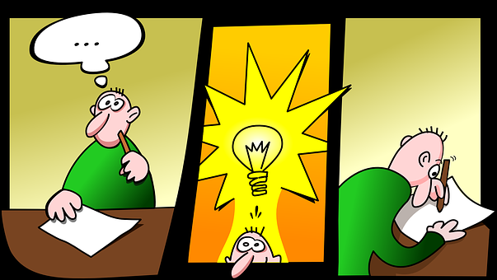
Presentación en grupos
Students work in small groups to summarise what they have learned in this unit of work. They should creatively present their work in one of the following 4 ways:
www.fodey.com
Newspaper article
iMovie
Short video clip
https://bubbl.us/
Create a mind map

Slide 13
World Class Teaching project has been funded with support from the European Commission. The contents of these actions are the sole responsibility of the contractor and can in no way be taken to reflect the views of the European Union.

