Slide 1
Faim “Zéro”:
Lesson 3
Notes:
https://pixabay.com/nl/photos/voedsel-vork-mes-tabel-plaat-2803655/

Slide 4
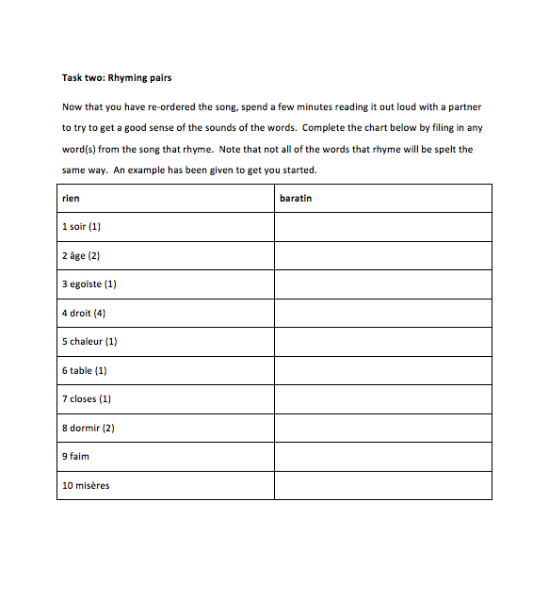
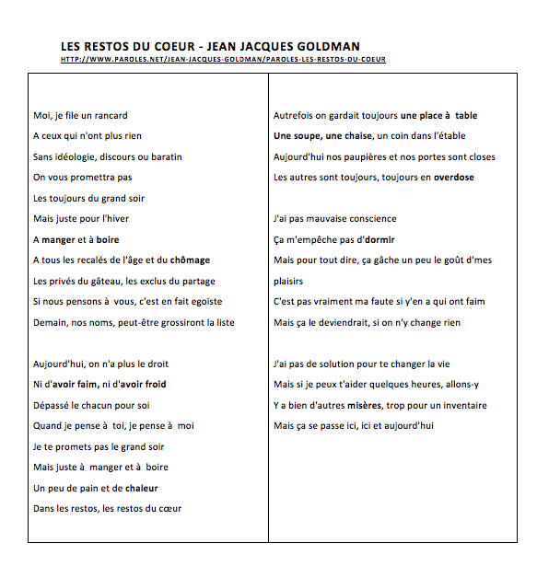
Les restos du cœur en France https://www.youtube.com/watch?v=xnp-wM9kzM8
Notes:
Word document activities x 2 Link to the song: https://www.youtube.com/watch?v=xnp-wM9kzM8

Slide 5
Extension Task
Read the following article: https://www.restosducoeur.org/covid19-les-restos-en-premiere-ligne-aupres-des-personnes-les-plus-demunies/
Now write your own verse in French about hunger in the UK (for example about food banks, or hunger during the COVID-19 pandemic).
Notes:
https://www.restosducoeur.org/

Slide 6
Les restos du cœur
See also:
https://www.1jour1actu.com/info-animee/cest-quoi-les-restos-du-coeur/
https://www.1jour1actu.com/france/cest-quoi-les-restos-du-coeur-90836/
https://www.1jour1actu.com/wp-content/uploads/actu-longue-resto2.pdf

Slide 8
World Class Teaching project has been funded with support from the European Commission. The contents of these actions are the sole responsibility of the contractor and can in no way be taken to reflect the views of the European Union.

