Slide 1
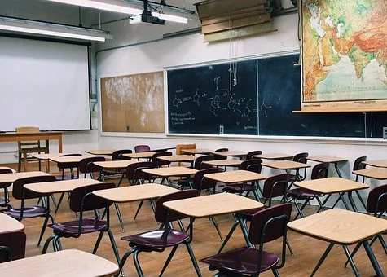
Éducation de
qualité
Notes:
https://pixabay.com/de/photos/klassenzimmer-schule-bildung-lernen-2093744/

Slide 4
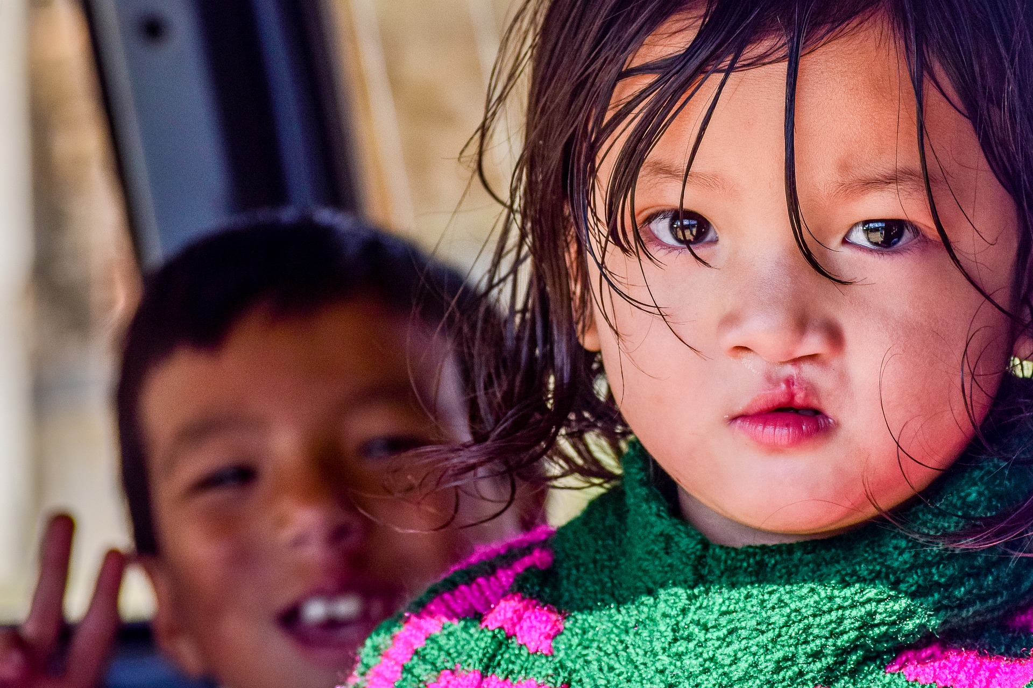
Point de départ – discussion en paires
#SonÉducationNotreAvenir
Notes:
6 x a4 laminated picture / text prompts as a starting point for discussion – see also *Word mat
Image by <a href="https://pixabay.com/users/suketdedhia-2328834/?utm_source=link-attribution&amp;utm_medium=referral&amp;utm_campaign=image&amp;utm_content=2852806">Suket Dedhia</a> from <a href="https://pixabay.com/?utm_source=link-attribution&amp;utm_medium=referral&amp;utm_campaign=image&amp;utm_content=2852806">Pixabay</a>

Slide 5
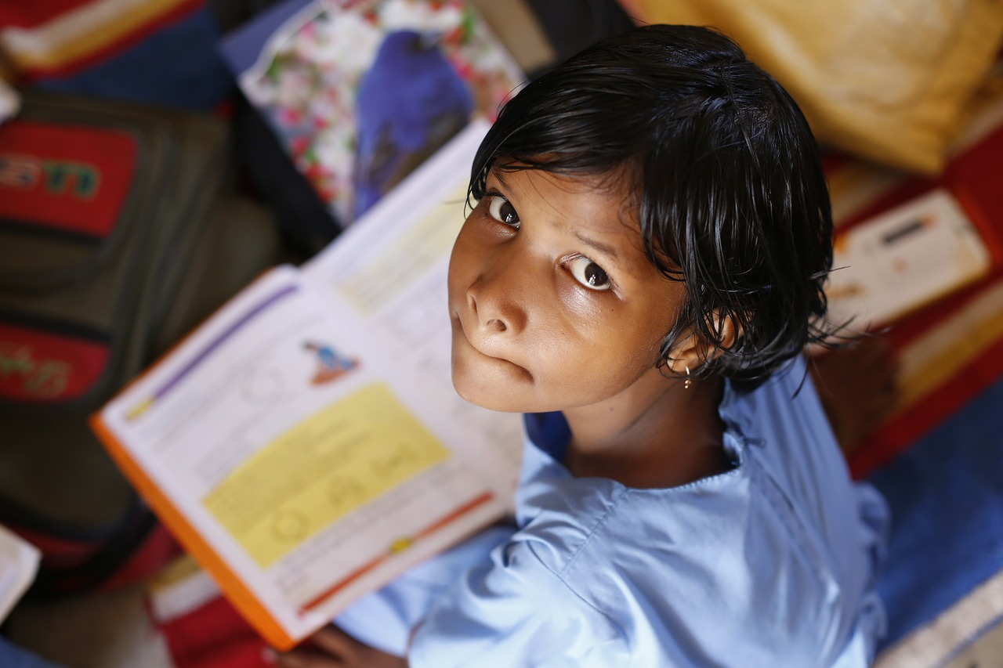
L’injustice, c’est 130 millions d’enfants qui vont à l’école primaire mais n’ont pas les connaissances de base pour lire, écrire et compter.
Notes:
6 x a4 laminated picture / text prompts as a starting point for discussion – see also *Word mat
Image by <a href="https://pixabay.com/users/akshayapatra-195187/?utm_source=link-attribution&amp;utm_medium=referral&amp;utm_campaign=image&amp;utm_content=306607">AkshayaPatra Foundation</a> from <a href="https://pixabay.com/?utm_source=link-attribution&amp;utm_medium=referral&amp;utm_campaign=image&amp;utm_content=306607">Pixabay</a>

Slide 6
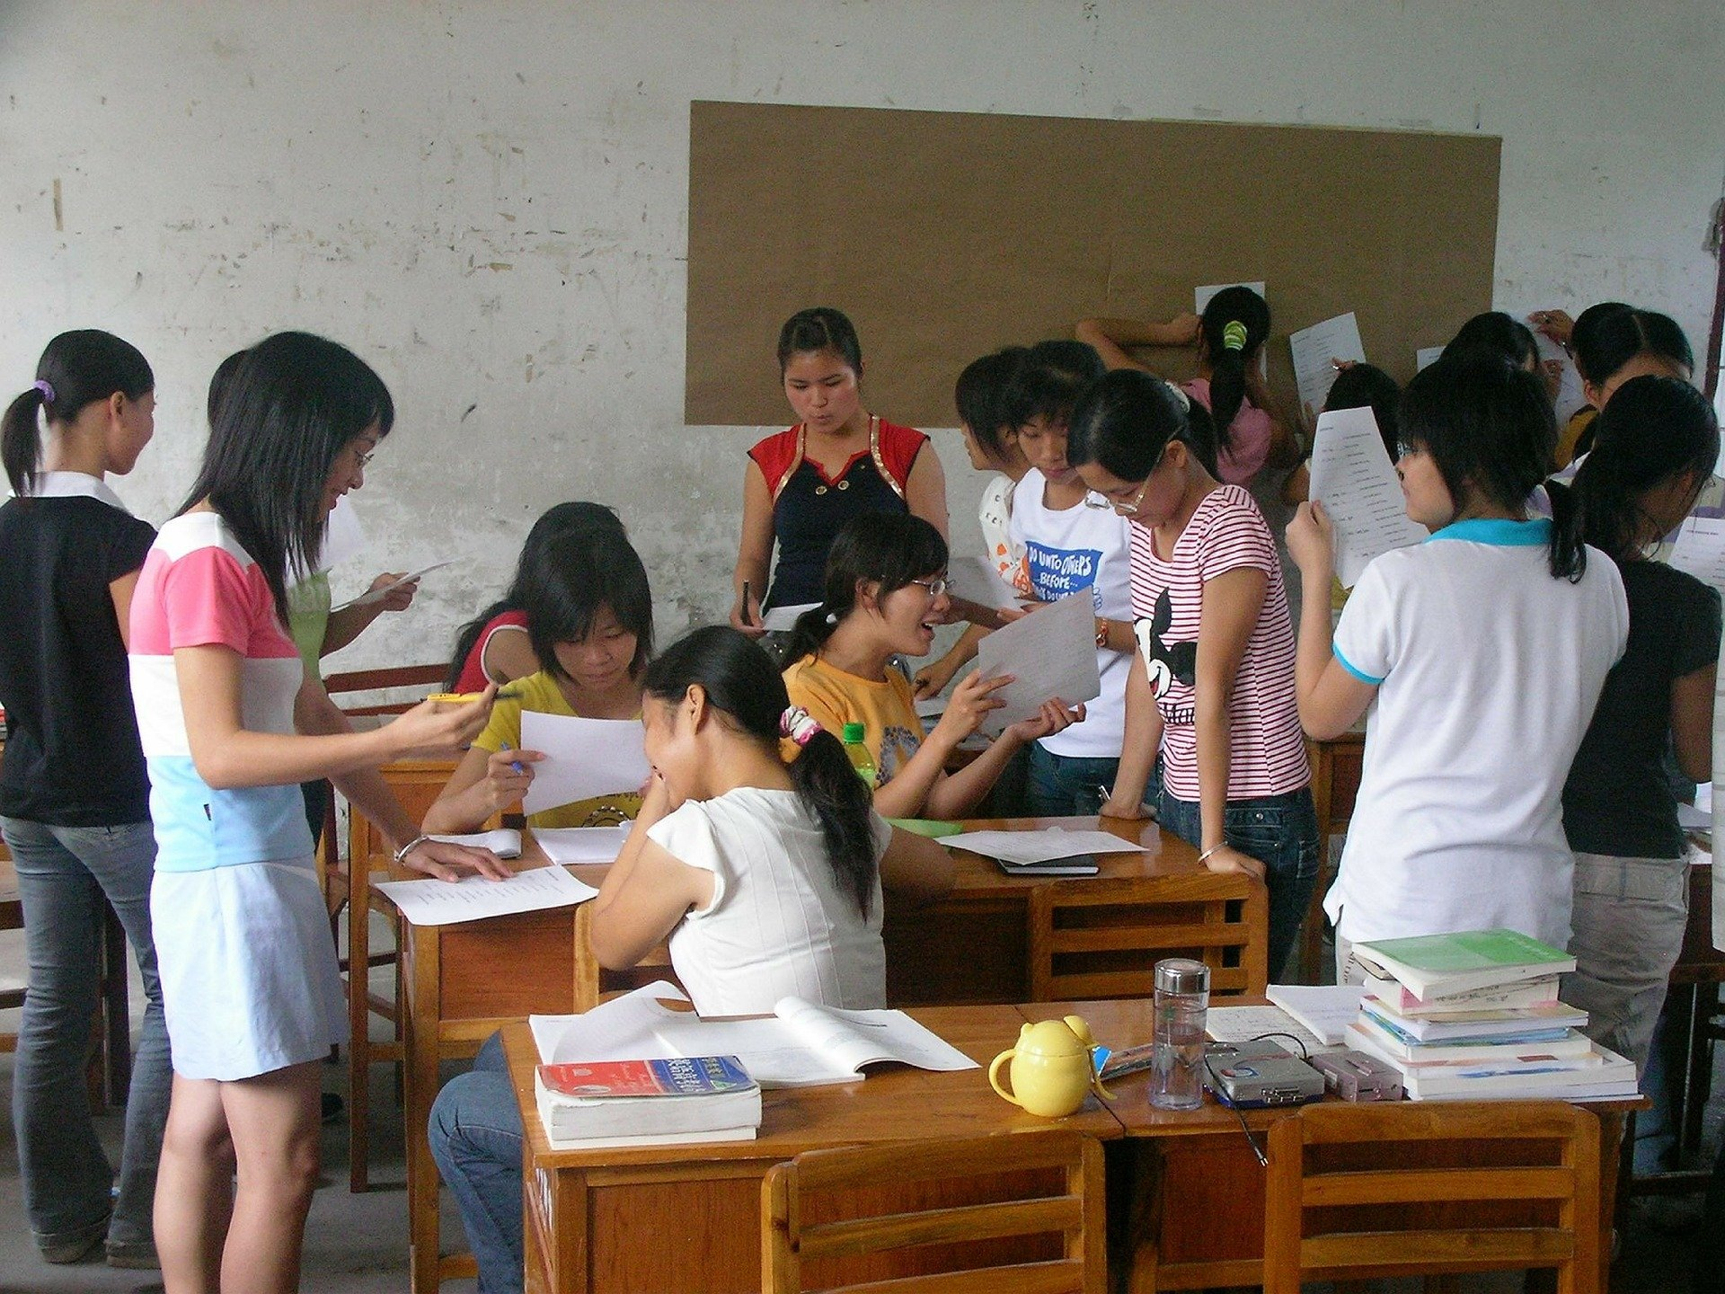
1 fille sur 5 est privée d’éducation dans le monde
Notes:
6 x a4 laminated picture / text prompts as a starting point for discussion – see also *Word mat
Image by <a href="https://pixabay.com/users/andros1234-139658/?utm_source=link-attribution&amp;utm_medium=referral&amp;utm_campaign=image&amp;utm_content=302116">andros1234</a> from <a href="https://pixabay.com/?utm_source=link-attribution&amp;utm_medium=referral&amp;utm_campaign=image&amp;utm_content=302116">Pixabay</a>

Slide 7
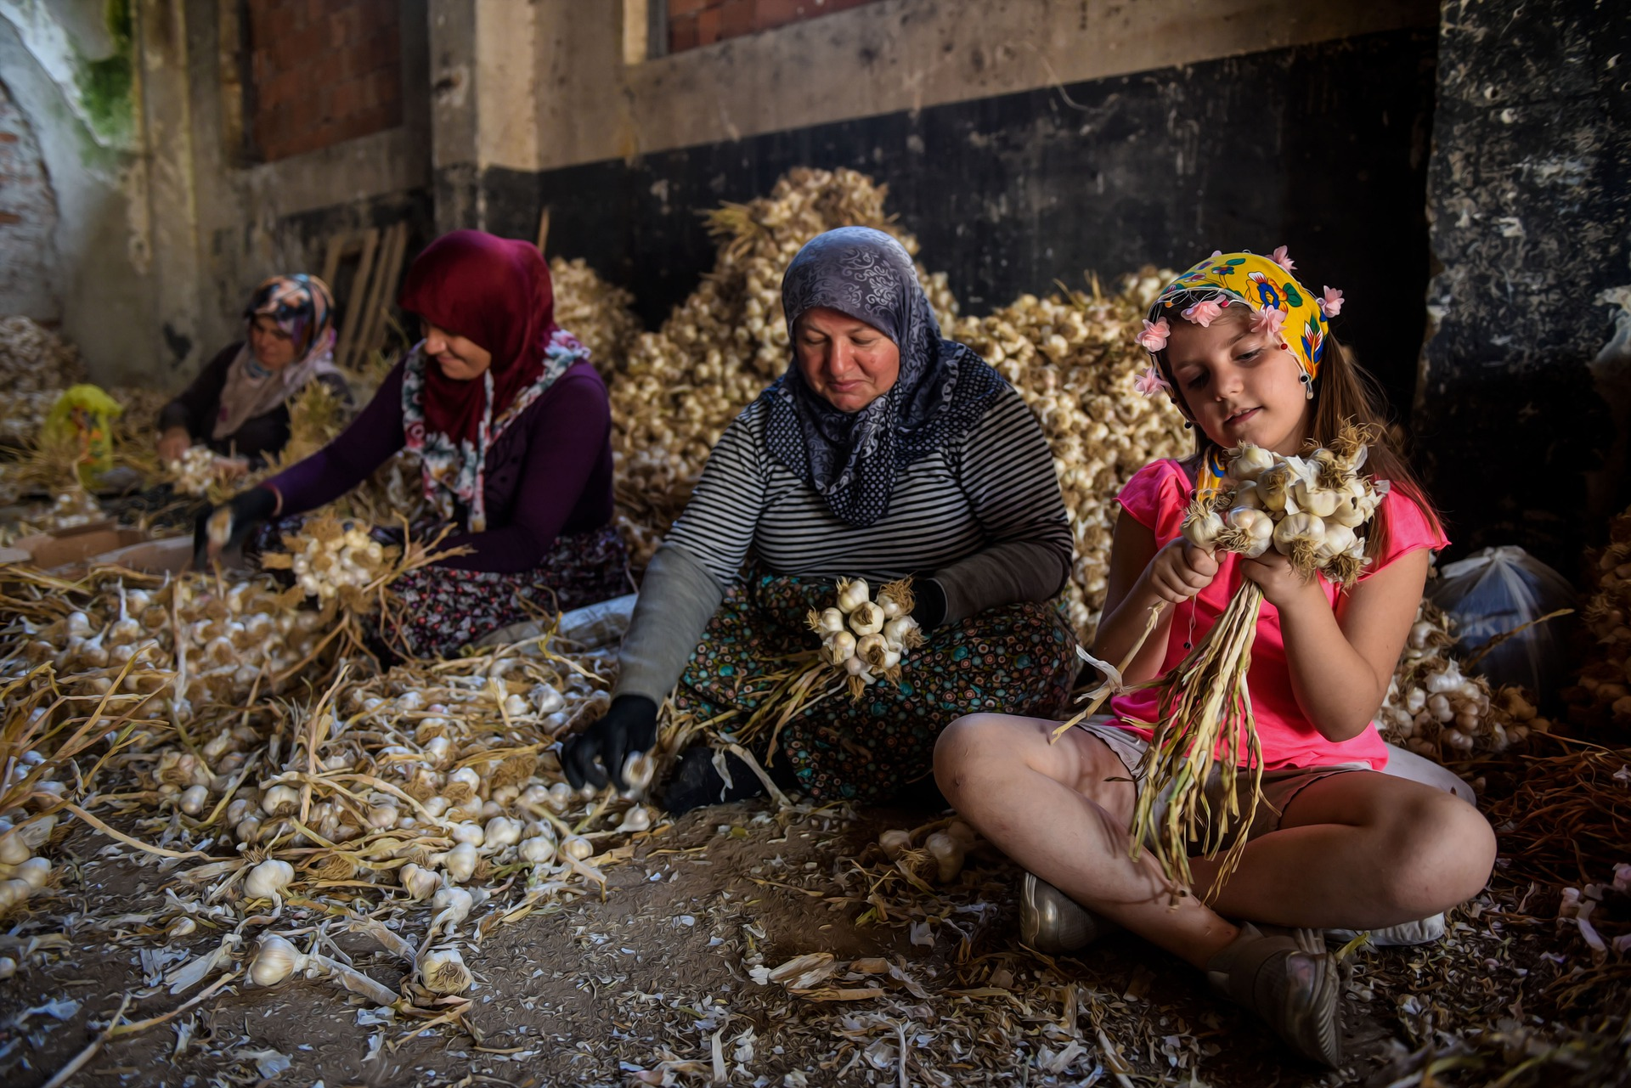
Travail infantile: 116 millions de filles dans le monde sont exploitées
Notes:
6 x a4 laminated picture / text prompts as a starting point for discussion – see also *Word mat
Image by <a href="https://pixabay.com/users/hmzasefaa-7327670/?utm_source=link-attribution&amp;utm_medium=referral&amp;utm_campaign=image&amp;utm_content=4373221">Hamza Sefa Yılmaz</a> from <a href="https://pixabay.com/?utm_source=link-attribution&amp;utm_medium=referral&amp;utm_campaign=image&amp;utm_content=4373221">Pixabay</a>

Slide 8
Pour une fille: 1 année d’école secondaire en plus =
15 à 25% de revenus supplémentaires
Notes:
6 x a4 laminated picture / text prompts as a starting point for discussion – see also *Word mat
Image by <a href="https://pixabay.com/users/nattanan23-6312362/?utm_source=link-attribution&amp;utm_medium=referral&amp;utm_campaign=image&amp;utm_content=2724241">Nattanan Kanchanaprat</a> from <a href="https://pixabay.com/?utm_source=link-attribution&amp;utm_medium=referral&amp;utm_campaign=image&amp;utm_content=2724241">Pixabay</a>

Slide 9
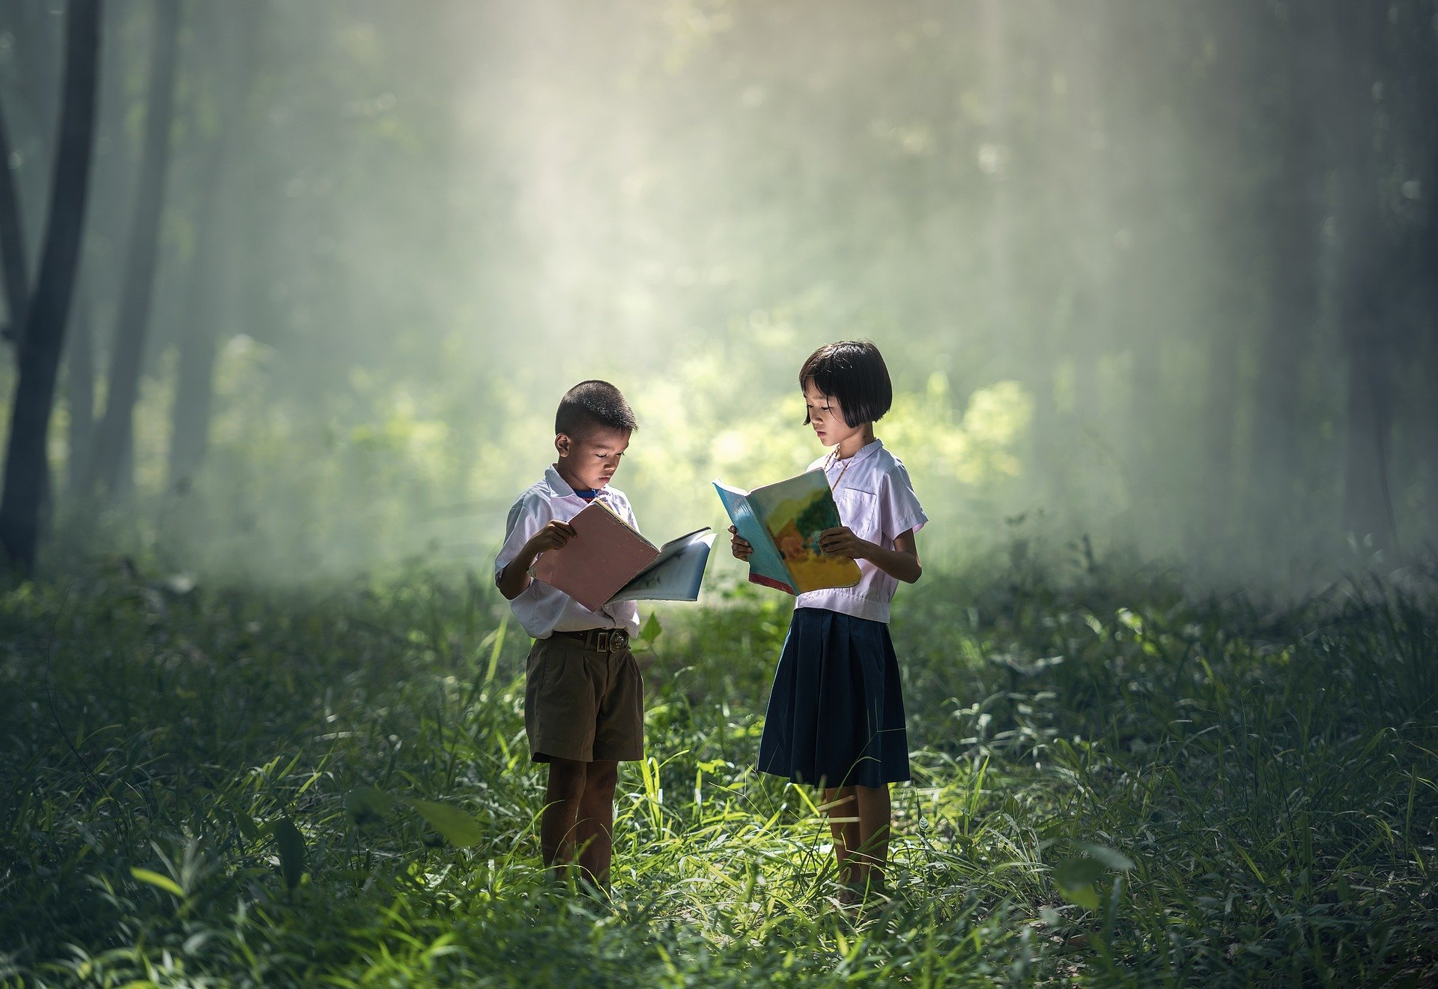
On estime que 50 % des enfants en âge de fréquenter l’école primaire qui ne sont pas scolarisés vivent dans des zones touchés par un conflit.
Objectif 4 #ÉducationdeQualité
Les inscriptions dans l’enseignement primaire dans les pays en développement ont atteint 91%, mais 57 000 000 enfants n’ont toujours pas accès à la scolarité.
L
Notes:
6 x a4 laminated picture / text prompts as a starting point for discussion – see also *Word mat
Image by <a href="https://pixabay.com/users/stocksnap-894430/?utm_source=link-attribution&amp;utm_medium=referral&amp;utm_campaign=image&amp;utm_content=2596809">StockSnap</a> from <a href="https://pixabay.com/?utm_source=link-attribution&amp;utm_medium=referral&amp;utm_campaign=image&amp;utm_content=2596809">Pixabay</a>
Image by <a href="https://pixabay.com/users/sasint-3639875/?utm_source=link-attribution&amp;utm_medium=referral&amp;utm_campaign=image&amp;utm_content=1822474">Sasin Tipchai</a> from <a href="https://pixabay.com/?utm_source=link-attribution&amp;utm_medium=referral&amp;utm_campaign=image&amp;utm_content=1822474">Pixabay</a>

Slide 10
Word Mat
Français | Anglais
trop de | too many
avenir | future
puissant | powerful
connaissances de base | basic skills
lire, écrire et compter | read, write and count
un monde juste | a fair world
privée de | denied
travail infantile | child labour
en plus | extra / additional
revenus supplémentaires | extra income
fréquenter l’école | to attend school
les pays en développement | developing countries
Notes:
*Word mat to go with poster activity as support and in place of a dictionary

Slide 11
Le droit à une éducation
Notes:
Word document task

Slide 12
Le droit à une éducation

Slide 13
Chanson – Metzo Diata (Sénégal) Petit ami veut aller à l’école
Notes:
Word document

Slide 15
World Class Teaching project has been funded with support from the European Commission. The contents of these actions are the sole responsibility of the contractor and can in no way be taken to reflect the views of the European Union.

