Slide 1
Éducation de qualité:
Lesson 3
Notes:
https://pixabay.com/de/photos/tafel-schultafel-leer-schiefertafel-597238/

Slide 4
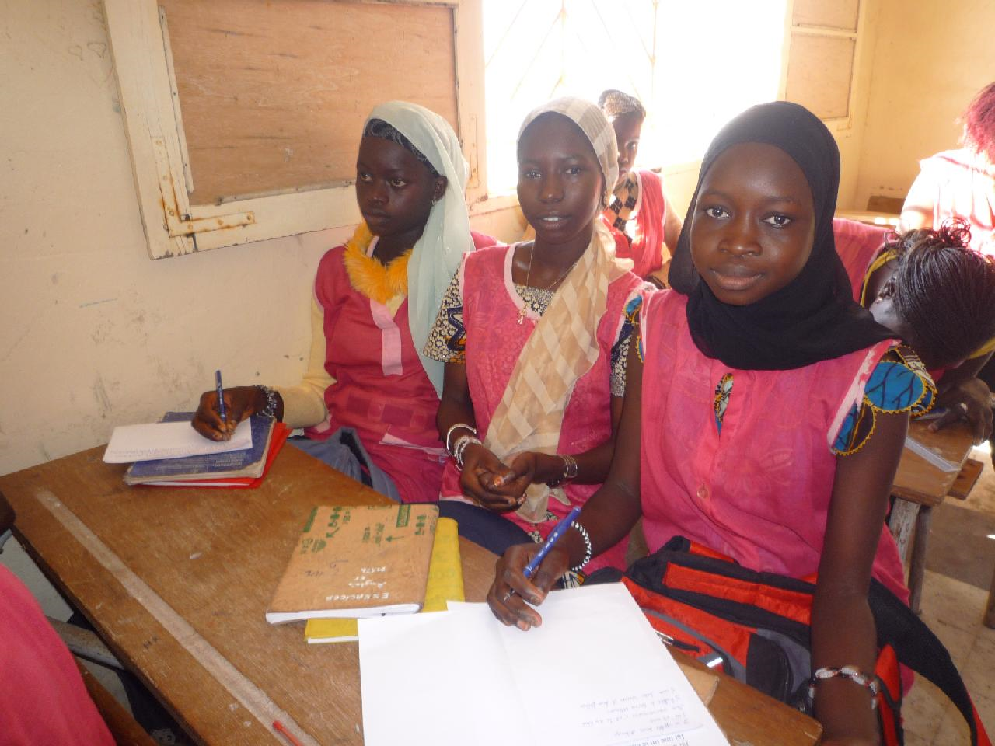
Students accessing their right to education in Senegal
Notes:
Students accessing their right to education in Senegal

Slide 5
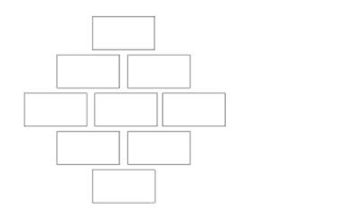
What are the benefits of education?
In pairs match the English and French statements
Discuss and rank the French version in a Diamond 9
Most important reason
Least important reason

Slide 6
Sur le chemin de l’école Trailer for the film: total time 1 min 24 secs
Regarde la bande annonce du film français, Sur le chemin de l’école et réponds aux questions suivantes en anglais:
1 What are the names of the 4 main characters?
2 What countries do they come from?
3 Who has the longest journey to school (km)?
4 Whose journey takes the longest time?
5 What animal do Jackson and his friends encounter on their journey?
6 How much value do they place on education?
Notes:
Link to trailer: https://www.youtube.com/watch?v=aEHQePgNXNU
Link to full film: https://www.youtube.com/watch?v=OIsFlkvupBs

Slide 7
Sur le chemin de l’école
Regarde la bande annonce du film français, Sur le chemin de l’école et réponds aux questions suivantes en français:
1 Comment s’appellent les 4 caractères principaux du film?
2 Ils viennent de quels pays ?
3 Qui a le trajet le plus long en kilomètres?
4 Qui prends le plus de temps à voyager à l’école?
5 Ils voient quels animaux sur le chemin de l’école?
6 Ils mettent une grande /petite valeur sur l’éducation?

Slide 8
Sur le chemin de l’école Les réponses
Regarde la bande annonce du film français, Sur le chemin de l’école et réponds aux questions suivantes en français:
1 Comment s’appellent les 4 caractères principaux du film? Jackson, Samuel, Zahira, Carlos
2 Ils viennent de quels pays? le Kenya, l’Inde, le Maroc, l’Argentine
3 Qui a le trajet le plus long en kilomètres? Zahira, 22km
4 Qui prends le plus de temps à voyager à l’école? Zahira, 4 heures
5 Jackson et ses amis voient quel animal sur leur chemin de l’école? Un éléphant
6 Ils mettent une grande /petite valeur sur l’éducation? Une grande valeur

Slide 9
Sur le chemin de l’école Answers
Regarde la bande annonce du film français, Sur le chemin de l’école et réponds aux questions suivantes en anglais:
1 What are the names of the 4 main characters? Jackson, Samuel, Zahira, Carlos
2 What countries do they come from? Kenya, India, Morocco, Argentina
3 Who has the longest journey to school (km)? Zahira 22km
4 Whose journey takes the longest time? Zahira, 4 hours
5 What animal do Jackson and his friends encounter on their journey? An elephant
6 How much value do they place on education? A huge importance

Slide 10
Sur le chemin de l’école: bande annonce du film français
http://boutdegomme.fr/ekladata.com/boutdegomme.eklablog.com/perso/cinema/Sur-le-chemin-de-l-e-cole-complet-.pdf
http://www.kinomachtschule.at/data/surlechemindel_ecole.pdf
Dossiers pédagogiques x 2 sur le film Sur le chemin de l’école
Notes:
These links take you to information about the film which you can print or share on screen with your students. They cover key aspects of the students’ journeys in the film ‘Sur le chemin de l’ecole’. The conversations within the families of each child explore the importance they place on going to school. You may want to pick out these sections and show them, after students have read information in these links.

Slide 11
Pair work in Senegalese classroom

Slide 12
Other possible links to explore…
https://www.theguardian.com/education/gallery/2012/sep/14/schools-around-the-world-children?fbclid=IwAR3Xm6uySxQhaG_YpL71nwYLZUbBUL82ui9AtXcD-Ua2ql_l6yS_9QNygk4
Guardian – Schools around the world photos and case studies

Slide 13
https://www.un.org/sustainabledevelopment/fr/wp-content/uploads/sites/4/2016/10/Why_it_matters_Goal_4_French.pdf
Notes:
Longer more complex text to exploit with more able learners

Slide 14
‘Éducation de qualité What have you learnt?
In pairs practice a French sentence which demonstrates your learning about our education topic.

Slide 16
World Class Teaching project has been funded with support from the European Commission. The contents of these actions are the sole responsibility of the contractor and can in no way be taken to reflect the views of the European Union.

