Slide 1
Igualdad de género:
Lesson 1
Notes:
Image source: https://pixabay.com/illustrations/equality-gender-woman-duality-sky-2110561/

Slide 4
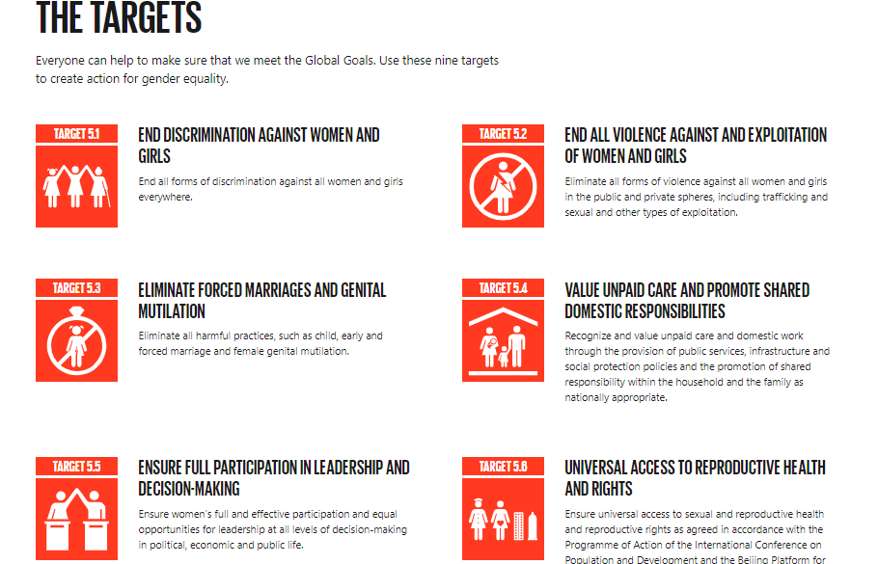
Read the following article in Spanish- Gender equality: Why does it matter?
Notes:
Source: https://www.globalgoals.org/5-gender-equality There are 9 targets as part of Sustainable development Goal 5 to create action for gender equality.

Slide 5
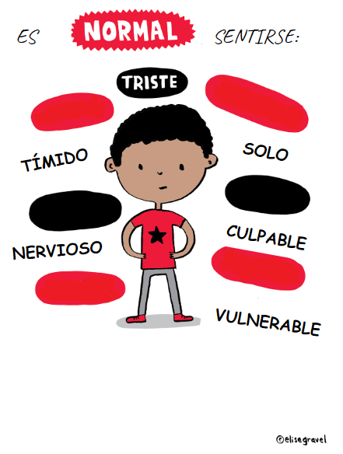
BELL WORK: Can you translate the following poster into English?
ENFADADO
AVERGONZADO
FRUSTRADO
FURIOSO
INQUIETO
CELOSO
Todos nos sentimos así a veces.
No nos hace más débiles, sino
Y es bueno hablarlo.
HUMANOS
Notes:
For weaker learners, there is a supplementary vocabulary builder sheet which contains all the key vocab for this lesson - could be used first or alongside this and the other activities and tasks as support
Do students agree with the sentiment of the poster?
http://elisegravel.com/en/livres/free-printable-stuff/

Slide 6
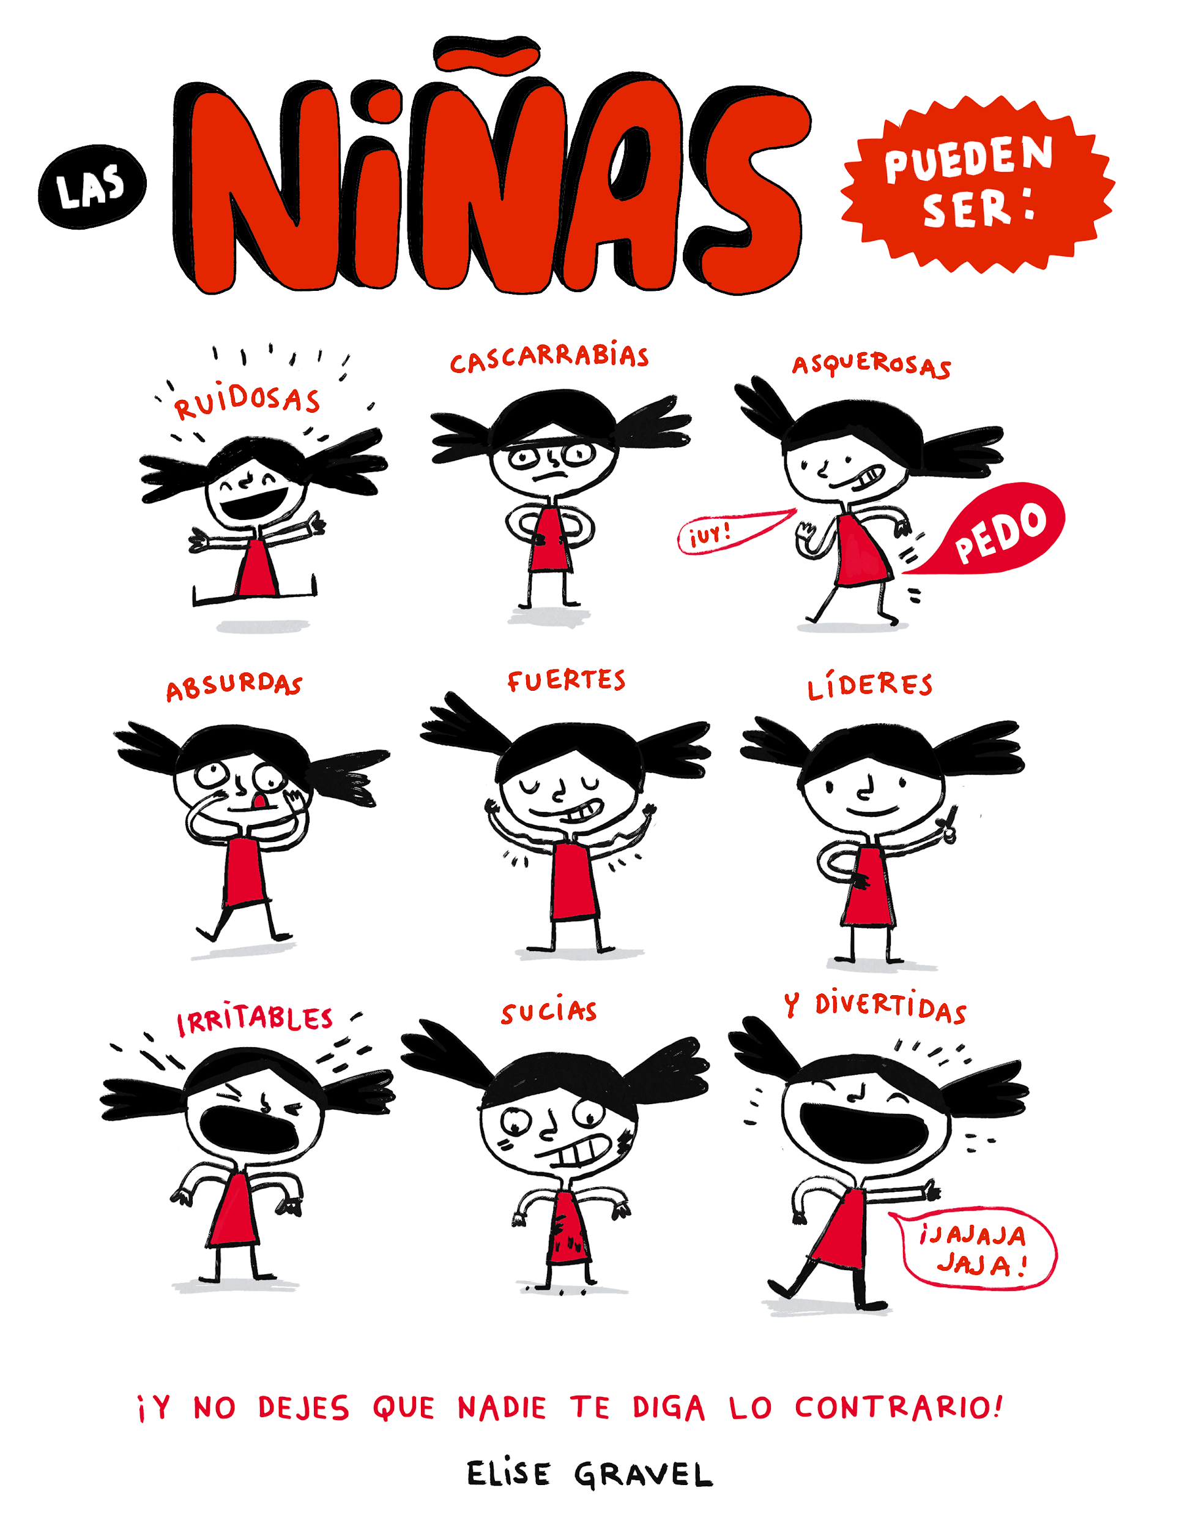
Extension task:
What do you notice about all these adjectives?
What do they have in common and why?
According to this poster, how can girls be?
Do you agree?
Notes:
http://elisegravel.com/en/livres/free-printable-stuff/

Slide 7
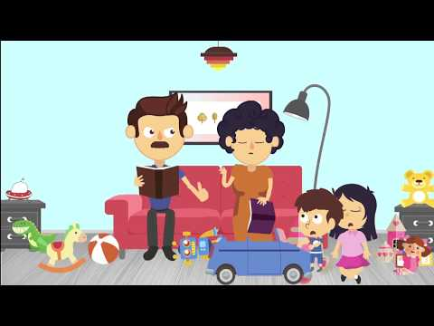
¿Hay igualdad entre los chicos y las chicas?
Notes:
Watch the video and discuss as a class https://www.youtube.com/watch?v=2d7K7nP-2Ro

Slide 8
 | strong |  | grumpy
 | noisy*
Starting with noisy* in the middle, play dominoes in pairs
(4 cards each) to match up the feminine adjectives
Notes:
Dominoes game – matching pairs
http://elisegravel.com/wp-content/uploads/2018/01/Ninas.png

Slide 9
 | smelly |  | ridiculous
 | angry |  | dirty
 | funny |  | leader
Notes:
http://elisegravel.com/wp-content/uploads/2018/01/Ninas.png

Slide 10
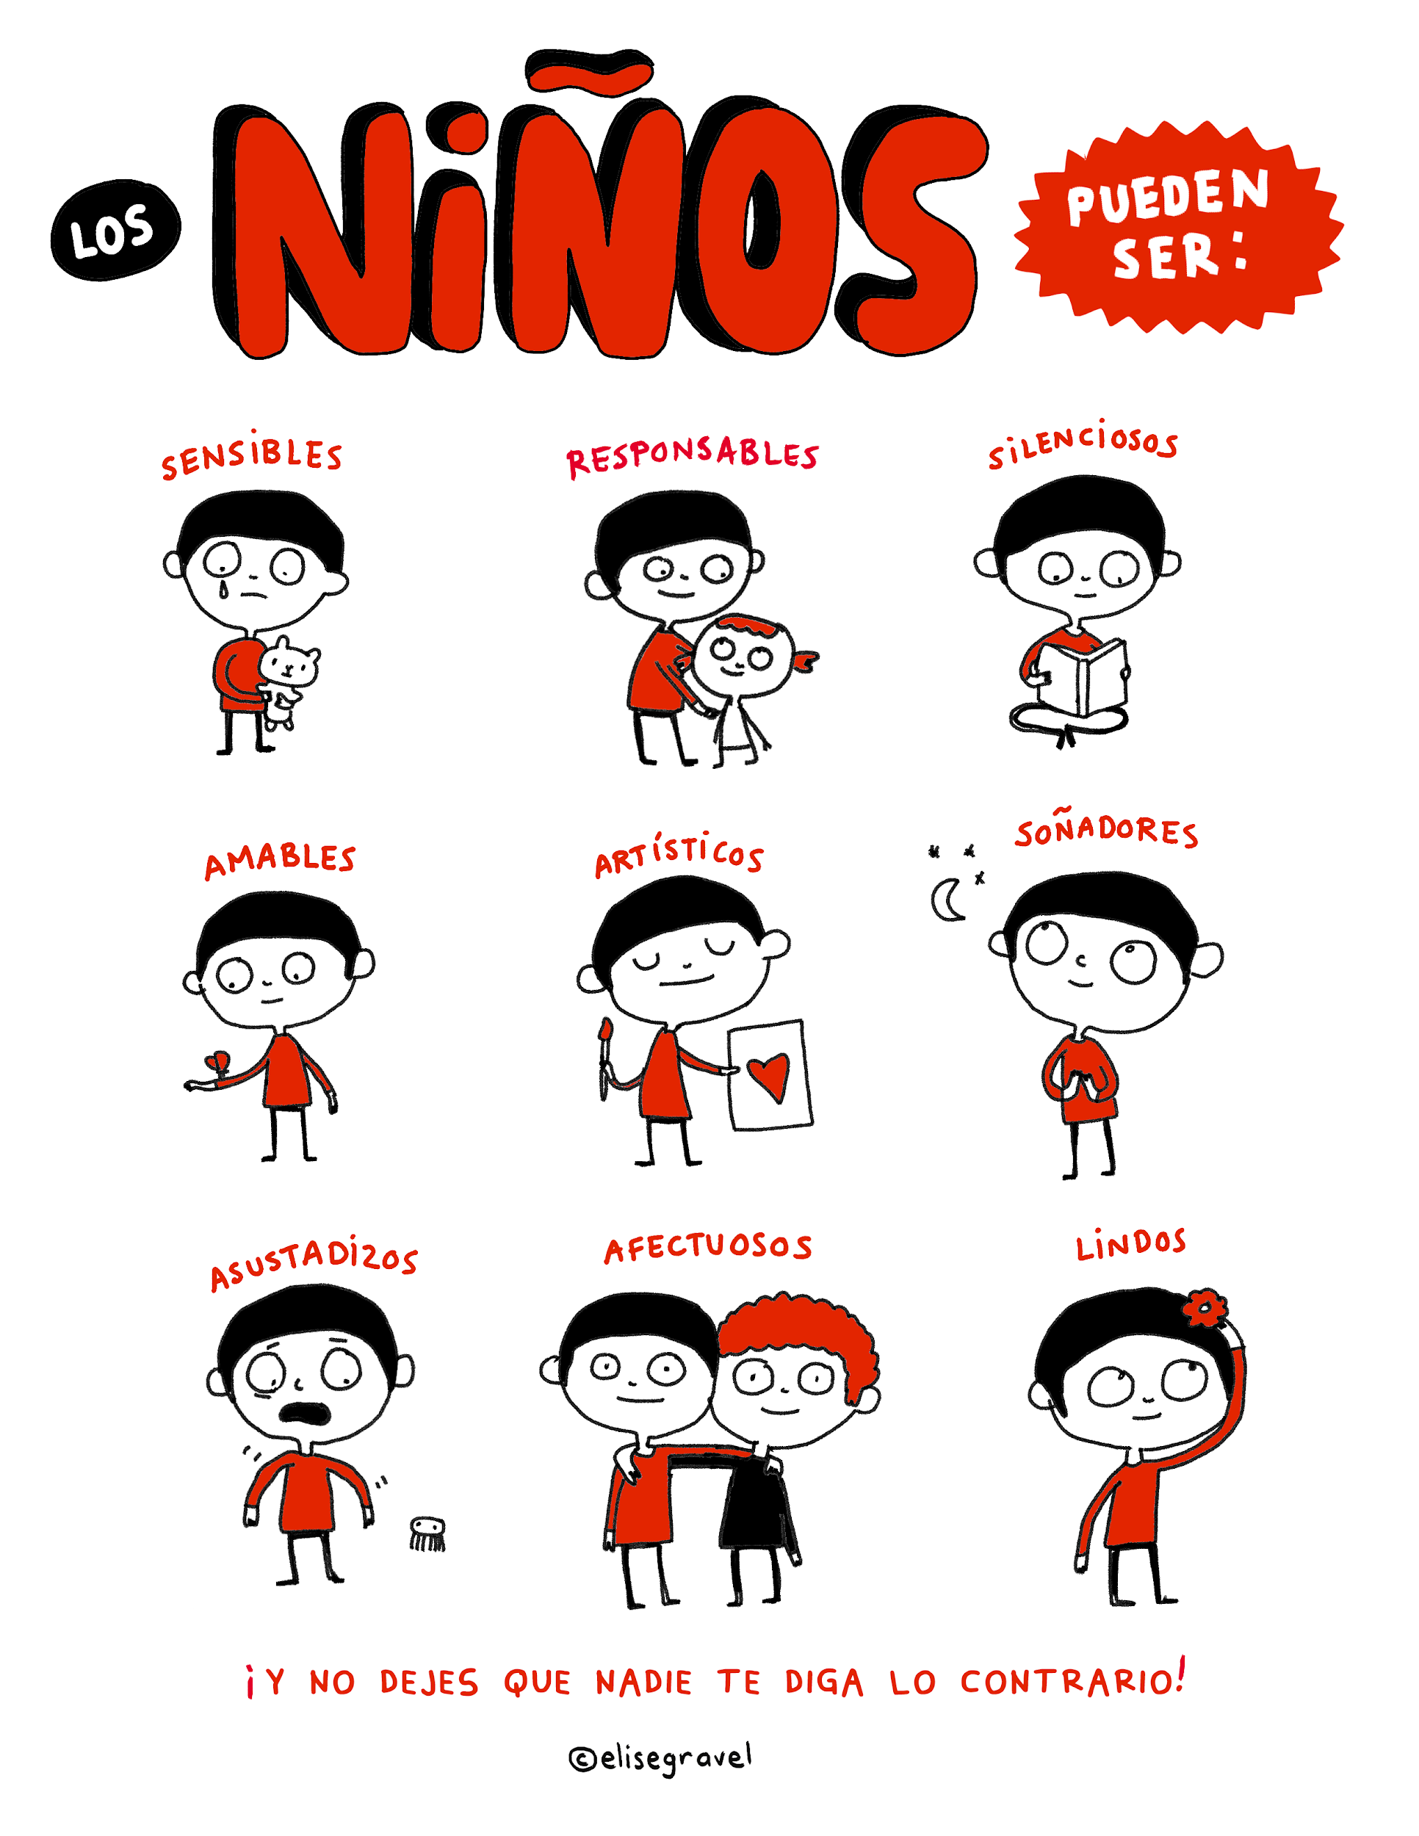
According to this poster, how can boys be?
Do you agree?
Notes:
http://elisegravel.com/wp-content/uploads/2018/01/ninos-2.png

Slide 11
 | Be Quiet |  | Responsible
 | Be gentle
Notes:
Hand out 9 cards per person, face up and in pairs, work together to try to match up the cards.
Follow on games could include snap and blind pairs (all cards face down)
Cut up all 18 cards and put into envelopes then ask students to divide themselves into pairs and hand out 9 cards per person http://elisegravel.com/wp-content/uploads/2018/01/ninos-2.png
http://elisegravel.com/en/livres/free-printable-stuff/

Slide 12
 | Be dreamers |  | Be pretty
 | Be afraid |  | Be affectionate
 | Be creative |  | Be sensitive
Notes:
Hand out 9 cards per person, face up and in pairs, work together to try to match up the cards.
Follow on games could include snap and blind pairs (all cards face down)
Cut up all 18 cards and put into envelopes then ask students to divide themselves into pairs and hand out 9 cards per person http://elisegravel.com/wp-content/uploads/2018/01/ninos-2.png
http://elisegravel.com/en/livres/free-printable-stuff/

Slide 13
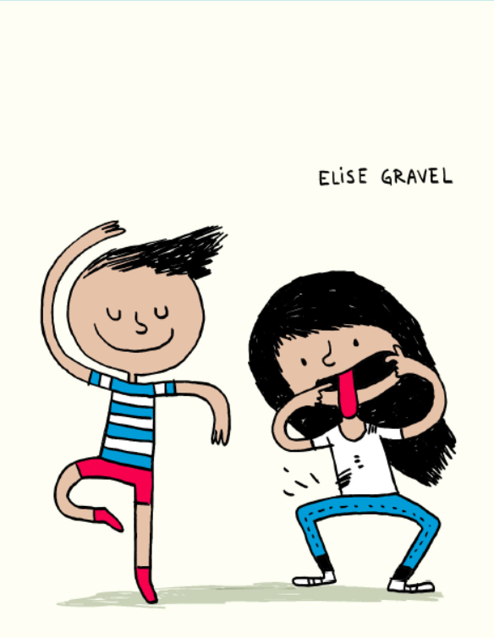
Una historia corta : Tú Puedes – Élise Gravel
TÚ PUEDES
Notes:
Read and discuss as a class
http://elisegravel.com/en/livres/free-printable-stuff/

Slide 14
TÚ PUEDES
Notes:
http://elisegravel.com/en/livres/free-printable-stuff/

Slide 15
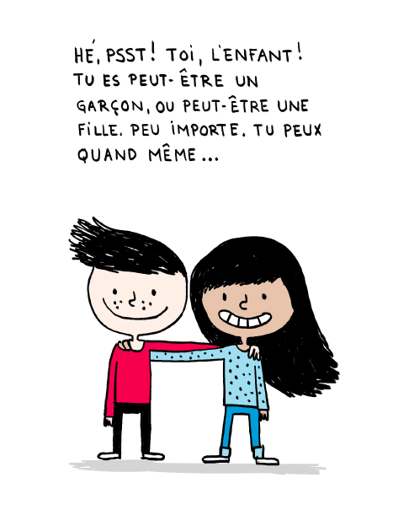
¡EH, PSST! ¡TÚ, CHAVAL!
PUEDES SER UN NIÑO O PUEDES SER UNA NIÑA. PERO NO IMPORTA, TÚ PUEDES...
Notes:
http://elisegravel.com/en/livres/free-printable-stuff/

Slide 16
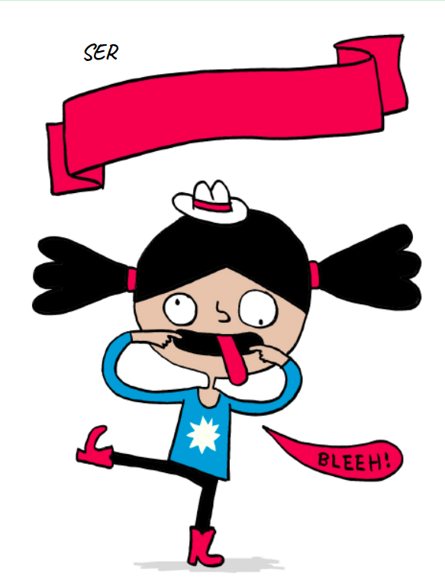
DIVERTIDO
Notes:
http://elisegravel.com/en/livres/free-printable-stuff/

Slide 17
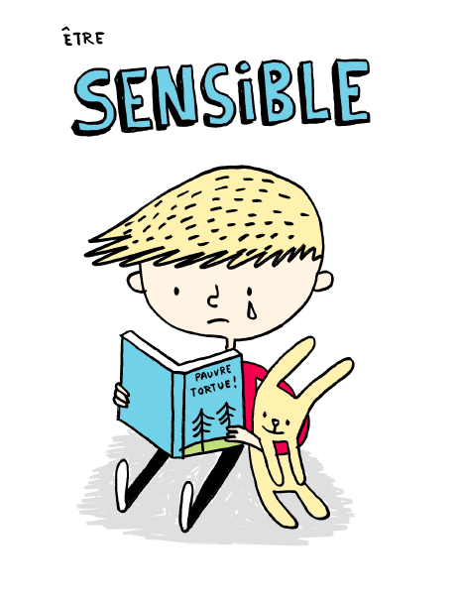
SER
Notes:
http://elisegravel.com/en/livres/free-printable-stuff/

Slide 18
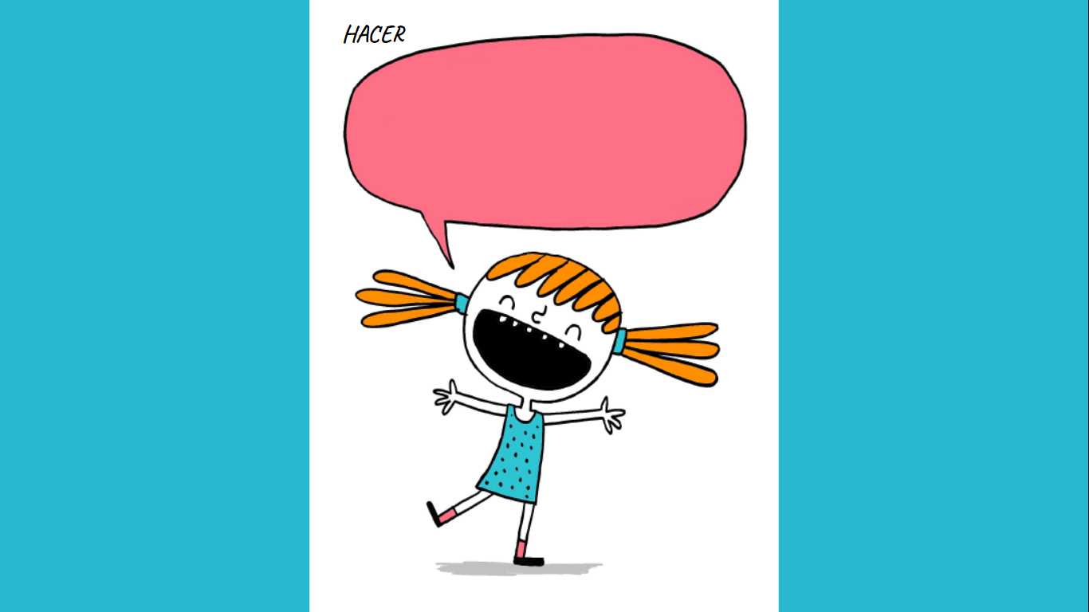
HACER
RUIDO
RUIDO
Notes:
http://elisegravel.com/en/livres/free-printable-stuff/

Slide 19
SER UN
ARTISTA
Notes:
http://elisegravel.com/en/livres/free-printable-stuff/

Slide 20
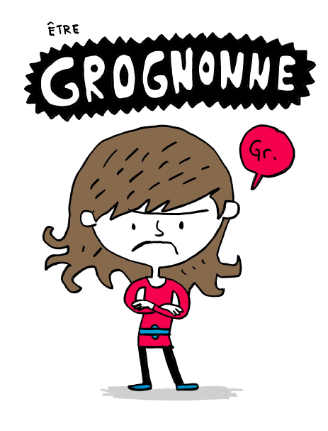
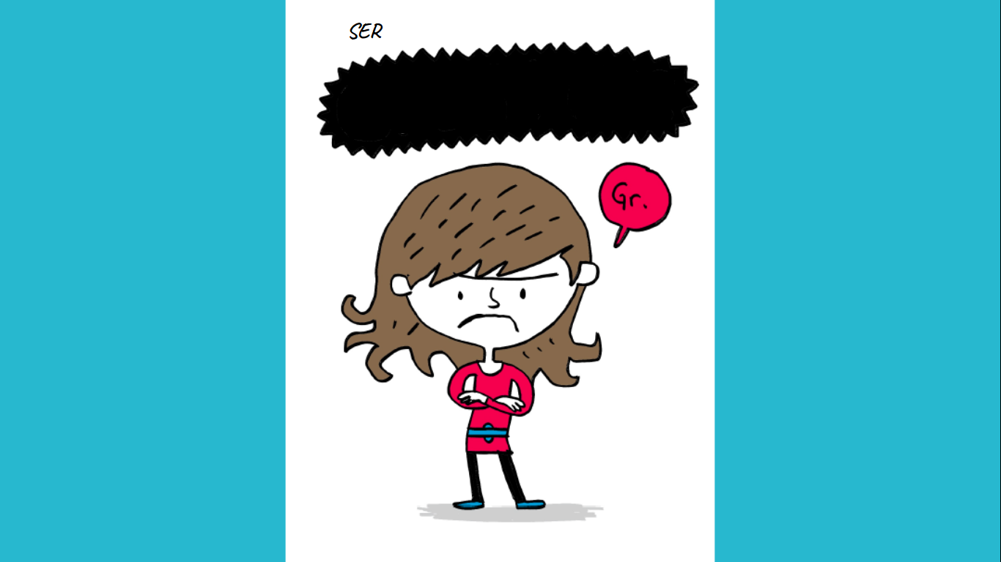
SER
GRUÑÓN
GRUÑÓN
Notes:
http://elisegravel.com/en/livres/free-printable-stuff/

Slide 21
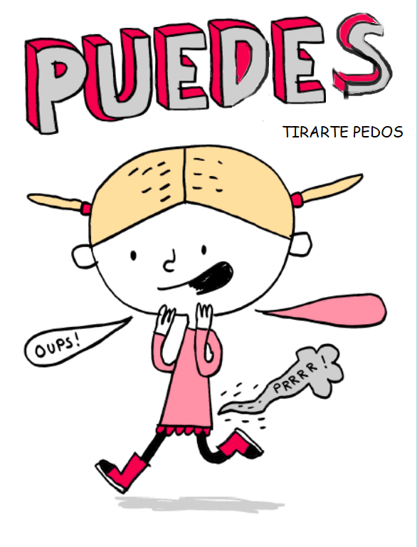
Notes:
http://elisegravel.com/en/livres/free-printable-stuff/

Slide 22
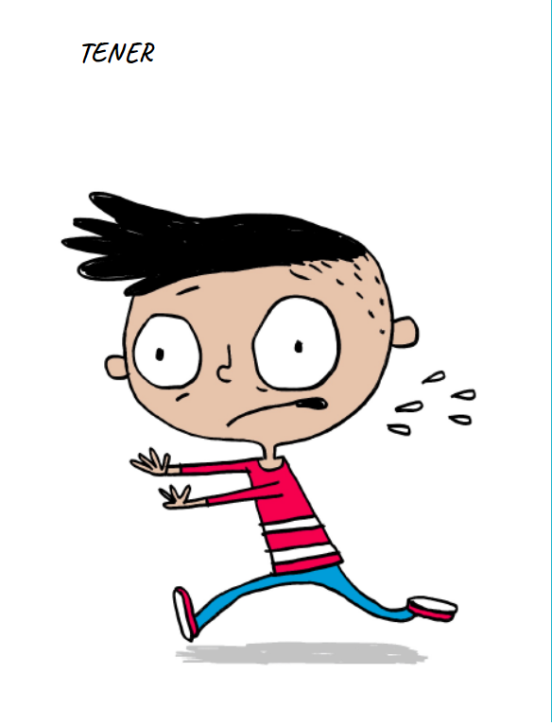
MIEDO
Notes:
http://elisegravel.com/en/livres/free-printable-stuff/

Slide 23
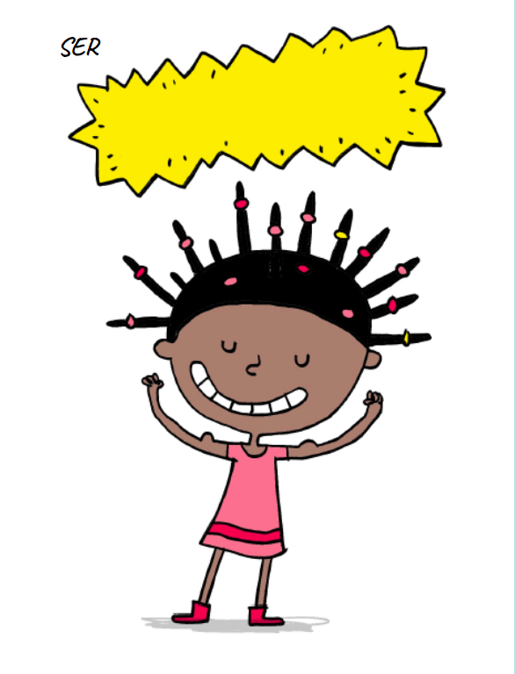
FUERTE
Notes:
http://elisegravel.com/en/livres/free-printable-stuff/

Slide 24
SER
RESPONSABLE
Y CUIDAR DE OTROS
Notes:
http://elisegravel.com/en/livres/free-printable-stuff/

Slide 25
ESTAR
SUCIO
Notes:
http://elisegravel.com/en/livres/free-printable-stuff/

Slide 26
ESTAR
FURIOSO
Notes:
http://elisegravel.com/en/livres/free-printable-stuff/

Slide 27
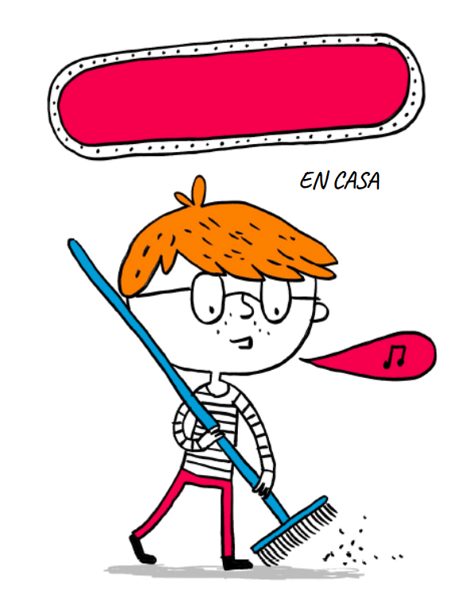
AYUDAR
Notes:
http://elisegravel.com/en/livres/free-printable-stuff/

Slide 28
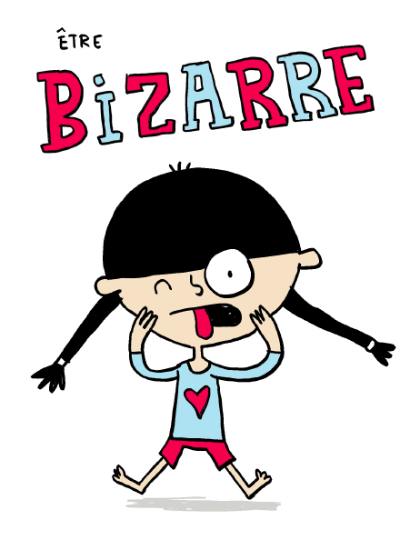
SER
PECULIAR
Notes:
http://elisegravel.com/en/livres/free-printable-stuff/

Slide 29
Notes:
http://elisegravel.com/en/livres/free-printable-stuff/

Slide 30
Notes:
http://elisegravel.com/en/livres/free-printable-stuff/

Slide 31
Notes:
http://elisegravel.com/en/livres/free-printable-stuff/

Slide 32
PUEDES SER
COMO QUIERAS SER
EXCEPTO MALVADO O MALEDUCADO . ¿VERDAD?
SÉ COMO QUIERAS SER
Notes:
http://elisegravel.com/en/livres/free-printable-stuff/

Slide 33
Notes:
http://elisegravel.com/en/livres/free-printable-stuff/

Slide 34
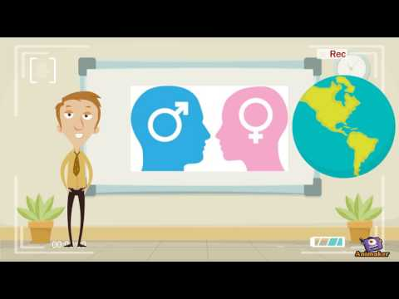
¡Vamos a debatir!
In English, consider what you have learned in the first part of this lesson.
What do you think influences gender norms?
How much do the following factors play a part?
family | society | friends | the media
What are the consequences of stereotypes?
Watch the video as a prompt
Notes:
Video link https://www.youtube.com/watch?v=DzXE_2vRZaQ

Slide 35
¿Verdadero o falso?
Boys can... | Girls can...
Be quiet | Be adventurous
Be good at school | Be weird
Help with the housework | Get angry
Take care of others | Get dirty
Be scared | Be strong
Be artistic | Smell
Be sensitive | Be grumpy
Be Naughty | Make noise
Be Impolite | Be funny / odd
Notes:
Read the story again - ARE THESE STATEMENTS TRUE / FALSE?

Slide 37
World Class Teaching project has been funded with support from the European Commission. The contents of these actions are the sole responsibility of the contractor and can in no way be taken to reflect the views of the European Union.

