Slide 1
Égalité entre les sexes:
Lesson 1
Notes:
Image source: https://pixabay.com/illustrations/equality-gender-woman-duality-sky-2110561/

Slide 4
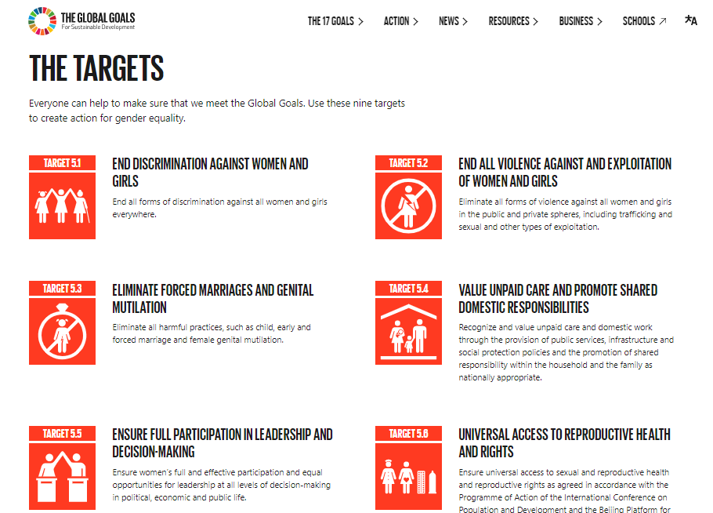
Notes:
Source: https://www.globalgoals.org/5-gender-equality There are 9 targets as part of Sustainable development Goal 5 to create action for gender equality.

Slide 5
BELL WORK: Can you translate the following poster into English?
Notes:
For weaker learners, there is a supplementary vocabulary builder sheet which contains all the key vocab for this lesson - could be used first or alongside this and the other activities and tasks as support
Do students agree with the sentiment of the poster?
http://elisegravel.com/en/livres/free-printable-stuff/

Slide 6
Extension task:
What do you notice about all these adjectives?
What do they have in common and why?
According to this poster, how can girls be?
Do you agree?
Notes:
http://elisegravel.com/en/livres/free-printable-stuff/

Slide 7
C’est quoi l’égalité entre les filles et les garçons?
Notes:
Source
https://www.youtube.com/watch?v=nKwVOTntlVc&app=desktop
Watch the video and dicuss as a class

Slide 8
 | strong |  | grumpy
 | noisy*
Starting with noisy* in the middle, play dominoes in pairs
(4 cards each) to match up the feminine adjectives
Notes:
Dominoes game – matching pairs
http://elisegravel.com/en/livres/free-printable-stuff/

Slide 9
 | smelly |  | ridiculous
 | angry |  | dirty
 | funny |  | leader
Notes:
http://elisegravel.com/en/livres/free-printable-stuff/

Slide 10
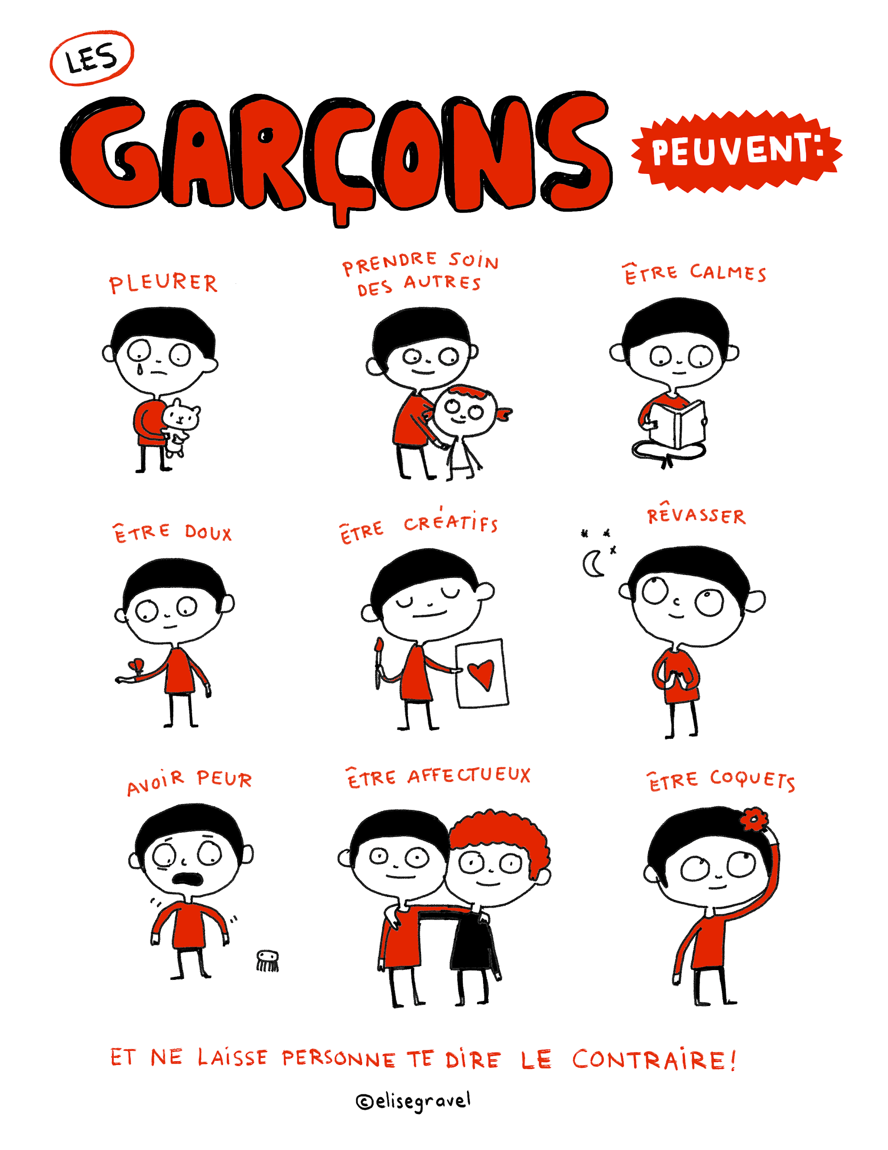
According to this second poster, what can boys do / be Do you agree?
Notes:
http://elisegravel.com/en/livres/free-printable-stuff/

Slide 11
 | Be calm |  | Take care of others
 | Be gentle
Notes:
Hand out 9 cards per person, face up and in pairs, work together to try to match up the cards.
Follow on games could include snap and blind pairs (all cards face down)
Cut up all 18 cards and put into envelopes then ask students to divide themselves into pairs and hand out 9 cards per person
http://elisegravel.com/en/livres/free-printable-stuff/

Slide 12
 | daydream |  | Be pretty
 | Be afraid |  | Be affectionate
 | Be creative |  | cry
Notes:
Hand out 9 cards per person, face up and in pairs, work together to try to match up the cards.
Follow on games could include snap and blind pairs (all cards face down)
Cut up all 18 cards and put into envelopes then ask students to divide themselves into pairs and hand out 9 cards per person
http://elisegravel.com/en/livres/free-printable-stuff/

Slide 13
Une petite histoire : Tu Peux – Élise Gravel
Notes:
Read and discuss as a class
http://elisegravel.com/en/livres/free-printable-stuff/

Slide 14
Notes:
http://elisegravel.com/en/livres/free-printable-stuff/

Slide 15
Notes:
http://elisegravel.com/en/livres/free-printable-stuff/

Slide 16
Notes:
http://elisegravel.com/en/livres/free-printable-stuff/

Slide 17
Notes:
http://elisegravel.com/en/livres/free-printable-stuff/

Slide 18
Notes:
http://elisegravel.com/en/livres/free-printable-stuff/

Slide 19
Notes:
http://elisegravel.com/en/livres/free-printable-stuff/

Slide 20
Notes:
http://elisegravel.com/en/livres/free-printable-stuff/

Slide 21
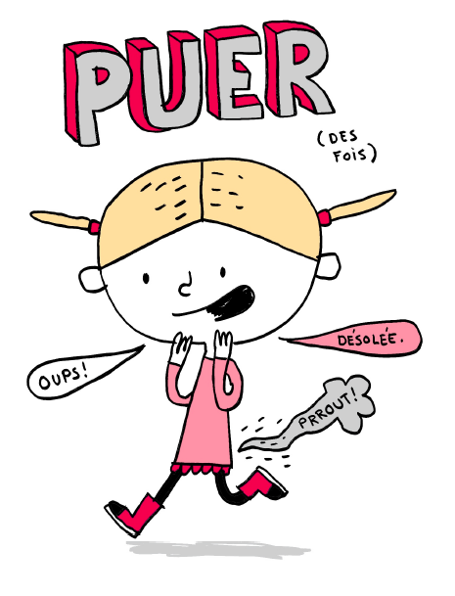
Notes:
http://elisegravel.com/en/livres/free-printable-stuff/

Slide 22
Notes:
http://elisegravel.com/en/livres/free-printable-stuff/

Slide 23
Notes:
http://elisegravel.com/en/livres/free-printable-stuff/

Slide 24
Notes:
http://elisegravel.com/en/livres/free-printable-stuff/

Slide 25
Notes:
http://elisegravel.com/en/livres/free-printable-stuff/

Slide 26
Notes:
http://elisegravel.com/en/livres/free-printable-stuff/

Slide 27
Notes:
http://elisegravel.com/en/livres/free-printable-stuff/

Slide 28
Notes:
http://elisegravel.com/en/livres/free-printable-stuff/

Slide 29
Notes:
http://elisegravel.com/en/livres/free-printable-stuff/

Slide 30
Notes:
http://elisegravel.com/en/livres/free-printable-stuff/

Slide 31
Notes:
http://elisegravel.com/en/livres/free-printable-stuff/

Slide 32
Notes:
http://elisegravel.com/en/livres/free-printable-stuff/

Slide 33
Notes:
http://elisegravel.com/en/livres/free-printable-stuff/

Slide 34
On va discuter!
In English, consider what you have learned in the first part of this lesson.
What do you think influences gender norms?
How much do the following factors play a part?
family | society | friends | the media
What are the consequences of stereotypes?
Video prompt: https://www.youtube.com/watch?v=q7SAANUgeZU&app=desktop

Slide 35
Vrai ou faux?
Boys can... | Girls can...
Be quiet | Be adventurous
Be good at school | Be weird
Help with the housework | Get angry
Take care of others | Get dirty
Be scared | Be strong
Be artistic | Smell
Be sensitive | Be grumpy
Be Naughty | Make noise
Be Impolite | Be funny / odd
Notes:
Read the story again - ARE THESE STATEMENTS TRUE / FALSE?

Slide 37
World Class Teaching project has been funded with support from the European Commission. The contents of these actions are the sole responsibility of the contractor and can in no way be taken to reflect the views of the European Union.

