Slide 1
Gleichstellung der Geschlechter:
Lesson 1
Notes:
Image source: https://pixabay.com/illustrations/equality-gender-woman-duality-sky-2110561/

Slide 4
Gleichstellung der Geschlechter
Notes:
Discuss with students: What do those signs stand for? What do students know about gender equality?
Photo: https://pixabay.com/go/?t=image-list-shutterstock&id=701721763

Slide 5
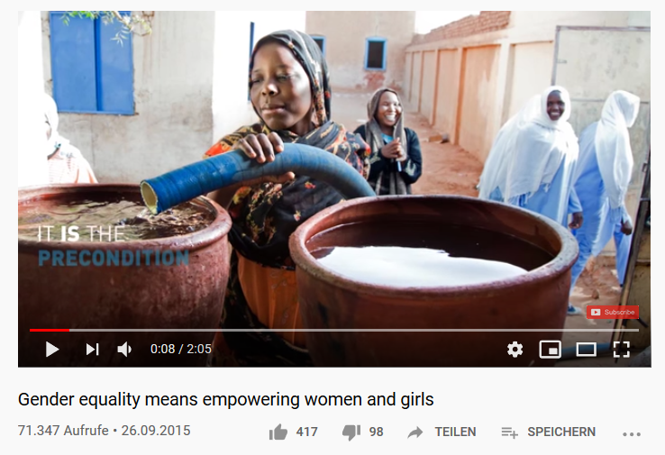
Was bedeutet Gleichberechtigung der Geschlechter?
Notes:
Watch the video and dicuss with the class
https://www.youtube.com/watch?v=nbhjXK2mMe8

Slide 6
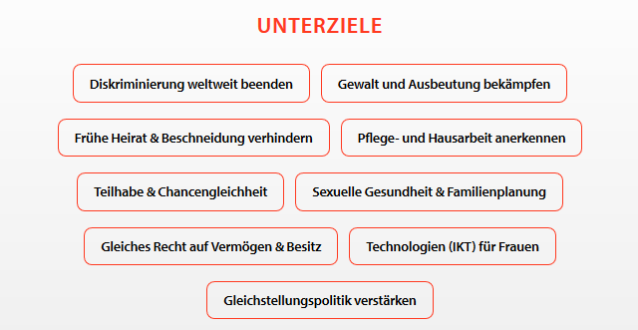
Translate the targets into English.
Notes:
Source: https://www.alumniportal-deutschland.org/global-goals/sdg-05-geschlechtergleichheit/

Slide 7
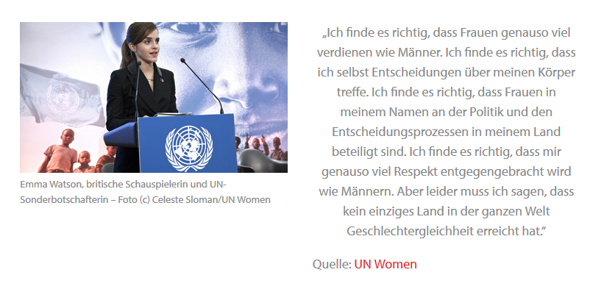
Zitat
Notes:
Students skim read the text; what is the key message of Emma Watson´s speech?
Source: https://www.alumniportal-deutschland.org/global-goals/sdg-05-geschlechtergleichheit/

Slide 8
Create a mind map about gender equality in German.
(see example below)
***Use vocabulary from the previous activities. You can find more key vocabulary for this unit on the following website:
https://nachhaltigkeit.bvng.org/die-globalen-ziele-fuer-nachhaltige-entwicklung/sdg-ziel-5-gleichheit-der-geschlechter/
Arbeitswelt
Vorurteile
Gleichberechtigung von Frauen und Männern
Bezahlung
bessere/ schlechtere Chancen
gleiche Rechte haben
fair/unfair
Notes:
Create a mind map about gender equality; Link to SDG 5 gender equality – explanation in German
Students can use the following online dictionary: www.leo.org

Slide 9
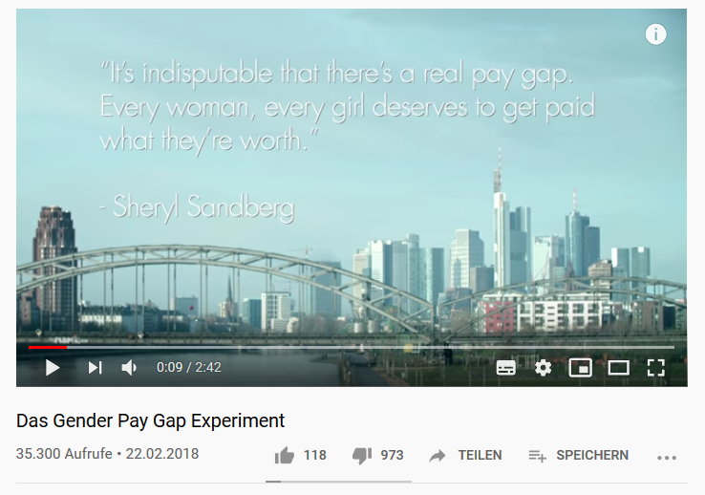
Ungleiche Bezahlung von Frauen – ein Experiment
Notes:
Students watch the video and make notes: What surprised me? What does not yet make sense to me? How does the video make you feel?
Video: https://www.youtube.com/watch?time_continue=9&v=JZZ8VDgjw34
Video in English: https://www.youtube.com/watch?time_continue=2&v=ULKPgqnnmQI

Slide 10
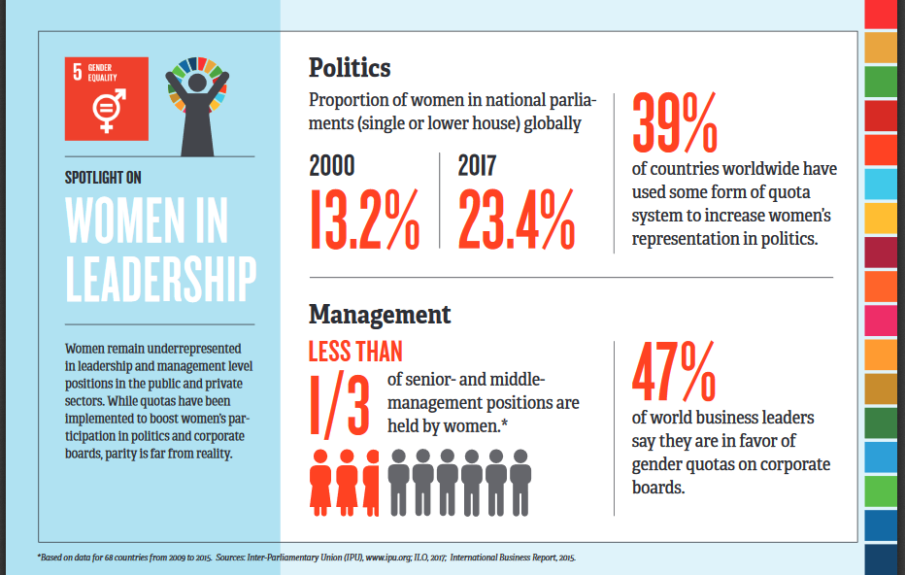
Diskussion
https://www.unwomen.org/-/media/headquarters/attachments/sections/multimedia/2017/infographic-spotlight-sdg5-all-data-cards-web-en.pdf?la=en&vs=4644
Notes:
Look at some of the posters published by UN Women with students as preparation for the discussion (see following slide)
SDG5 – gender equality; one of 13 UN sustainable development goals;
More posters of gender inequality: https://www.unwomen.org/-/media/headquarters/attachments/sections/multimedia/2017/infographic-spotlight-sdg5-all-data-cards-web-en.pdf?la=en&vs=4644
Picture taken from p.7 of pdf document (link above)

Slide 11
Diskussion
In English, consider what you have learned in the first part of this lesson.
What do you think influences gender norms?
How much do the following factors play a part?
family | society | friends | the media
What are the consequences of stereotypes?
Notes:
Homework: Write a short paragraph in German summarising what you have learnt about gender equality in this lesson.

Slide 13
World Class Teaching project has been funded with support from the European Commission. The contents of these actions are the sole responsibility of the contractor and can in no way be taken to reflect the views of the European Union.

