Slide 1
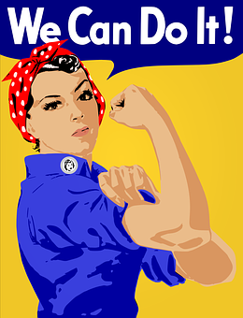
Igualdad de género:
Lesson 3
Notes:
Image source: https://pixabay.com/illustrations/equality-gender-woman-duality-sky-2110561/

Slide 4
Trabajo en grupo - las desigualdades entre hombres y mujeres
10 tarjetas en español, 10 tarjetas en inglés - translation match up task
Students work collaboratively to match the Spanish and English
Opportunity for discussion in English at the end of the task
Question prompts if necessary

Slide 5
LOS MEDIOS
La presencia de las mujeres como protagonistas de noticias en la prensa escrita, la radio y la televisión sólo ha aumentado al 24% en 2015, desde el 17% en 1995
Y sólo 9% de las noticias tratan asuntos sobre la (des)igualdad de género, mientras que el 4% cuestiona estereotipos de género
1995
2015
0
25
50
75
100
Source: UN Women
Notes:
Images created in Canva

Slide 6
THE MEDIA
The presence of woman as main characters in the media (newspapers, radio and TV) has only increased to 24% in 2015 from 17% in 1995.
Only 9% of the news discuss gender equality issues whilst 4% questions gender stereotypes.
(The figures of 2015 are based on a study of 114 countries and the figures of 1995 are based on a study of 71 countries.)

Slide 7
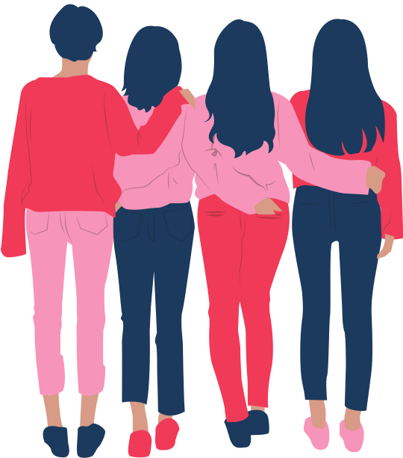
VIOLENCIA CONTRA LAS MUJERES
En 1993, la Declaración sobre la Eliminación de la Violencia contra la Mujer de la Asamblea General de las Naciones Unidas estableció un marco de acción para luchar contra esta pandemia
Sin embargo, más de 25 años después, 1 de cada 3 mujeres sigue sufriendo violencia física o sexual, principalmente por parte de un compañero sentimental
Source: UN Women
Notes:
Images created in Canva

Slide 8
VIOLENCE AGAINST WOMEN
In 1993, the Declaration of the General Assembly of the United Nations to eliminate violence against women has been launched to fight against this pandemic trend. However, 25 years later, 1 out of 3 women is a victim of physical or sexual violence, most often committed by a partner.

Slide 9
CONFLICTOS
No obstante, desde 1990 hasta 2017, sólo el 8% de quienes negociaban en las mesas de negociación de paz eran mujeres
En 2000, la pionera resoluciòn 1325 del Consejo de Seguridad de las Naciones Unidas reconoció que la guerra repercute de forma distinta en las mujeres e hizo hincapié en la necesidad de incrementar la participación de las mujeres en las conversaciones de paz
8%
92%
Source: UN Women
Notes:
Images created in Canva

Slide 10
CONFLICT
In 2000, the Resolution 1325 of the UN Security Council acknowledged for the first time the different consequences of war for women and it put emphasis on the necessity to encourage women to participate in country negotiations.
However, only 8% of the participants of the the trial and peace negotiations between 1990 and 2017 were women.

Slide 11
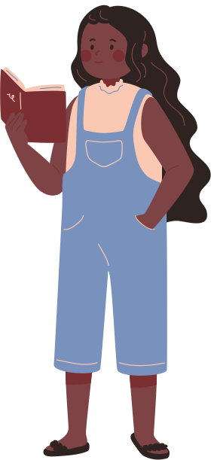
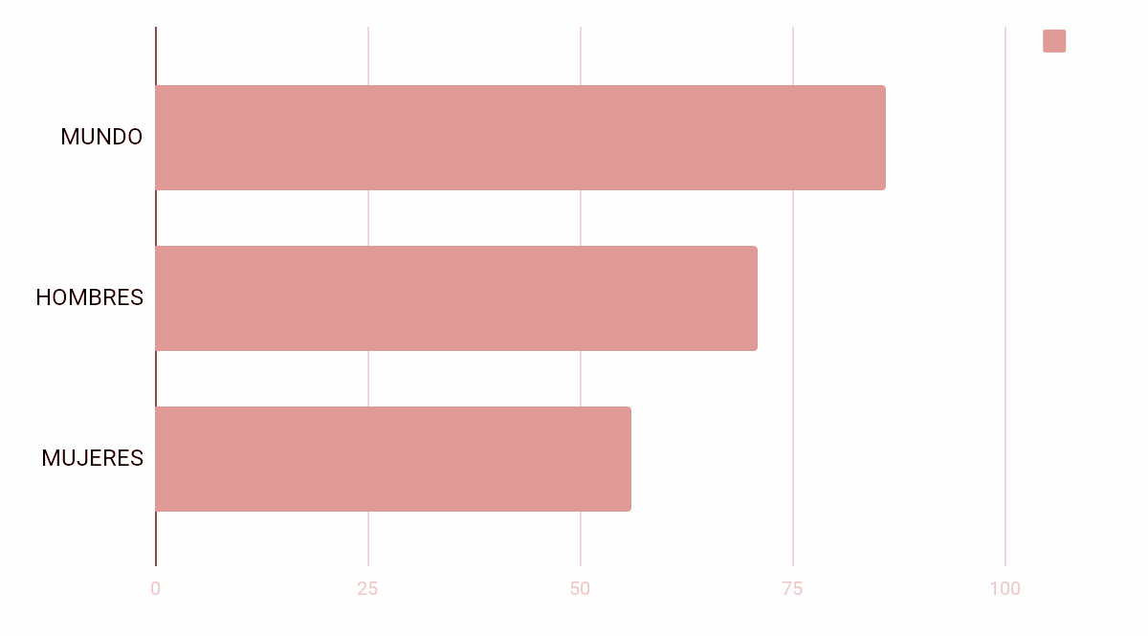
ALFABETIZACIÓN
La tasa de alfabetización entre personas adultas ha aumentado del 76% en 1990 al 86% actualmente
Pero las mujeres siguen representando más de dos terceras partes de las personas analfabetas a escala mundial
Source: UN Women
Notes:
Images created in Canva

Slide 12
LITERACY RATES
The literacy rate of adults has increased from 76% in 1990 to 86% in 2018.
However, women represent more than two thirds of the illiterate in the world.
The rate of literate woman in low-income countries is 56%, compared to 71% in men.

Slide 13
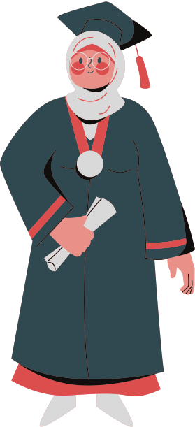
EDUCACIÓN
Todas las regiones en desarrollo han, o han casi, conseguido la paridad de género en la educación primaria
Sin embargo, en muchos países la disparidad de género aumenta en la educación secundaria y superior
70 mujeres jóvenes por cada 100 hombres jóvenes
Acaban el bachillerato en países de bajos ingresos
Mujeres jóvenes
Hombres jóvenes
0
25
50
75
100
Source: UN Women
Notes:
Images created in Canva

Slide 14
EDUCATION
All developing regions have attained or nearly attained equal levels of education between the sexes in primary education.
However, there is a high disparity between the sexes in secondary and further education in numerous countries.
70 girls for each 100 boys receive their International Baccalaureate qualification in low-income countries.

Slide 15
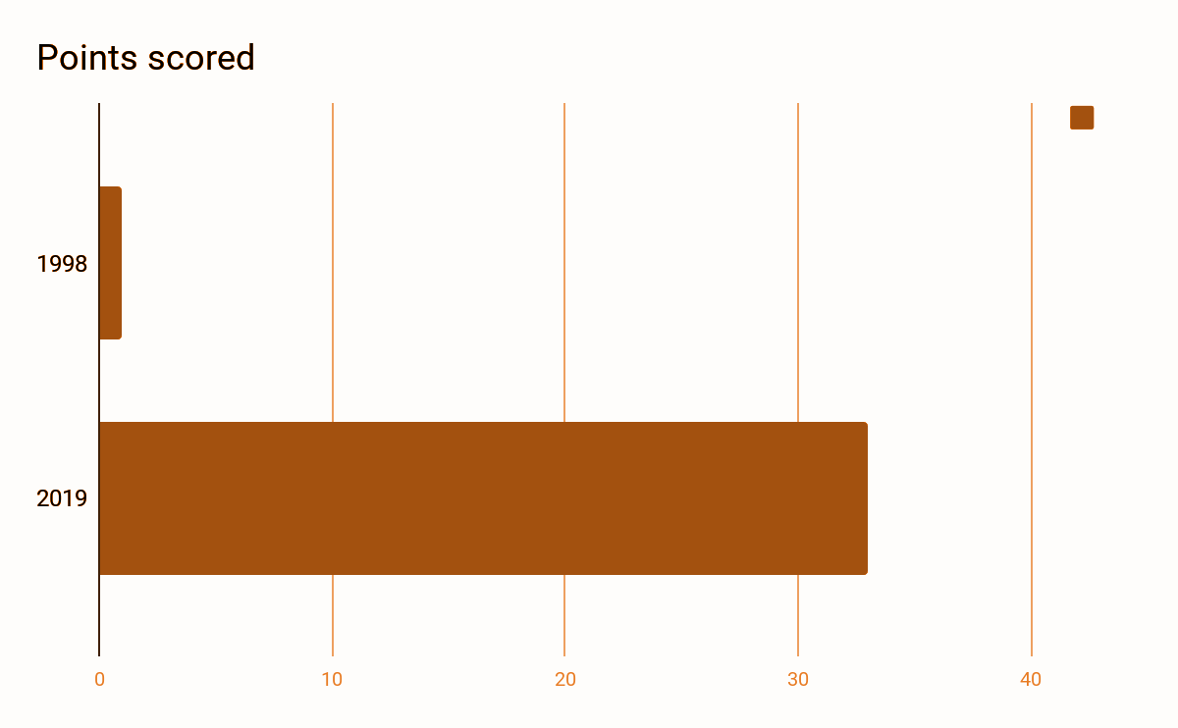
PERSONAL DIRECTIVO SUPERIOR
33 directoras ejecutivas lideran actualmente empresas de la lista Fortune 500, frente a la única mujer que aparecía en esa lista en 1998
No obstante, representan tan sólo un 7% del personal directivo de la lista
Source: UN Women
Notes:
Images created in Canva

Slide 16
MANAGERIAL STAFF
In 2019, 33 women held the post of director in one of 500 registered companies, according to the review Fortune, in comparison to only one in 1998.
However, this only represents 7% of all directors of this list.

Slide 17
SALARIOS
En torno al 49% de las mujeres de todo el mundo en edad de trabajar participan en el mercado laboral, en comparación con más del 75% de hombres en edad de trabajar
Además, a nivel mundial, las mujeres ganan un 23% menos que los hombres
0%
25%
50%
75%
100%
Source: UN Women
Notes:
Images created in Canva

Slide 18
SALARIES
49% of working age woman in the world (aged 15 and above) make up the active working population compared with 75% of men of working age.
And at global level, women earn 23% less than men.

Slide 19
POLÍTICA
El porcentaje de mujeres en los parlamentos se ha duplicado en los últimos 25 años
24%
No obstante, hoy las mujeres sólo representan cerca del 24% de las y los parlamentarios
76%
Source: UN Women
Notes:
Images created in Canva

Slide 20
POLITICS
In the last 20 years, the percentage of women in parliament has practically doubled.
But currently parliaments are made up of only 24% women

Slide 21
ACCESO A AGUA LIMPIA
7 de cada 10 personas en todo el mundo tienen acceso a agua salubre en sus casas
20 millones de horas
15 millones de horas
No obstante, las mujeres dedican 16 millones de horas al día a buscar agua en 25 países subsaharianos
10 millones de horas
5 millones de horas
0 millones de horas
mujeres
hombres
niñas/os
Source: UN Women
Notes:
Images created in Canva

Slide 22
ACCESS TO CLEAN WATER
7 in 10 people across the world has access to drinking water in their homes.
Despite this, in 25 sub Saharan countries, women still spend 16 million hours per day going to fetch water.
Women-16 million hours
Men - 6 million hours
Children - 4 million hours

Slide 23
MUERTES MATERNAS
44% menos de muertes maternas en todo el mundo que en 1990
Sin embargo, todavía mueren 830 mujeres cada día por causas relacionadas con el embarazo que pueden evitarse
El 99% de esas muertes se producen en países en desarrollo
Source: UN Women
Notes:
Images created in Canva

Slide 24
DEATH IN CHILDBIRTH
There are 44% less maternal deaths than in 1990
But 830 women every still die every day from pregnancy related issues that could have been avoided.
99% of these deaths occur in developing countries.

Slide 25
Other potential ideas…
Can you think of other issues related to gender inequality?
How do you feel about the facts you have just learnt?
How does all this relate to your own life?

Slide 26
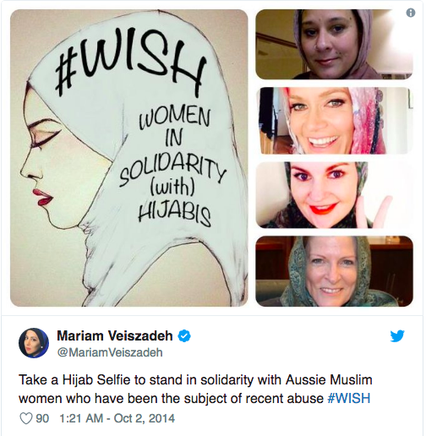
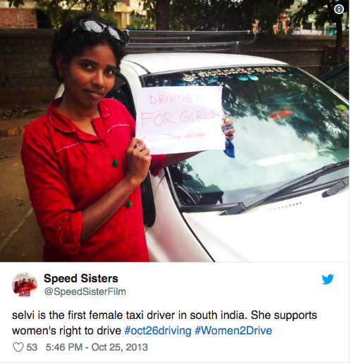
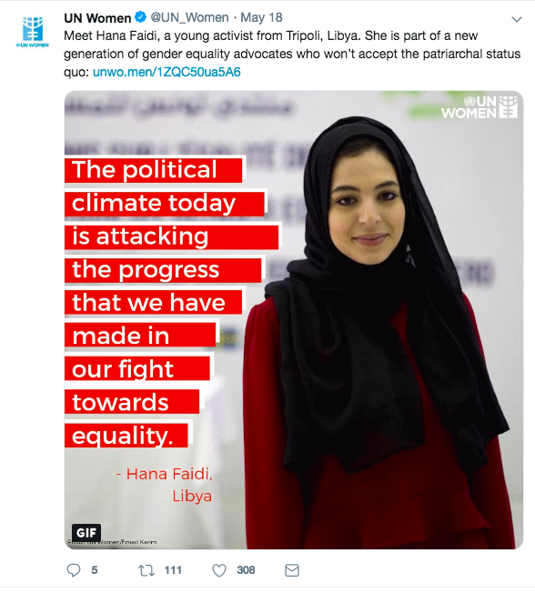
¡Los tiempos cambian!
Here are some groundbreaking individuals who are challenging gender stereotypes & inequalities - can you uncover any other everyday heroes and heroines?

Slide 27
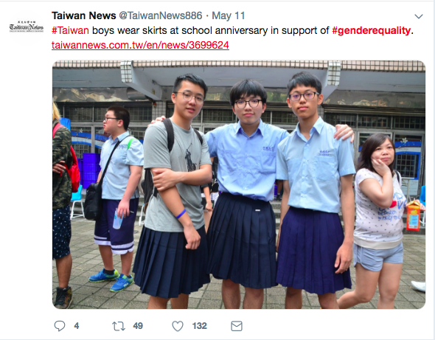
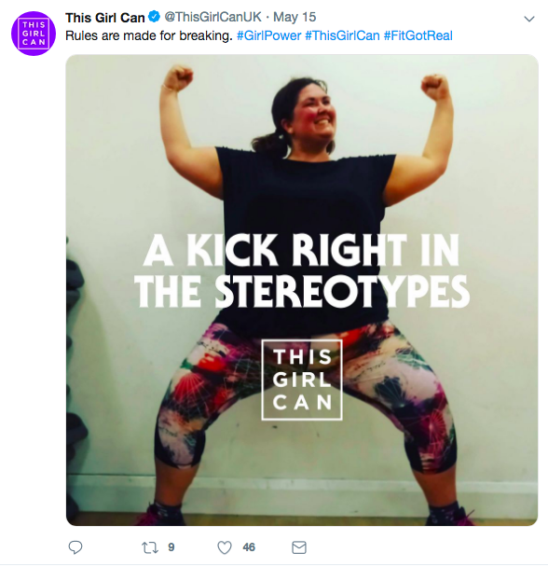
https://www.un.org/es/sections/issues-depth/gender-equality/index.html
Notes:
Possible follow on story ‘La mitad de Juan’ about ‘boys’ and ‘girls’ games : : http://ceipnuestrasenoradelvillar.centros.educa.jcyl.es/sitio/upload/La-mitad-de-Juan.-Gemma-Lineas-y-Africa-Fanlo.-Ed.-La-Galera.pdf

Slide 28
Justin Trudeau : Soy feminista
El discurso feminista de Justin Trudeau:
https://www.youtube.com/watch?v=1K6CsTefO2U

Slide 29
¿Dónde está Ruanda?
Notes:
Image source:https://commons.wikimedia.org/wiki/File:Map_of_Africa.jpg

Slide 30
¿Cuántas mujeres políticas hay en Ruanda?
¡Adivinar!
Hay más mujeres políticas en Ruanda que en el resto del mundo.
Notes:
Answer: Over 60%; Sources: https://www.npr.org/sections/goatsandsoda/2016/07/29/487360094/invisibilia-no-one-thought-this-all-womans-debate-team-could-crush-it?t=1581433181878; https://www.unwomen.org/en/news/stories/2018/8/feature-rwanda-women-in-parliament;

Slide 31
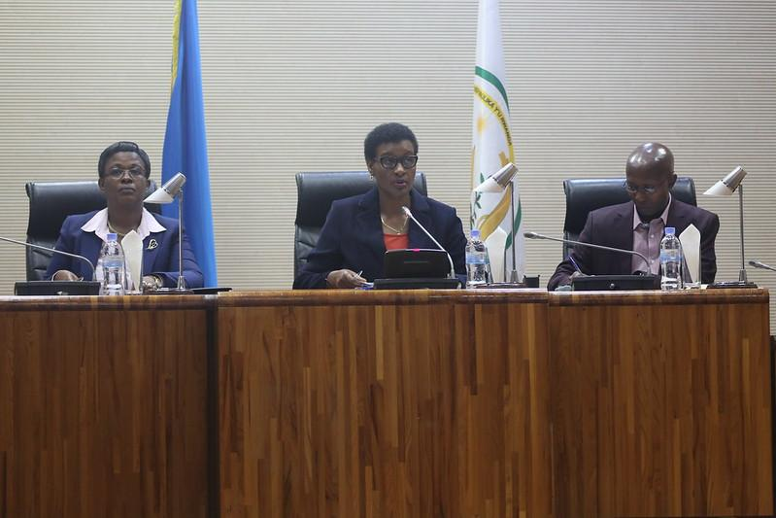
In fact, 64% of Rwanda’s parliament are female- the highest percentage in the world.
World Bank, quoted on the Rwandan High Commission website
Photo courtesy of the Rwandan Parliament Flickr page
Notes:
Rwandan High Commission https://www.rwandahc.org/

Slide 32
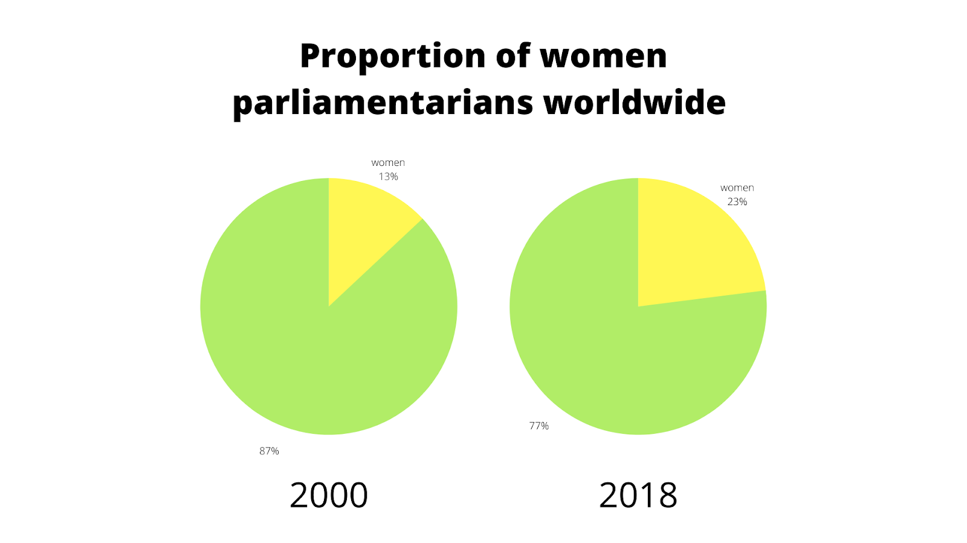
Notes:
Extension for students: What would you expect that would change if 60% of MPs in the UK were women?

Slide 33
World Class Teaching project has been funded with support from the European Commission. The contents of these actions are the sole responsibility of the contractor and can in no way be taken to reflect the views of the European Union.

